Slide 1
Interactive Read Alouds for Diverse Learners
Provided by Lowell Buysse, Brittany Escobedo, Becca Morehouse
Using Augmentative and Alternative Communication (AAC) Devices, Switches, and Adapted Materials

Slide 2
What We Will Discuss
Why do read aloud in a diverse setting?
What does engagement look like?
Barriers for read aloud
Whole group, small group, and individual reading resources
How to collaborate related services
How to implement Assistive Technology as needed to aid participation
Read aloud examples

Slide 3
Why is read aloud appropriate?
Increases stamina for sitting for a full group lesson
Increase language comprehension
Increase engagement with text
Improves the ability to cue to the speaker
Listening comprehension
Provides an opportunity for “shared enjoyment”

Slide 4
Read Aloud in a DCD/ASD Setting
What does a read aloud look like?
What does engagement look like?
Students will be sitting or laying in a spot that meets their sensory needs.
Students may not look at the book but can still benefit from listening to increase listening comprehension skills.
Students will need to slowly increase the amount of time they are engaged.
The use of switches to increase engagement in books.
Repetitive books can record the same phrase.

Slide 5
Engagement in Shared Reading
Shared Reading is defined as the interaction that occurs between an adult and students as they read a book together with the intention of enhancing the student’s language and literacy skills (Ezell & Justice, 2005).
How can we build skills?
Labeling objects in the illustrations (e.g., “I see a dog”)
Talk about what is going on in the book (e.g., “That dog is making a mess.”)
Referring to real-life connections (e.g., “Wow, sometime I make a mess too”)
Referencing the print (e.g., “There is a b like in your name.”)

Slide 6
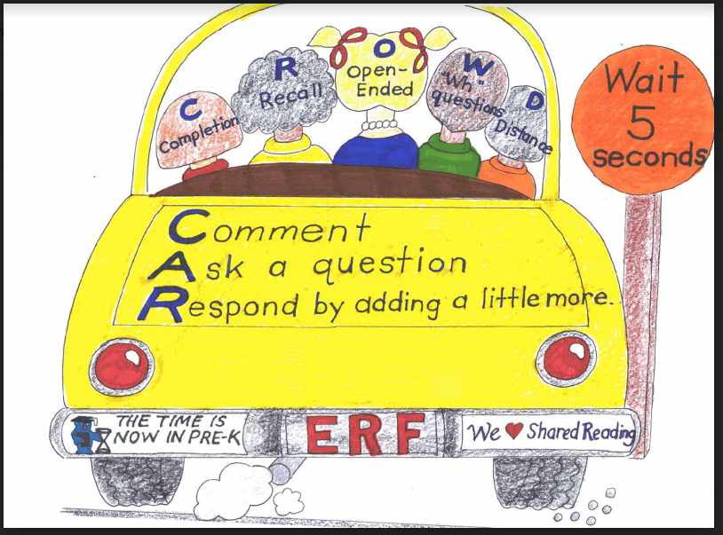
CAR as a teaching strategy
With earliest emergent literacy learners..
Comment and Wait
Ask for participation and Wait
Respond by adding a little more
If a learner isn’t able to respond, another can model the correct response.
Communication objectives related to the use of Communicative Functions

Slide 7
Barriers to whole group read aloud
Varied academic levels
Varied communication needs
Physical needs
Sensory needs
Engagement and ability to attend
Turn taking
Vision needs
Hearing needs

Slide 8
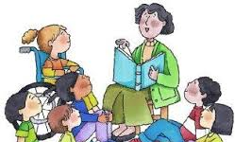
Whole Group Resource

Slide 9
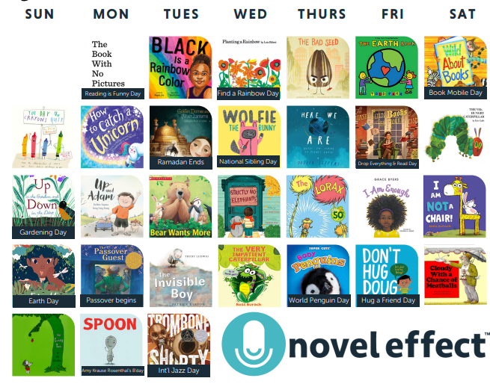
Novel Effect ($7.99/ month or $79/yr.)
Provides multi-sensory soundscapes while book is read
Increased engagement
Increased comprehension
Better concentration
Sync with a speaker
Create your own related to listening- Communication pages
Additional comments of characters

Slide 10
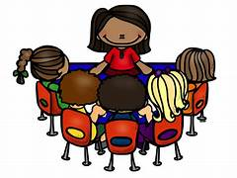
Small Group/Individual Resources

Slide 11
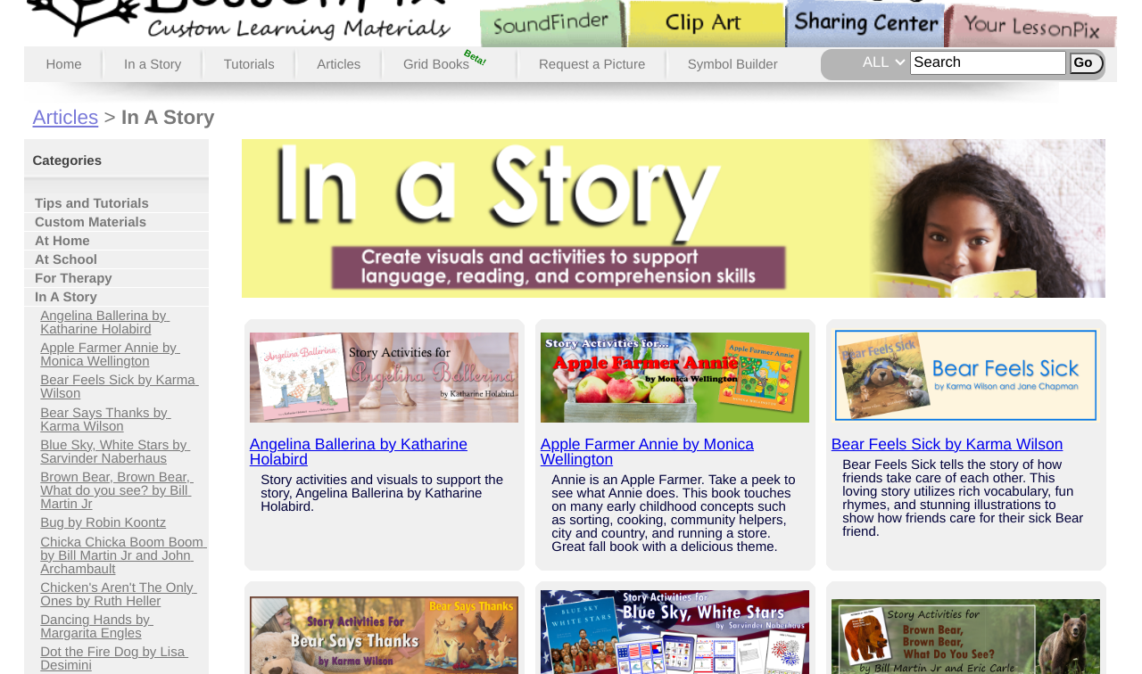
LessonPix
LessonPix is great for:
Book Activities
Under “In a Story” tab
Sequencing activities
Make a paper puppet
“There Was an Old Lady” books
Crafts
$36.00/yr.
Endless visuals
Expectations for read aloud

Slide 12
Tar Heel Shared Reader and Gameplay
Prompts to the communication partner
Emphasis on turn taking
Adjustable symbols
Words/ symbols per page
Simple text / words per page
Built in switch access
Prompts for “More” etc.

Slide 13
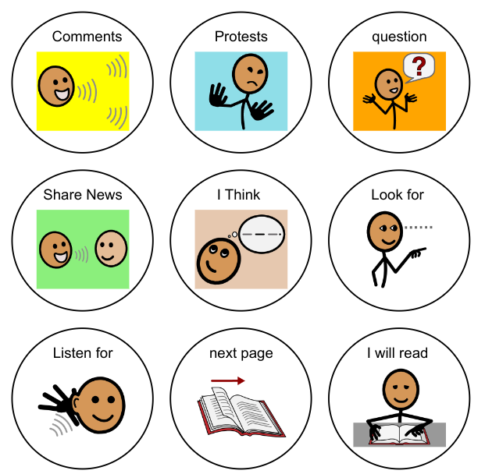
Communicative Functions to target during Read Alouds
What to say?
Wide range of messages types
Generic enough to be used across books/ parts of the day
Can be easily repeated within the same activity
Comments can be errorless- no right or wrong answers

Slide 14
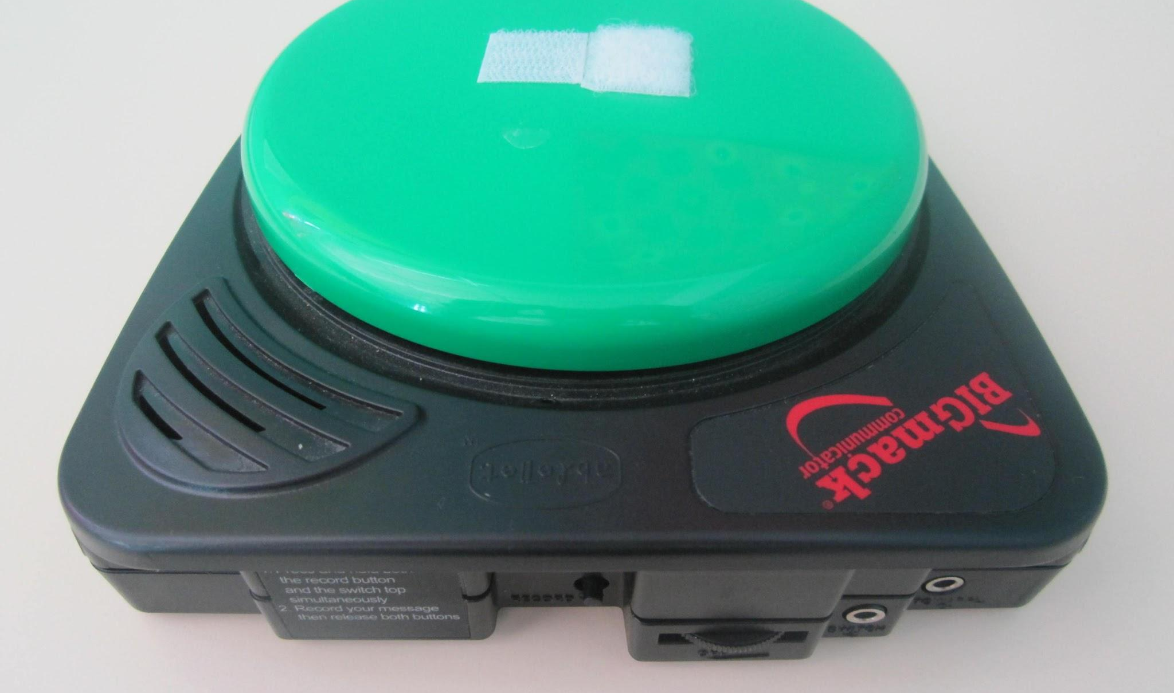
Power of Commenting
It can gain others attention - “I have something to say”
Comments programmed can be generic enough to be used across activities/days
If used on a voice output switch- there should be a symbol representation indicating - I am “talking”
Possibly recorded in a child’s voice - not adult’s voice
A Social Script can be created related to a book read- used later

Slide 15
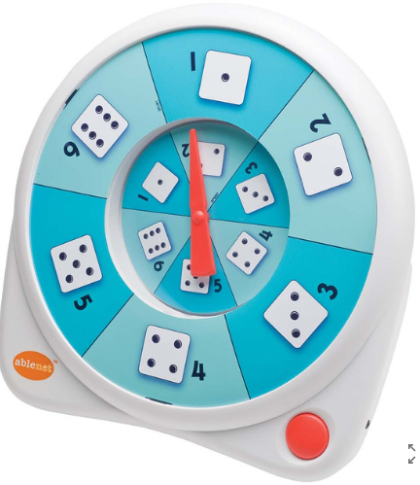
Mid-level AT Tools to increase participation
iTalk 4 by AbleNet - allows recording of 4 messages
Step by Step with levels
AlterNet Spinner - can be set up with questions for the group
Quicktalker(s) - with various literacy related questions/comments
Talking Brix - can be single or attached (beginning, middle, end)

Slide 16
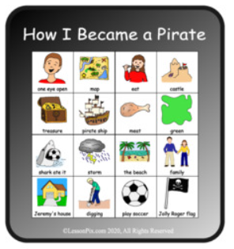
High Level AT Tools to increase
Decide Now app on iPad - customized spinners for kids names- short questions or vocabulary
Randomizer or GamePlay switches for a modified Bingo related to vocabulary in the book - or “I Spy game”- locating visuals within the book
Individual student devices - keep it simple You may want to keep the communication and motor requirements “low” if the goal is participation in a group setting

Slide 17
Communication devices and Read Aloud
Levels of support available for modeling
Pick your priorities - may NOT be the time to teach vocabulary - it IS time to target engagement and participation
Are the devices charged and ready? Can you “share” displays between devices - ex. “Airdrop for iPad to iPad or device”

Slide 18
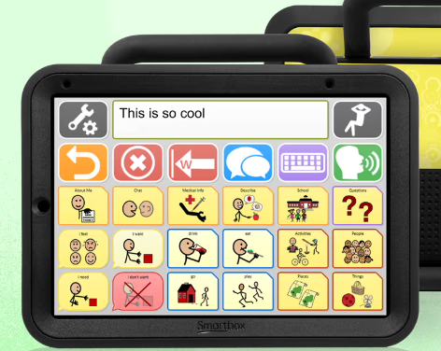
Communication devices and Read Aloud, continued
Challenges with various kids in the same group using various apps on devices (ex. Proloque2Go, TouchChat, TD Snap)
Maybe using the high tech device is targeted during a more individualized time compared to whole group read aloud
Can be done as a follow-up or pre-teach or just remain available in the classroom for free choice
Remember - the group dynamics have to “keep moving” in order to keep all kids engaged (as best you can)

Slide 19
How to Implement Successfully
Day 1-Read the book all the way through
Days 2-4-Stop throughout the book for discussion.
Use switches to increase engagement on these days.
Days 2-4- Do activities
Based on the needs of the group activities can be whole group or broken up into small groups.
Activities
Sequencing
Story Comprehension
Craft
Take your time

Slide 20
Book Resources
Tumblebooks
Novel Effect
Epic
LessonPix
Tarheelreader
Tarheel Gameplay

Slide 21
Book Suggestions
Chicka Chicka Boom Boom by Bill Martin Jr. & John Archambault
Bear Wants More by Karma Wilson
Brown Bear Brown Bear by Bill Martin Jr. & Eric Carle
The Little Blue Truck Series by Alice Schertle
The Gruffalo by Julia Donaldson
The Mitten by Jan Brett
Sneezy The Snowman by Maureen Wright and Stephen Gilpin
Mix it Up by Herve Tullet
Maple and Willow Series by Lori Nichols

Slide 22
Thank you!

