Slide 1
Got Support? Uniquely Matching Mentors and Protégés (MMP) of Low-Incidence Disability Fields
Provided by Ann Mayes, Minnesota Mentor Program Specialist
Statewide Professional Development to Support the Workforce and Low Incidence Disability Areas.

Slide 2
Minnesota Mentor Program Focus
Low-Incidence Disability Category | Percentage of Total Special Education
Developmental Cognitive Disabilities - Mild/Moderate | 3.3
Deaf/Hard of Hearing | 1.52
Developmental Cognitive Disabilities - Severe/Profound | 0.99
Severely Multiply Impaired | 0.98
Physically Impaired | 0.96
Blind/Visually Impaired | 0.28
Traumatic Brain Injury | 0.23
DeafBlind | 0.0073

Slide 3
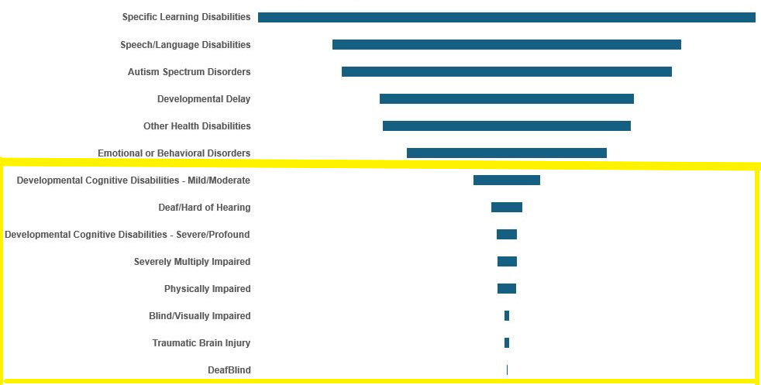
Primary Disability Child Count 12/1/2023

Slide 4
Although Important, Not the Focus of MMP
Low-Incidence Disability Category | Percentage of Total Special Education
Specific Learning Disabilities | 24.24
Speech/Language Disabilities | 17.03
Autism Spectrum Disorders | 16.11
Developmental Delay | 12.38
Other Health Disabilities | 12.11
Emotional or Behavioral Disorders | 9.78

Slide 5
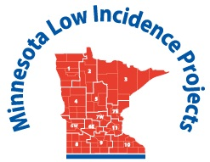
Minnesota Mentor Program Applications Open Now
Protégés are teachers with little teaching experience or teachers who need continued support and guidance from a mentor.
Mentors are teachers with more than five years of experience who support and guide newer or geographically isolated teachers.

Slide 6
Applying to the Minnesota Mentor Program
A mentor-protégé relationship can continue as long as needed.
Many teachers of low-incidence disabilities are also isolated, like their students.
Connecting with other educators across the state in the same field decreases isolation and increases connection to retain educators.

Slide 7
Unique Benefits of the Minnesota Mentor Program
A mentor-protégé relationship can continue as long as needed.
Many teachers of low-incidence disabilities are also isolated, like their students, therefore…
Connecting with other educators across the state in the same low-incidence disability field decreases isolation and increases connection to retain educators.

Slide 8
Mentor and Protégé Matches
Teaching in the same low-incidence disability field
Similar setting (e.g., itinerant with itinerant; or Setting III with Setting III)
Instructional age range of students
Specific skills (e.g., Braille instruction)
Mentor or protégé requests are considered.

Slide 9
Mentor and Protégé Activities and Supports
Annual, virtual MMP Kick-Off in early August:
MMP Book: “Thanks for the Feedback: The Science and Art of Receiving Feedback”
Breakout Rooms: For mentor-protégé teams
One-Page Descriptions
Morning Plenary Session and activities based on the MMP Book with low-incidence disabilities focus

Slide 10
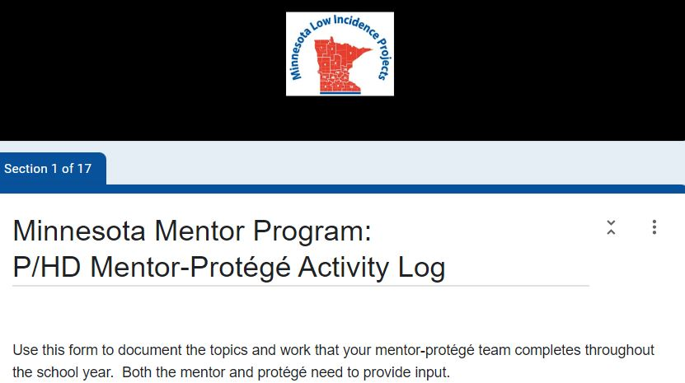
Low-Incidence Disability-Specific Activity Logs
Individualized Google Forms
Disability-Specific Resources and Practices
Meeting Tracking Sheet for Mentors
IEP and Assessment Resources
Assistive Technology Supports

Slide 11
Electronic Monthly Newsletter: October to April
Includes:
Mentor and protégé discussion ideas.
Highlights low-incidence-specific activities and suggestions.
Reminders about using the disability-specific activity logs that include specific topics.
And more…

Slide 12
The Impact of MMP Mentors
94% of protégés felt they had enough communication support (2022-2023 survey results)
Mentoring was most impactful:
Addressing work-related stress
Creating low-incidence disability-specific accessible materials
Writing and implementing IEPs and due process
Collaboration strategies with colleagues

Slide 13
MMP Mentor Qualities Valued by Protégés
Knowledgeable and experienced in the same low-incidence disability field
Comfortable with questions and helped think through situations
Took time to learn about protégé as a person
Available for impromptu texts, videos, or phone calls
Approachable: protégé could contact the mentor and get a timely response

Slide 14
Mentor Support and Resources

Slide 15
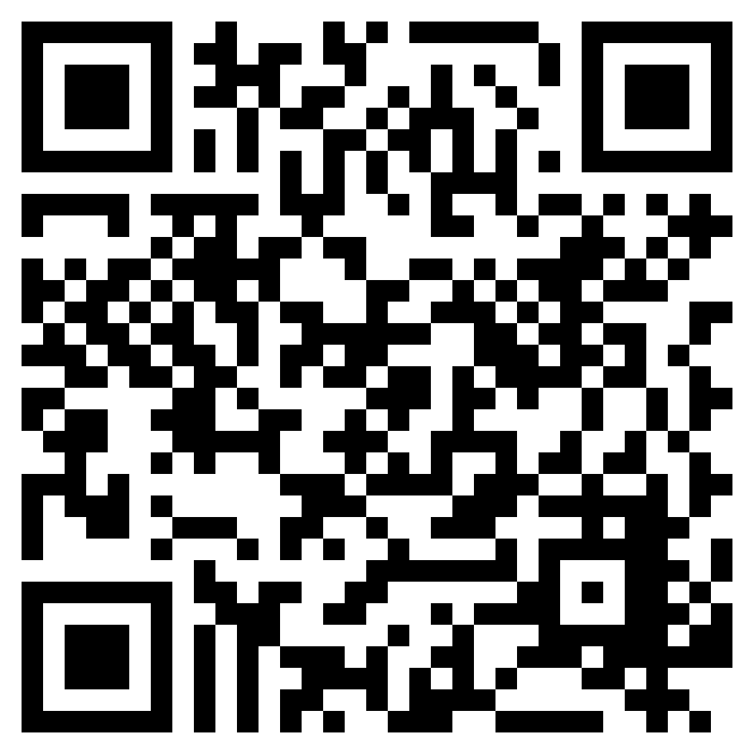
Minnesota Mentor Program Website

Slide 16
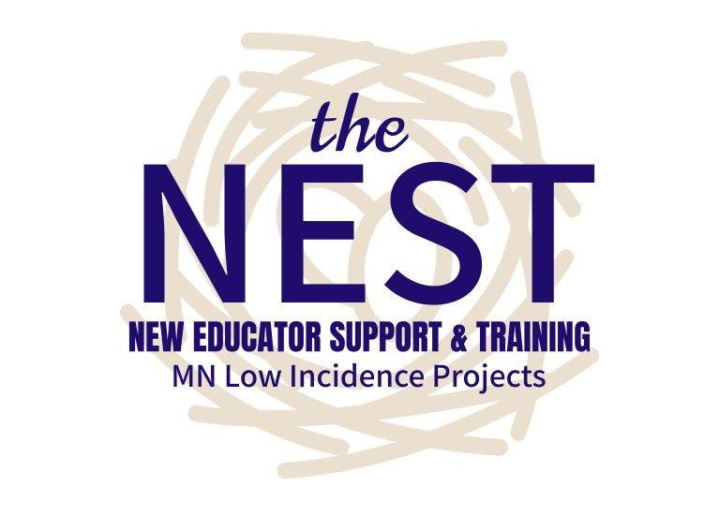
More Information: NEST Booth at Charting the Cs

Slide 17
Thank you!
Ann.Mayes@brightworksmn.org
612-638-1527 videophone

