Slide 1
Resources in Minnesota’s Transition Framework
Breakout Session, Wednesday, April 17, 2024
Heather Kosec and Alyssa Klein

Slide 2
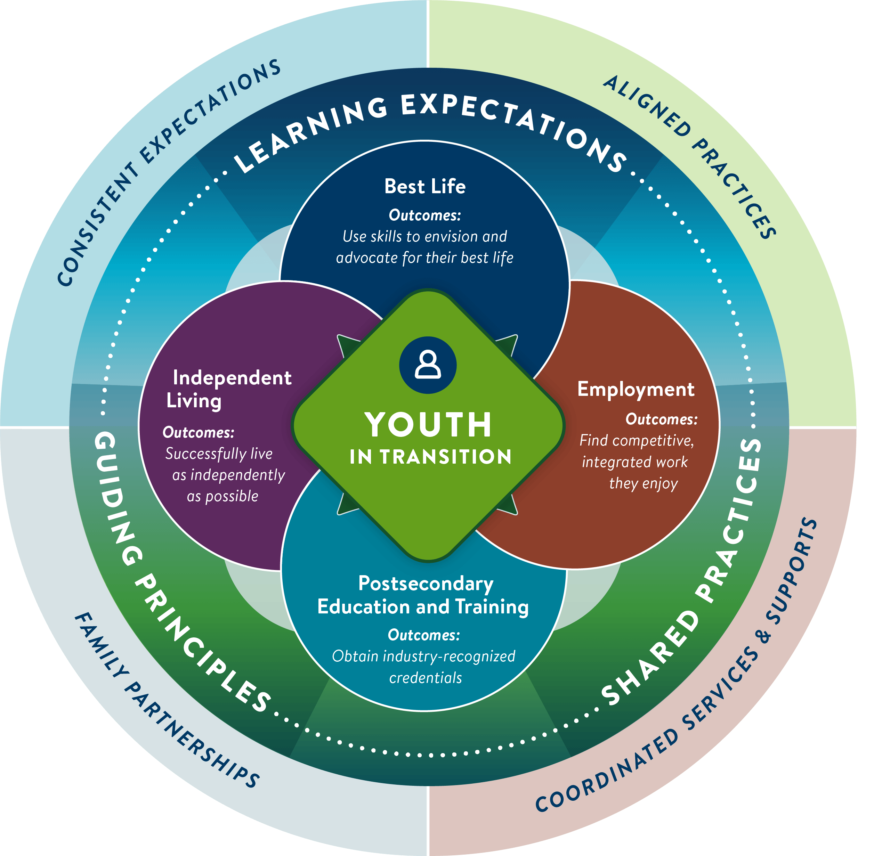
Minnesota’s transition framework defines high-quality transition planning and programming for youth with disabilities and those who support them.

Slide 3
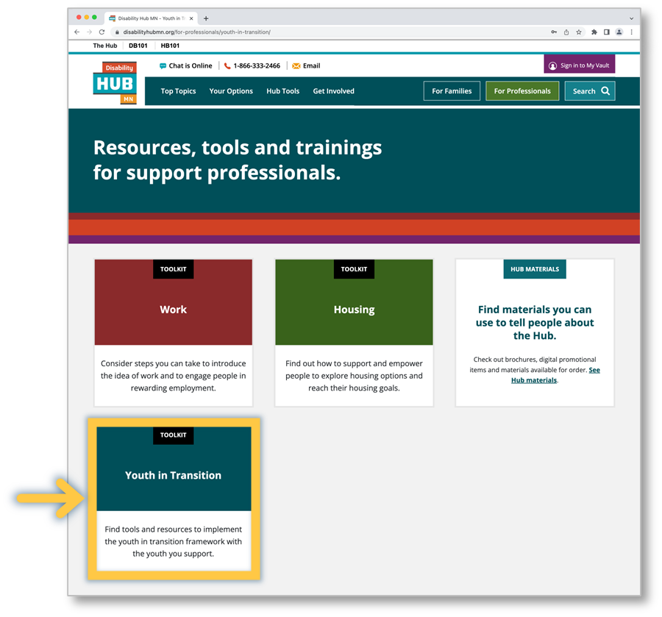
Youth in Transition Toolkit
The Youth in Transition toolkit (disabilityhubmn.org) helps professionals implement Minnesota’s Transition Framework.

Slide 4
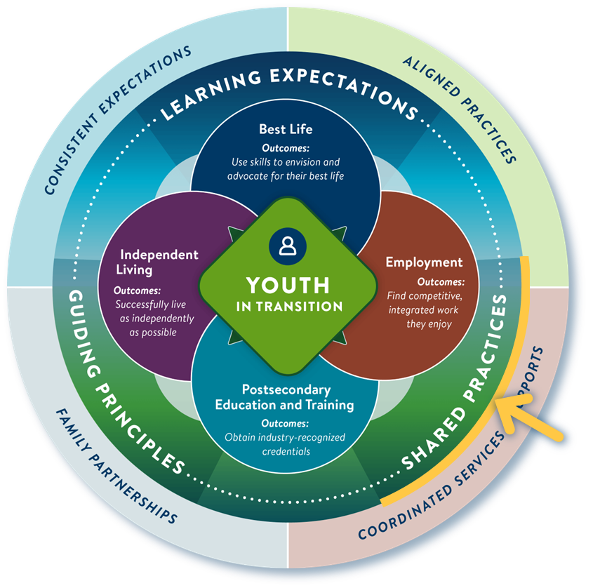
Shared practices
Shared practices ensure a consistent experience for youth and families while optimizing the role of everyone on the transition planning team.
Person-centered practices
Collaborative practices
Youth planning process

Slide 5
Person-centered Practices
Student driven
Choice and self-determination
Interests, strengths and abilities
Community inclusion
Availability of services and supports

Slide 6
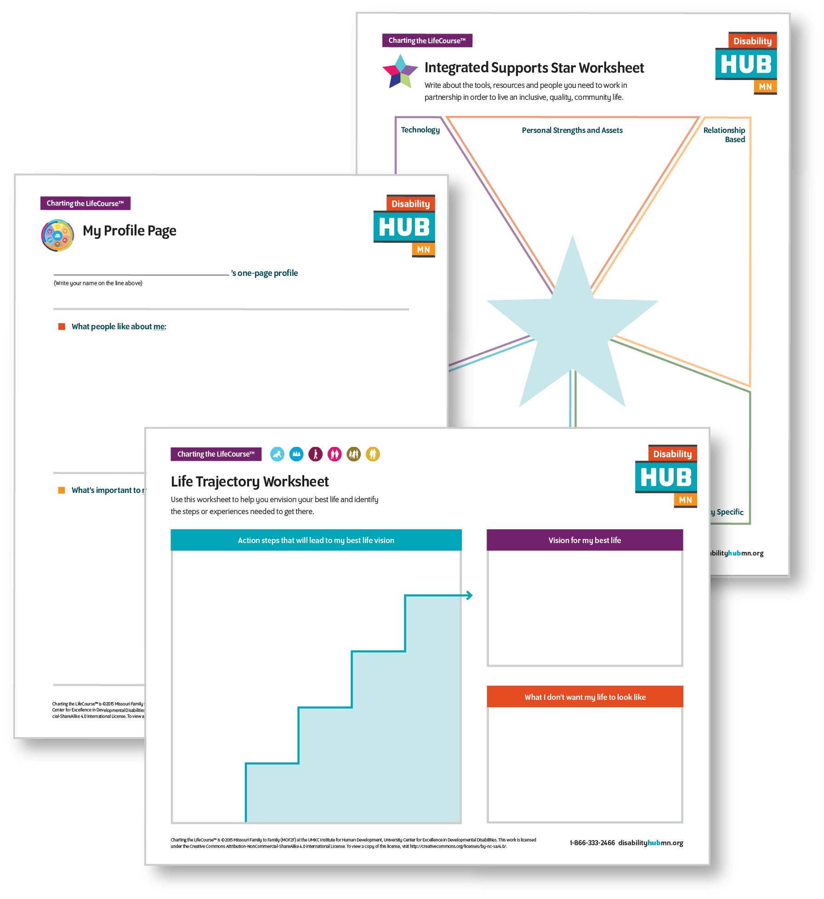
Charting the LifeCourse
Charting the LifeCourse (disabilityhubmn.org)
Tools for youth and family members to:
Articulate their vision for a best life
Identify and access key supports
Have conversations with others in planning for a good life now and in the future.

Slide 7
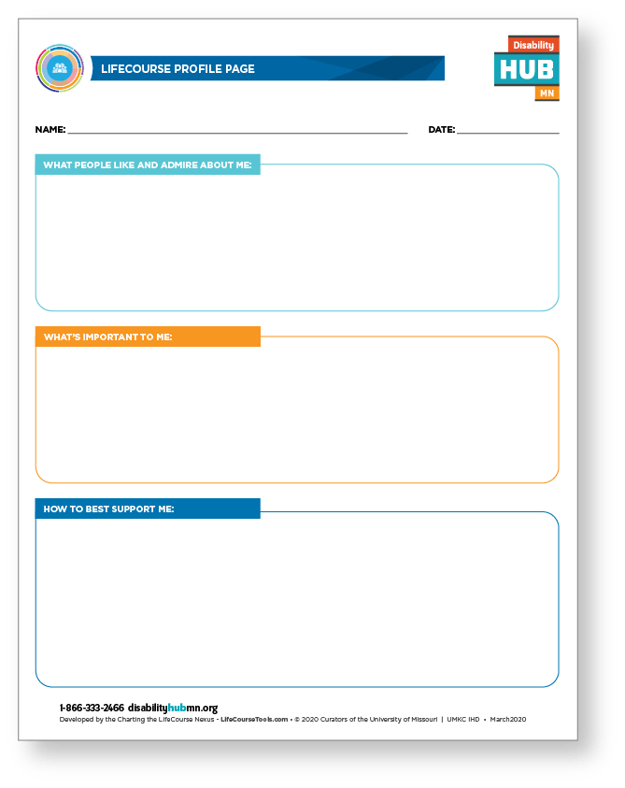
My One-Page Profile
An at-a-glance way to know what really matters to a youth
Youth can list their strengths and interests, what's important to them, and the best ways to offer support
Engage families in completing it
Template – CtLC Profile Page (disabilityhubmn.org)

Slide 8
Life Trajectory
Use the life trajectory worksheet to help a youth envision their best life and identify the steps or experiences needed to get there
Template - CtLC Life Trajectory (disabilityhubmn.org)

Slide 9
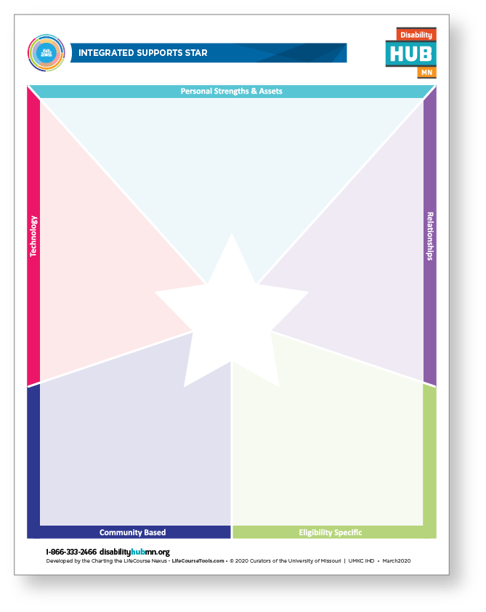
Integrated Supports Star
See where a youth has strong supports and where more attention might be needed.
Supports can be centered around relationships, technology, or personal strengths and assets. Others are based on eligibility criteria.
Using various supports in combination can support a youth’s best life.
Template - Integrated Supports Star (disabilityhubmn.org)

Slide 10
Youth Planning Process
Youth planning process (disabilityhubmn.org)

Slide 11
Youth Planning Process: 6 Steps
Build the team
Identify transition/Pre-ETS strengths and needs
Create plans
Implement plans
Track progress
Reflect

Slide 12
Identify Transition/Pre-ETS Strengths and Needs
Use the Transition/Pre-ETS Inventory with the youth’s team to:
Identify and prioritize the youth’s strengths and needs
Identify youth’s learning stage(s) within each of the transition/Pre-ETS topics

Slide 13
Put it in Practice
Activity!

Slide 14
Discussion
What worked well?
How might you use the Transition/Pre-ETS Inventory going forward?
What questions do you have?

Slide 15
Thank you!
Heather Kosec, Youth Services Manager, heather.kosec@state.mn.us
Alyssa Klein, Youth Services Coordinator, alyssa.klein@state.mn.us

