Slide 1
Minnesota’s NEW Transition Framework
Keynote Presentation, Wednesday, April 17, 2024
Heather Kosec and Alyssa Klein

Slide 2
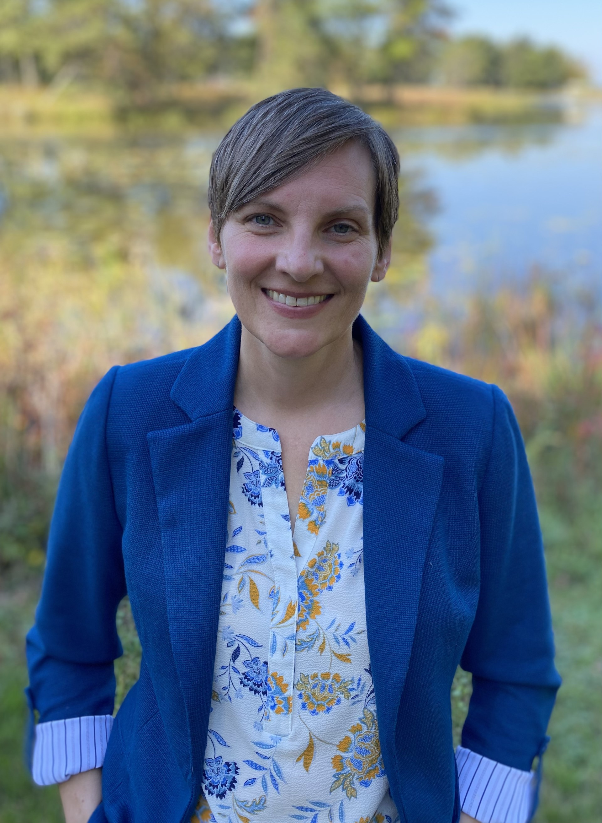
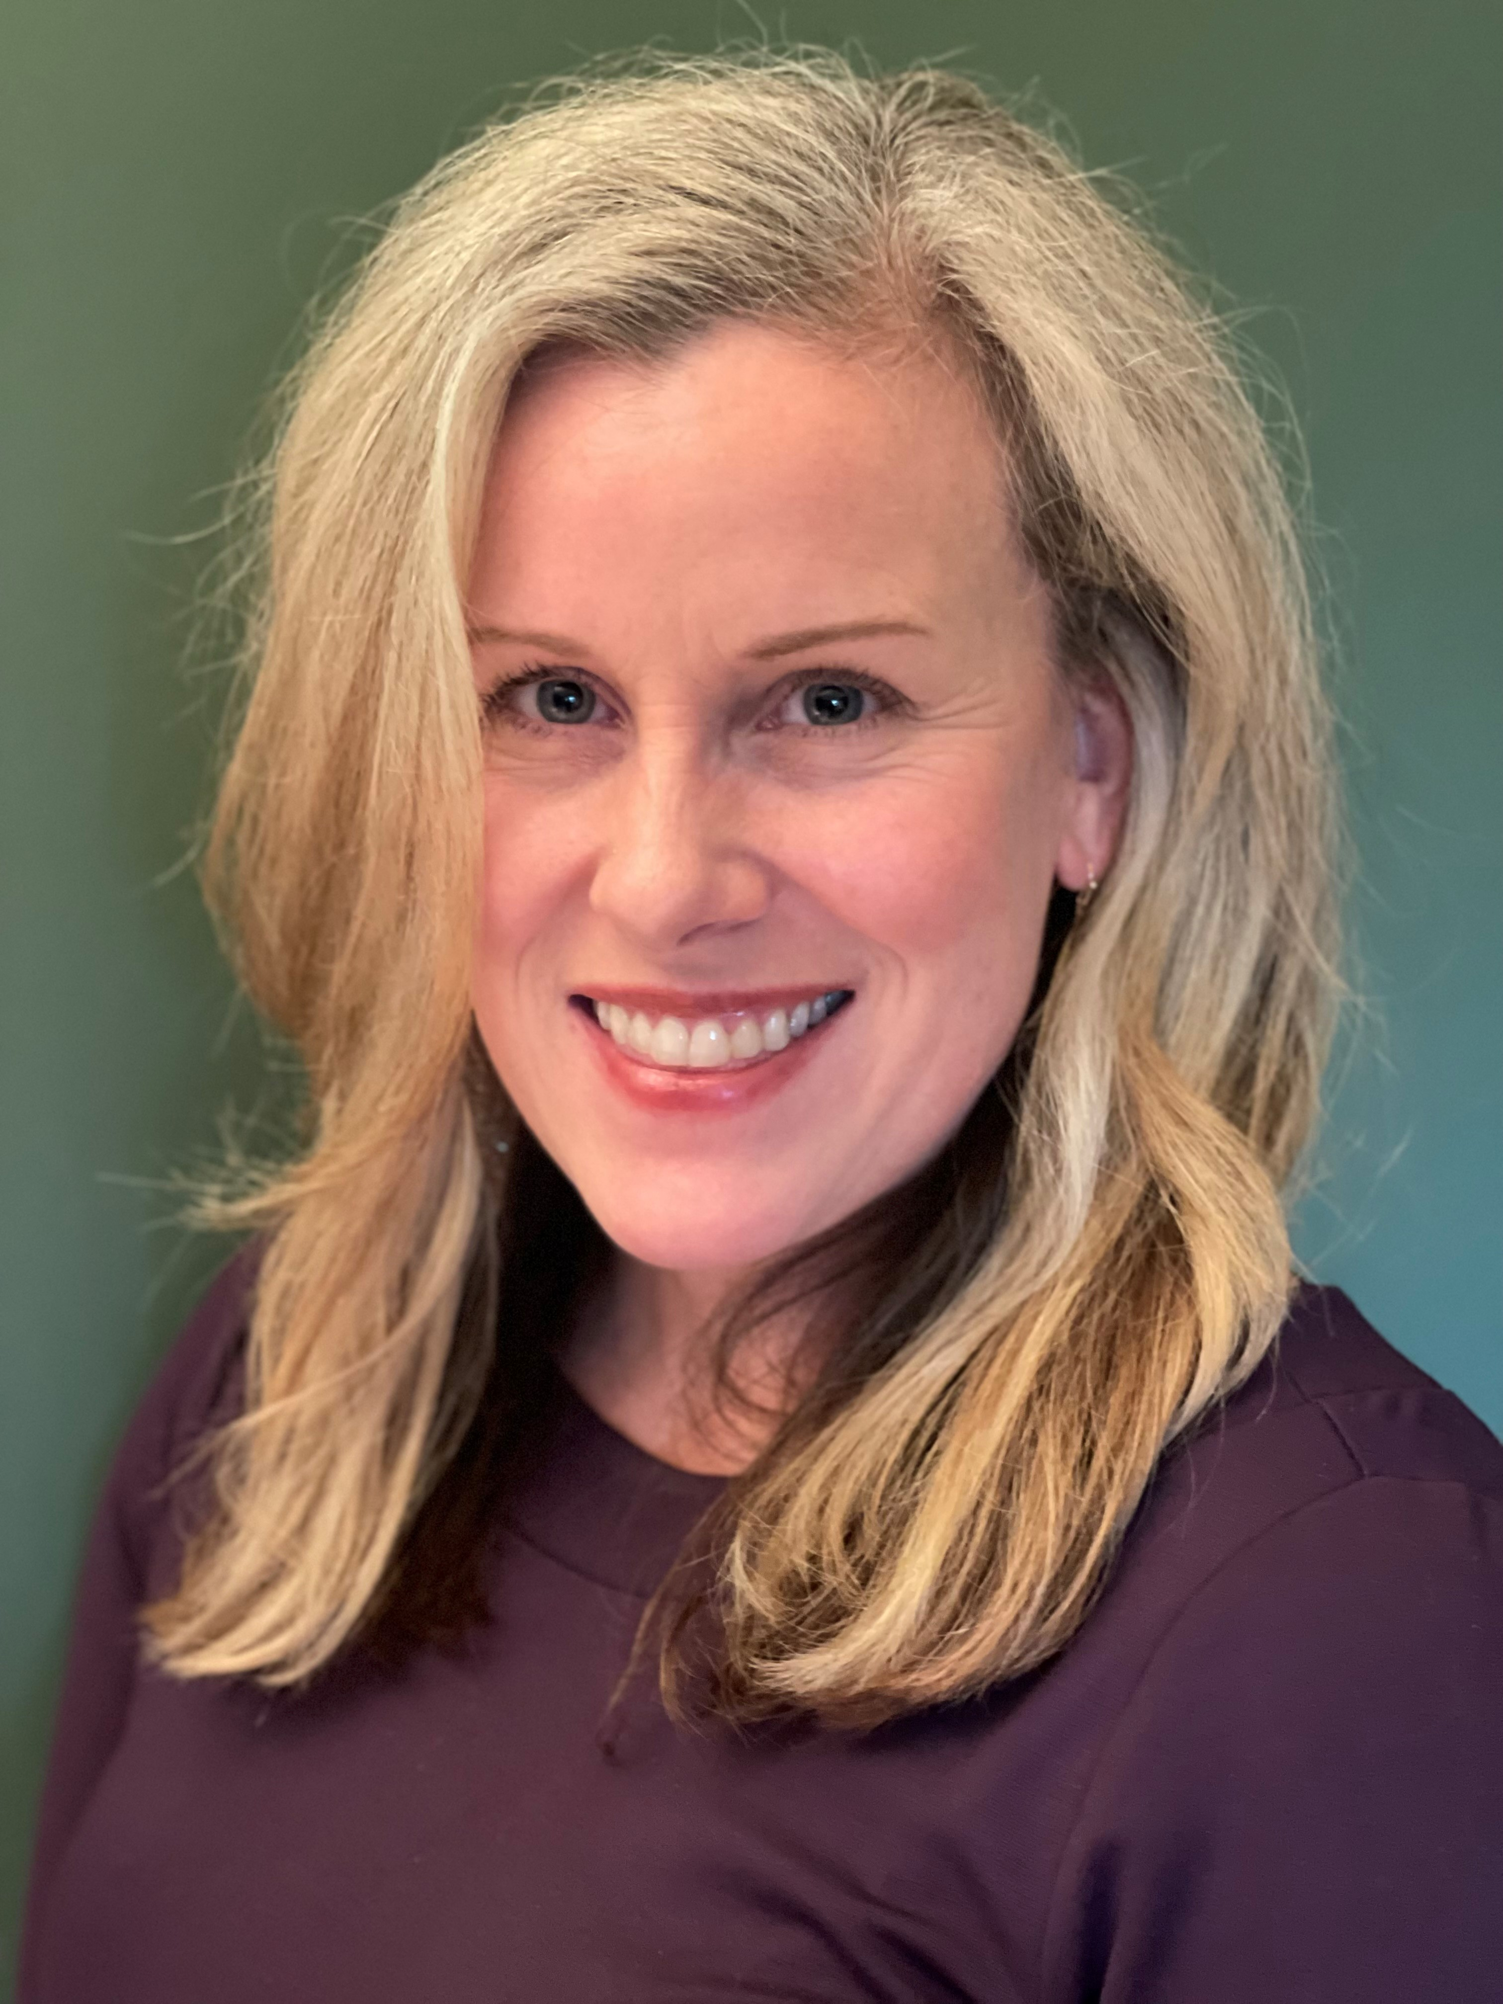
Introductions

Slide 3
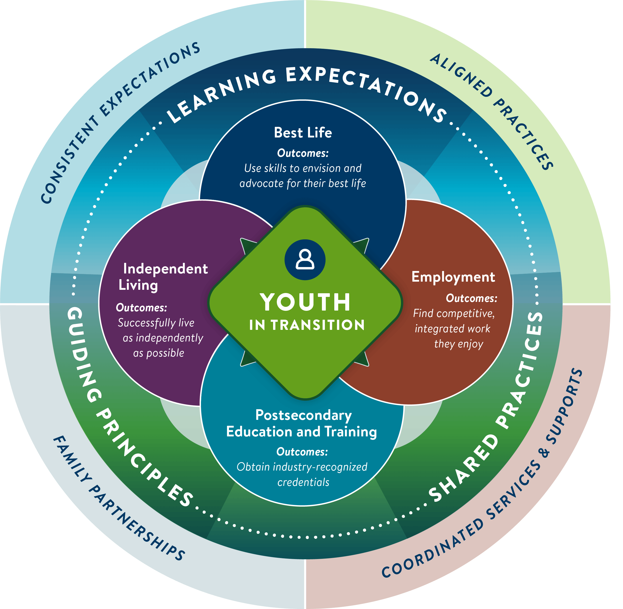
Minnesota’s transition framework defines high-quality transition planning and programming for youth with disabilities and those who support them.

Slide 4
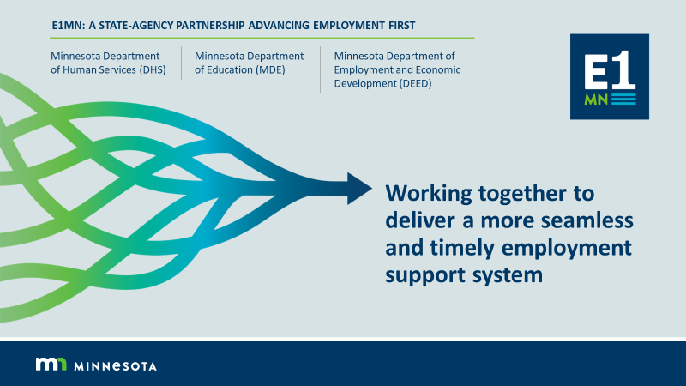
E1 MN

Slide 5
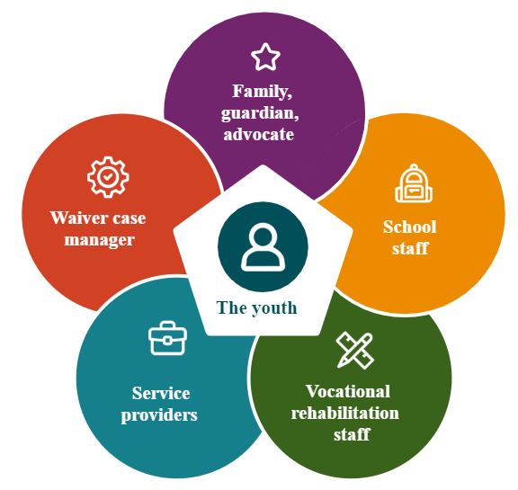
Professional partnerships
The framework strengthens the partnership between:
Schools
Vocational Rehabilitation Services (VRS)/
State Services for the Blind (SSB)
Waiver (county/tribal nation) case managers
Service providers

Slide 6
Minnesota’s Transition Framework features three key elements:
Guiding principles
Shared practices
Learning expectations

Slide 7
1. Guiding principles
The framework’s guiding principles are based
on person-centered practices:
The youth is at the center of transition planning.
Families play a key role in successful transition outcomes.
Transition planning should start early in a youth’s life.
High expectations matter.
Strong partnerships support a smoother transition to adulthood.
Success is measured by improved youth outcomes.

Slide 8
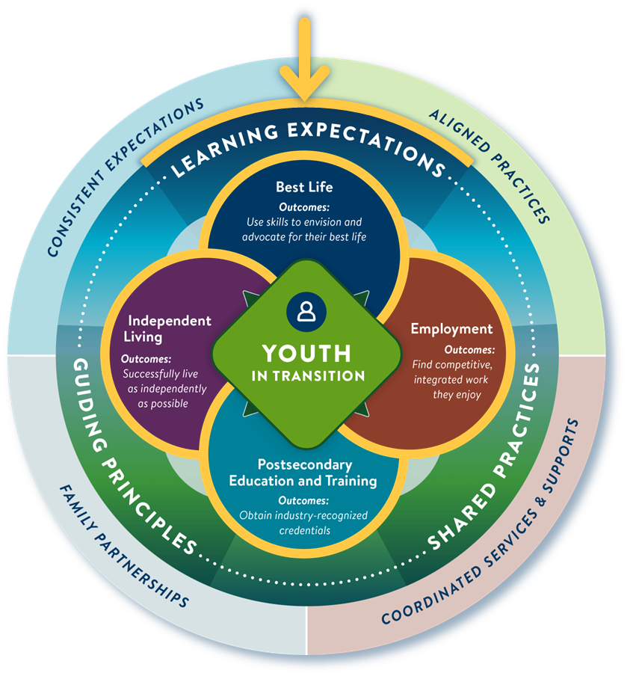
2. Learning expectations
Learning expectations define what students need to know to get to the outcomes of these four domains:
My best life
Independent living
Post-secondary education and training
Employment

Slide 9
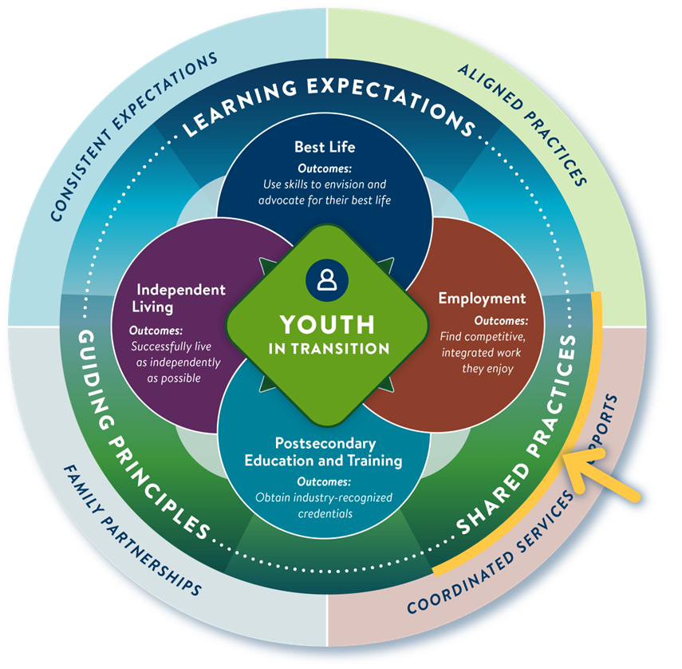
3. Shared practices
Shared practices ensure a consistent experience for youth and families while optimizing the role of everyone on the transition planning team.
Person-centered practices
Collaborative practices
Youth planning process

Slide 10
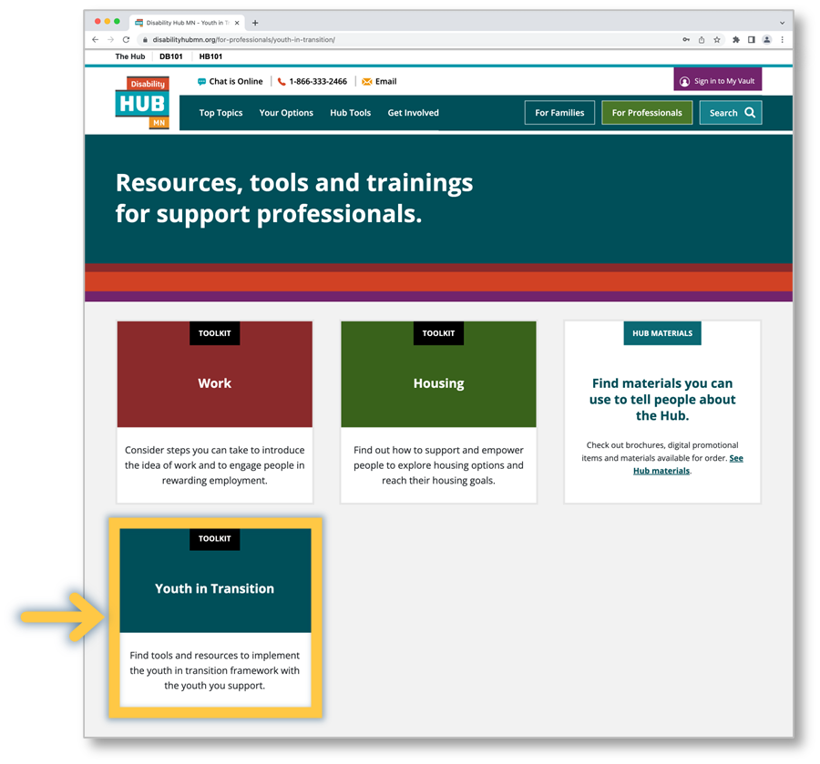
Youth in Transition Toolkit
The Youth in Transition toolkit (disabilityhubmn.org) helps professionals implement Minnesota’s Transition Framework.

Slide 11
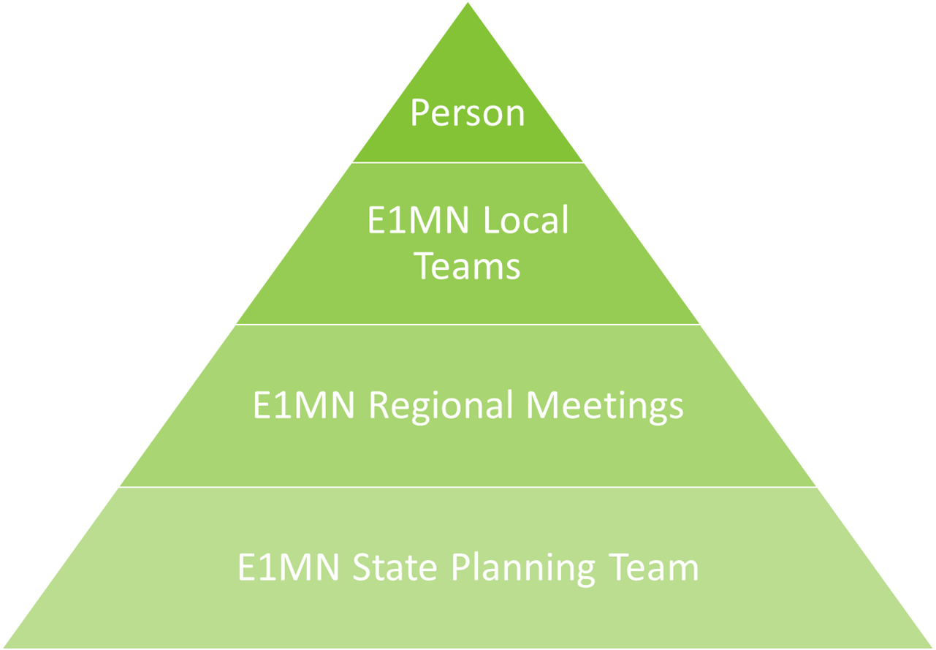

Building a Statewide System

Slide 12
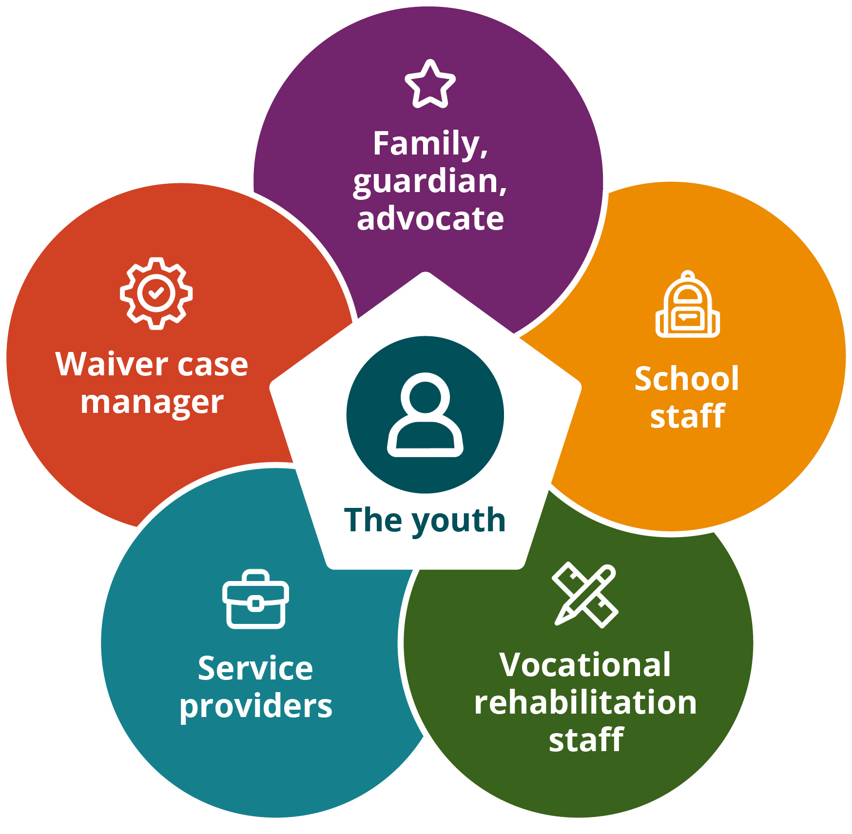
What is an E1MN Local Team?
School district or charter school staff
Vocational rehabilitation staff:
  Vocational Rehabilitation Services (VRS)
  State Services for the Blind (SSB)
Waiver case managers
Additional members as appropriate

Slide 13

What does an E1MN Local Team do?
Work together to ensure all students with disabilities they serve get high quality transition services
Meet regularly to coordinate services
Complete self-assessment and implement strategies for system improvement
Partner to make your jobs easier!

Slide 14
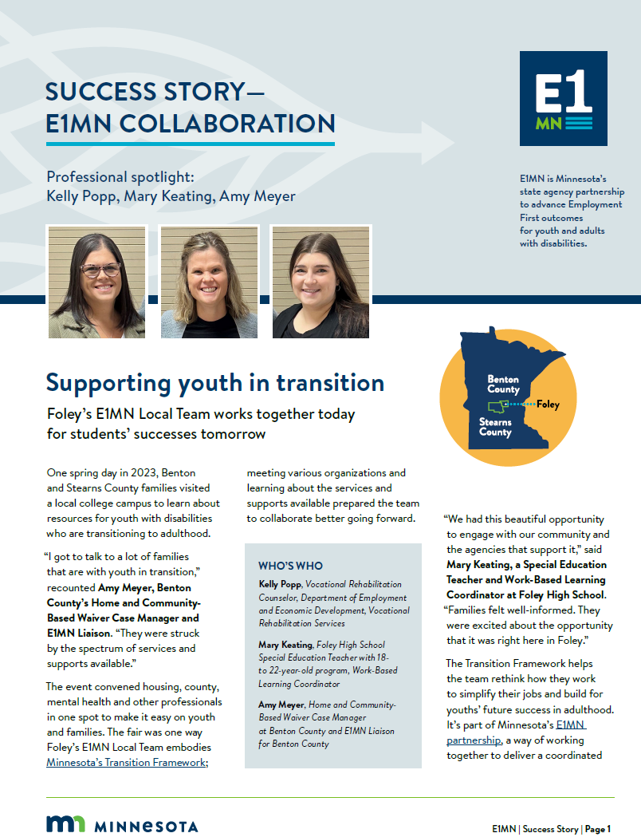
Foley’s E1MN Local Team
Foley story (disabilityhubmn.org)

Slide 15
Call to Action
Learn more about the Transition Framework (disabilityhubmn.org)
Discuss with your leadership and co-workers
Learn about, join, form an E1MN Local Team
Come to our breakout session: Resources in Minnesota’s Transition Framework
Contact us if you have questions!

Slide 16

Thank you!
Heather Kosec, Youth Services Manager, heather.kosec@state.mn.us
Alyssa Klein, Youth Services Coordinator, alyssa.klein@state.mn.us

