Slide 1

Improving Workflow, Productivity and Interaction in the classroom using Braille
Charting the Cs Conference
April 15, 16 and 17, 2024

Slide 2
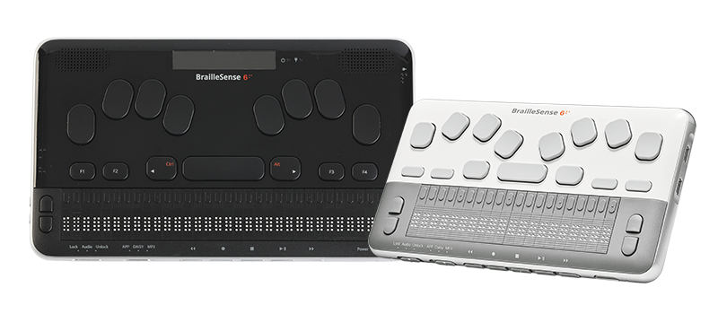
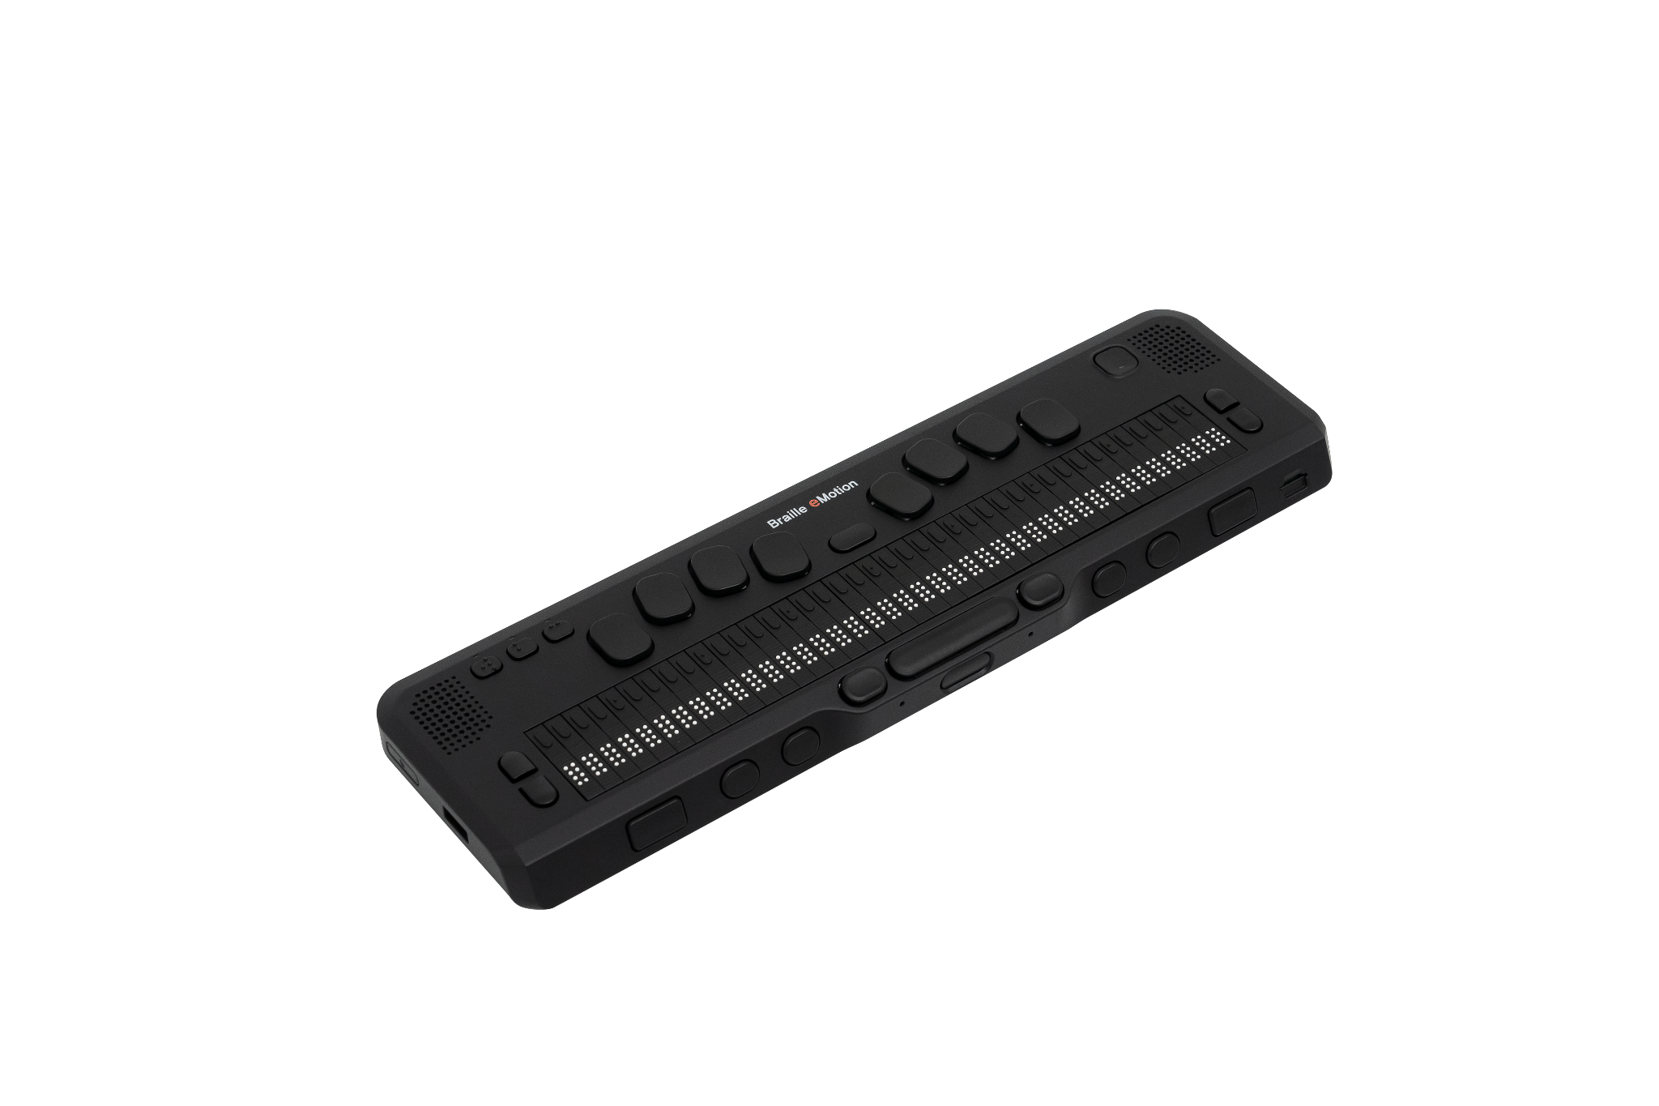
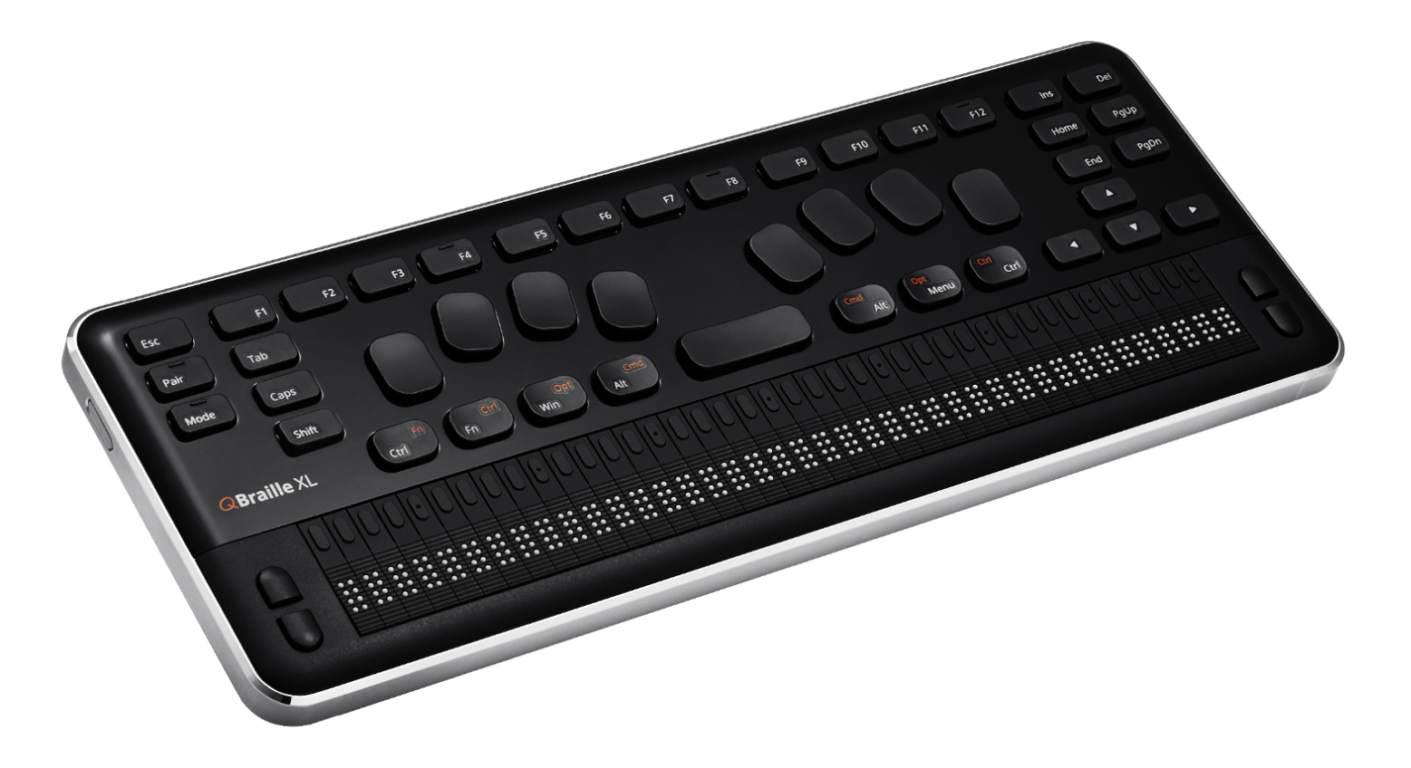
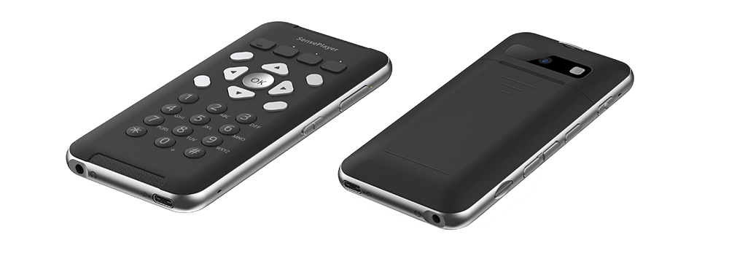
Table of Contents
HIMS Products
BrailleSense 6
BrailleSense 6 mini
Braille eMotion
QBraille XL
SensePlayer OCR
Contact Info

Slide 3
Presenter
Antonio Guimaraes
Sales Account Manager HIMS, Inc.
Masters in interactive telecommunications.
Daily user of the technology he represents
E-Mail: antonio@hims-inc.com
Direct phone: (512) 944-2847

Slide 4
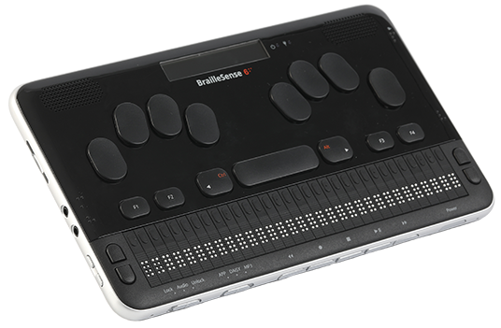
BrailleSense 6
The most Powerful, Lightweight and Intuitive 32 cell braille notetaker
Running Android (Version 12) operating system on a braille notetaker
8 core processor, 6 GB of RAM and 128 GB of flash memory
USB C with support for mainstream peripherals such as monitors, cameras, microphones, mixers, storage devices, video capture cards and the list goes on.
2x USB C ports / 2x USB A ports

Slide 5
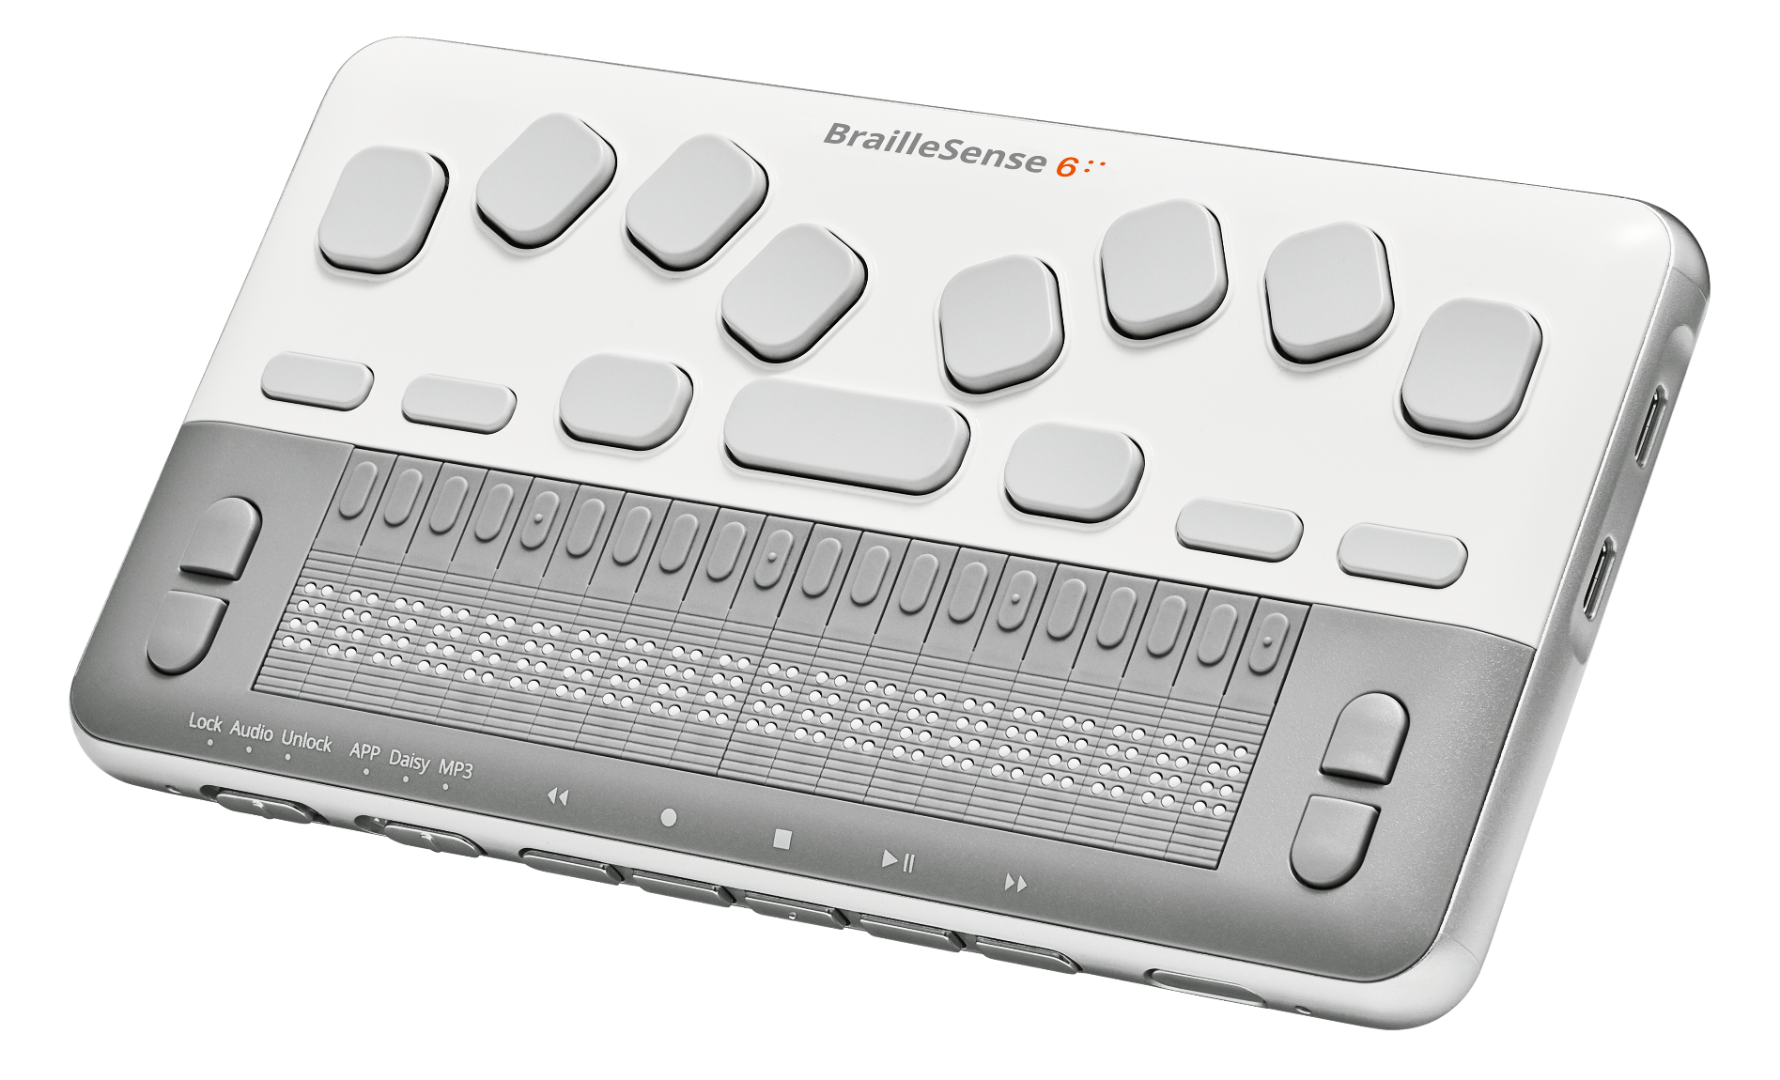
BrailleSense 6 mini
All the power of the 32-cell model with 20 braille cells at a fraction of the size and cost
8 core processor, 6 GB of RAM and 128 GB of flash memory
2 x USB C ports
Weight: 0.93 lbs

Slide 6

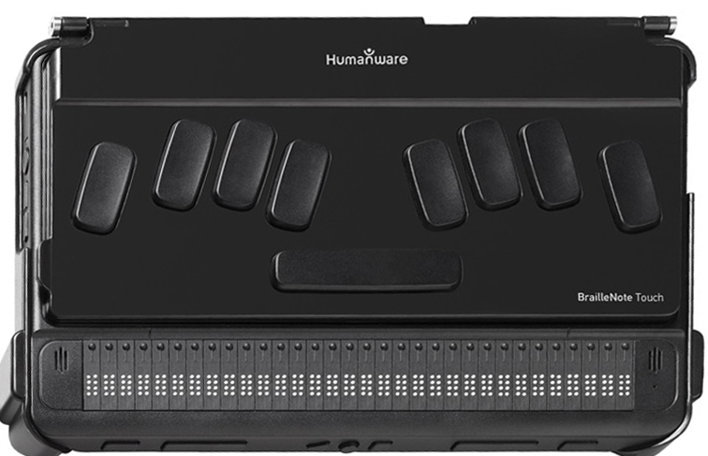
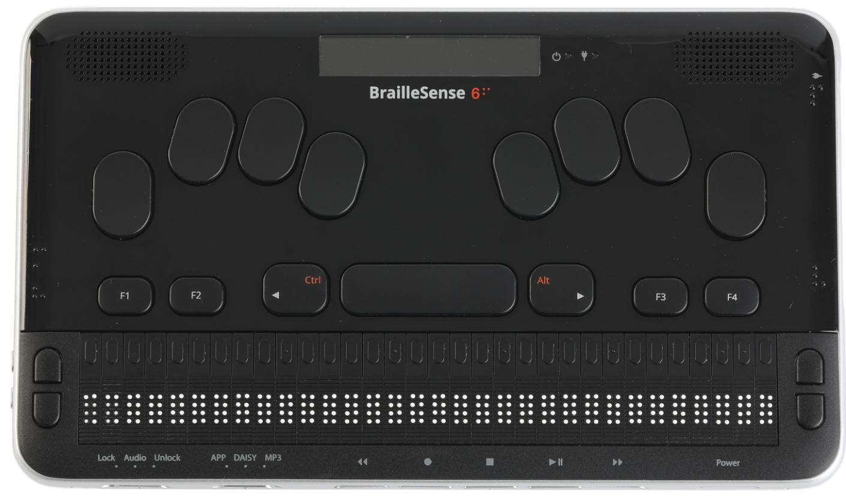

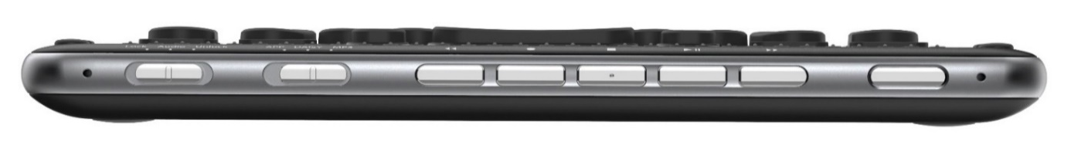
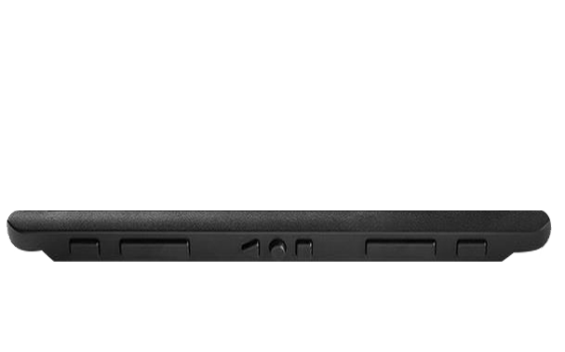
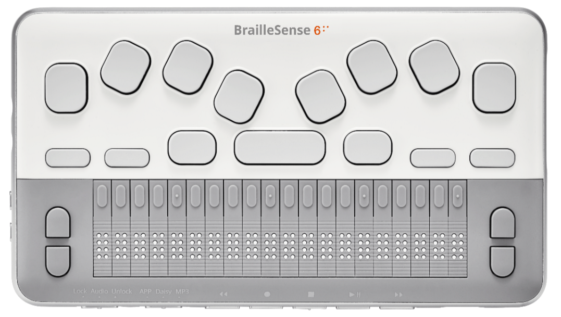
Size Comparison: Smaller, Slimmer and Lighter
Other notetaker
BrailleSense 6
1.55 lbs
2 lbs
6.70”
5.66”
9.64”
10.07”
0.86”
1.26”
BrailleSense 6 mini
0.93 lbs
4.06”
7.28”

Slide 7
BrailleSense 6 User Interface
Super intuitive and easy to use
Context Sensitive Help
Global Hotkeys and Shortcut commands
Easy to navigate help documentation off the Main Menu

Slide 8



Cloud Storage
Google Drive, Microsoft OneDrive and Dropbox all accessed from within the HIMS File Manager
Open most file types straight from the cloud
Copying, cutting and pasting content to and from the cloud is as easy as doing the same from a thumb drive
Creating sharable links doesn’t get easier

Slide 9
HIMS Email App
Support for Exchange, IMAP and POP3
Sign on with Google streamlines the login process
Activate links within messages and automatically launch default apps such as Zoom cloud meetings, YouTube and other media types

Slide 10
Mainstream Access
Support for Exchange, IMAP and POP3
Sign on with Google streamlines the login process
Activate links within messages and automatically launch default apps such as Zoom cloud meetings, YouTube and other media types

Slide 11










Applications
(1) Traditional BrailleSense Apps
File Manager, Word Processor, Notepad and E-mail
Media Player, DAISY Player, Podcasts and FM Radio
Address Manager, Schedule Manager and Web Browser
Excel Viewer, Online DAISY and Dictionary / Thesaurus
Calculator, Terminal for Screen Reader and other Utilities
Settings, Global Options and help
(2) Android Apps and Stock Android Apps
Accessible apps the user installs
Google Services: Drive, Docs, Sheets, Sides, etc.
Google classroom for blind students and teachers alike
Download and read books using online library

Slide 12
Braille eMotion
NEW 40 cell braille display
Seamlessly connect to multiple devices simultaneously, via 1 USB and 5 Bluetooth connections for enhanced accessibility and efficiency.
Upgrading Braille eMotion is a snap with the built-in Wi-Fi, as well as offering additional power and versatility for future enhancements. Wi-Fi can also be used to download text-to speech voices in various languages.
Effortlessly navigate through documents, websites, and applications with our user friendly interface and ergonomic design.
Boost productivity with HIMS own internal standalone applications, including Notepad, DAISY and Document Reader, Media Player, Calculator, Alarm, Stopwatch, Countdown Timer, and Voice Recorder.

Slide 13
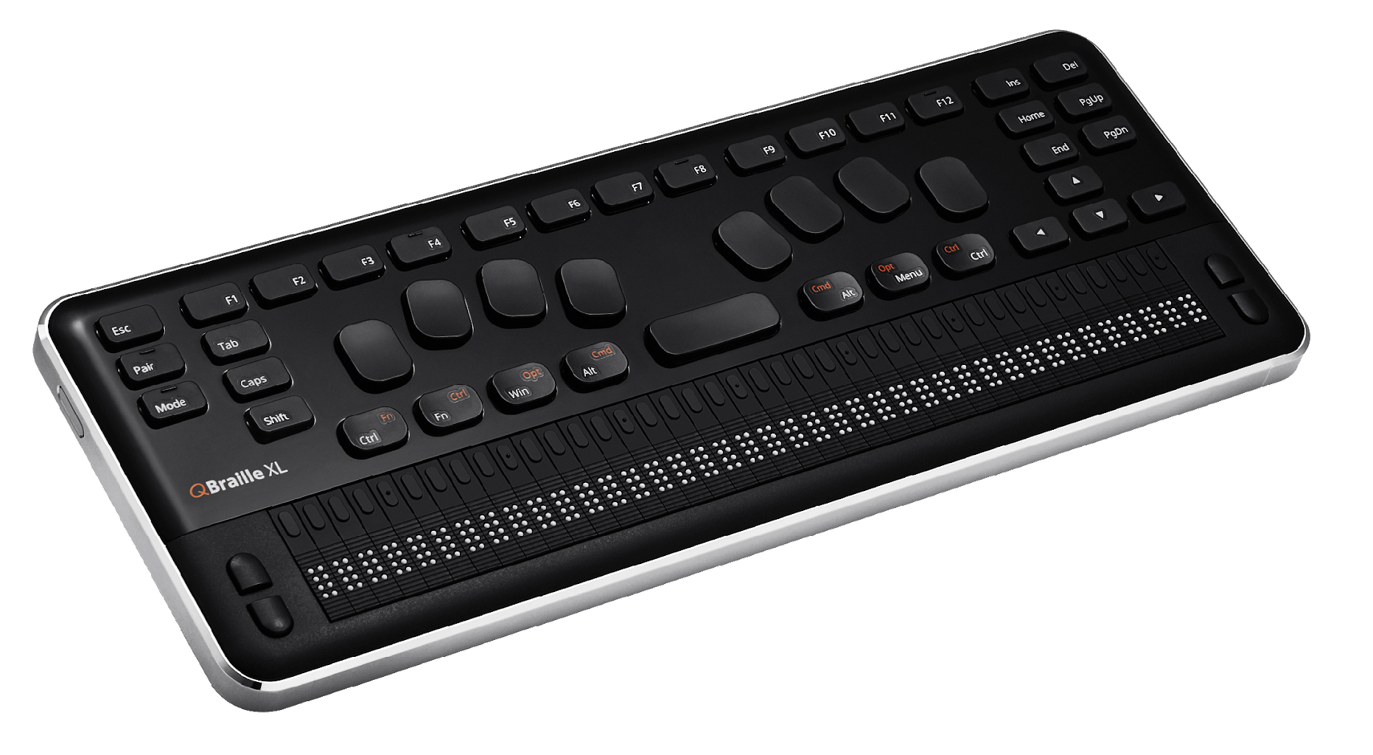
QBraille XL
40 cell braille display that combines a Perkins style braille keyboard with extended Qwerty keys found on Microsoft and Apple keyboards
Most keystrokes carry over from a regular computer keyboard
Ergonomically friendly because the user doesn’t need to constantly move between the keyboard and the braille display
Up to seven simultaneous connections with the ability to move between them at will
Also serves as a stand-alone basic notetaker and book reader with support for DAISY and PDF files
Other internal functions include stopwatch, countdown timer, calculator, scheduler etc.

Slide 14
SensePlayer OCR
Media Player with support for your favorite file types
Intuitive tactile keyboard for easy use and instant feedback
Enhanced 1.5 specially tuned stereo speakers for ultimate audio playback.
Smart Connect lets you control your iPhone and other smart devices with the SensePlayer’s tactile keyboard.
(Optional) Built-in OCR let’s users scan and read text without requiring internet or phone connectivity.
User replaceable battery and slim design make the SensePlayer portable and user-friendly

Slide 15
Thank You!
Phone: 512-837-2000
  Option 1 for Technical Support
  Option 2 for Sales and Customer Service
Fax: 512-837-2011
Support E-Mail: support@hims-inc.com
Sales E-Mail: sales@hims-inc.com
Webpage: https://hims-inc.com/
Address: 4616 W. Howard Ln. Ste 960
Austin TX 78728
Human
Information
Management
Service

