Slide 1
ASL Concepts in STEAM
Beth Hamilton and Kristin Stai

Slide 2
Welcome
Welcome
Mock STEAM Lessons
ASL Vocabulary
ASL Classifiers
ASL Tips in STEAM
Conclusion
Q and A

Slide 3
Beth Hamilton, continued.
Bachelor of Science in Chemistry with a minor in Biology from Muskingum College
Master of Education in Deaf Education from Kent State University
Teaching since 2002

Slide 4
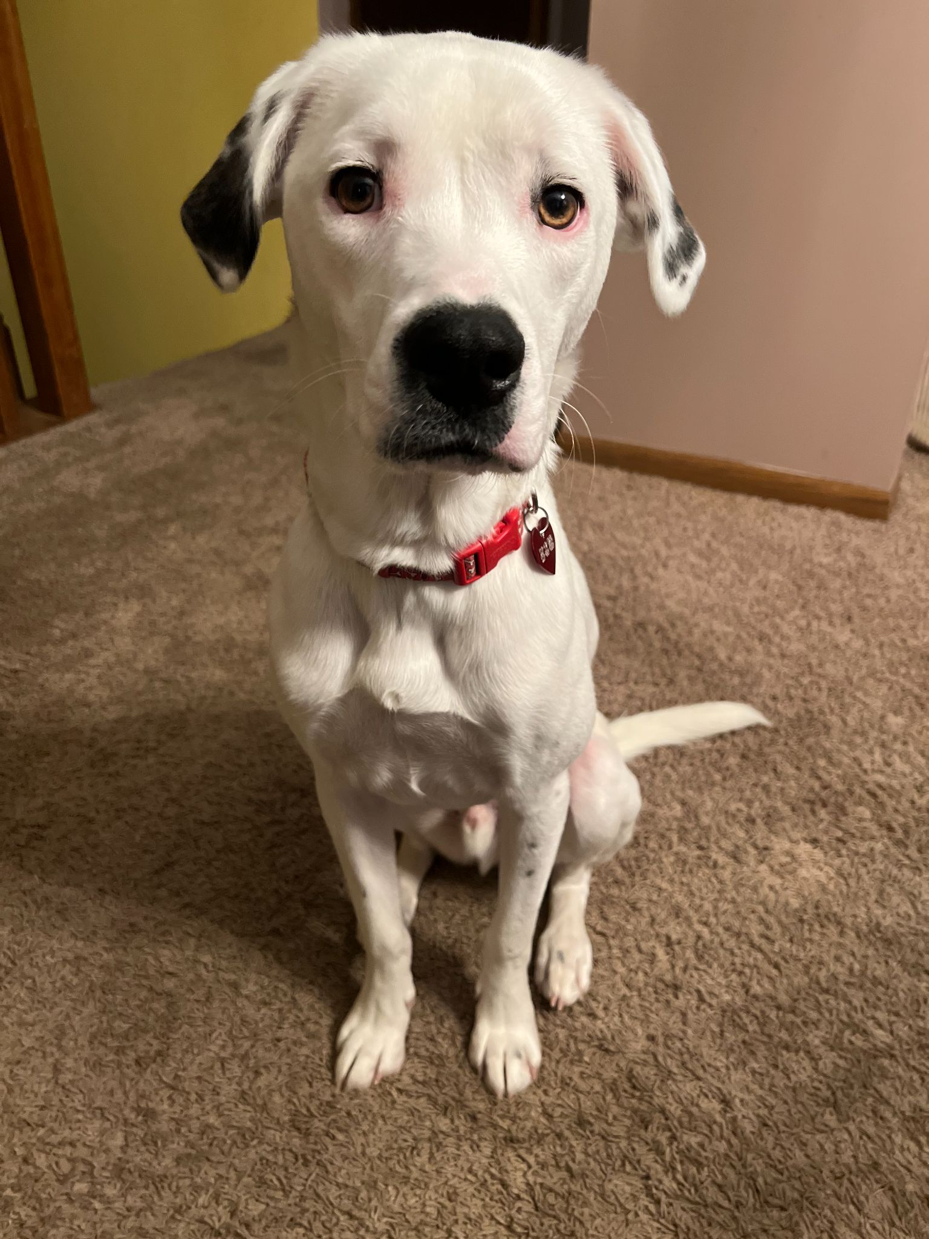
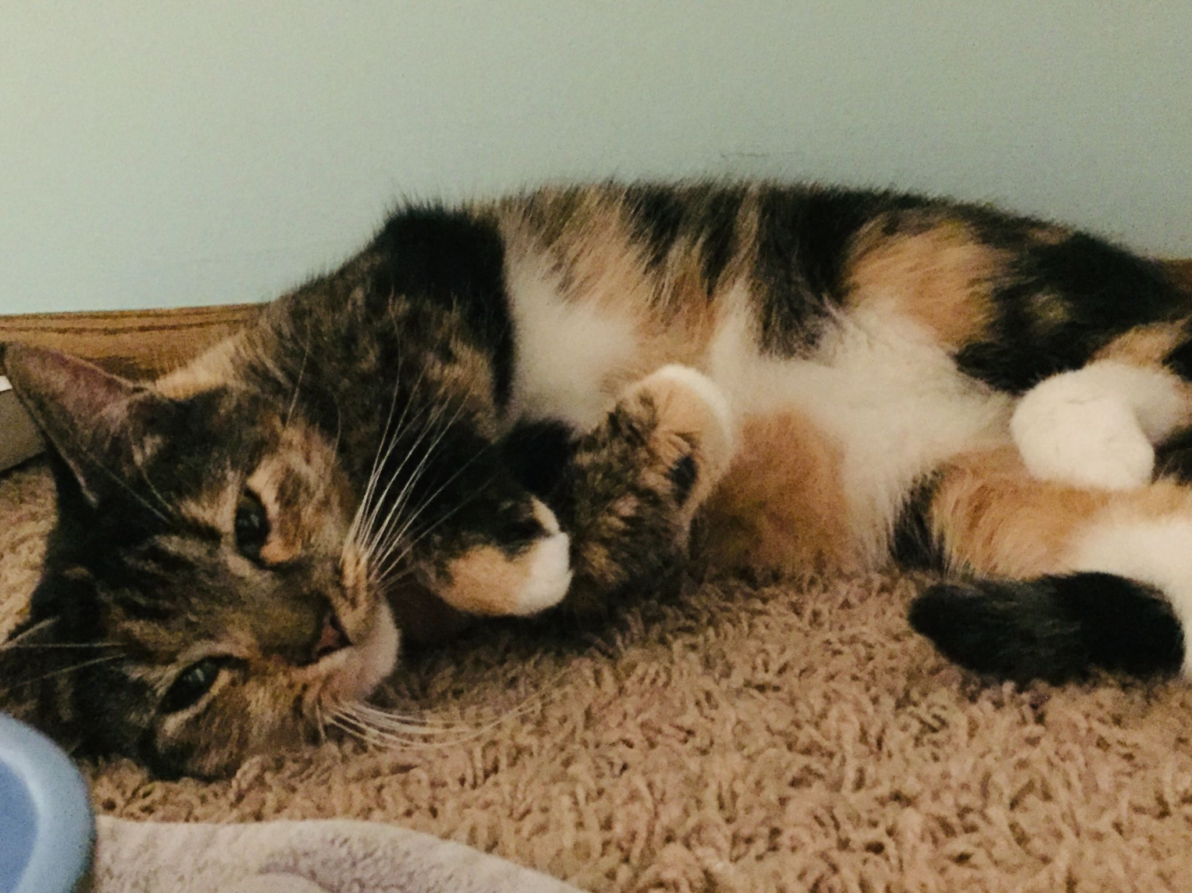
Beth Hamilton, continued 2
Deaf
Ohio native (also lived in Virginia and Kentucky before settling in Minnesota)
Hearing husband, 1 CODA, 1 dog and 1 cat
Enjoys reading, hiking, traveling, coffee and tea, and playing card/board games

Slide 5
Kristin Stai
Bachelor of Arts in Biology with a minor in History from University of Minnesota – Twin Cities (U of M-TC)
M. Ed. in Science Education (U of M-TC)
M. Ed. in Deaf Education (U of M-TC)
Teaching since 2001

Slide 6
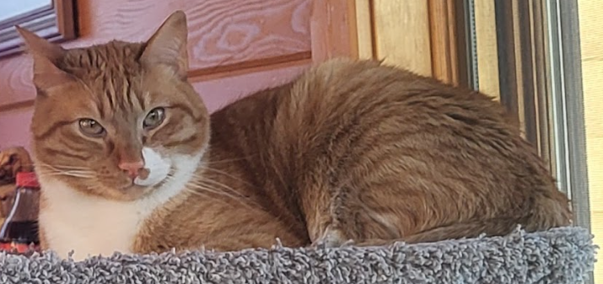
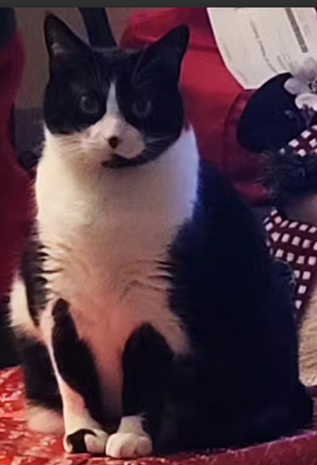
Kristin Stai, continued.
Deaf
Born and raised in Minnesota
Hearing husband, 2 cats and 1 foster cat
Enjoys reading, hiking at Minnesota State Parks, yoga, weight training, traveling, and spending time with friends and family

Slide 7
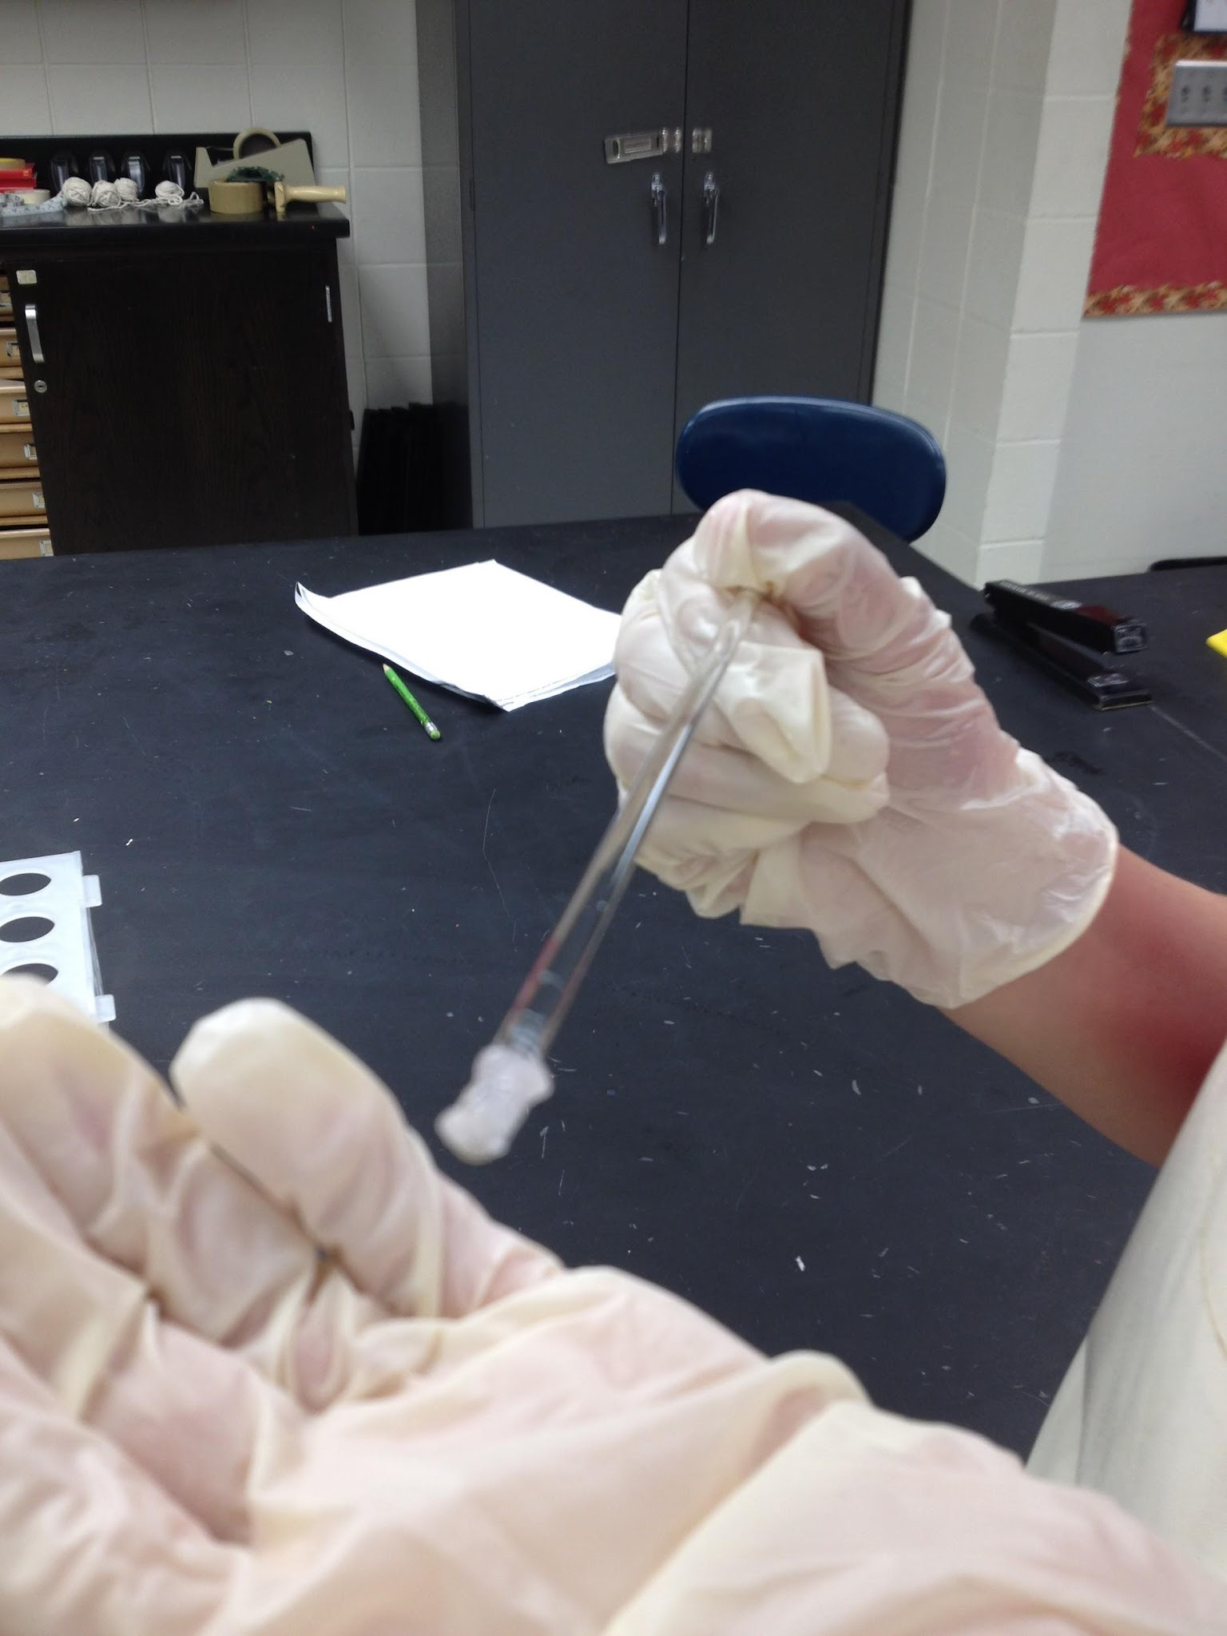
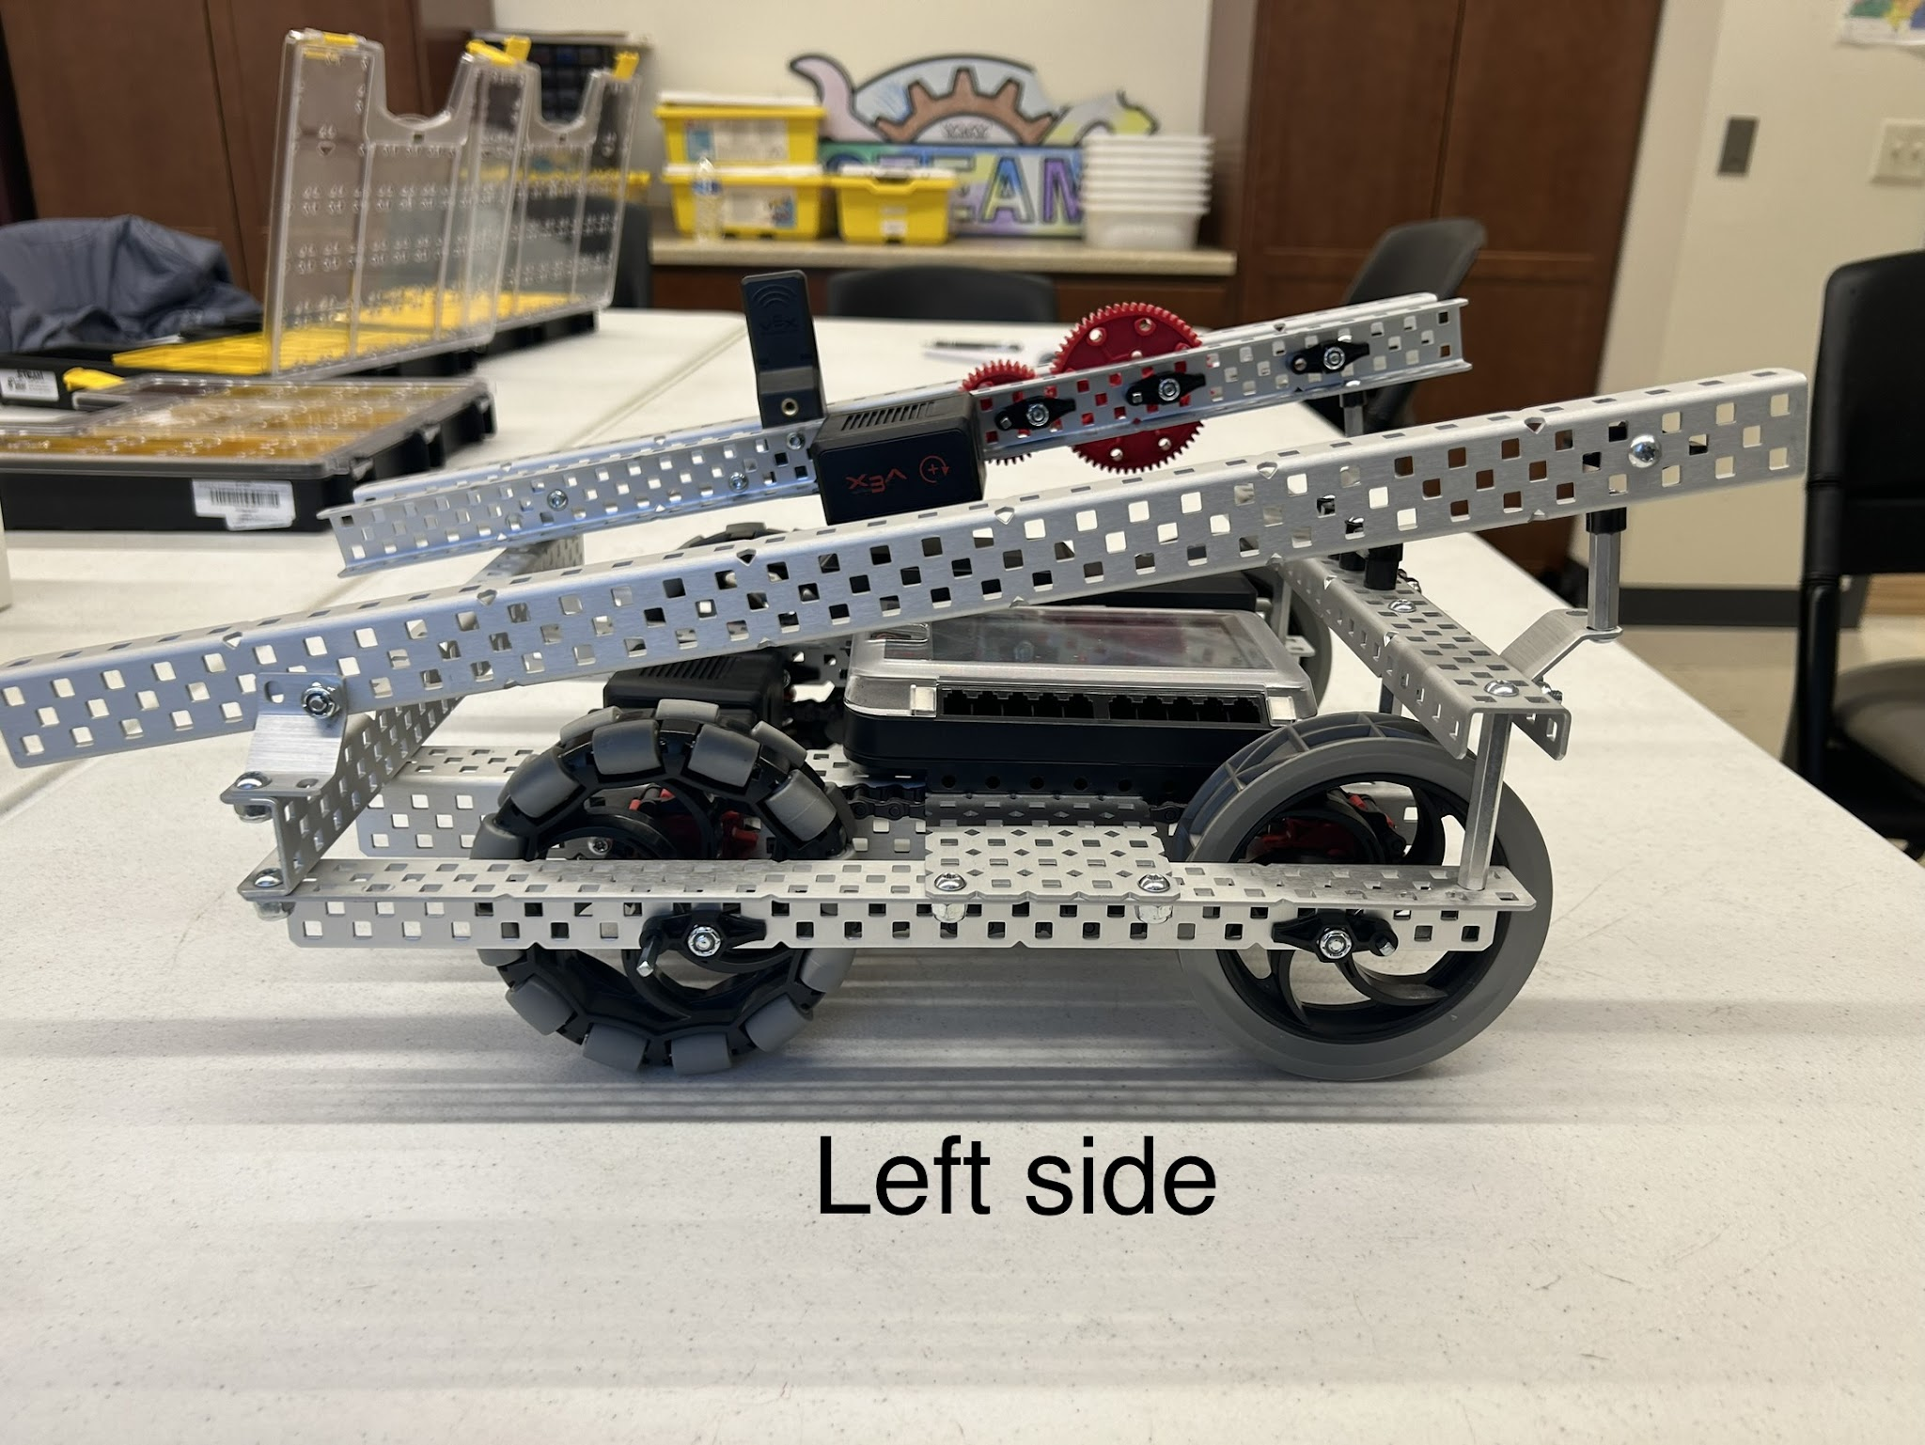
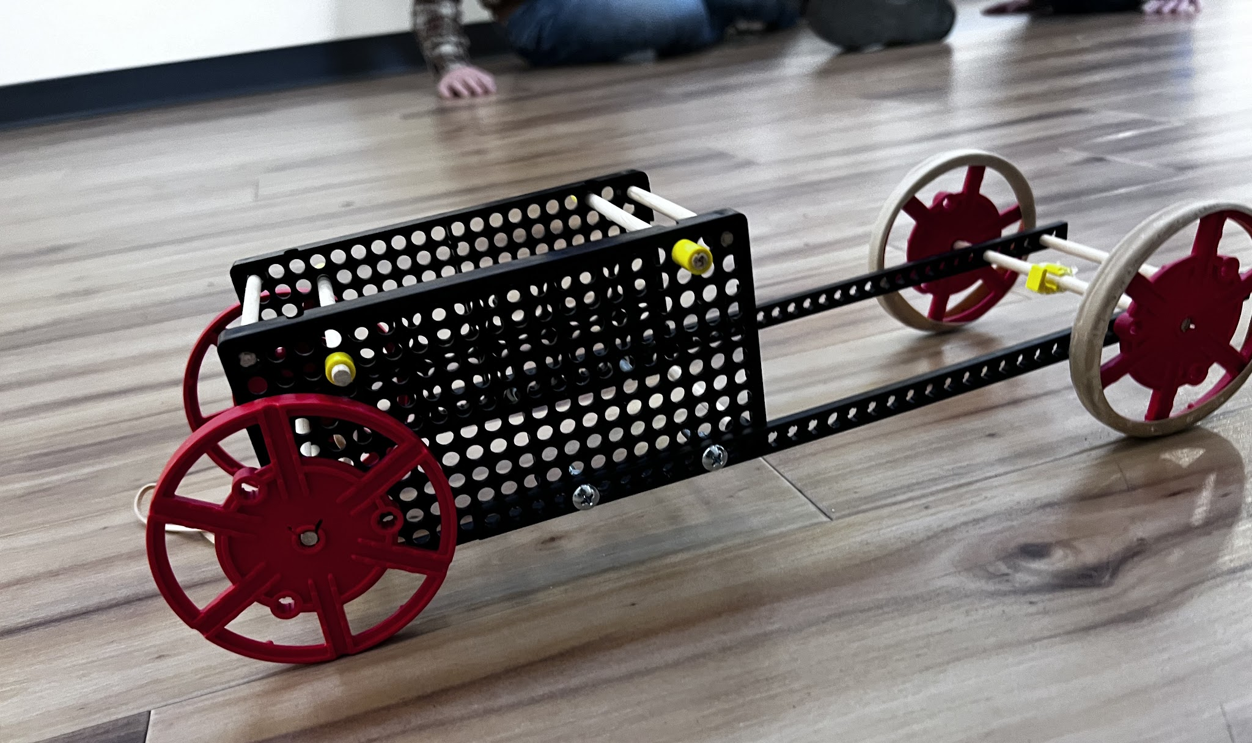
Science/STEAM Courses Offered at Metro Deaf School
Earth Science
Biology
Chemistry
Robotics
Design and Modeling
Forensics

Slide 8
Mock Engineering Lesson
What makes planes glide in the air?
What makes planes crash?
How do you know?

Slide 9
Problem: How can you design a paper airplane that will fly?
What will your design look like?
Why do you think it will fly or crash?

Slide 10
Small Group Activity
Discuss the design of the paper airplane
Make the paper airplane
Test the airplane
Discuss why it worked and why it didn’t work

Slide 11
Post Activity Discussion Questions
Was your design confirmed/not confirmed?
What did you learn from the observations in your testing?
How does this apply in real life?
Vocabulary: lift, drag, thrust, gravity

Slide 12
Demonstration on Scientific Method vs. CER Method
Raisins and Water
Scientific Method
CER method (Claim, Evidence, Reasoning)

Slide 13
Raisins and water lab activity – Using Scientific Method
Ask questions
Write/draw predictions in journals
Do activity (experiment)
Observe
Discuss results
Write/draw results and conclusions in journals

Slide 14
Raisins and water lab activity – Using CER Method
Discuss phenomenon/phenomena
Ask questions and make predictions
Do activity (experiment), observe and discuss results
Write/draw in journals:
What did you see/what will happen? (Claim)
What evidence supports your claim? What did you observe? (Evidence)
Why did this happen? Was your claim supported or refuted? (Reasoning)

Slide 15
ASL Vocabulary – Physical Science
matter (#MATTER)
mass (#MASS – NOT weight)
volume (#VOL)
density (#DENSITY – NOT thick)
temperature (index finger)
solute (#SOLUTE)
solvent (#SOLVENT)
solution (tea or dissolve + mixture, not solve)

Slide 16
ASL Vocabulary - Atom
atom (#ATOM or fist with C hs holding)
nucleus (N – center)
proton (P – inside C hs)
neutron (N – inside C hs)
electron (E or index finger – outside C hs)

Slide 17
ASL Vocabulary – Chemical Names
Use chemical symbols to represent elements
Oxygen (#O with circular movement) or (O move down 2)
Salt – Sodium chloride NaCl (#NACL)
Acid – Hydrochloric acid HCl (#HCL)
Compounds with Subscripts
H2O (H move down 2 move back up O)

Slide 18
ASL Vocabulary - Physics
force (C hs with B hs, push or pull signs)
momentum (#MOMENTUM)
inertia (#INERTIA)
acceleration (#ACC or A hs shake)
mass (#MASS)
speed
velocity (V hs with index finger)

Slide 19
ASL Vocabulary - Biology
fungi
bacteria
virus
parasite
DNA (#DNA)
RNA (#RNA)
protein

Slide 20
ASL Vocabulary - Cells
cell (#CELL or fist with C hs)
nucleus (n center)
cell parts/organelles
all fingerspell unless it’s already accepted abbreviations
Golgi apparatus = #GA
Endoplasmic reticulum = #ER
https://sciencenotes.org/animal-cell-diagram-organelles-and-characteristics/

Slide 21
Definition of ASL Classifier
Classifiers can be used to:
describe the size and shape of an object
represent the object itself
demonstrate how the object moves
convey how it relates to other objects and/or people
https://www.lifeprint.com/asl101/pages-signs/classifiers/classifiers-00.htm

Slide 22
ASL Classifiers – Phases of Matter
Use of technical signs
gas (#GAS)
liquid (#LIQUID)
solid (rock)
Use of classifiers to demonstrate phase changes
evaporation
Melting
https://sciencenotes.org/states-of-matter/

Slide 23
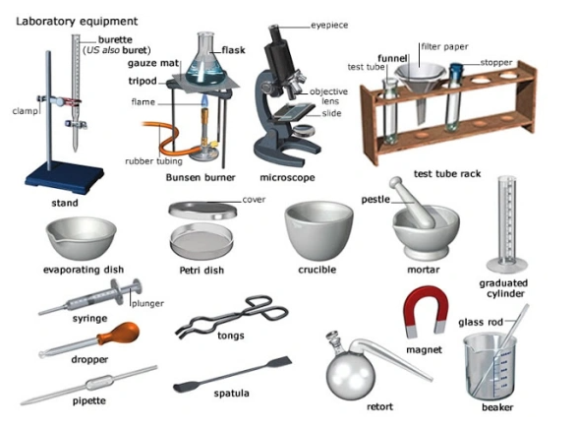
ASL Classifiers – Lab Equipment

Slide 24
ASL Tips in STEAM
Fingerspell clearly and deliberately
Use classifiers to demonstrate concepts
Use placeholders in space as reference
Think visually as if you’re watching a video
Don’t get hung up on words
Use technical signs when appropriate
Signs in the visuals (posters, presentations)
Write/type in the words to show emphasis

Slide 25
Conclusion
ASL is in state of flux for STEAM. Research vocabulary signs prior using, instead of making them up.
ASL has natural, spatial, 3D features. Use classifiers appropriately to communicate complex concepts or models with students.

Slide 26
Deaf Studies and STEAM Resources
Deaf Scientist Corner website https://twu.edu/dsc/
Johanna B. Lucht - NASA engineer: https://www.nasa.gov/centers/armstrong/features/nasa-s-first-deaf-engineer-in-active-mission-control-role-impresses
Julia Velasquez - student astronaut for Xploration Station: http://www.xplorationstation.com/stories/StudentAstronaut-Finalist:-Julia-Velasquez

Slide 27
Online ASL Resources
Atomic Hands https://www.atomichands.com/
ASLCore https://aslcore.org/
DeafTEC https://deaftec.org/stem-dictionary/
TERC Signing Science https://signsci.terc.edu/video/SSD.htm
NTID/RIT One Stop ASL Resource https://www.rit.edu/ntid/dhhvac/resources
Science in ASL https://www.youtube.com/channel/UCEWSRmvpG01dJegOmsrWbMA
Deaf in Scrubs https://www.youtube.com/channel/UC1mrgxxrCtcAUBFR5Z9Kn6A

Slide 28
Thank you!
Beth Hamilton, bhamilton@mdsmn.org
Kristin Stai, kstai@mdsmn.org
Metro Deaf School 1125 Energy Park Drive St. Paul, MN 55108 651-224-3995

