Slide 1
Sexuality for All Abilities: Curriculum Training
Katie Thune, MA Ed.
Anna Hayek
madhatterwellness.com

Slide 2
Training Overview
Centering and Check In
Challenges in Society/Equitable Sex Education
Sexuality for All Abilities Curriculum Overview
Tips for Learners with High Needs
Answering Difficult Questions
Trauma Informed and Inclusive Interactions
Q & A
Close

Slide 3
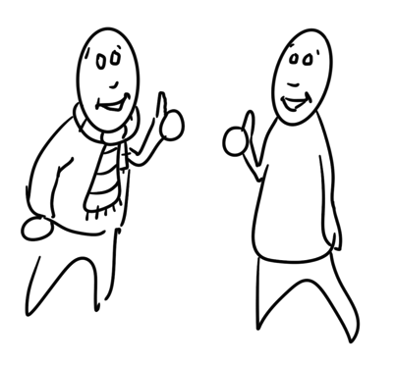
Agreements
This is a non-judgmental and safe space.
Participate at your own comfort level.
All questions, comments, and ideas are welcome.
Take care of yourself.

Slide 4
CENTERING

Slide 5
Who We Are And What We Do
Mad Hatter Wellness, founded by Katie Thune, provides learning opportunities to empower people of all abilities with knowledge and skills to make safe and healthy choices.
We focus on educating about healthy relationships, with ourselves and others, as well as safety, consent, and lots more. All of this is a part of comprehensive sexual education.
Four main programs: Sexuality for All Abilities, Open Conversations, Empowered Together and The Power of Me

Slide 6
Things to Think About
All humans are sexual beings.
Conversations about sexual health can bring up a range of emotions.
Sexual education is a lifelong process.
We all have different comfort levels with this topic. This is okay!
None of us are perfect.

Slide 7
Language We Use
Person first language AND Identity first language
Developmental age vs Chronological age
People needing more supports or less supports instead of high-functioning/low-functioning

Slide 8
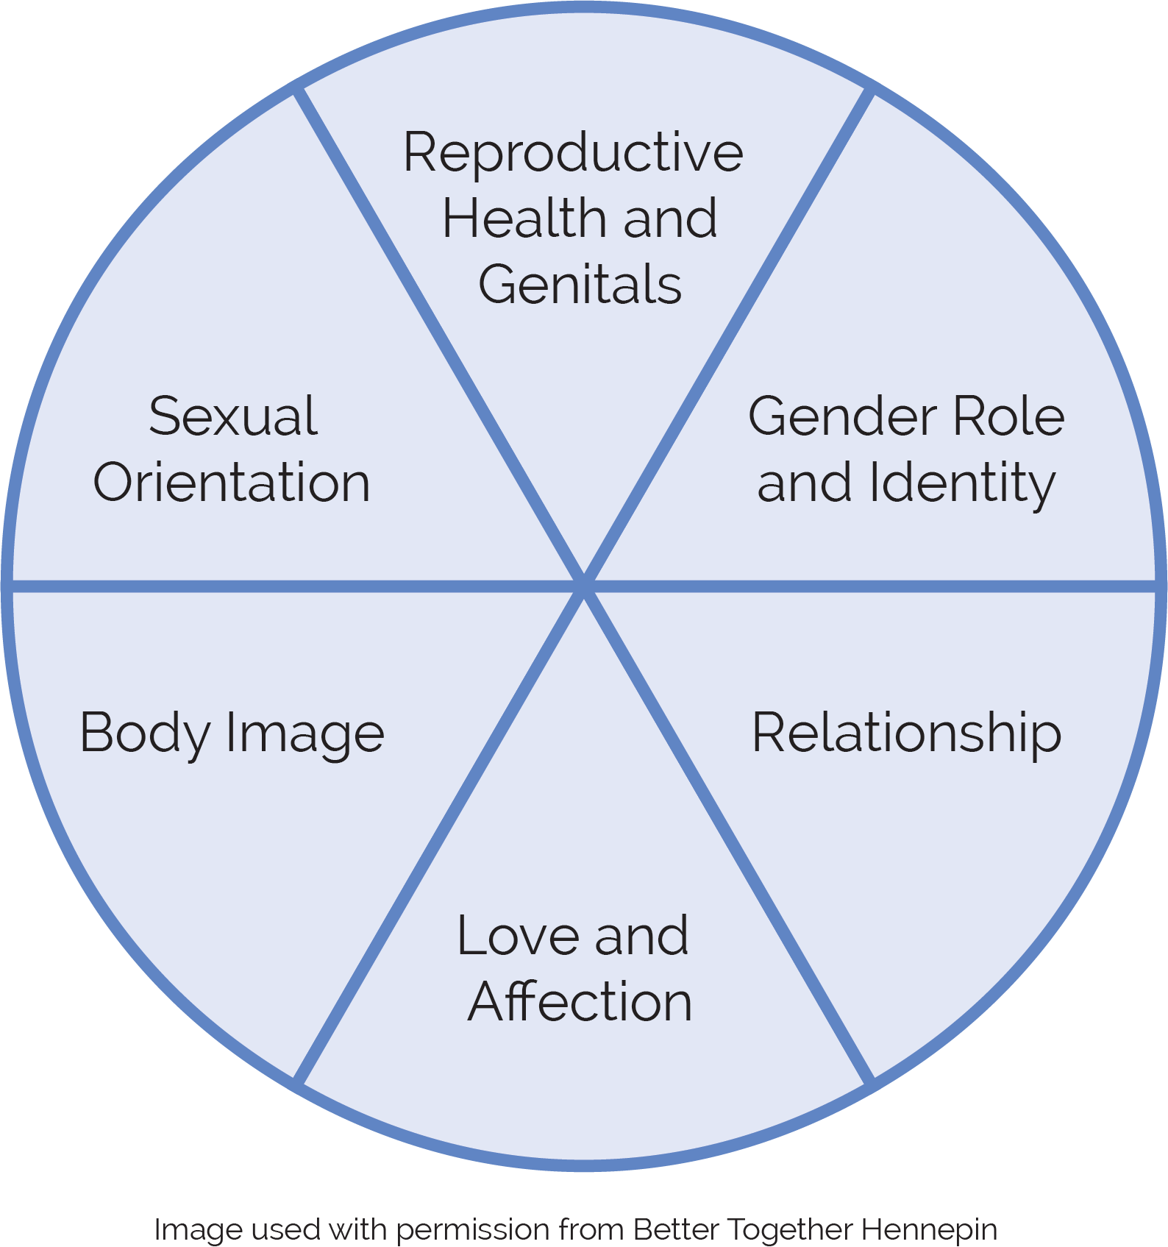
What Are We Talking About When We Use The Term Sexuality?

Slide 9
Our Hope for This Training
You will leave this training feeling a little more comfortable talking about this topic.
You will leave with 1-2 tools or strategies to use with yourself, your students, people you support, or the people in your life.

Slide 10
Focus Question
What was your experience with sex ed growing up? Think about at school, with family and friends, etc.

Slide 11
How Has Sexual Education Failed People with Disabilities?
Lack of education
Stranger Danger principle
Sex ed as abuse prevention
Reactive education
Hidden curriculum
Informal curriculum

Slide 12
Our Hope for Sexuality Education
Comprehensive
Non-reactive
Non-judgmental
Non-shaming
Inclusive (age, gender, disability, race, sexual orientation, etc.)
Accessible to ALL

Slide 13
Comprehensive Sex Ed to Us
Sexuality is not just about sex. It’s also about life and relationships - relationships with others, ourselves, and our bodies.
Comprehensive sex education (CSE) is a sex education instruction method based on curriculum that aims to empower students with knowledge, attitudes, skills and values to make appropriate, healthy, and safe choices in their sexual lives. CSE includes learning about and practicing self-determination and self-advocacy.

Slide 14
Sexual Rights for People with Disabilities
People with disabilities have a right to:
sexual education.
sexual expression.
be respected.
be protected.
be supported in all relationships.
engage in consensual sexual relationships.
acquire sexual knowledge.
make their own decisions.
be believed and seen.

Slide 15
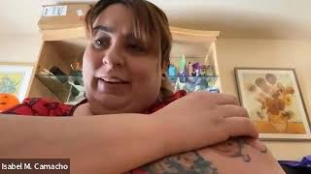
Why do you think it’s important to teach about healthy relationships and sexuality?
Notes:
This is Isabel.

Slide 16
Helpful Strategies for Equity – Sexual Health and Students With Disabilities
Teach accurate terms for private body parts.
Talk about body rights: “My body belongs to me.”
Use teachable moments and rules when applicable.
Encourage assertiveness and appropriate noncompliance.
Use repetition (pre-teach, re-teach, review).
Role-play healthy boundaries.
Teach and practice consent!
Speak less, wait more, use visuals.

Slide 17
Self-Advocacy and Self-Determination
Self-advocacy is the extent to which a person has the ability to speak up for one’s self.
Self-determination requires an individual to make decisions about their own life. This includes skills such as: choice-making, decision-making, problem solving, goal setting, self-monitoring, leadership, resiliency and so much more.

Slide 18
SEXUALITY FOR ALL ABILITIES CURRICULUM OVERVIEW

Slide 19
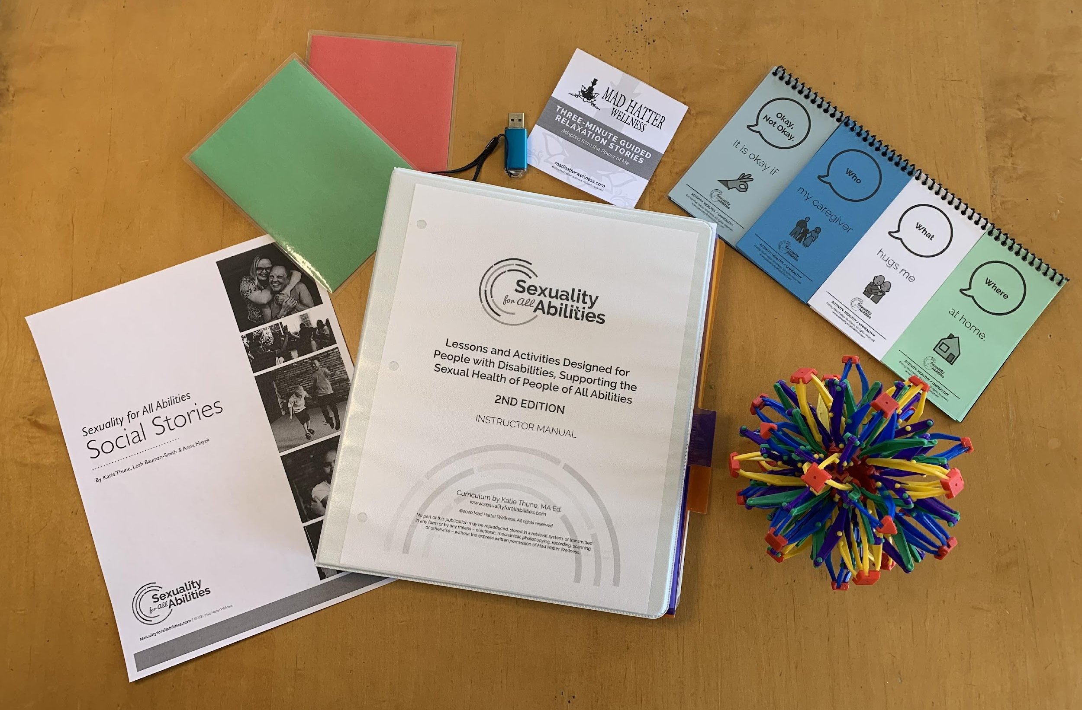
Sexuality for All Abilities Lessons and Materials
Lessons and Activities (includes flash drive with worksheets, social stories, modified lessons and other materials)
Access to Safety Videos
Breathing Sphere
Boundaries Flip Books
Red/Green Cards

Slide 20
Contents in SFAA
Healthy Relationships
Safe and Healthy Boundaries
Private and Public
Romantic Relationships
Puberty/Changes in Our Body
Human Reproduction
Pregnancy
Outcomes of Sexual Activity
Gender
Sexual Orientation
Consent and Body Rights
Get Away and Tell Someone
Social Media Literacy and Online Safety

Slide 21
Additional Materials
Glossary
Optional Assessment
Tips for Answering Difficult Questions
Tips for Teaching
Strategies for a Positive Classroom
Flash Drive (Modified Lessons, Social Stories, Sample Letter to Parents, Additional Resources, PDF with Video Links, etc)

Slide 22
Included in Each Lesson
Five parts of each lesson:
Center
Check In and Connect
Learn
Review
Close
Also included in each lesson:
Adaptations/Modifications
Areas of Possible Confusion
Additional Resources
Frequently Asked Questions

Slide 23
Modified Lessons for Learners with High or Complex Needs
30-minute lessons
Series of short lessons for each topic
Scripted language
Line drawings and photographs for comprehension
Communication boards or cards for communication
Modify further (if necessary) to meet your student needs

Slide 24
HEALTHY RELATIONSHIPS LESSON

Slide 25
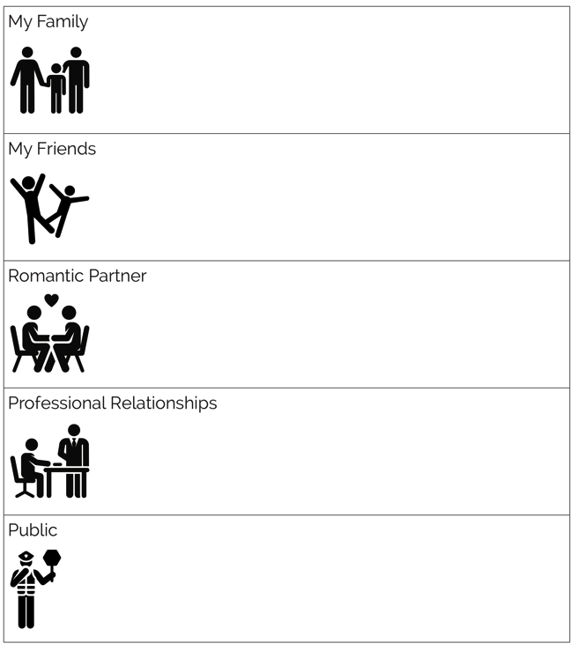
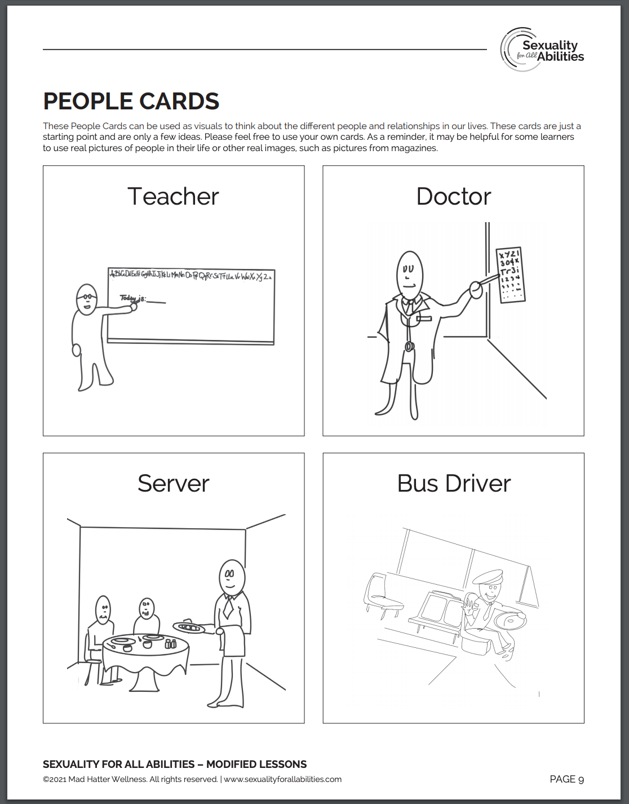
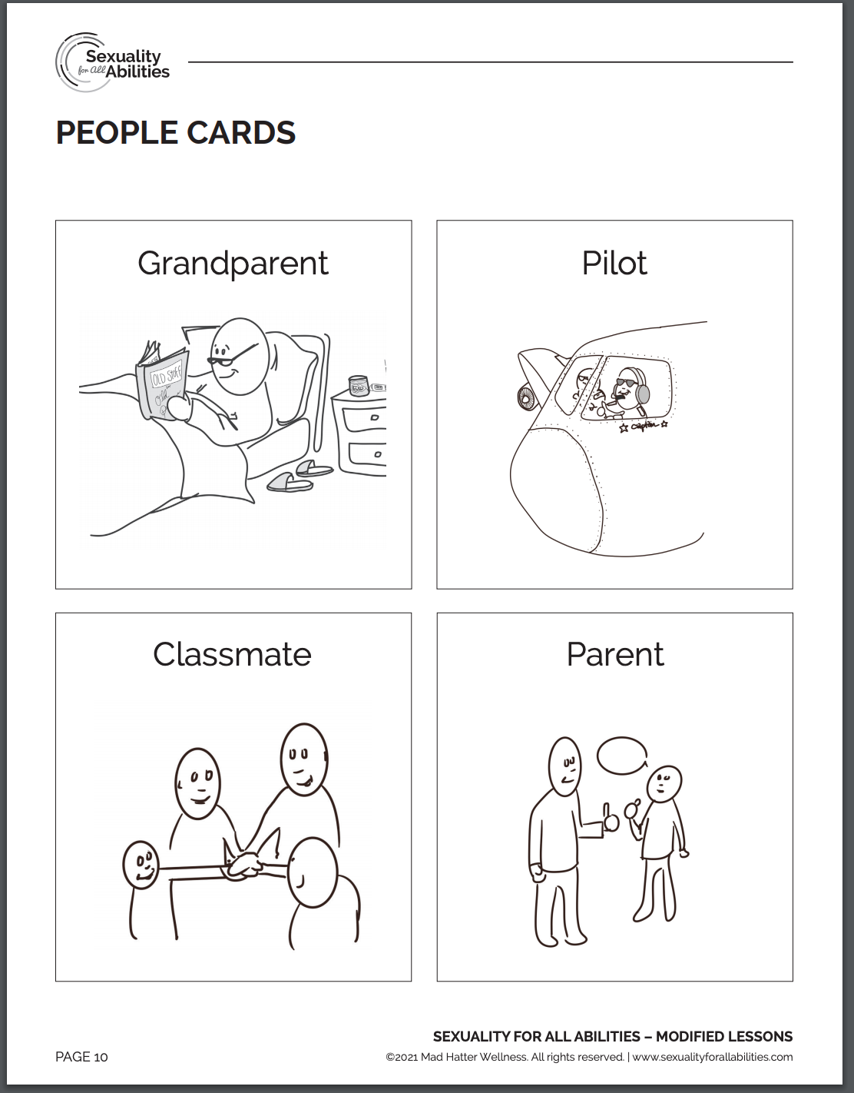
People in My Life
Sort the different people in your life in all 5 categories.
Note: in the Romantic Partner category it is important that BOTH people have knowledge and want that relationship.

Slide 26
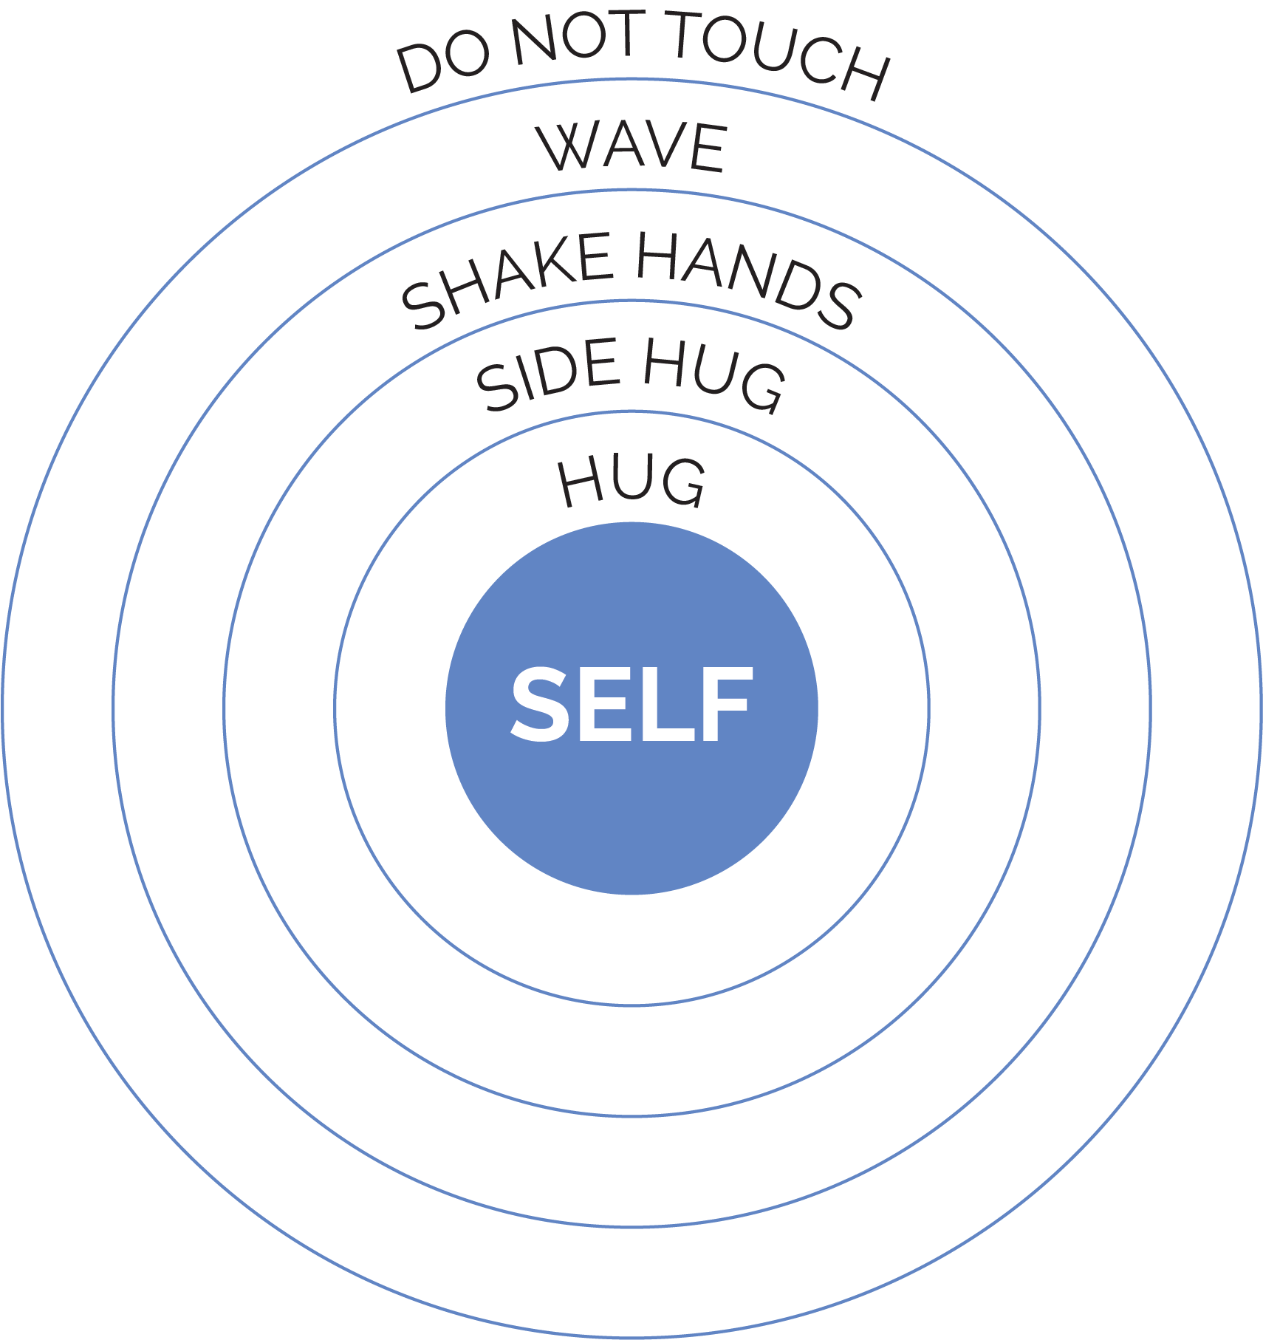
Relationship and Touch Circles
Write the names of the people in your life in the relationship circle.
Note: If a person is in my hug circle, it does not mean I have to give them a hug every time I see them.

Slide 27
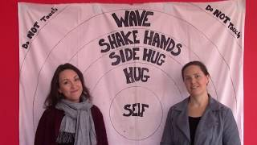
Relationship and Touch Circle
Notes:
Watch Relationship Circle video

Slide 28
Healthy and Unhealthy Behaviors in A Relationship
Healthy Behaviors
Unhealthy Behaviors

Slide 29
Behaviors at School
Healthy Behaviors
High five
Handshake
Wave
Hello
Compliments
Unhealthy Behaviors
Hugs
Touch private body parts
Show private body parts
Hitting, kicking, spitting, etc.
Gossip
Example of how to talk about healthy behaviors at school, work or home.

Slide 30
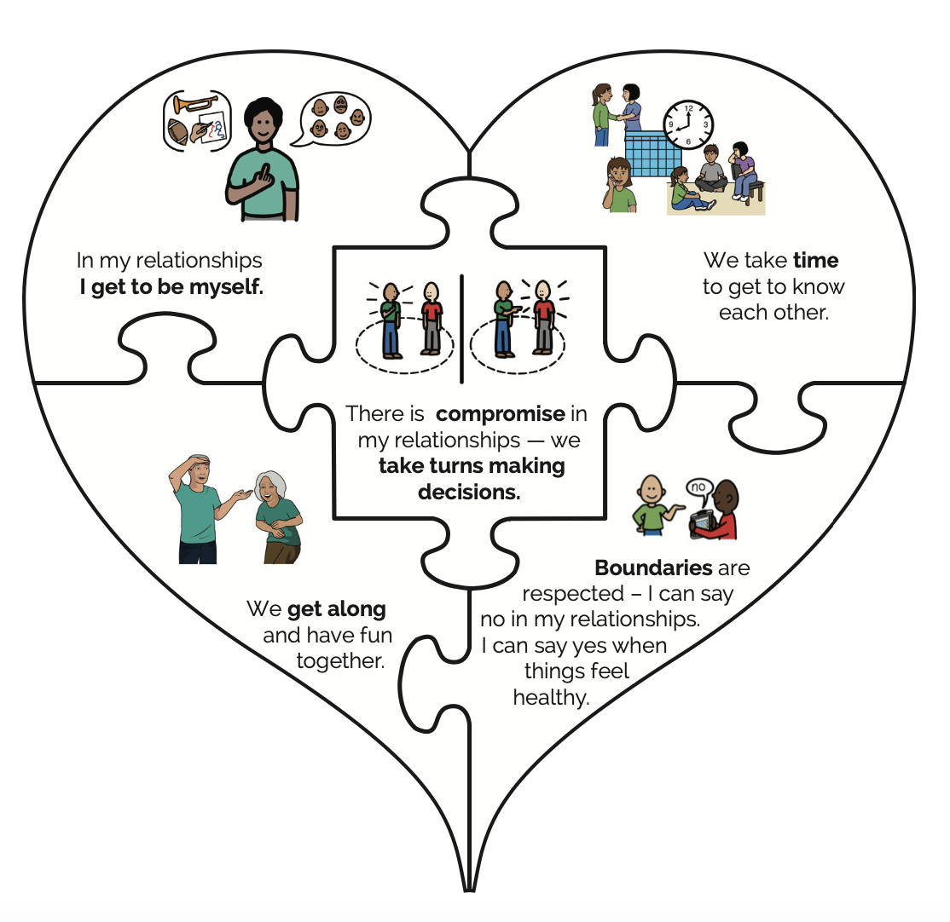
The Heart of Relationships

Slide 31
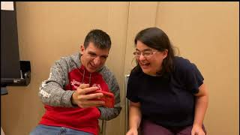
The Heart of Relationships Video
Notes:
Show video with examples from each piece. Show first 2 pieces of the video

Slide 32
SAFE AND HEALTHY BOUNDARIES LESSON

Slide 33
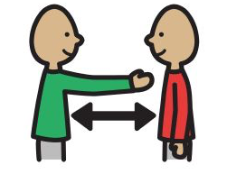
Boundary
Define it:
A boundary is a line that others cannot cross without your permission.

Slide 34
Flip Books About Boundaries

Slide 35
Red/Green Cards
Green Card
Healthy
Okay
Appropriate
Safe
Expected
Comfortable
Go
DO NOT USE: good
Red Card
Unhealthy
Not okay
Inappropriate
Unsafe
Unexpected
Uncomfortable
Stop
DO NOT USE: bad

Slide 36
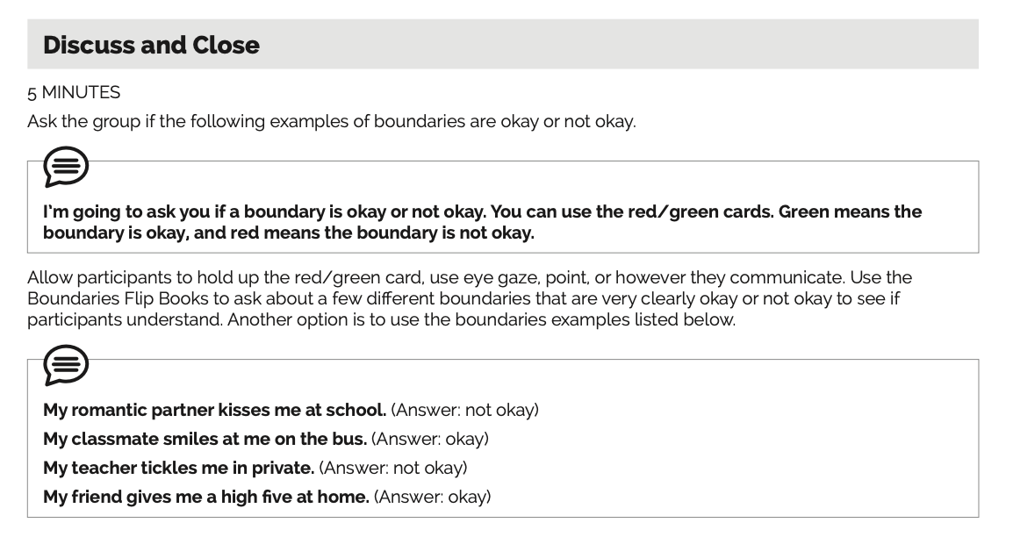
Boundaries Flip Books Example Activity

Slide 37
PUBLIC AND PRIVATE LESSON

Slide 38
Private and Public
A private place is a place that belongs to you, when you are alone, and when others cannot see you.
A private behavior or action is something that you do when you are by yourself, and it should occur in an appropriate private place.
A public place is a place where there is more than 1 person, places where you are likely to see other people.
A public behavior or action is something that you can do when you are with or around other people.

Slide 39
Private Vs. Public Ex.
Private Places/Behaviors
Public Places/Behaviors

Slide 40
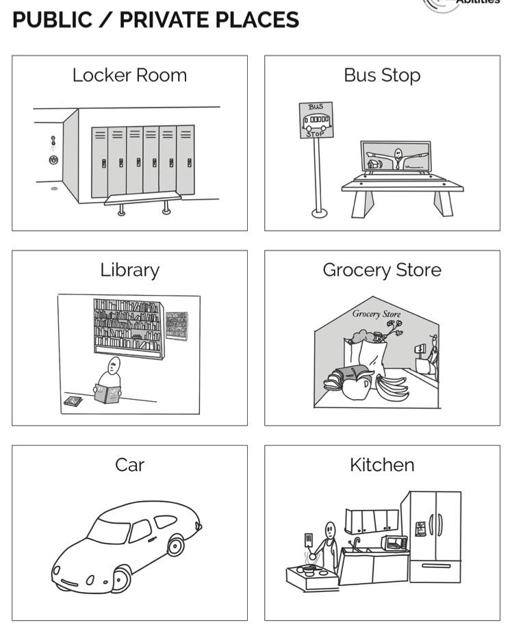
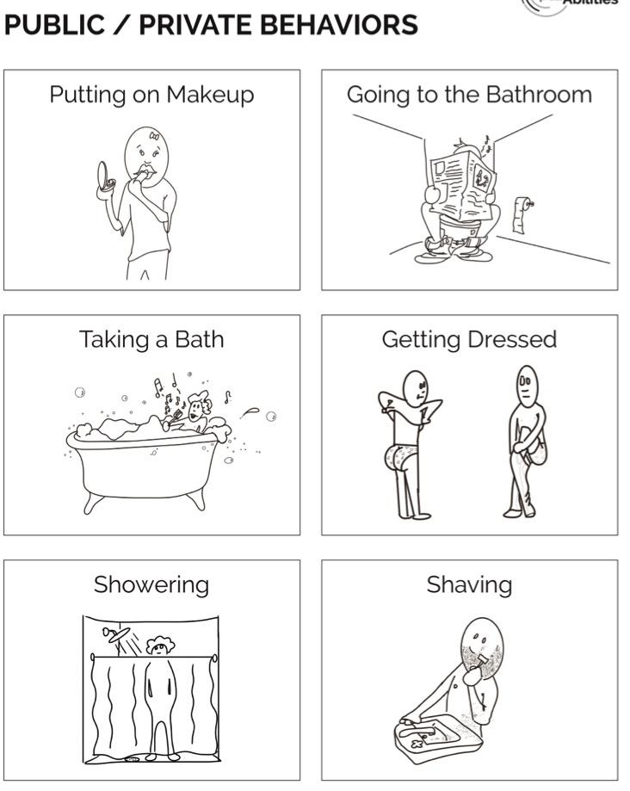
Private Vs. Public Ex., continued

Slide 41
Safety Rule – Private Behaviors Are for Private Places
Notes:
Watch video.

Slide 42
Masturbation Social Story

Slide 43
Masturbation
Use YES/NO Communication Cards to answer questions about masturbation.
Examples:

Slide 44
PERSONAL SAFETY LESSONS

Slide 45
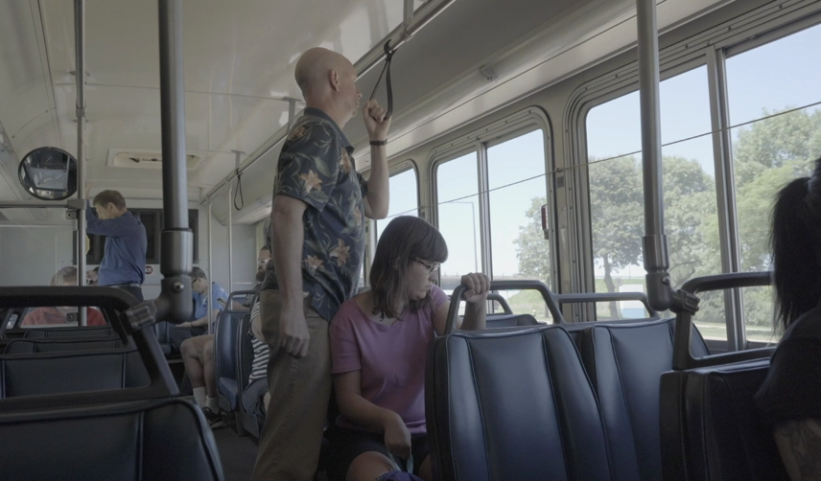
Body Rights
Define it. Body Rights: the rights you have to be in charge of your own body.
Safety rule: My Body Belongs to Me
Notes:
Show bus video.

Slide 46
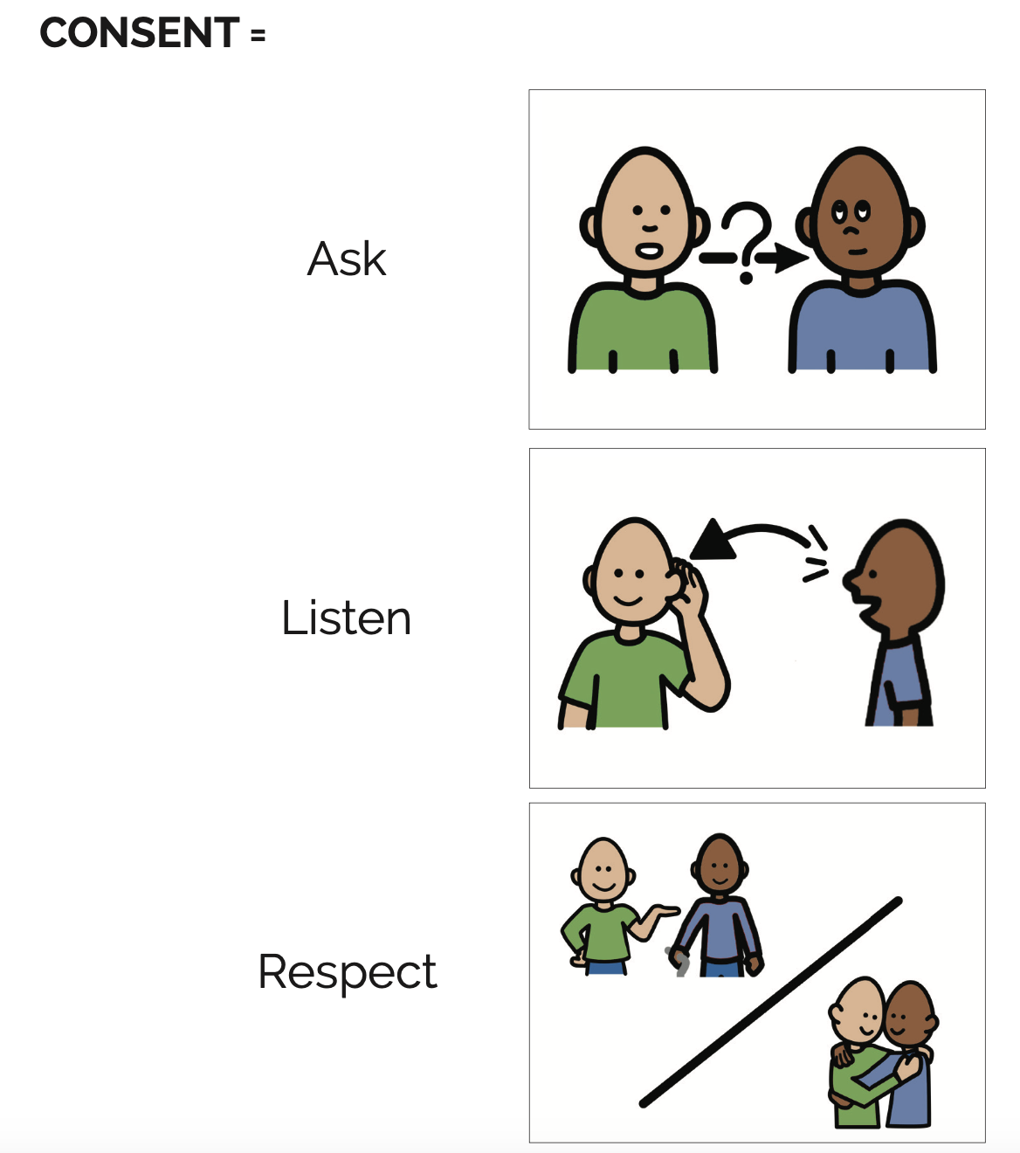
Consent
Define it: Consent is when a person agrees to a certain activity or behavior.

Slide 47
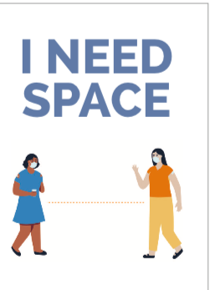
Get Away And Tell Someone

Slide 48
Safety Network
It is NEVER too late to tell someone if someone makes you feel uncomfortable or unsafe.
If you tell someone and they don’t believe you, tell someone else.
Try to come up with a list of 3-5 people who are friends, family, or professionals.

Slide 49
Tips for Social Media Literacy and Online Safety
Teach the lesson on Social Media Literacy & Online Safety.
Discuss social media scenarios in ALL lessons.
The Internet is a PUBLIC place. Use the Safety Video.

Slide 50
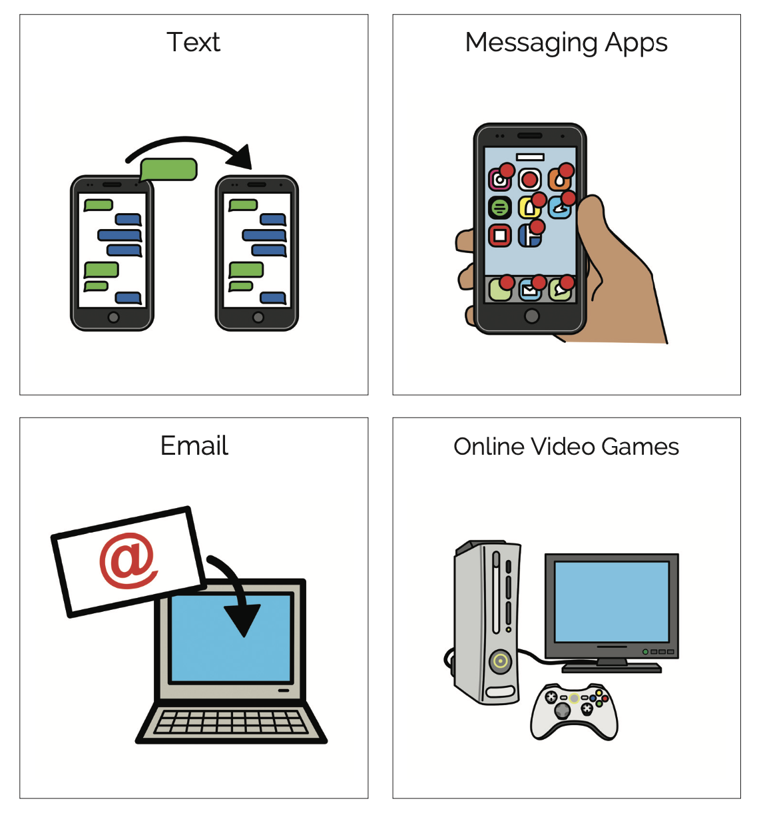
How do you communicate online?

Slide 51
ROMANTIC RELATIONSHIPS LESSON

Slide 52
Romantic Relationships
Define and discuss: Crushes. Sexual feelings. Dating.
Talk about rejection and how to move through those feelings.
One-sided and Two-sided crushes
Safety Rule – Say No

Slide 53
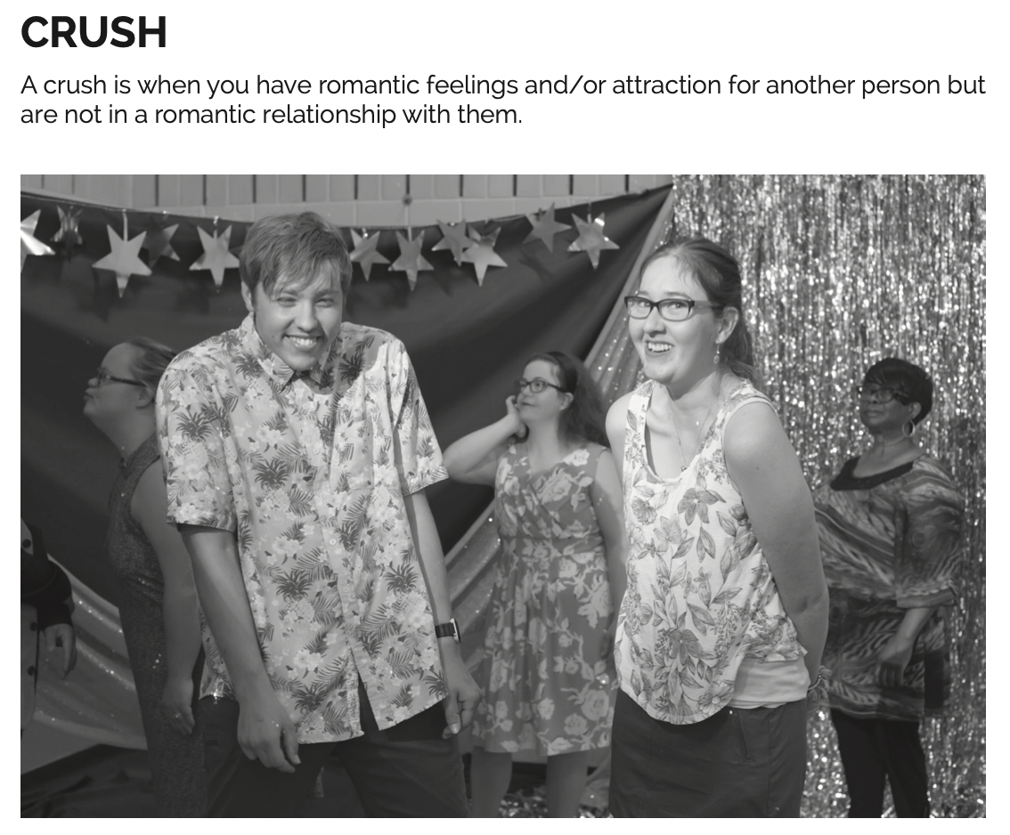
Crushes

Slide 54
PUBERTY/ CHANGES AS WE AGE

Slide 55
Puberty Changes in Me
BODY (physical)
FEELINGS (emotional)
RELATIONSHIPS (social)

Slide 56
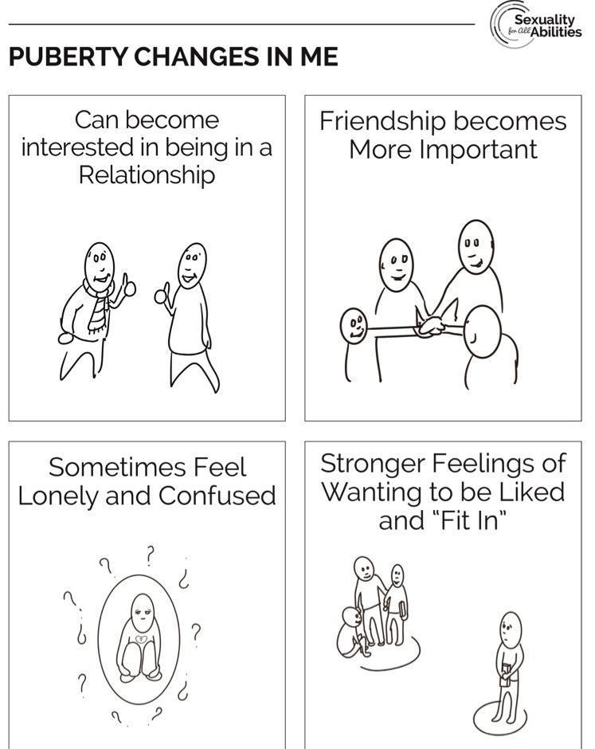
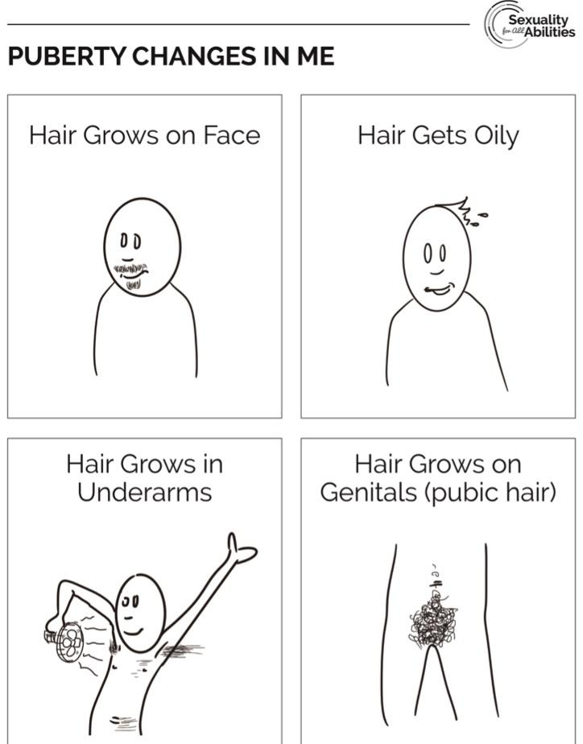
Puberty Sorting Cards

Slide 57
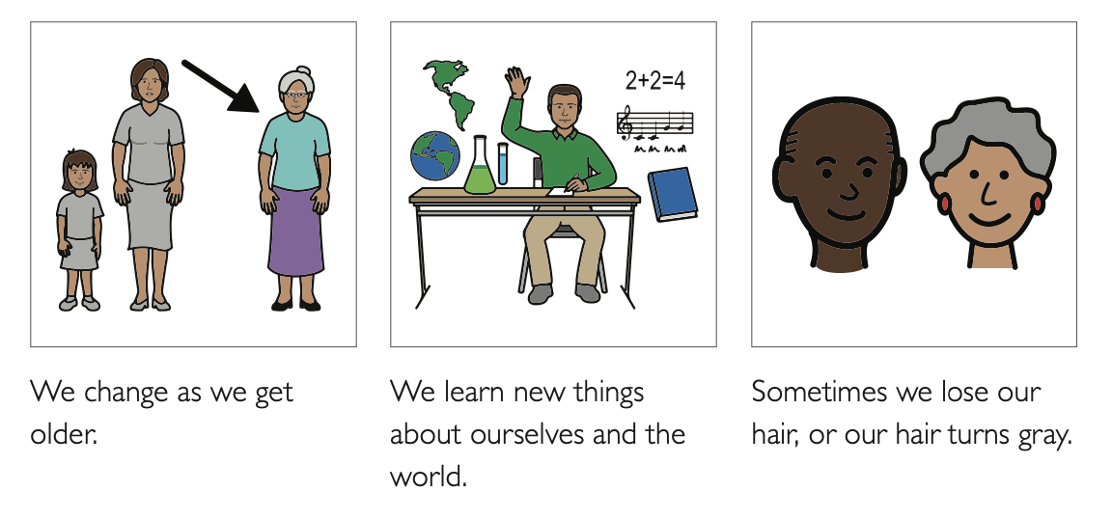
Changes As We Age

Slide 58
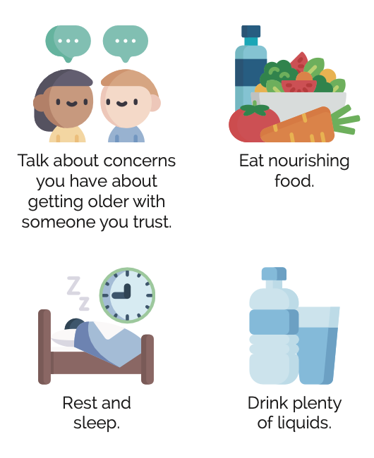
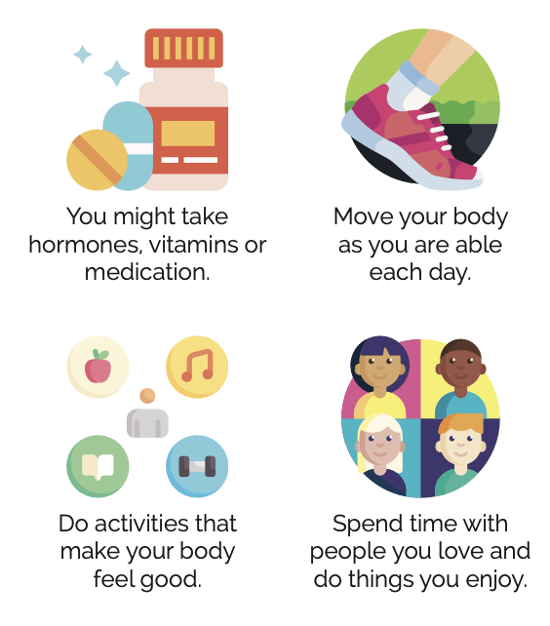
Taking care of our body as we age

Slide 59
GENDER AND SEXUAL ORIENTATION LESSONS

Slide 60
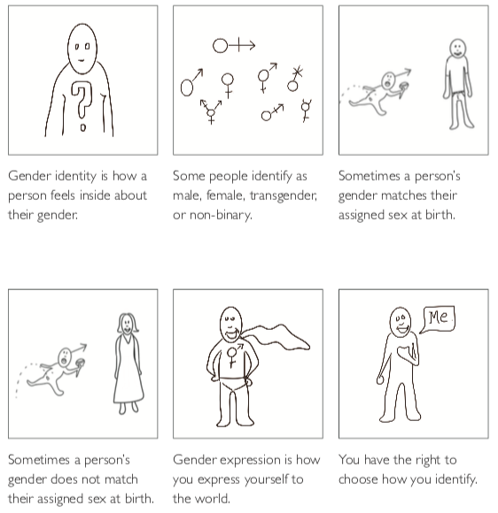
Gender
Define it: Gender is how a person feels on the inside about being male, female or a different gender. Some people identify as she, he or they. Some people have other ways of identifying.

Slide 61
Sexual Orientation
Sexual Orientation refers to who you are attracted to. It can change over time.

Slide 62
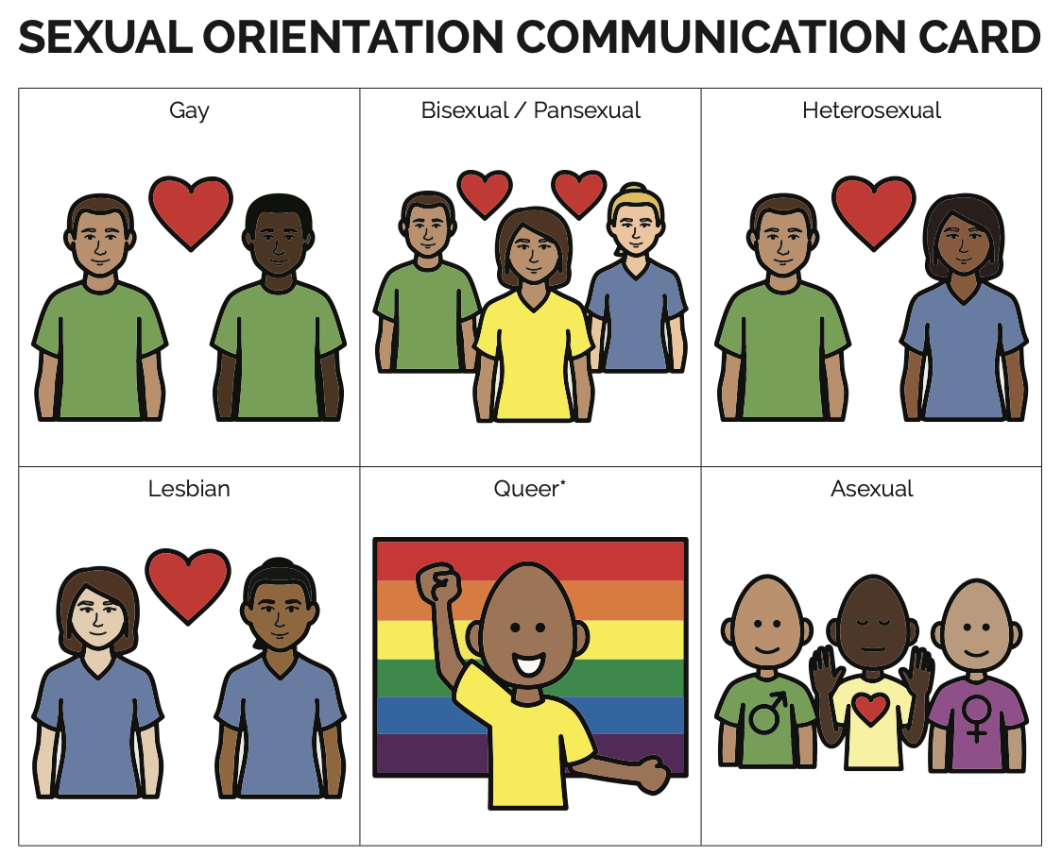
Sexual Orientation Communication Card

Slide 63
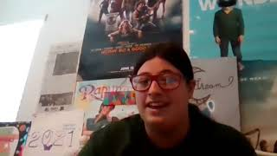
Interview With Savy

Slide 64
Focus Question 1
How can you support your LGBTQIA+ participants?
What are some ways you can help LGBTQIA+ participants feel safe, supported and healthy?

Slide 65
HUMAN REPRODUCTION, PREGNANCY, AND OUTCOMES OF SEXUAL ACTIVITY LESSONS

Slide 66
Tips when Teaching These Lessons
Invite guest teachers in to support or co-teach (school nurse, public health nurse, free clinic, etc).
Use the SFAA glossary.
It’s okay to answer a question with “I’m not sure, but I will find the answer for you.”
If you are new to teaching about this, it may take time to get comfortable with these topics.

Slide 67
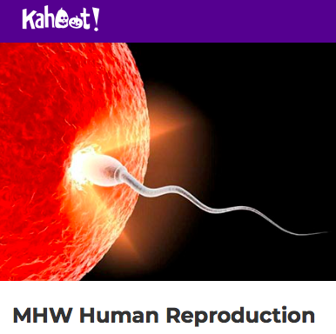
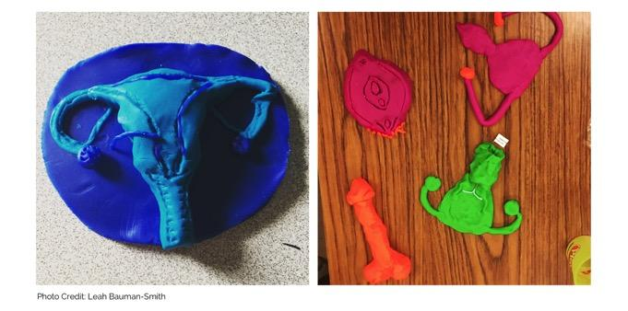
Human Reproduction
Private Body Parts Handouts
Human Reproduction Kahoot
Pregnancy and Reproduction Video by Amaze
Play doh activity ☺

Slide 68
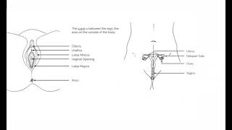
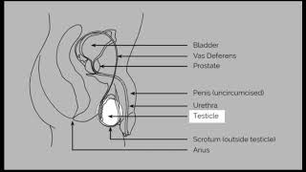
Private Body Parts Handouts/Videos

Slide 69
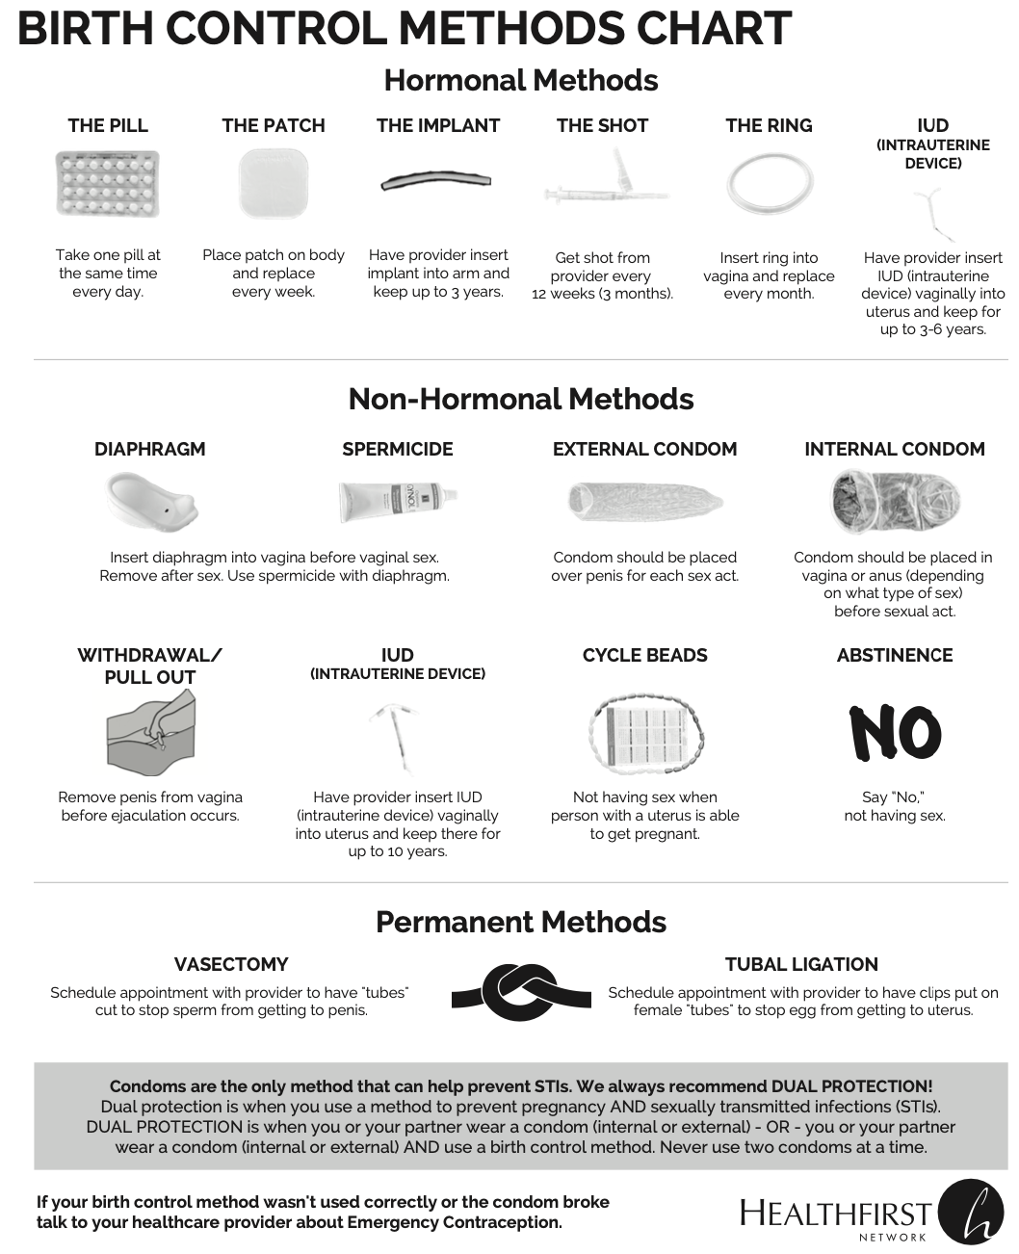
Birth Control Methods

Slide 70
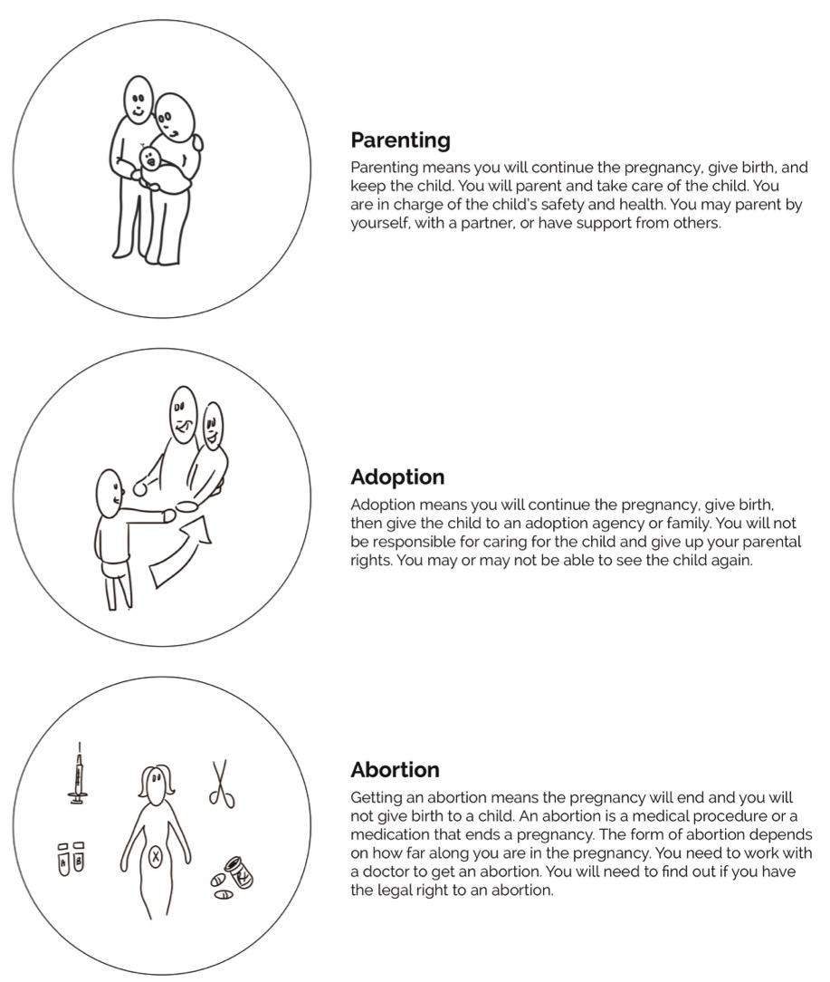
PREGNANCY OPTIONS

Slide 71
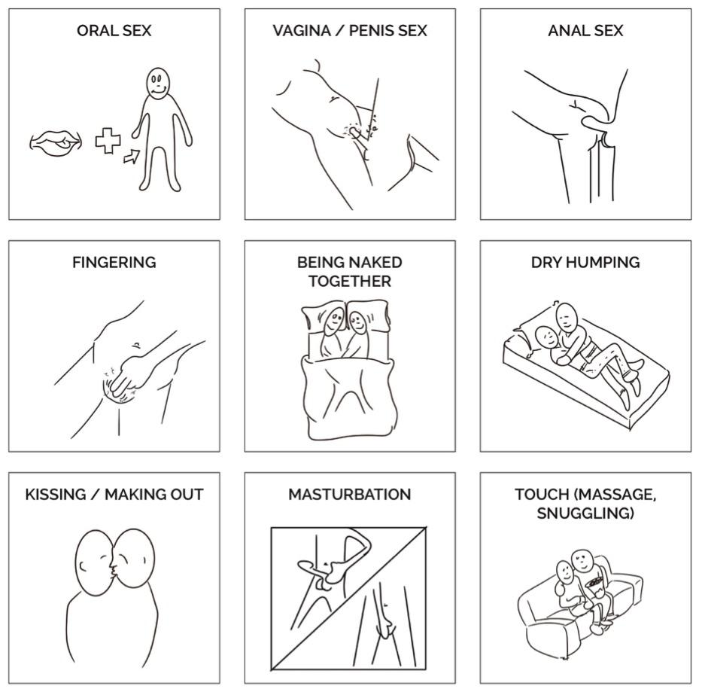
Outcomes Associated with Sexual Activity
Discuss physical, emotional, mental and social outcomes.
Include Sexually Transmitted Infections.
Discuss consent, safety, pregnancy, etc.
Consider talking about types of sexual activity.

Slide 72
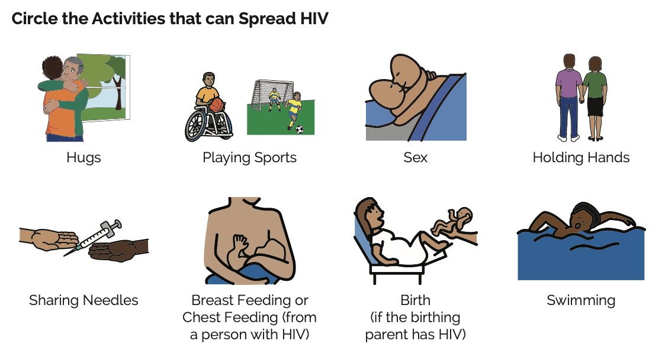
HIV Activity

Slide 73
TIPS FOR LEARNERS WITH HIGH NEEDS

Slide 74
Key Strategies for Learners with High Needs
Speak less, wait more, and use visuals.
Use kinesthetic learning or tactile learning activities.
Assume ability.
Make a connection to self.
Use shared language with all staff, families, etc.
Communicate with parents/caregivers often.

Slide 75
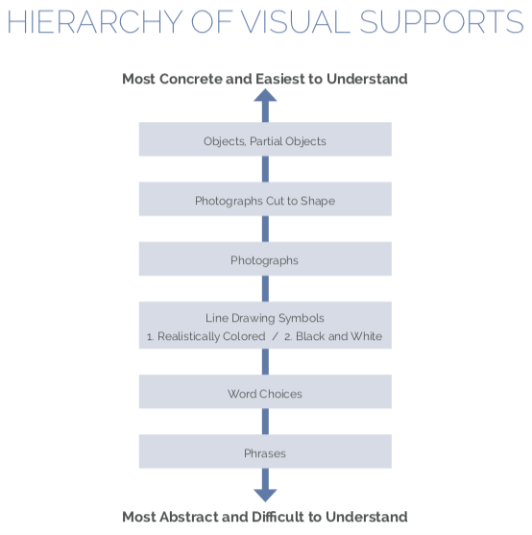
Hierarchy of Visual Supports

Slide 76
Visual Supports 1
Images for Comprehension:
helps define the concepts being taught.
are used when teaching lessons.
include line drawings, photos, etc.
video supports
Images for Communication:
give people a voice for consent, safe boundaries, etc.
need to be taught.
can be uploaded into communication device.
include communication boards or cards.
are taught during lesson, used after lesson.
need to be practiced.

Slide 77
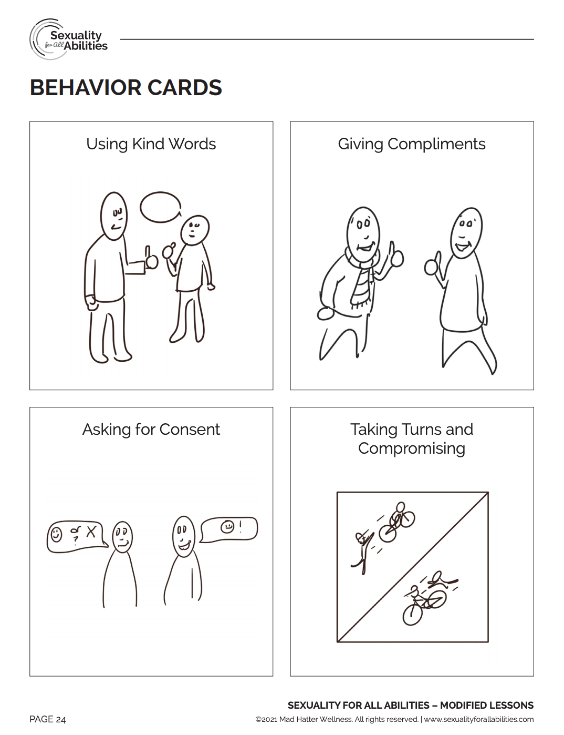
Line Drawings/Photographs

Slide 78
Video Supports

Slide 79
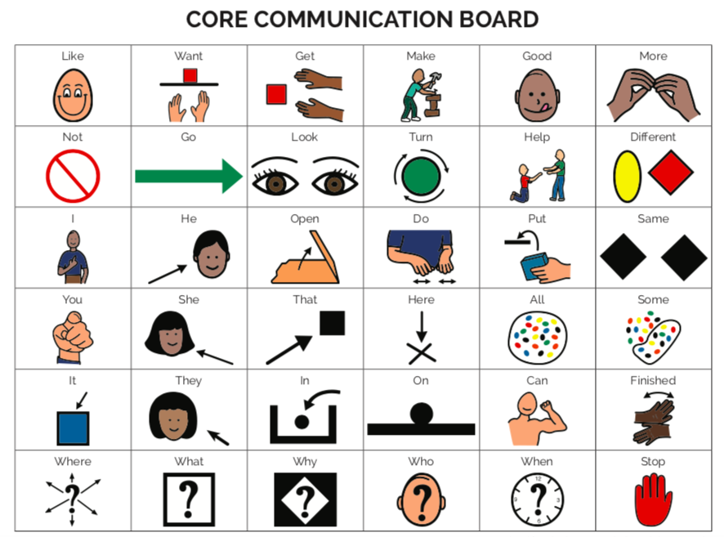
Communication Boards

Slide 80
Communication Cards

Slide 81
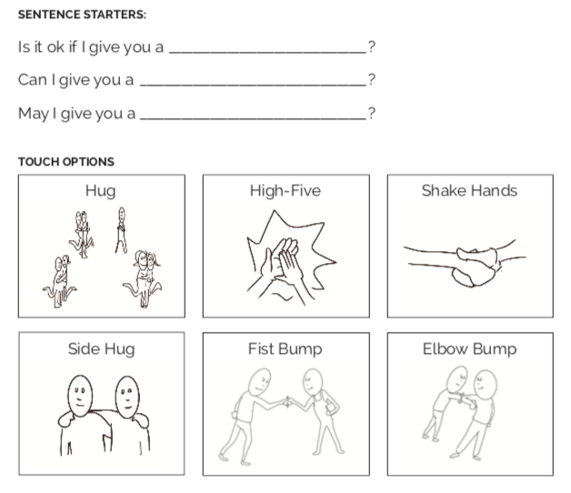
Consent Practice

Slide 82
ANSWERING DIFFICULT QUESTIONS

Slide 83
Responding to Questions
Affirm the learner. “That’s a great question!” or “I get that question all the time!”
Identify the motivation and type of question.
Correct any misinformation and answer the factual parts of the question.
Explore a range of values. “Some people believe ____, while other people believe _____.”
Refrain from stating your own values. (Always think about what/why/how much you share about yourself.)
Adapted from Foundations: Core Skills Training for Sex Ed presented by Planned Parenthood

Slide 84
Underlying Motivations and Types Of Questions
Information and/or clarification (getting the facts)
Am I normal?
“Shock-Value” or “Can I get you?” questions
Permission seeking
Values based
Personal questions
Adapted from Foundations: Core Skills Training for Sex Ed presented by Planned Parenthood

Slide 85
Sample Questions From Students with Developmental Disabilities
How old do you have to be to have sex?
Can I have sex with animals?
Is it normal to masturbate?
Can I kiss people who work with me (PCAs, Paras, etc)?
Lots of different questions about how to get pregnant or how do I know if I am pregnant (there is a lot of confusion about this topic).
Students will often try to ask you personal questions about your own life; such as how did you get pregnant?

Slide 86
TRAUMA-INFORMED INTERACTIONS

Slide 87
Tips for Approaching Interactions with a Trauma-informed Lens
Most people have trauma.
Acknowledge global trauma.
Give choices.
Don’t force or get into power struggles.
Expect the unexpected.
Use calming strategies.
Make meaningful connections.
Be patient.

Slide 88
Tips for Inclusivity
Don’t make assumptions. Ask people what kind of language and labels they prefer.
Consider that someone may be approaching a situation from a different mindset than you – culture, religion, language, and more
Speak up if you notice someone or a perspective being excluded.
Consider multiple learning styles and abilities.

Slide 89
MORE SUPPORT

Slide 90
Minimizing the Risk of Sexual Violence Self-Paced Course
Code: curriculum

Slide 91
Self-Paced Courses
Courses that can be used in the classroom, employment settings or at home with families
Flexible pricing
Topics:
Healthy Relationships, Boundaries, Safety
Puberty
Gender & Sexual Orientation
Reproductive & Sexual Health

Slide 92
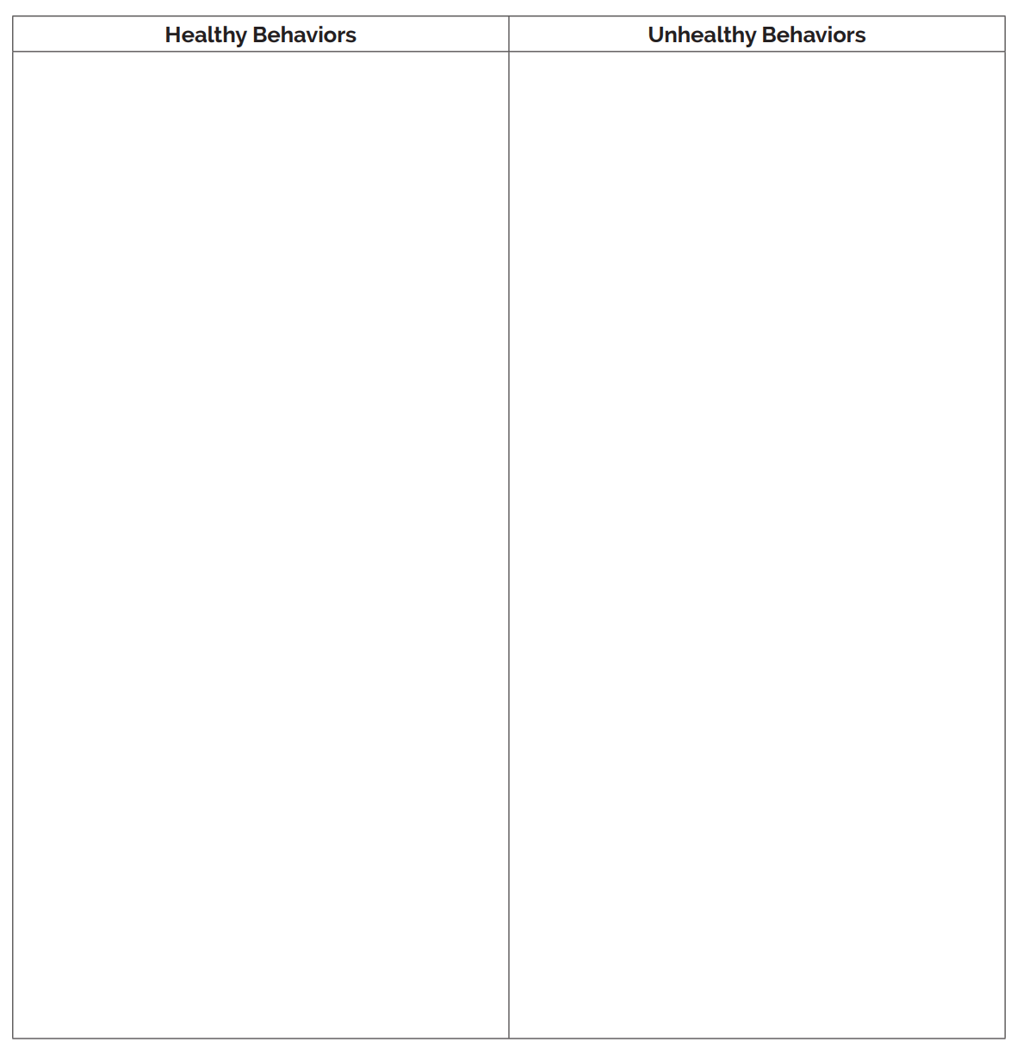
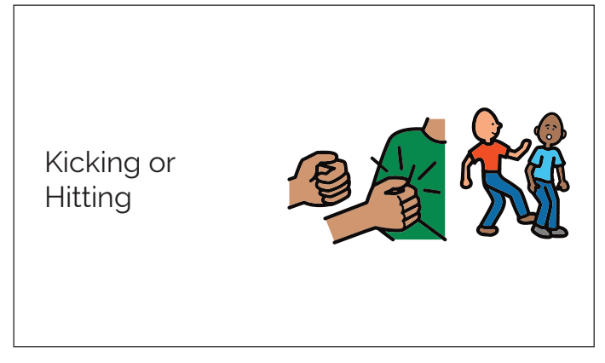
Open Conversations
designed for families and schools to teach kids about bodies, boundaries, consent, safety and healthy relationships
appropriate for preschool-third grade
coloring pages, activities, social stories

Slide 93
Family Discussion Guide and Workbook

Slide 94
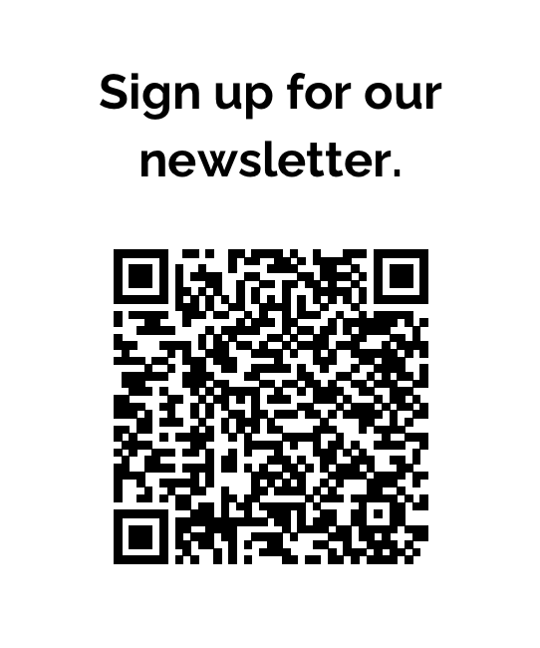
How We Can Support You!
MHW Newsletter – tips, tools, resources
Quarterly Educator calls (FREE)
Quarterly Caregiver calls (FREE)
Educational Tools in our shop
Sexuality for All Abilities Book
Consulting
Additional Training

Slide 95
Reflections
What is one idea or strategy you learned today that you want to implement?
What concerns do you have about supporting people with disabilities, and their parents, support staff, etc.?
What are you excited about or looking forward to?

Slide 96
QUESTIONS????

Slide 97
Contact Us! ☺
Katie Thune Educator, Speaker, Author katie@sfaabilities.com www.madhatterwellness.com 612-524-8364
Kim Rossow Parent/Caregiver Education Specialist kim@sfaabilities.com
“Like” Mad Hatter Wellness on Facebook Follow us on Instagram @madhatterwellness Follow us on Twitter @madhatterwell

