Slide 1
Integrating Occupational Therapy within Secondary Education Outcomes
Provided by Davia Christiansen DOT, MSEd, MHA, MHI, OTR/L
Statewide Professional Development to Support the Workforce and Low Incidence Disability Areas

Slide 2
IDEA and Occupational Therapist School-Based Role
IDEA legislation and Related Special Education Service requires Occupational Therapists to provide support that is educationally relevant, or is required to assist a child with a disability to benefit from special education following due process to aim at helping children learn and perform school tasks (MN Low Incidence Project, 2014).

Slide 3
Occupational Therapy Best Practice
MN Low Incidence Projects (2014) define the occupational therapist role as providing a least restrictive environment, client-centered services, function-based intervention related to occupational roles, episodic care, and evidence-based practice.

Slide 4
RTI/MTSS Occupational Therapy Process in General Education
(Cahill & Beisbier, 2020)

Slide 5
Occupational Therapist Role in Low-Incidence Students
Functional outcomes in education matter now over the long term.

Slide 6
Functional Outcomes
Improved Academic Performance
Enhanced Social and Emotional Well-being
Assistance for Students with Special Needs
Adaptations for Physical Disabilities
Transition Planning
Collaboration with Educators and Families
Promotion of Healthy Lifestyles
(Cahill & Bazyk, 2020)

Slide 7
Integrating Occupational Therapy in Secondary Education
Instrumental in supporting students' overall development, independence, and lifelong success.
Focus on challenges that may impact a student’s ability to engage in everyday activities, both academic and non-academic.

Slide 8
Now:
In 20 Years:
Skill Development
Productivity
Research and Development
Career Opportunities
Economic Impact
Innovation and Progress

Slide 9
How do we Integrate a Functional Goal?
Involve Students and Parents
Accommodation and Supports
Generalize Skills
Conduct a Functional Assessment

Slide 10
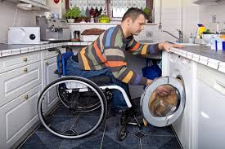
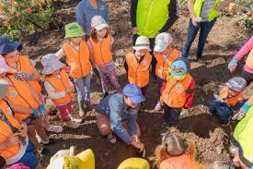
Set MEASURABLE and REALISTIC functional goals related to:
Independent Living
Community Engagement
Vocational Skills

Slide 11
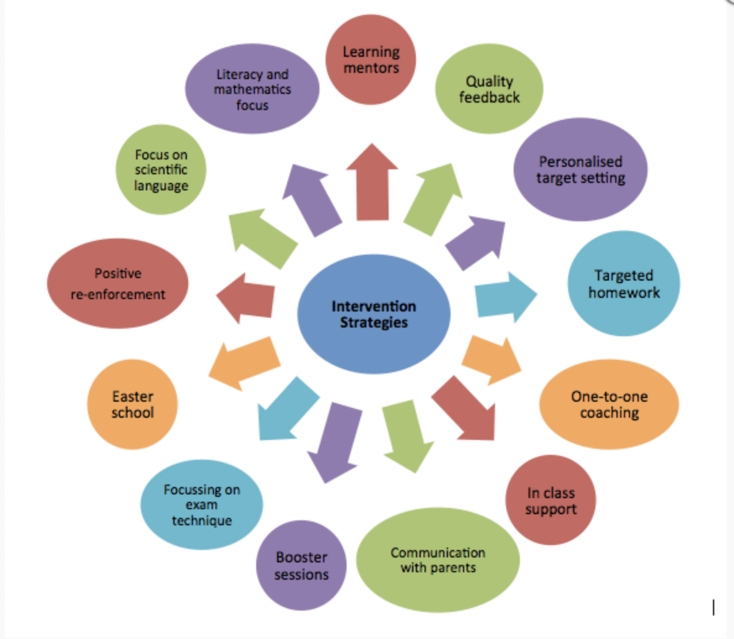
Intervention Strategies Examples
Reframe the teacher’s perspective
Improve the student’s skills
Adapt the task
Adapt the environment
Adapt the routine

Slide 12
What are the types of services?
Direct Services
Indirect Services
In-person interaction between a professional and the student.
Support students through collaboration, consultation, or support to other individuals. Indirect services can include direct intervention.

Slide 13
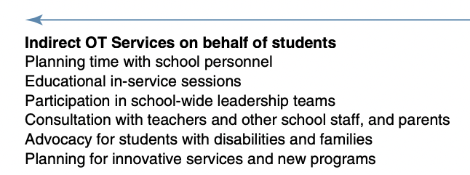
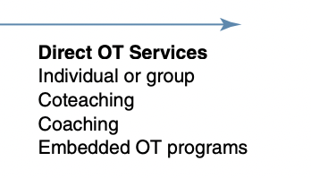
Are Services a Continuum or Separate Paths?
(Cahill & Bazyk, 2020)

Slide 14
What is Indirect Service?
Consultation: provide guidance and support to general education teachers, parents, or other service providers to implement effective strategies.
Professional Development: Training on inclusive practices, differentiated instruction, or strategies
*Direct Services can be included within Indirect Programming.
Parent Training and Support: Providing resources, workshops, or information to parents to help them support their child's learning and development.
Collaborative Planning: Working with a team to develop and implement accommodations or/and modifications within the education setting.

Slide 15
Accommodations vs Modifications
Occupational Therapy Considerations

Slide 16
Occupational Therapy Considerations
Activities of daily living
Cognitive-based interventions
Technology-based interventions
Instrumental activities of daily living
Safety, driving, and communication management
Play and leisure
(Cahill & Beisbier, 2020)

Slide 17
Accommodations
Accommodations are adjustments made to the way tasks are presented or completed without altering the content or learning expectations. They help students access information and demonstrate their knowledge without changing the fundamental nature of the task.
(Keptner & McCarthy, 2020)

Slide 18
Modifications
Modifications involve changing the content, curriculum, or expectations of what a student is taught or expected to learn. Modifications are more substantial adjustments that may alter the curriculum to meet the student's individual needs.
(Keptner & McCarthy, 2020)

Slide 19
What is “Functional”?
Providing a student with dyslexia access to audiobooks:
Functional Non-Functional
Accommodation
Adapting a science experiment to simplify procedures for a student with motor coordination difficulties:
Functional Non-Functional
Modification

Slide 20
Assistive Technology
Tools and devices that are used to support students with disabilities in an educational setting. These technologies are designed to help students participate more fully in classroom activities, access curriculum materials, and enhance their overall learning experience.
(Keptner & McCarthy, 2020)

Slide 21
Determining Functional Accommodations and Modifications
Individualized approach
Assessment-based
Adherence to curriculum standards
Goal of independence

Slide 22
Free Google Extension Tools
Read & Write for Google Chrome
Grammarly
Google Keep
SpeakIt!
EquatIOMercury Reader
Kami

Slide 23
Free Apple Tools
VoiceOver
Speak Screen (iOS)
Speech (macOS)
Dictation (iOS and macOS)
Guided Access (iOS)
Text Replacement (iOS)
Accessibility Shortcut (iOS)

Slide 24
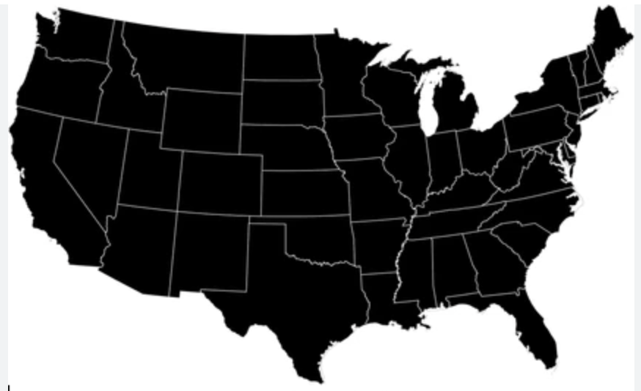
Free Educational Organization Support
National Center on Accessible Educational Materials (AEM Center)
Understood.org
TechMatrix
Bookshare
Assistive Technology in Education (ATE) Community
Infinitec
Center on Technology and Disability (CTD)
SETC (Special Education Technology Center)
Edutopia – Assistive Technology

Slide 25
Practice Examples of Potential Occupational Therapy Supports in the Secondary Environment

Slide 26
Osteogenesis Imperfecta
Osteogenesis Imperfecta (brittle bone) is a genetic or heritable disease in which bones fracture (break) easily, often with no obvious cause or minimal injury to severe with many medical complications
Environmental Needs:
Assistive Technology:
Staff Education:
Student Direct and Indirect Services:

Slide 27
Osteogenesis Imperfecta Support Ideas
Environmental Needs: Raised Desks for wheelchair, bathroom equipment, reachers and pointers, etc.
Assistive Technology: Often depends on past and current bone breaks and hardware in body, voice to text, text to speech, ergonomic tools, etc
Staff Education: ADL needs, transfer training, safety, and environmental considerations, etc.
Student Direct and Indirect Services: Dependent on student medical need, AT and DME exploration, etc.

Slide 28
Muscular Dystrophies
Muscular Dystrophies are a group of muscle diseases caused by mutations in a person's genes. Over time, muscle weakness decreases mobility, making everyday tasks difficult.
Environmental Needs:
Assistive Technology:
Staff Education:
Student Direct and Indirect Services:

Slide 29
Muscular Dystrophies Support Ideas
Environmental Needs: Elevated desks, bathroom devices, Hoyer lift, alternative locker space, table-level access, etc.
Assistive Technology: Ergonomic tools with energy conservation, Laptop/Ipad Tech, tools for feeding, etc.
Staff Education: ADL needs, transfer training, education, safety, and environmental considerations, etc.
Student Direct and Indirect Services: Increasing direct and indirect support with the progression of the disease for Activities of Daily Living and adaptions/modifications

Slide 30
Epidermolysis Bullosa
Epidermolysis Bullosa that causes fragile, blistering skin. The blisters may appear in response to minor injury, even from heat, rubbing or scratching.
Environmental Needs:
Assistive Technology:
Staff Education:
Student Direct and Indirect Services:

Slide 31
Epidermolysis Bullosa Support Ideas
Environmental Needs: Depends on needs- wheelchair/visual supports, needing needs, bathroom equipment, etc.
Assistive Technology: iPad/Computer based apps, Voice to Text, Tactile Tools with soft grip, etc.
Staff Education: One-to-one support for writing and fine motor needs, education, alternative testing options instead of writing, etc.
Student Direct and Indirect Services: Modify and Accommodate Paperwork, safety awareness training, etc.

Slide 32
Traumatic Brain Injury
Traumatic Brain Injury (TBI) usually results from a violent blow or jolt to the head or body. An object that goes through brain tissue, such as a bullet or shattered piece of skull, also can cause traumatic brain injury.
Environmental Needs:
Assistive Technology:
Staff Education:
Student Direct and Indirect Services:

Slide 33
Traumatic Brain Injury Support Ideas
Environmental Needs: Lighting, Decrease Environmental Stimuli, Visual Considerations, Fatigue Inducing Tasks, etc.
Assistive Technology: Explore Computer-Based Calendars, Apps, and internal tools of School-device, Check Lists, Handouts, etc.
Staff Education: All staff working with student on memory/safety awareness, visual perception considerations, behavioral/personality changes, etc.
Student Direct and Indirect Services: Modify and Accommodate Paperwork, safety awareness training, visual supports, etc.

Slide 34
Transition to Postsecondary Education
Special education needs look more similar to a 504 plan within postsecondary education.
Understanding a students needs through accommodations and modifications is essential for their successful transition to postsecondary education.

Slide 35
Considerations for Transitions into Postsecondary
Students seek out support
Accommodations and modifications will vary
The college's disability services office works with students and faculty to assess needs and support

Slide 36
Best Practices for the Transition to Postsecondary Education
Early planning
Advocacy skills
Collaboration between high school and college
Understanding differences for academic and social changes
Use of technology and universal design

Slide 37
Potential Supports for Transition for Post-Secondary
Extended Time on Exams
Note-Taking Assistance
Assistive Technology
Flexible Attendance Policies
Accessible Learning Materials
Flexible Attendance Policies
Accessible Learning Materials
Priority Seating
Alternate Exam Formats
Breaks During Class
Modified Attendance Requirements
Flexible Deadlines
Communication Plans
Accessible Campus Facilities

Slide 38
Key Elements
By integrating occupational therapy within secondary education outcomes, schools can create a more inclusive and supportive environment that addresses the diverse needs of students, promoting their overall well-being and success in both academic and life skills.
Occupational therapy practitioners consistently collaborate with families and caregivers and provide services in the natural context of the desired occupation.

Slide 39
Key Elements Continued
The evidence also supports group service models and models that include peer mediation; these models can promote participation across areas of occupation.
Skills-based training and therapeutic practice in the context of valued occupations are recommended over isolated sensorimotor approaches.
Technology, manualized programs, and sports activities can be effective but should be evaluated and matched to age, diagnosis, and outcomes as guided by the evidence.

Slide 40
Questions…..

Slide 41
Additional Handout Resources:
Additional Assistive Technology Organizational Supports Documents:
Assistive Technology- School-Based - Google Docs https://docs.google.com/document/d/1zuX_z7CG8xmLGJJYCoZD-Pc64PryLoyQQiVV6jLdILk/edit
Assistive Technology Organizations - Google Docs https://docs.google.com/document/d/1vcYk2g2h9bsEdqCi3RywSU46IN601ytYhcdVNt1KRQc/edit

Slide 42
Web References
MN Department of Education-Secondary Education: https://education.mn.gov/MDE/dse/sped/sec/
5 Valuable Transition Programs: https://www.transitionsusa.org/developmental-disability-awareness-month-5-valuables-resources-transitions-usa-offers-to-its-students/
Ideas that Work: Transition Resources for Practitioners: https://osepideasthatwork.org/federal-resources-stakeholders/topical-issues/transition-resources-practitioners
NTACT: Transition Planning: https://transitionta.org/topics/secondary-education/transition-planning/
OSER: Transition Activities: https://www2.ed.gov/about/offices/list/osers/transition/index.html
Occupational Definitions: https://www.mnlowincidenceprojects.org/Projects/otpt/index.html
MN Low Incidence Project: The revised 2014 version of Occupational Therapy and Physical Therapy in Educational Settings: A Manual for MN Practitioners - Third Edition (2014).
AOTA Practice Advisory on Occupational Therapy in Response to Intervention https://www.aota.org/practice/practice-settings/-/media/e7371c748756467ba101d6966bb98eb2.ashx#:~:text=More%20than%2020%25%20of%20the,districts%20(AOTA%2C%202010).

Slide 43
References
Cahill, S. M., & Beisbier, S. (2020). Occupational therapy practice guidelines for children and youth ages 5–21 years. The American Journal of Occupational Therapy, 74(4), 7404397010p1-7404397010p48.
Cahill, S., & Bazyk, S. (2020). School-based occupational therapy. Case-Smith’s occupational therapy for children and adolescents, 627-658.
Douglas, R., McConnell, C., Abbott, A., Bare, G., Cleave, S., Crum, T., ... & Kuenzli, M. (2024). Occupational Therapy’s Role in Return to Occupations Post-Concussion in High School Athletes. Physical & Occupational Therapy In Pediatrics, 1-12.
Keptner, K., & McCarthy, K. (2020). Mapping occupational therapy practice with postsecondary students: A scoping review. The Open Journal of Occupational Therapy, 8 (1), 1.

Slide 44
Thank you!
Davia Christiansen DOT, MSEd, MHA, MHI, OTR/L
Occupational Therapist
daviachristiansen@gmail.com

