Slide 1
Open Conversations:
Teaching kids ages 4-10 of all abilities about bodies, boundaries, consent, safety and healthy relationships.
madhatterwellness.com

Slide 2
Workshop Overview
The Why of Sexuality Education
Topics
Sample Activities
More Resources
Q & A
Notes:
6:02 Katie

Slide 3
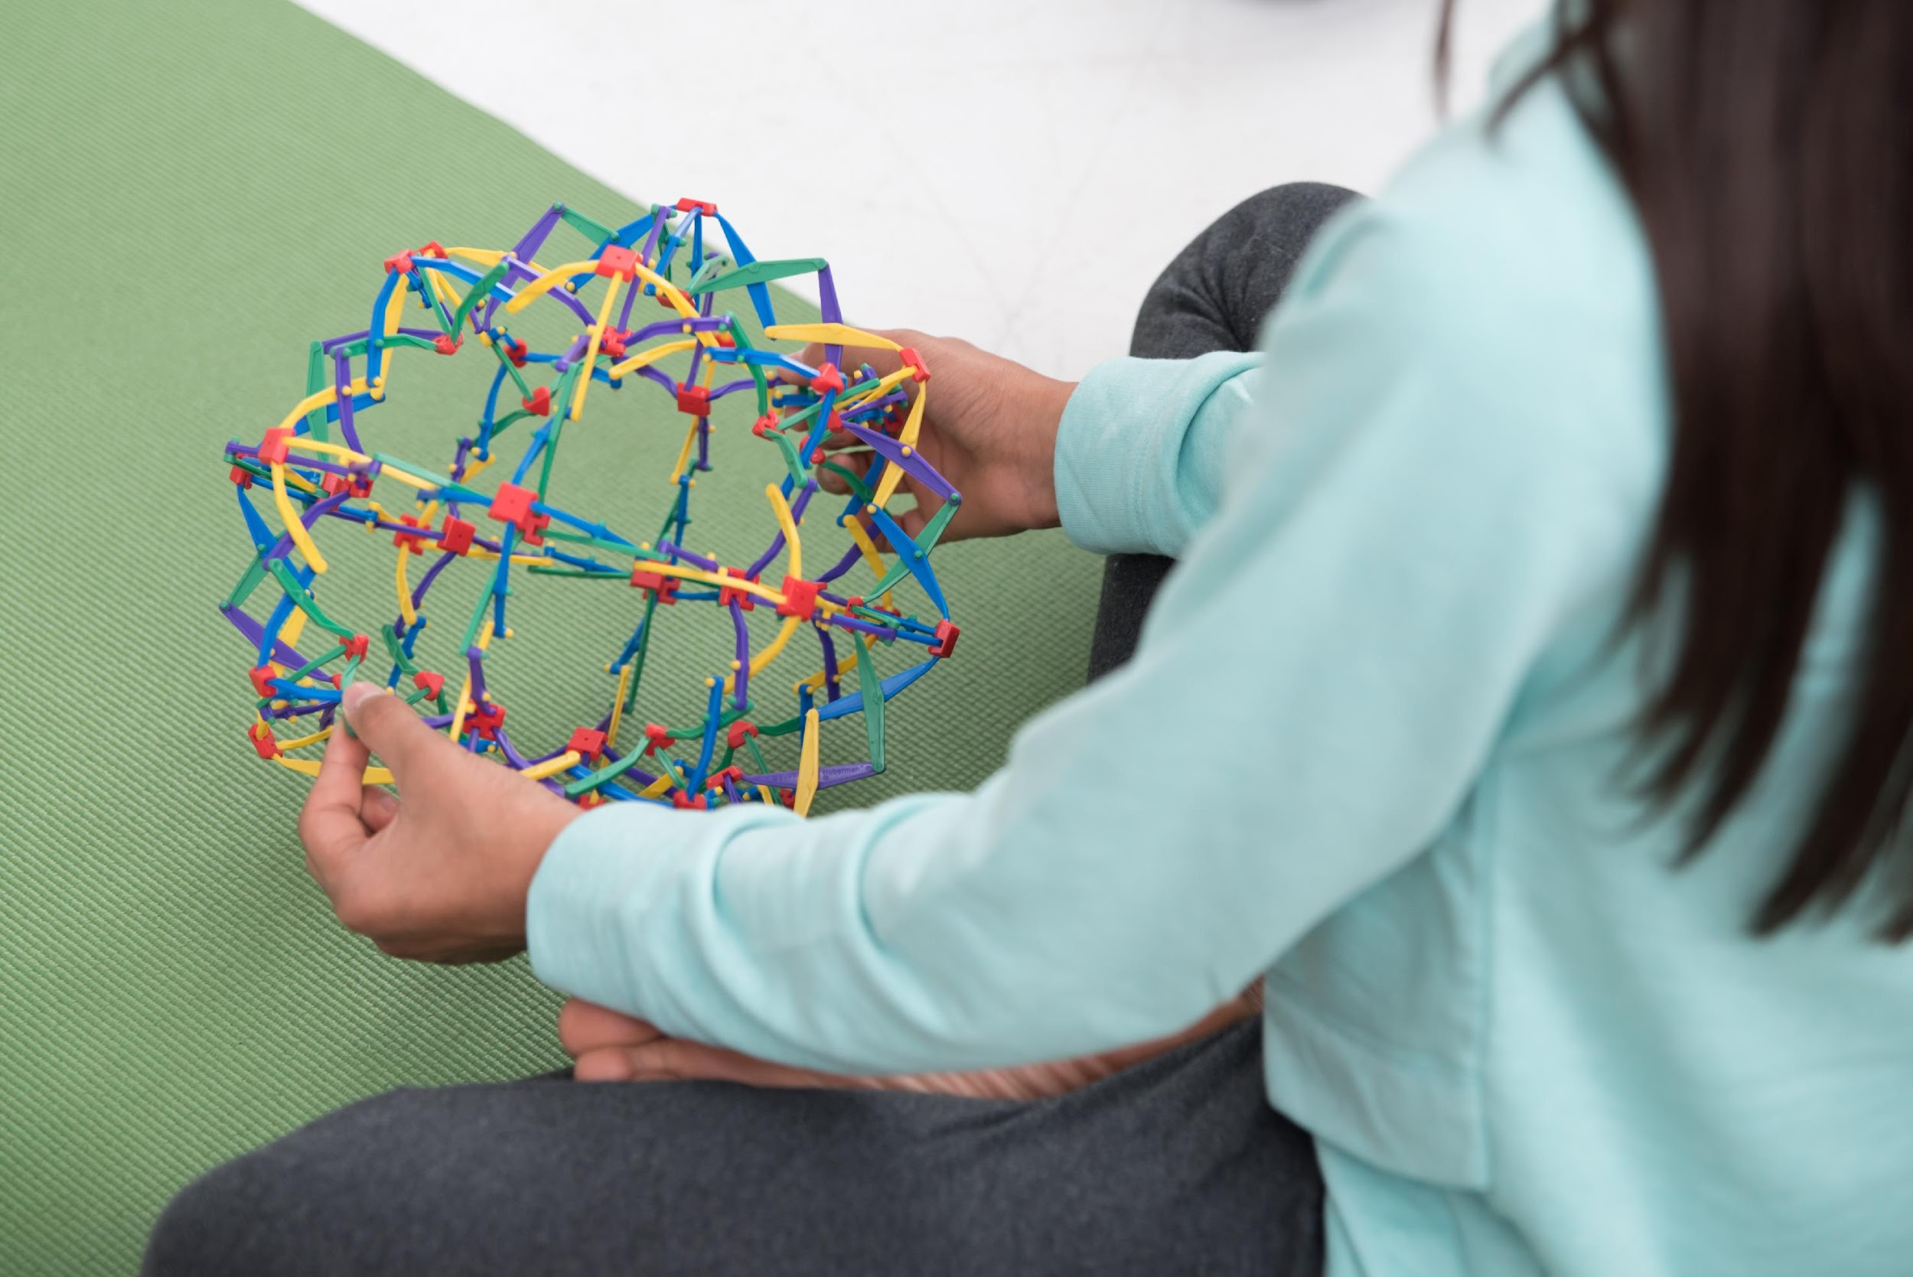
Center
www.madhatterwellness.com
Notes:
6:02 Katie

Slide 4
About Us
Mad Hatter Wellness, founded by Katie Thune, provides learning opportunities to empower people of all abilities with knowledge and skills to make safe and healthy choices.
We focus on educating about healthy relationships, with ourselves and others, as well as safety, consent, and lots more. All of this is a part of comprehensive sexual education.
Four main programs: Sexuality for All Abilities, Open Conversations, Empowered Together and The Power of Me

Slide 5
Things to Think About
Conversations about healthy and unhealthy relationships can bring up a range of emotions.
Relationship education is a lifelong process.
We all have different comfort levels with this topic. This is okay!
None of us are perfect.
Notes:
Conversations about healthy and unhealthy relationships can bring up a range of emotions. – for you, your co-trainer, the people in your classes, their families. Be gentle with yourself and others.
Relationship education is a lifelong process. – that’s why we’re here! Lots of adults we support never got this education, or who can actually remember what they learned in school anyways. Also – we as adults are still learning about ourselves as sexual beings.
Start from a place of thinking that everyone will get something out of this! – Assume ability!!!!!
We all have different comfort levels with this topic. – that’s OK! Very normal.
None of us are perfect. – we will most likely say the wrong thing at the wrong time. It’s okay. Apologize and move on. Try again the next time. Because these conversations are hard sometimes, and none of us are experts, we have to start somewhere. The more we talk about this, the easier it’s gonna get.

Slide 6
Background Information

Slide 7
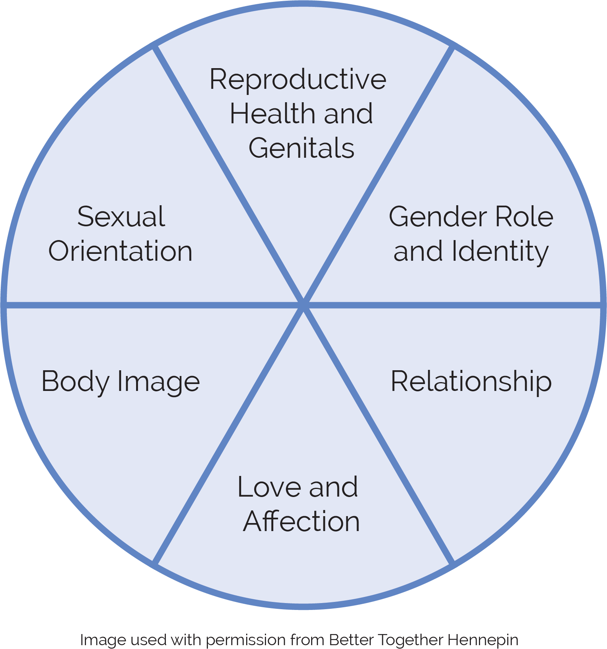
What Are We Talking About When We Use the Term Sexuality?
www.madhatterwellness.com
Notes:
Anna - Sometimes we get nervous about our children learning about sex. We might be scared that if they learn too much it will lead to early sexual experiences. Studies have found this not to be true- the more knowledge your child/children k have about these topics the more likely they are to have delayed first sexual experiences (data from Better Together Hennepin

Slide 8
Why is sexuality education at an early age so important?
Health (understanding body parts and what they do)
Safety (learning who and how to tell)
Healthy Relationships and Social skills
Vulnerability, Societal Attitudes and Learned Compliance
Lifelong learning - body changes and puberty
Helps develop a sense of self and identity

Slide 9
Our Hope for Sexuality Education for Young People
Comprehensive
Non-reactive
Non-judgmental
Non-shaming
Inclusive (age, gender, disability, race, sexual orientation, etc.)
Accessible to ALL

Slide 10
Focus Question
Do you remember having conversations about healthy and unhealthy relationships growing up?
Did anyone in your family talk with you about this?
What do you want your child to know about healthy relationships?
Notes:
Break up into small groups - 5 minutes to chat about this.
Groups of 4-5

Slide 11
Topics and Sample Activities

Slide 12
Tips for Parents and Caregivers
Keep the discussion positive!
Teach accurate terminology.
Talk about body rights – “my body belongs to me”.
Teach consent!
Encourage assertiveness and appropriate noncompliance.
Teach how to tell.
Use teachable moments.
Role play healthy boundaries.
Notes:
Katie
• Teach accurate terms for private body parts – the real words!!!
• Talk about body rights - instill a sense of body ownership (“my body belongs to me – no one can touch me unless I say it’s okay”)
• Teach how to read, interpret, and respond to own intuitive signals – listening to our body, mind, and heart. Everyone’s signals are different and important to think about what MY signals are. Read signals – what do I feel in my body? Interpret signals – do I have a stomach ache, crush on someone, or in an uncomfortable situation? Respond to signals – take medicine, ask someone out, or get out of situation.
• Define sexual exploitation – explaining this is not easy but if people are knowledgeable about abuse and laws that define sexual assault they will be better prepared to identify illegal behavior when it occurs
• Encourage assertiveness and appropriate noncompliance – being able to say “no” in an assertive way when appropriate.
• Teach how to tell – creating a list of individuals who would believe the person if they reported information. Important to have a list of multiple “safe” people. Teaching how – what if that person doesn’t believe you? Then you tell someone else.
• Teach the rules – rules are helpful for all people. Relationships and sexuality have so many gray area rules so anytime you can create a rule around these topics it can be extremely helpful.
• Self-advocacy and self-determination – next slide

Slide 13
Topics
Different Types of Families
Healthy Relationships
Body Parts
Gender
My Body Belongs to Me
Personal Safety
Boundaries
Private and Public
Pregnancy and Babies
www.madhatterwellness.com

Slide 14
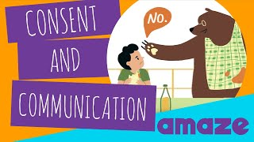
Videos
Amaze.org
YouTube
Genderwheel.com
Fight Child Abuse
A Novel Life
Play YouTube video (2:09)
Notes:
The videos used come from multiple sites (Amaze.org, YouTube - including our MHW YouTube channel, and genderwheel.com) - if you have a different video that you have found that you prefer to use that is great. Here’s an example of one of the videos. This one comes from Amaze.

Slide 15
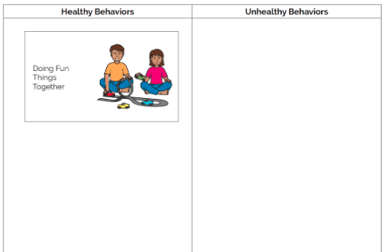
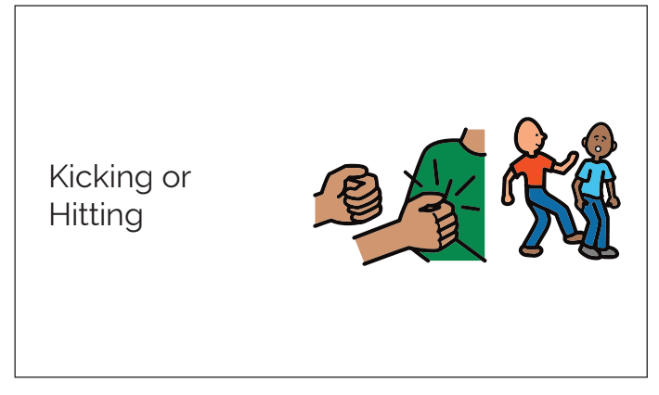
Sorting Activity

Slide 16
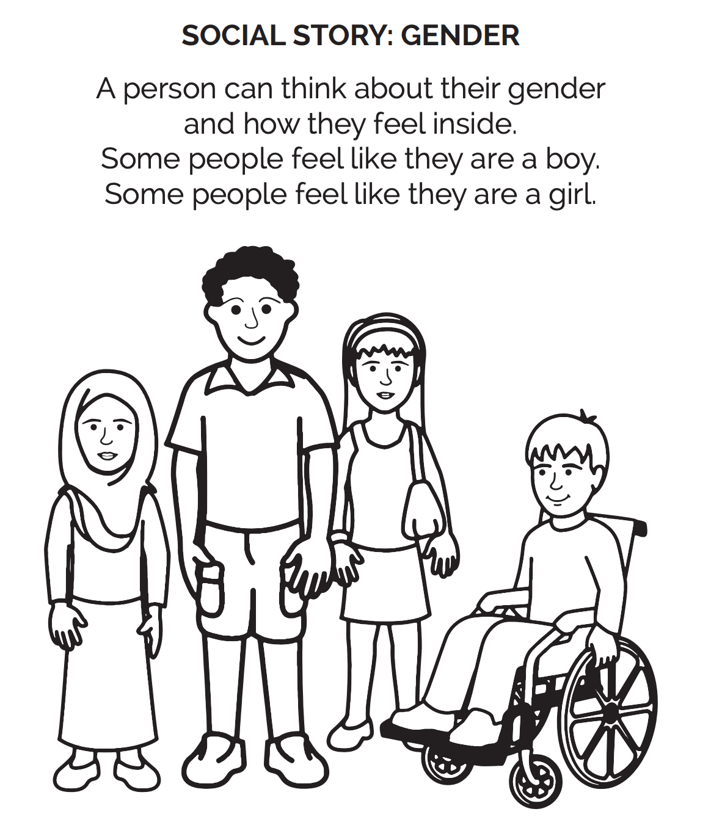
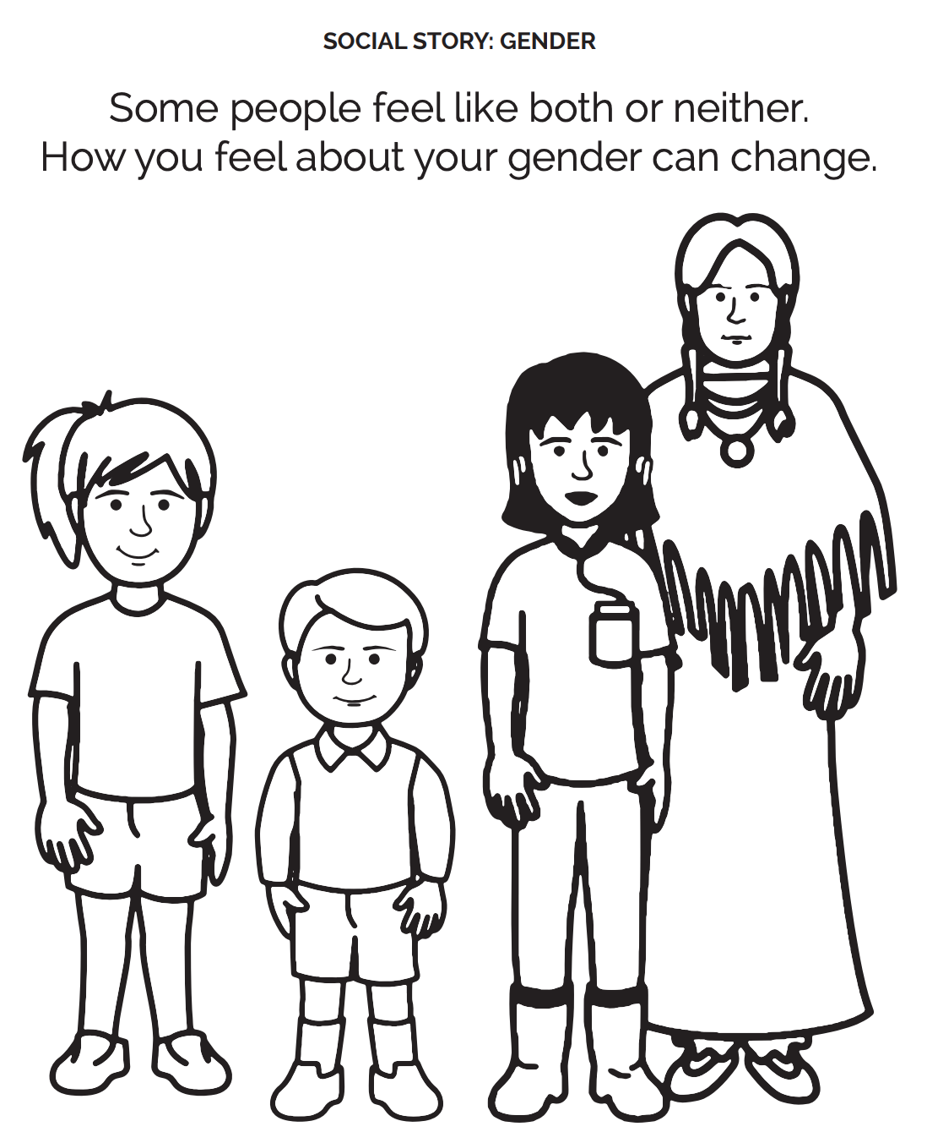
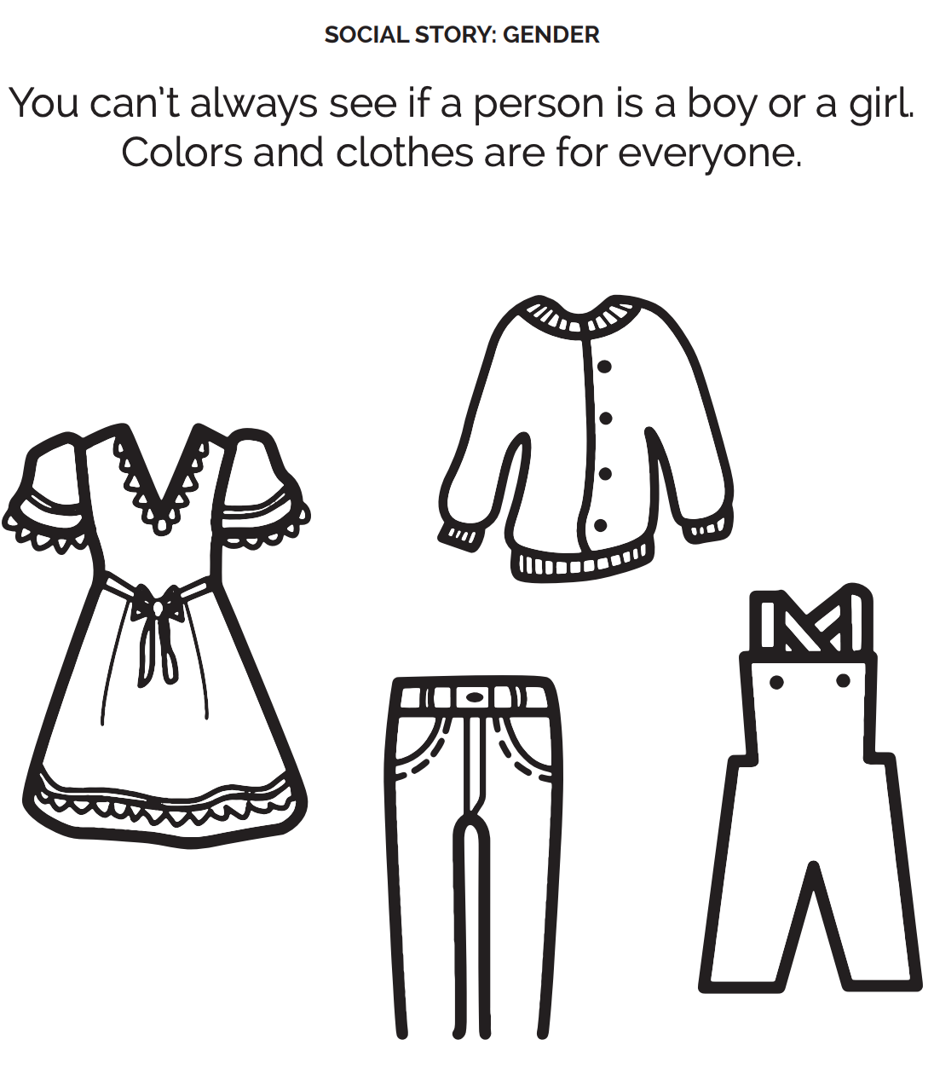
Coloring Social Story

Slide 17
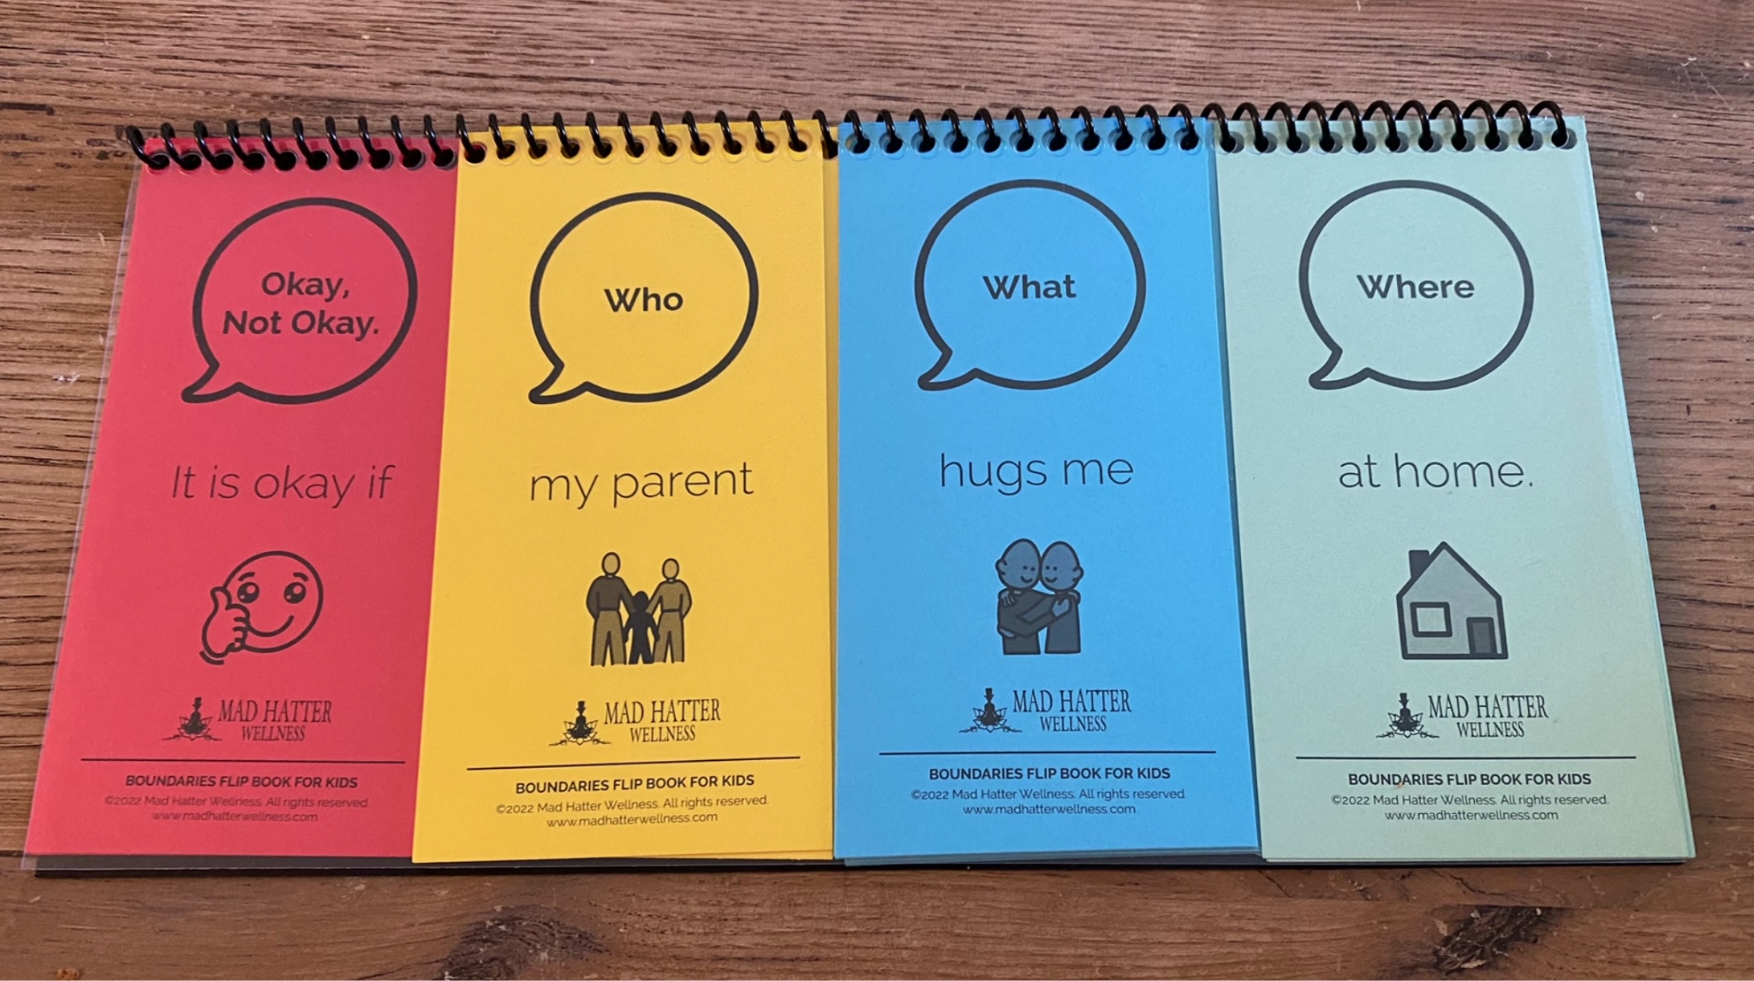
Boundaries Flip Book

Slide 18
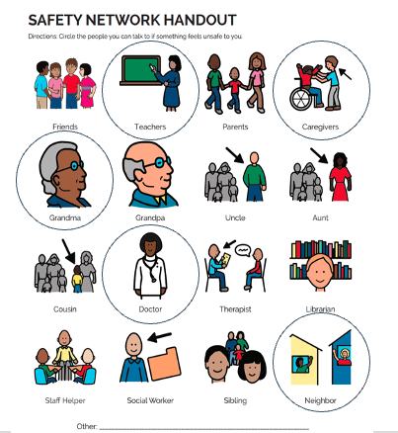
Circling Activity
www.madhatterwellness.com

Slide 19
How to be an Askable Adult
Only answer the questions that are asked.
Keep your answers simple.
Be positive. We want young people to feel empowered to ask questions.
If you don’t know the answer, model finding the answer from a reliable source.
We all make mistakes. Demonstrate learning from mistakes.

Slide 20
Answering Difficult Questions
Affirm the learner. “That’s a great question!” or “Thank you so much for asking that.”
Identify the motivation and type of question.
Correct any misinformation and answer the factual parts of the question.
Explore a range of values. “Some people believe ____, while other people believe _____.”
Adapted from Foundations: Core Skills Training for Sex Ed presented by Planned Parenthood
Notes:
When leading discussions on the topics within the video discussion guide, participants will most likely ask questions. Because you are an askable adult and a safe person in their life, it’s possible that they will feel very comfortable asking questions - even questions that may make you a bit uncomfortable.
Here is an optional script adapted by a sex ed training through Planned Parenthood that we have found extremely helpful when answering difficult questions.
First off, Affirm the learner. “That’s a great question!” or “Thank you so much for asking that.”
Take a moment to think about the motivation and why they might have asked that question. This will help you think about how to answer the question and how much to share.
Then, Correct any misinformation and answer the factual parts of the question.
Finally, if the question is a values-based question, Explore a range of values. For example, you can say, “Some people believe ____, while other people believe _____.” No need to share your own values when answering these questions.

Slide 21
Open Conversations Curriculum Overview

Slide 22
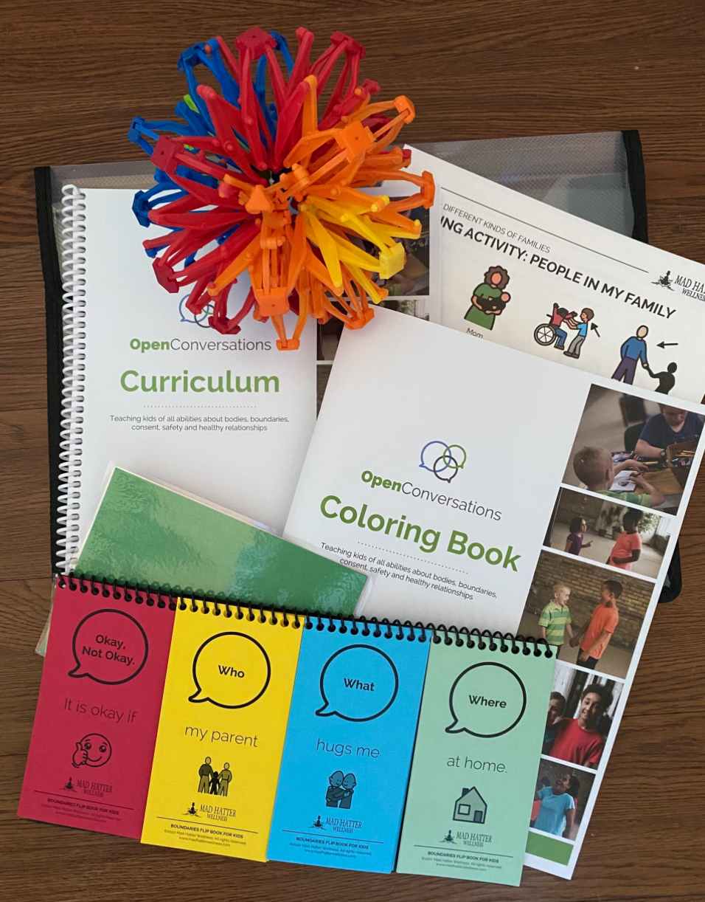
Open Conversations Curriculum
Spiral bound curriculum book
Boundaries flip book (4 books for schools)
Red/Green card(s)
Breathing Sphere
Flash drive to print multiples of worksheets and social stories (for schools and organizations)
Coloring Book (for families)
Printed activity worksheets (for families)

Slide 23
Included in Each Lesson
Key Messages
Check in and Connect
Learning Activities (Sorting, Circling, Drawing)
A Social Story in coloring book form
A Video
Boundaries Flip Book Activity in some lessons
Reflection
Relaxation

Slide 24
Learning Activities
There are a variety of modalities to teach the topics: discussion, brainstorming, hands-on, videos, and more
Each lesson includes: social story, video and other activities (sorting, circling, flip books).
You decide which activities work best for your group.
You can do all of the activities or just 1 or 2.

Slide 25
Focus Question 2
What questions do you have for teaching this material in your setting?

Slide 26
Additional Resources

Slide 27
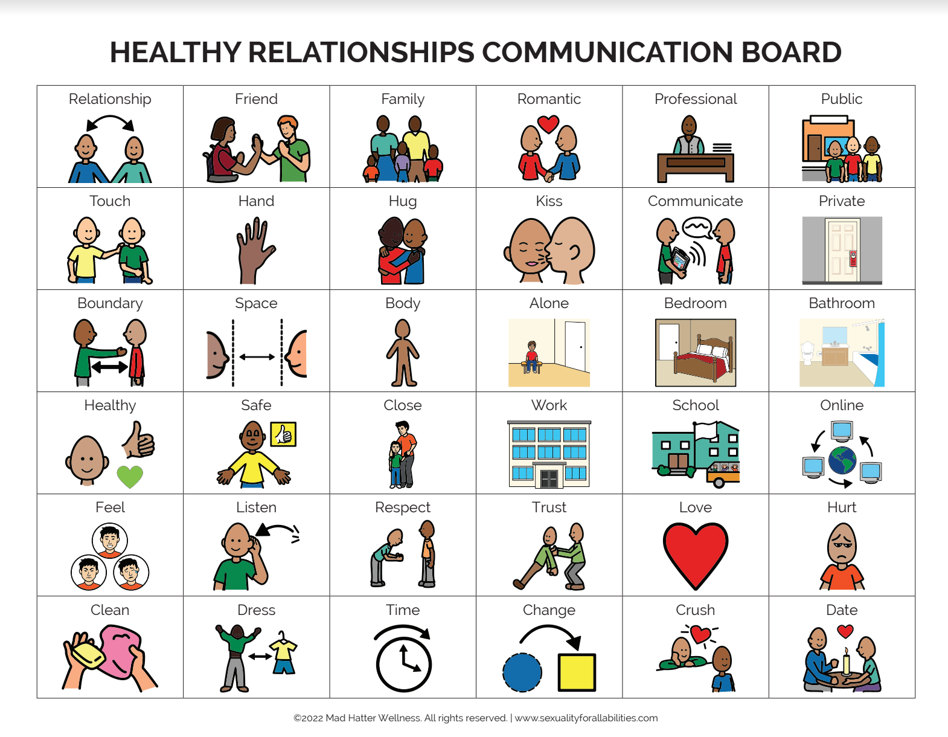
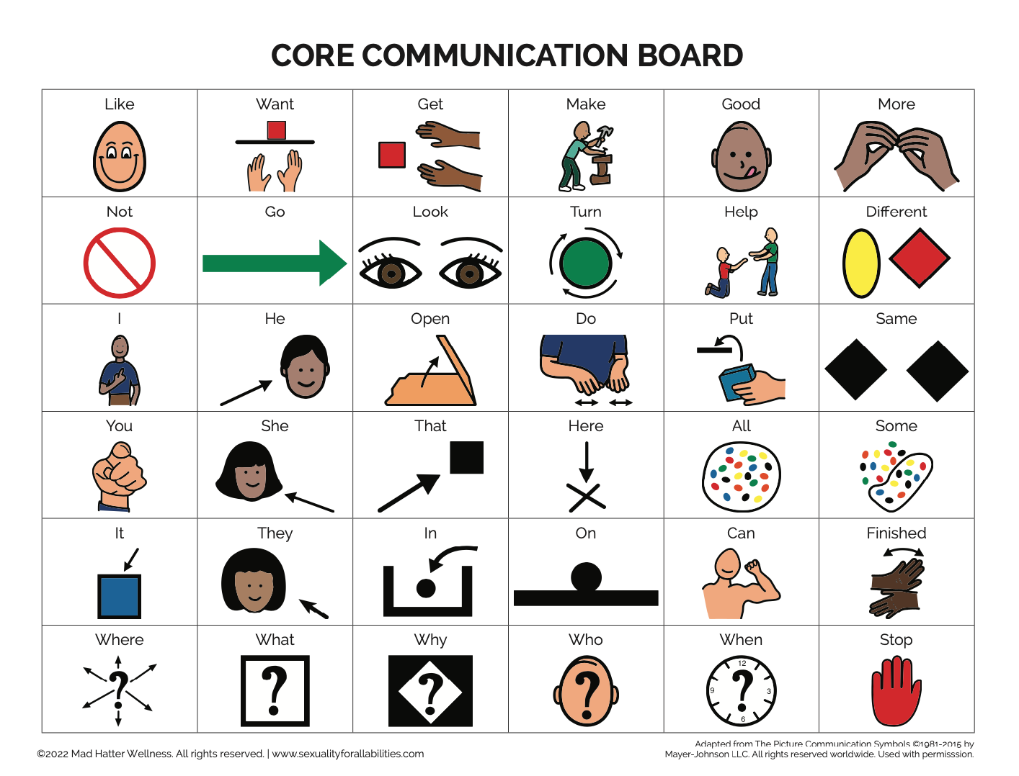
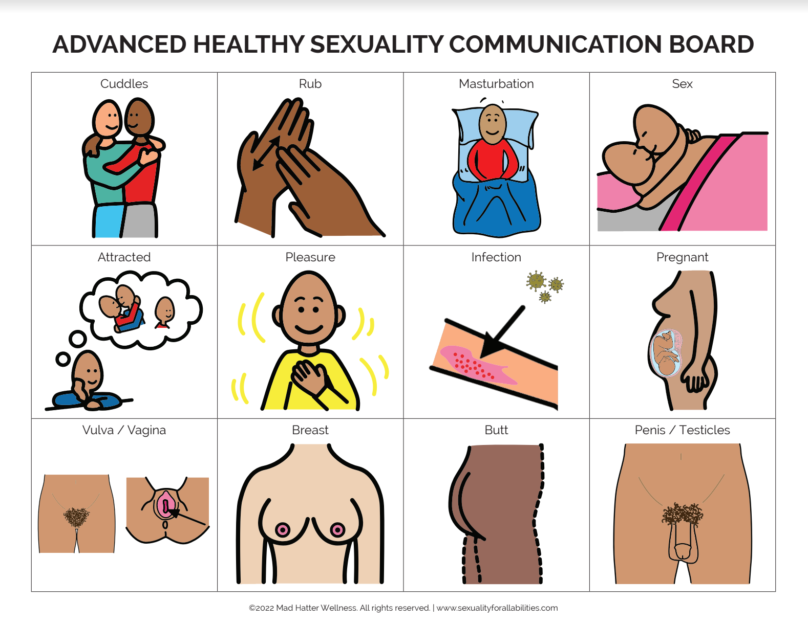
Communication Boards
Notes:
These boards contain carefully selected keywords surrounding healthy relationships and sexual health, paired with picture communication symbols (PCS) from Boardmaker.
these communication boardswere developed with the support and consultation of a Speech Language Pathologist (SLP) and other experts in Special Education and Disability Services.
The boards can be used to support learning and interactions around a sexuality education activity in the classroom, and aid in normal communication in everyday life surrounding types of relationships, places and behaviors, boundaries, consent, private body parts, and more.
One reminder when using communication boards is to be patient with the user because it takes time to learn how to communicate this way. This is a tool that definitely needs to be taught and practiced.

Slide 28
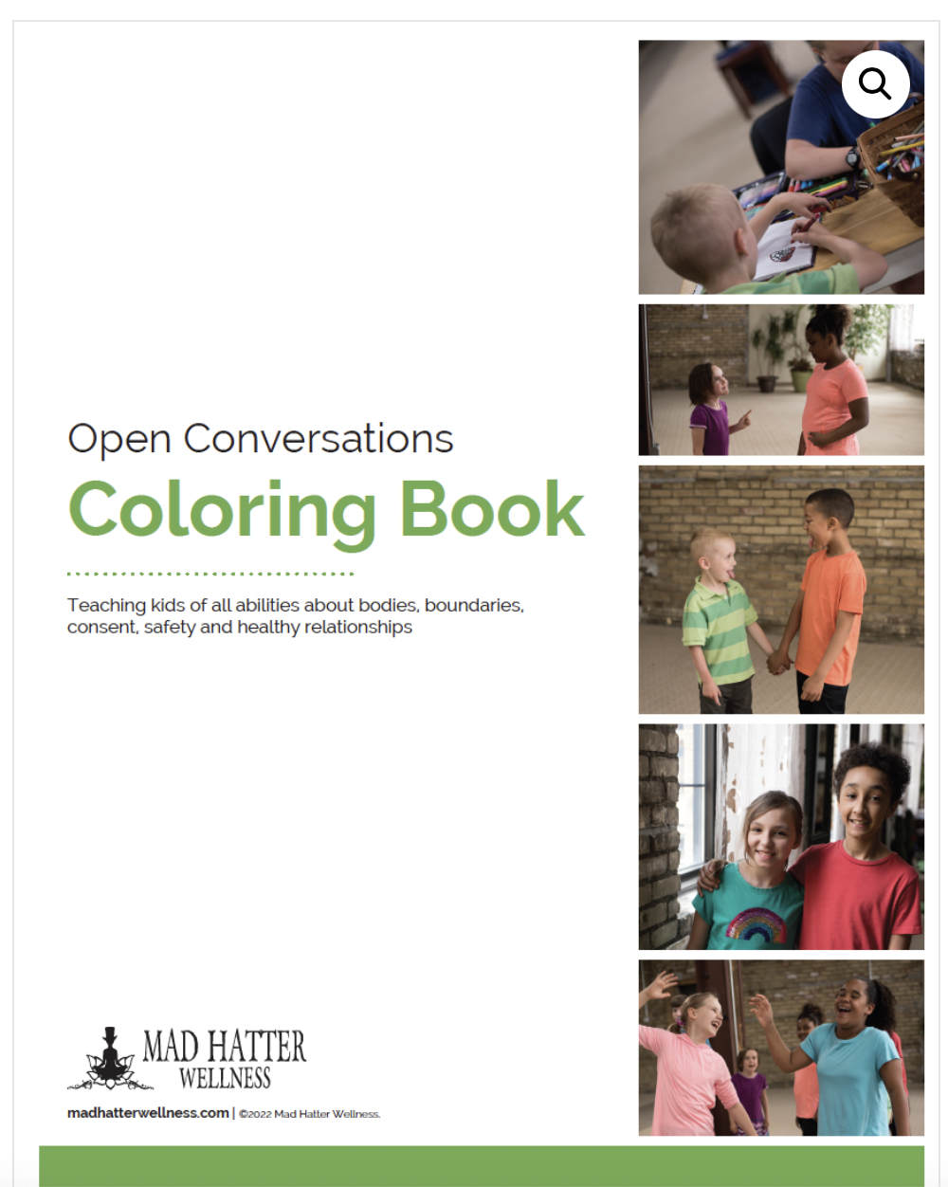
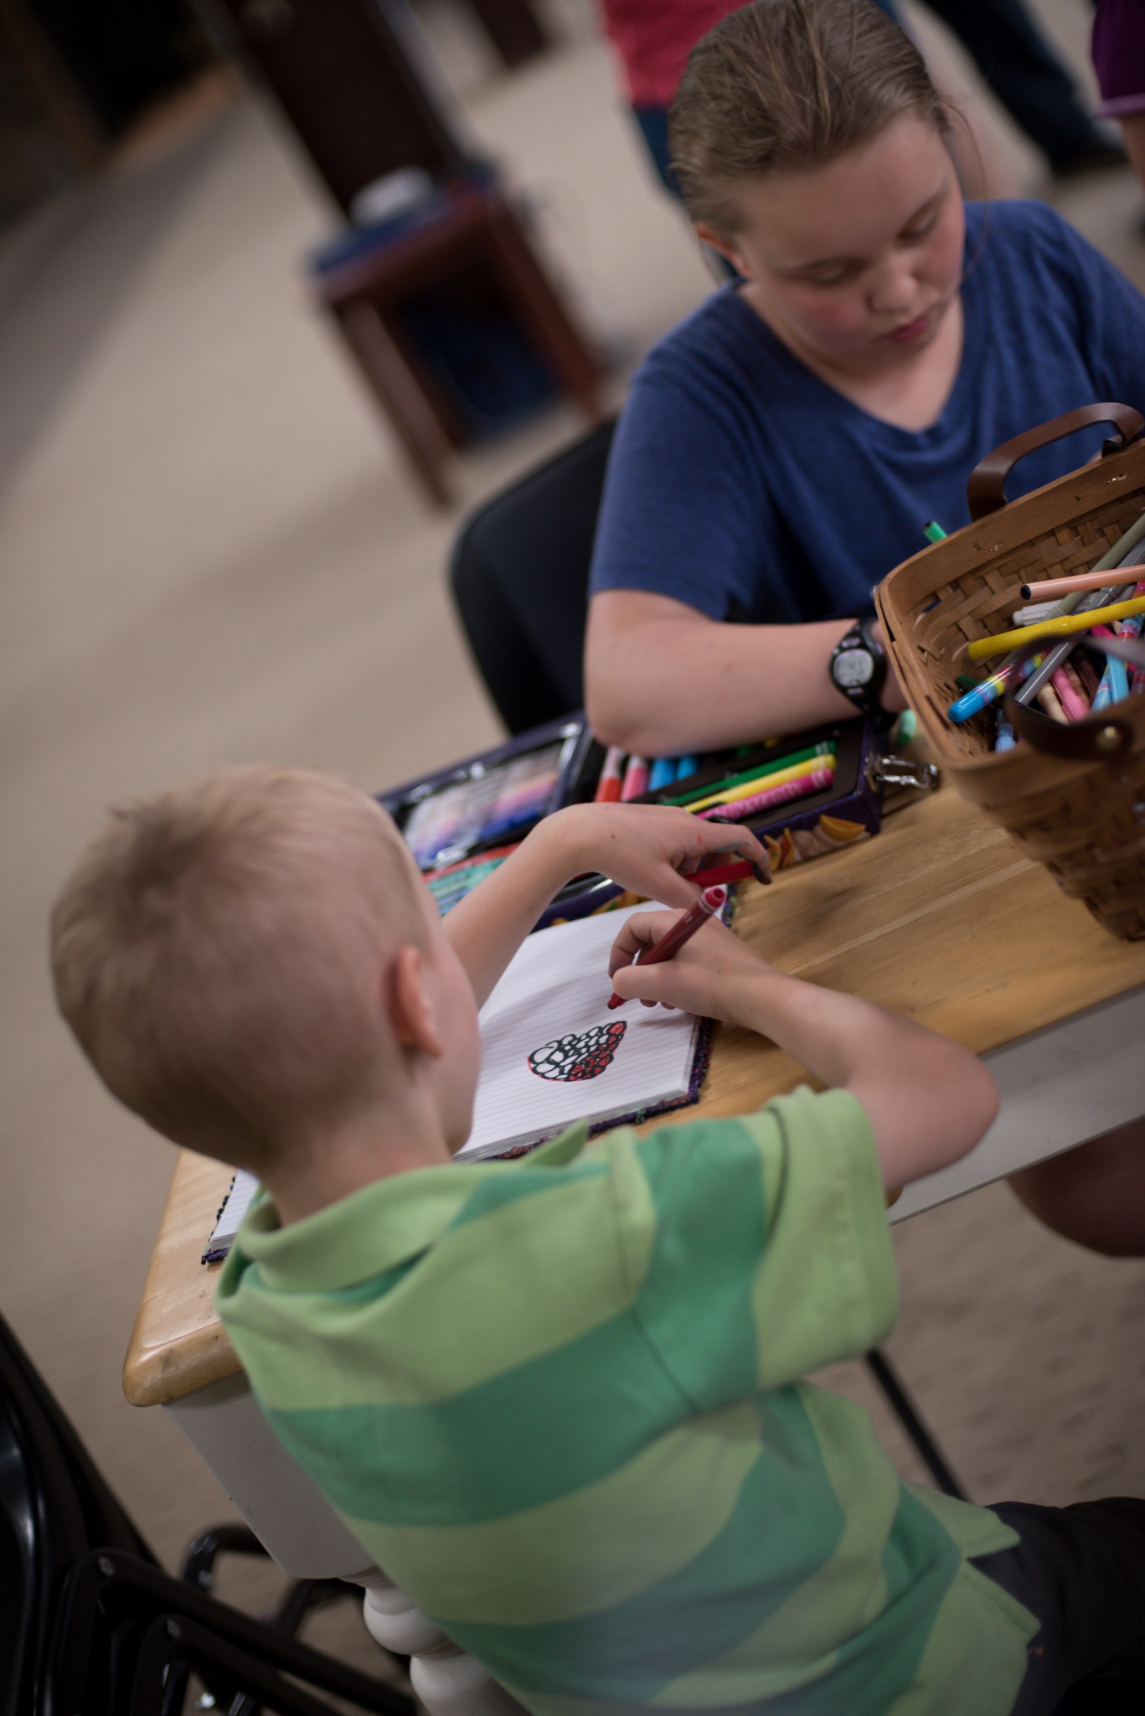
Coloring Book
www.madhatterwellness.com
Notes:
The Open Conversations coloring book can be used with the curriculum or independently. You can purchase them in the MHW shop or email us for discount bulk pricing.

Slide 29
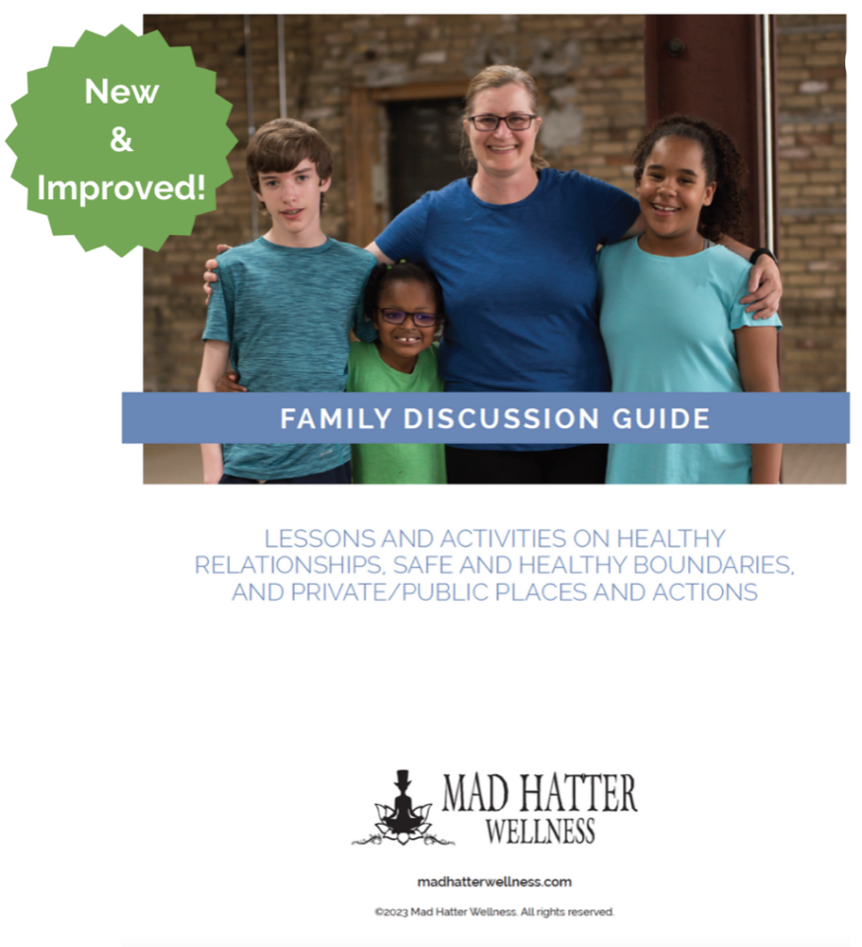
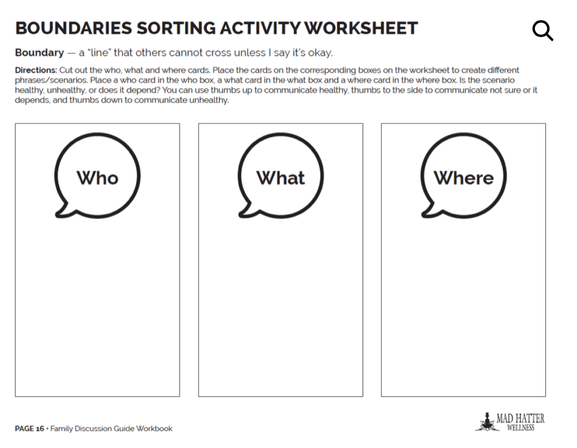
Family Discussion Guide and Workbook
www.madhatterwellness.com

Slide 30
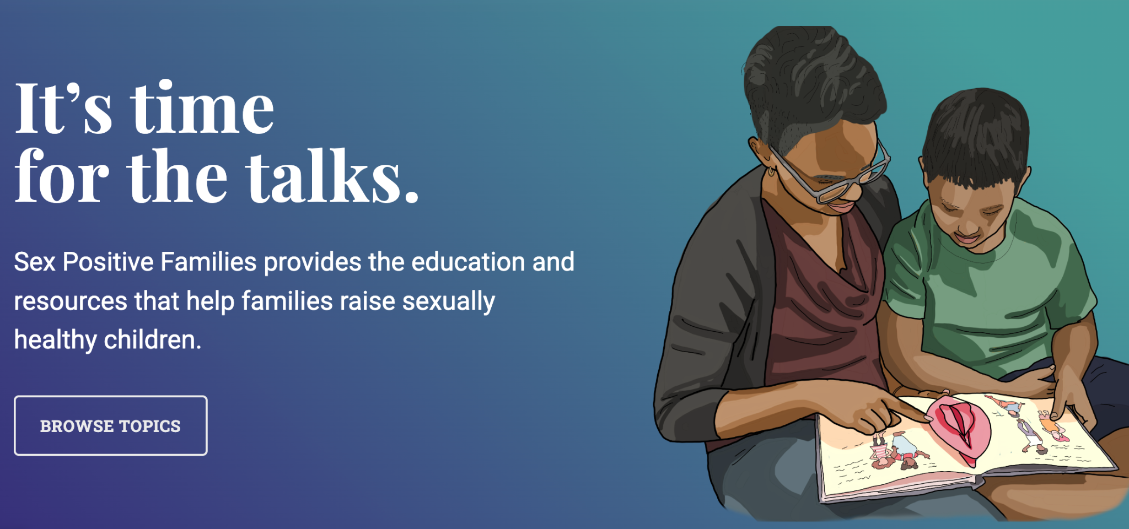
Helpful Websites
Sex Positive Families
Amaze & Amaze Jr.
MHW YouTube Channel
HUB (Healthy Understanding of Our Bodies)
Notes:
Sex Positive Families provides education and resources that help families raise sexually healthy children. Lots of really helpful info.
An all time fav online resource is Amaze and Amaze Jr., with countless short videos for youth of all ages and families that spark conversations, reinforce a message, help families find a place to start the conversation
MHW YouTube channel has Storytime with Kim (our parent educator), panels with parents/educators/adults with disabilities, guided relaxations, short informational videos and more
The HUB (Healthy Understanding of Our Bodies: https://thearcofhr.org/sexual-health-resource-hub/
Is a website that includes a collection of videos, learning tools, and webpages to help youth with disabilities and their supportive networks build a strong foundation for sexual health.

Slide 31
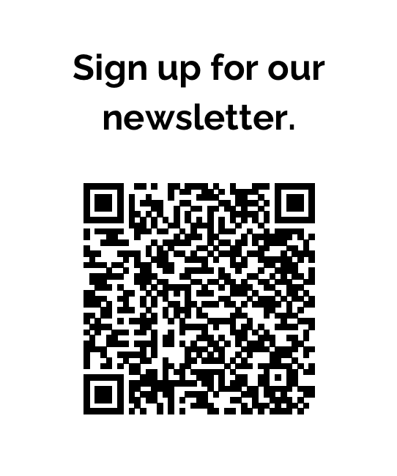
CONTACT US! ☺
Email: info@madhatterwellness.com
Website: www.madhatterwellness.com
Phone: 612-524-8364
Parent/Caregiver Education Specialist (Kim)
kim@sfaabilities.com
“Like” Mad Hatter Wellness on Facebook
Follow us on Instagram @madhatterwellness

Slide 32
Questions and Close

