Slide 1
SpOT Time: Collaborating and Programming Between Speech and OT Services
Presented by: Katie Juaire O.T.R/L, Molly Dickerson MA, CCC-SLP, and Meghan Karsky MS, CCC-SLP

Slide 2
Who are we?
Meghan Karsky is a Speech and Language Pathologist who has worked in the public school setting for 3 years and in the outpatient setting for one year. Her bubbly personality and happy face make her enjoyable.
Molly Dickerson is a Speech and Language Pathologist who has worked in the public school setting for 12 years, in homecare for 2.5 years and in a skilled nursing facility for 2 years. She is motivated by pairing fun with intervention and is good at it.
Katie Juaire is an Occupational Therapist who has been working in the school setting for 12 years. Her realistic fun helps ground the team to be successful.

Slide 3
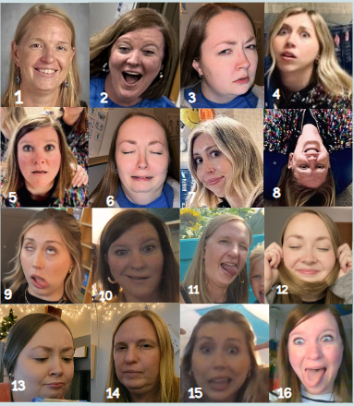
Who are YOU?

Slide 4
Learning Objectives:
Learn how to collaborate across disciplines to ensure that overlapping challenges related to both sensorimotor skills and communication can be addressed in a coordinated manner.
Understand the benefits of whole group vs. one-on-one service delivery models.
Explore curriculum-based, individualized, and modified lessons for each student’s unique learning needs.

Slide 5
Fun Tip #1
Always. Use. Glitter.
The janitors will love you.
And so will the children.

Slide 6
What is SpOT?
SpOT is a high language, high fine motor, 30-minute co-therapy whole group session where individualized support is provided to all students to target increasing a student's language and fine motor skills
+supplemental activities related to the theme (sensory boxes, matching activities, etc.)

Slide 7
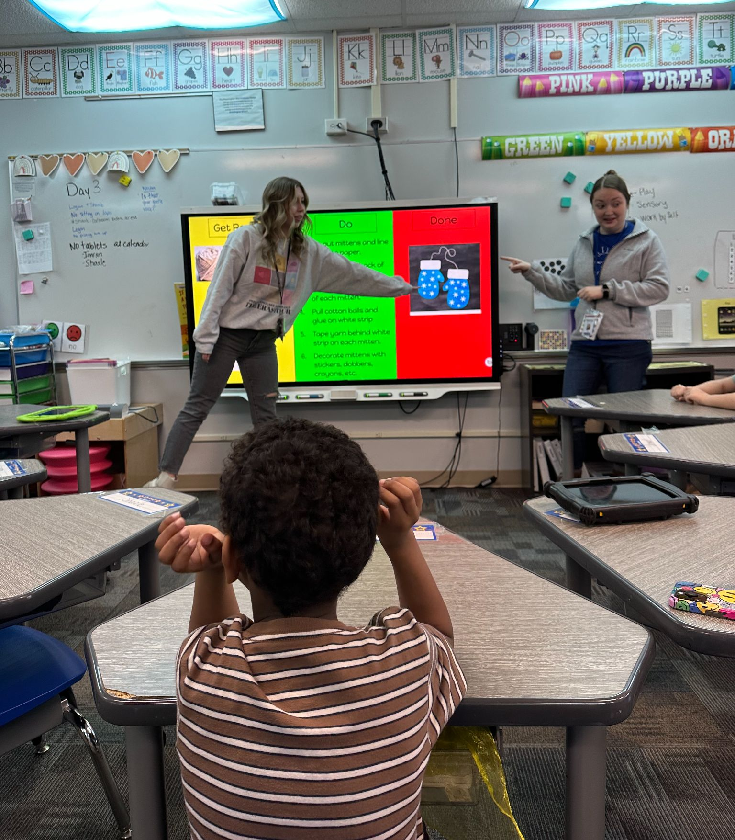
Ws of SpOT
Who?
Speech + Occupational Therapy
Case Manager & paras
Level 3 classrooms
When?
1x per week
30 minutes
Why?
Hands-on training approach for all team members
Target more goals spontaneously
Regulation before communication

Slide 8
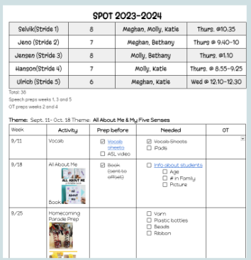
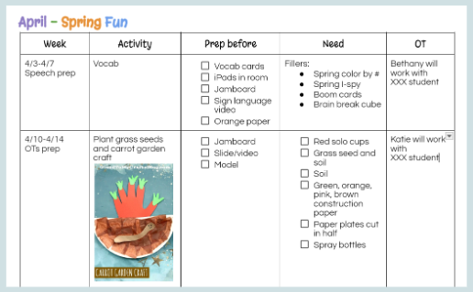
Collaborating

Slide 9
Ideas to Increase Efficiency and Decrease Workload

Slide 10
Fun tip #2

Slide 11
Let's dig deeper...
Training
SpOT Activites
The frills of SpOT

Slide 12
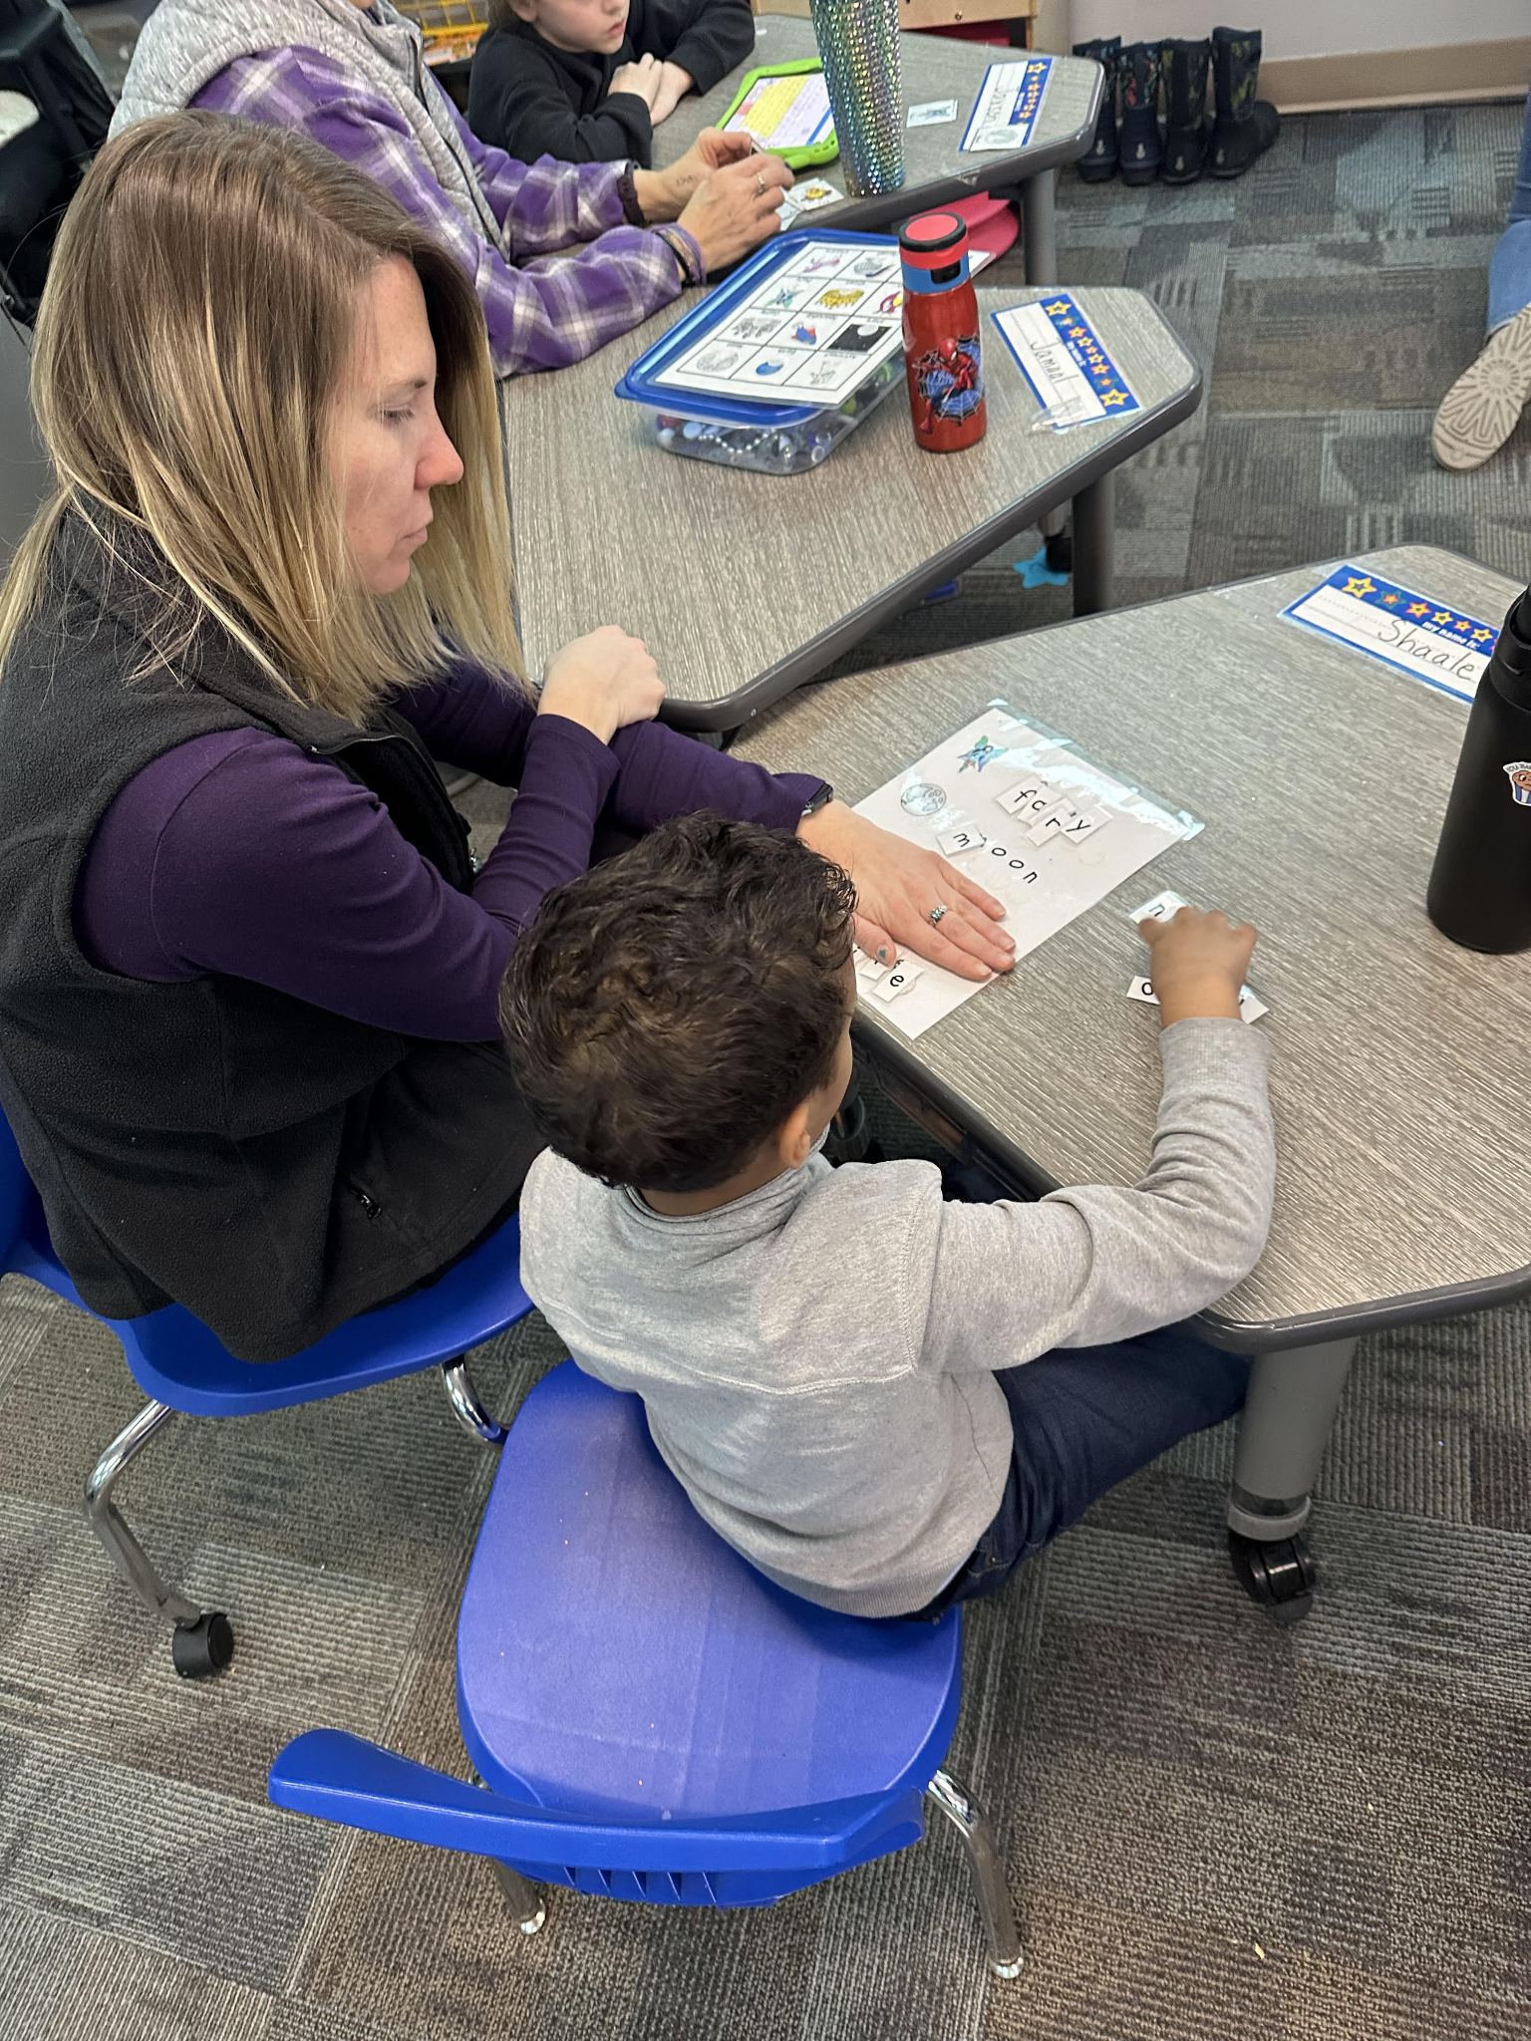
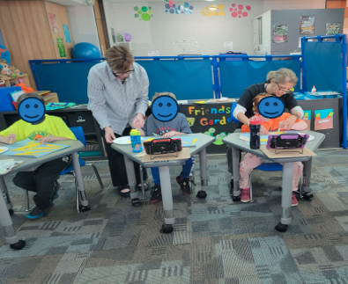
Hands-on Training Tool
How do we teach all things speech and OT with new staff, new students, new needs, changing modifications, ALL. YEAR. LONG?
Common language
Modifications and adaptions
AAC
Sensory regulation
Fine motor support

Slide 13
SpOT Activities - Crafts? Why do a craft?
Speech:
Vocabulary
Sequencing and following directions
Temporal, sequential, and spatial directions
+ more!
Occupational therapy:
Fine motor: cutting, pre-writing, coloring, writing name
Hand-eye coordination
Using adapted tools and assistive technology
Tactile input – multi-sensory
Everyone:
Executive functioning skills

Slide 14
SpOT Activities- Games? Why do a game?
Speech:
Engagement and joint attention
Turn-taking and following directions
Memory, attention, problem solving, ability to adapt
Adaptable (cause & effect vs. board game vs. card games)
Occupational therapy:
In-hand manipulation, pincer grasp
Hand strengthening
Hand-eye coordination, bilateral coordination
Tactile input

Slide 15
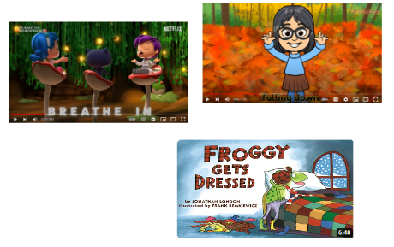
SpOT Activities- Videos? Why show a video?
related to theme
multimodal learning: combining visual, auditory and tactile elements
motivating & positive associations: leads to more participation
Speech:
Labeling, contextualized vocabulary, frequent models
Auditory processing
Comprehension questions
Occupational therapy:
Movement & sensory input
Calming, deep breathing

Slide 16
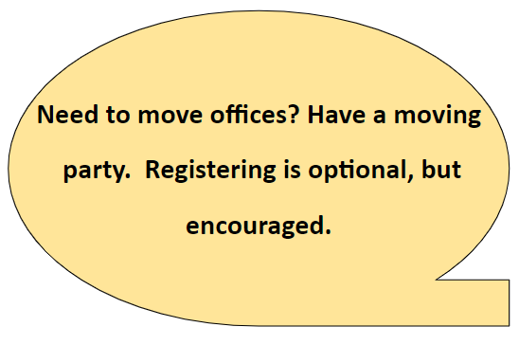
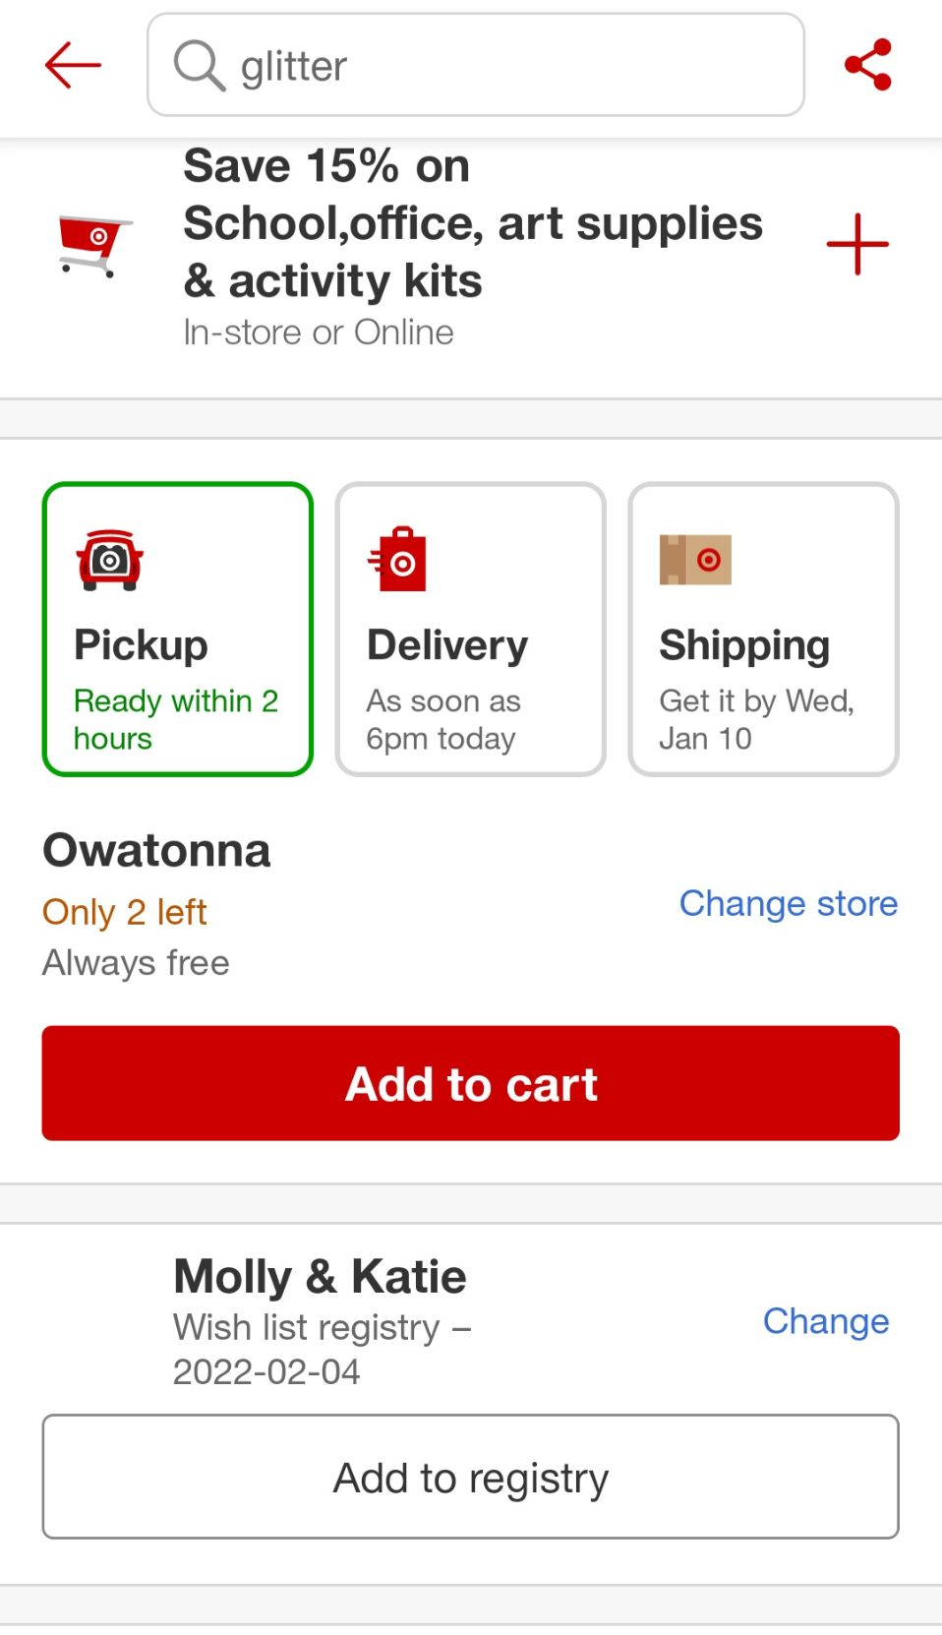
Fun tip #3

Slide 17
All the Frills

Slide 18
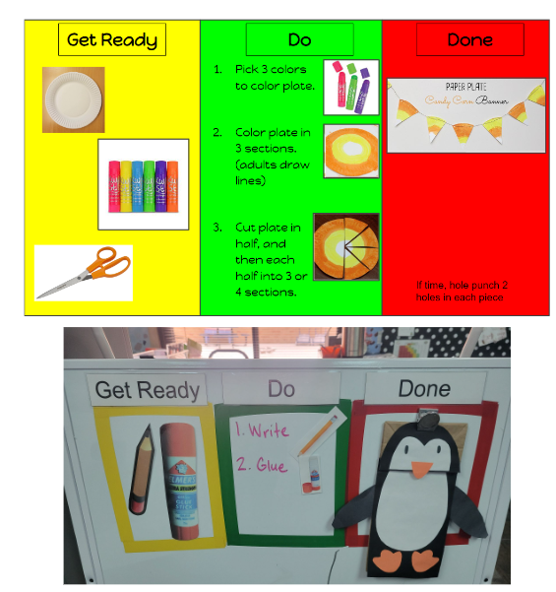
Get ready – Do – Done
Organizing and planning
Task initiation
Impulse control
Self-awareness
Enhances attention and focus
Structured and supported environment
Tailored to meet the specific needs of each individual student
Takes away verbal cues
Visual model

Slide 19
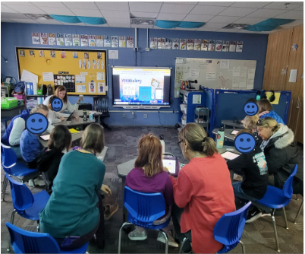
Whole group vs. 1:1
Target multiple goals at the same time
Modeling and peer learning
Students can learn from us and each other
Working on generalization of skills from 1:1 sessions
Engaging and motivating for students
Interdisciplinary collaboration
*we still do 1:1 sessions with our friends!

Slide 20
Modifying tasks
Why?
Diverse learning styles, needs, and abilities
Accommodating different paces of learning
Enhancing engagement and motivation
Too hard they aren’t going to try
Promotes inclusivity
Fosters independence

Slide 21
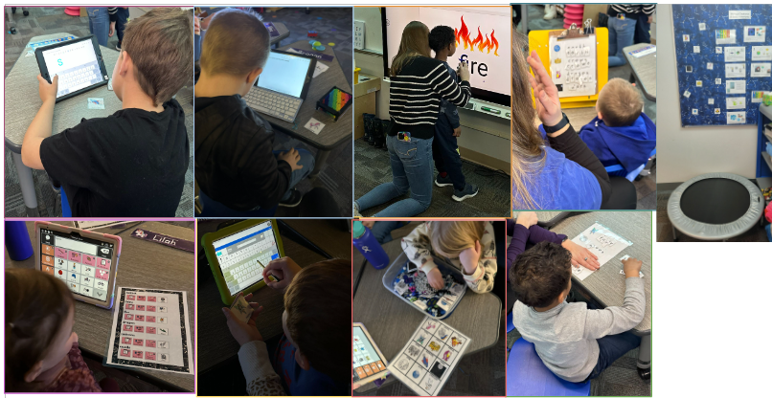
Examples of Modifying Tasks: Vocab
Typing vocab words
Matching letters to spell vocab words
Tracing words on smartboard
Typing with an external keyboard
Finding words on talker
Typing words in search bar on talker with stylus
Finding words in sensory bin and matching them

Slide 22
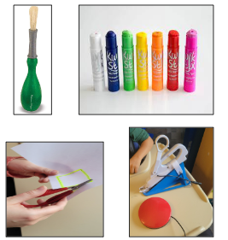
Examples of Modifying Tasks: Crafts
Visual models
Visual boundary for writing name
“X” for glue spots
Pre-cut out shapes for some students
Highlighted lines for cutting
Bingo dabbers, paint sticks
Name stamps
Switch scissors
Loop scissors
Slant boards
Pencil grips, modified utensils

Slide 23
Fun tip #4

Slide 24
Common Language
Why?
Consistency between staff
Less words
Helps with processing
Helps with regulation
Examples:
Do this
Walk with me
Hands down
First/then
What are you working for?
My turn/your turn
Feet on floor
All done

Slide 25
Reinforcers & Regulation
Bubbles
Play-Doh
Fidgets
Toys
Food
Stickers
Videos
Swing
Trampoline
Walk

Slide 26
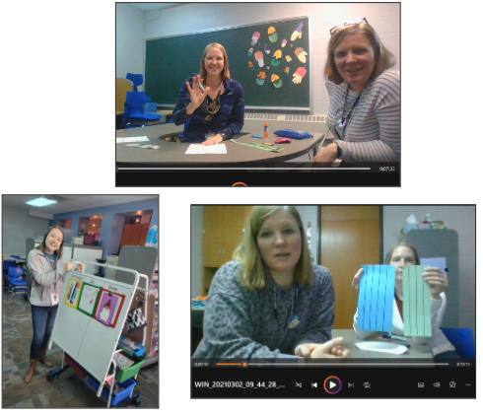
Variations of SpOT
Students receiving level 1 and 2 services and their case managers
Virtual
Groups of 3 - 13 students
On a cart
Brainstorm themes

Slide 27
Fun tip #5: make your co-workers compete for random things

Slide 28
Did you earn all of your pennies?

Slide 29
Questions?

Slide 30
Resources
360 ThinkingTM Cognitive Connections, LLP | www.efpractice.com
© Copyright February 2018, Kristen Jacobsen, M.S., CCC/SLP & Sarah Ward, M.S., CCC/SLP. All copyright and intellectual property rights reserved.
The Zones of Regulation | A Curriculum For Emotional Regulation (https://zonesofregulation.com/)
STAR Program | STAR Autism Support (https://starautismsupport.com/curriculum/star-program)

Slide 31
Thank you!
Molly Dickerson – mdickerson@isd761.org
Meghan Karsky – mhendricks@isd761.org
Katie Juaire – kjuaire@isd761.org

