Slide 1
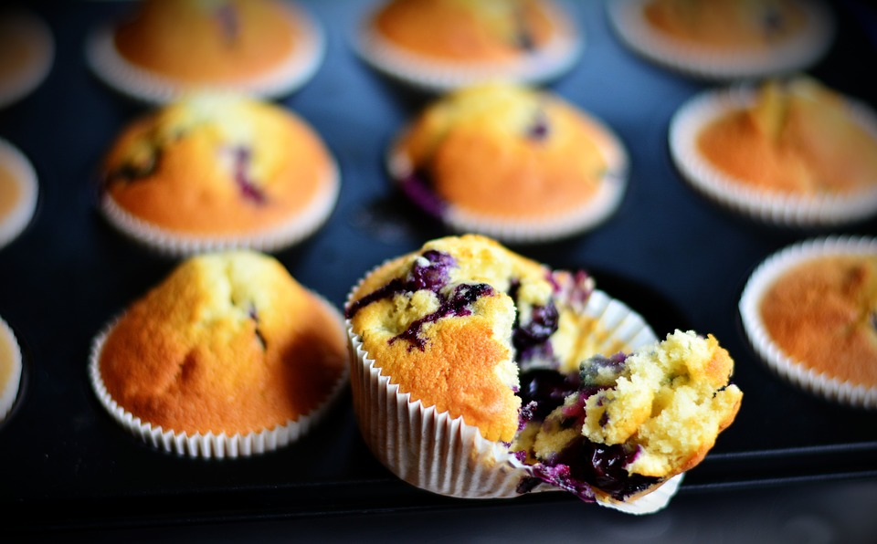
Life Skills that Last a Life Time
Presented by:
Paige Bellig and Jody Wehking

Slide 2
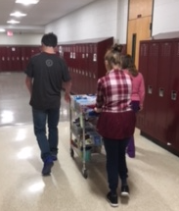
In The Beginning
The Vision
Funding…JAF
Location
Never Stop
Future Vision

Slide 3
Bumps Along the Way
Food Service Cooperation
ServSafe Training
Staffing
Space
Administration
What is the best interest for the students

Slide 4
Rules and Regulations
Minnesota Department of Education Link: Smart Snacks
Food Requirement Rules
Food Rules
Smart Snack Calculator
Smart Snacks Product Calculator

Slide 5
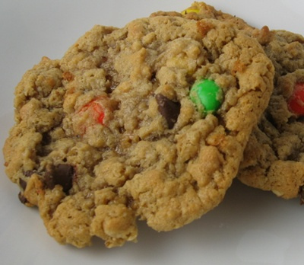
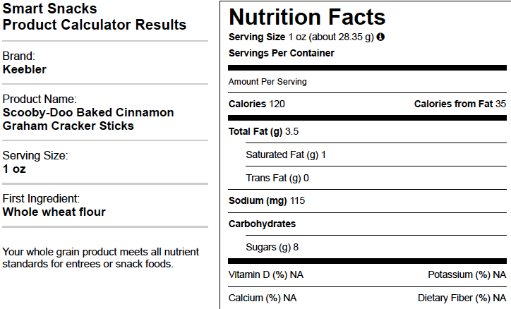
Smart Snack Guidelines
What is your product?
First Ingredient
Serving Size
Calories
200 or less
Total Fat
Less than 35% of total calories
Saturated Fat
Less than 10% of total calories
Trans Fat
Must be zero
Sodium
Must be 200 mg or less
Sugars
Less than 35% of Weight
Carbs
No recommendations from the state.

Slide 6
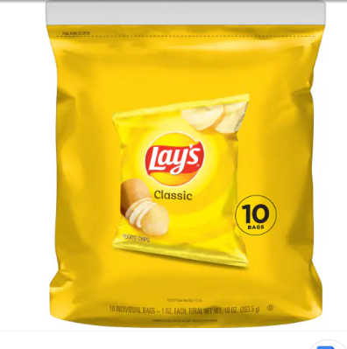
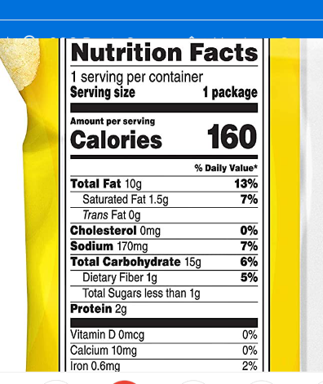
Lay’s Classic Potato Chips

Slide 7
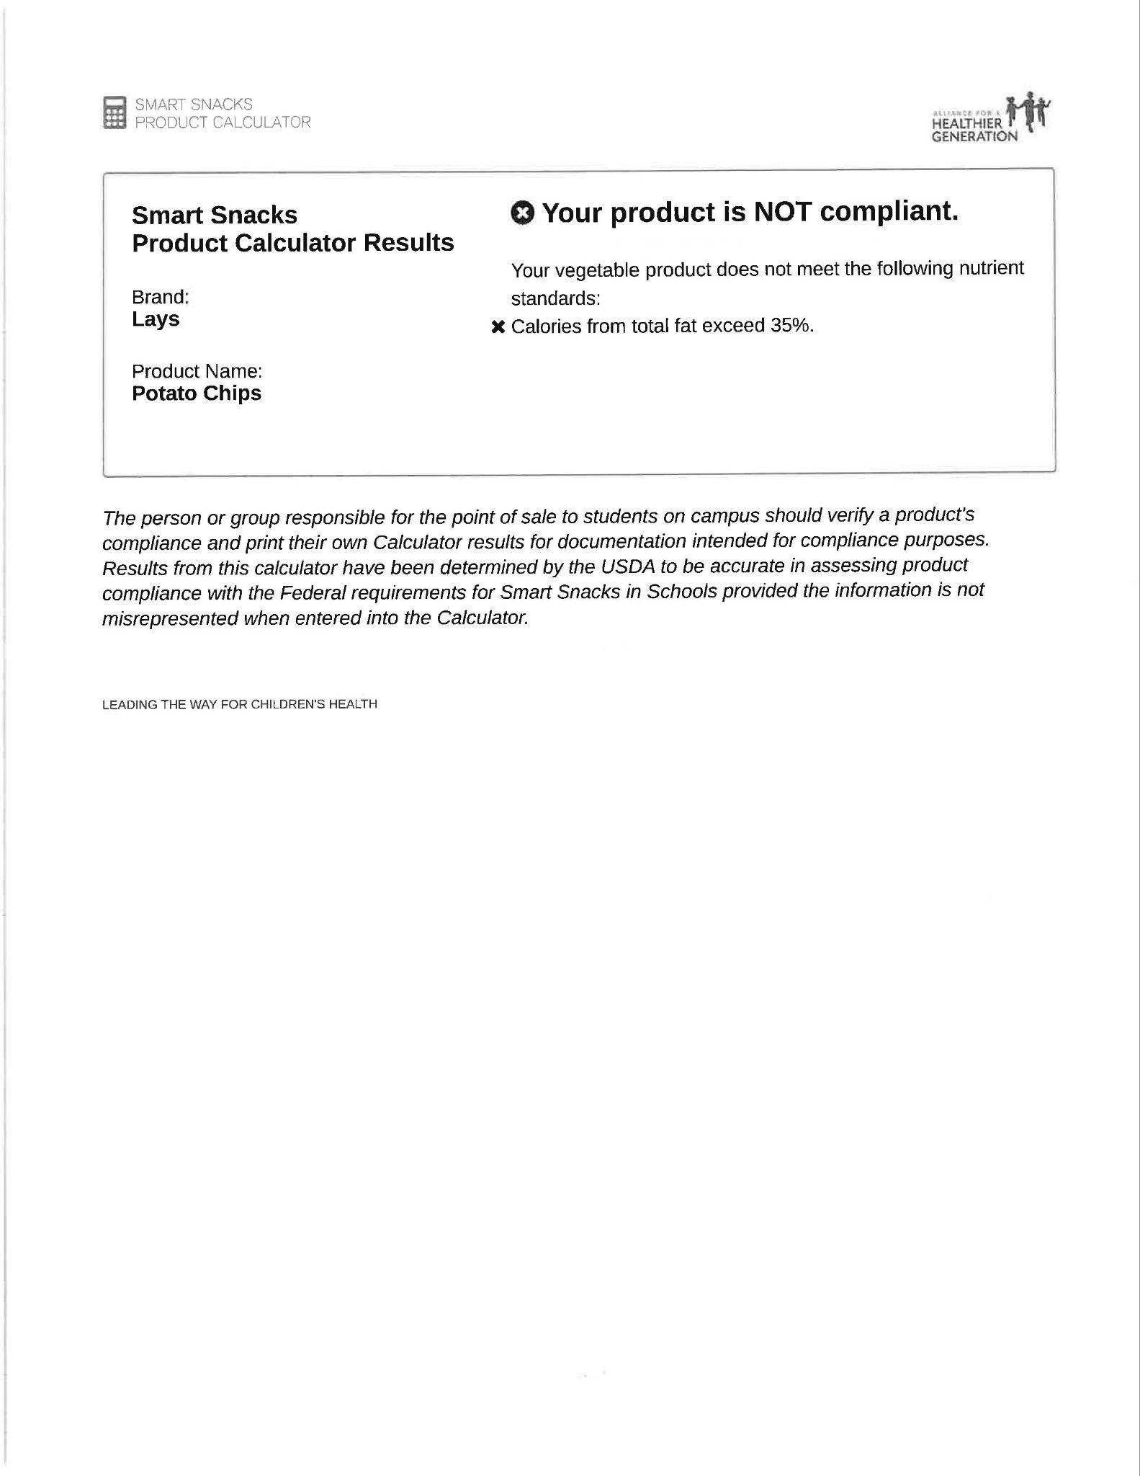
Smart Snacks Product Calculator: Lay’s Potato Chips

Slide 8
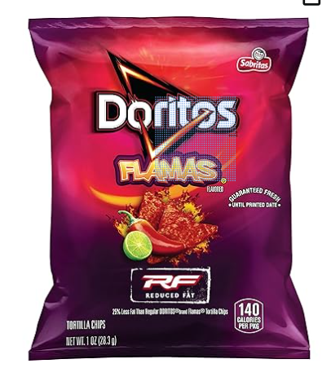
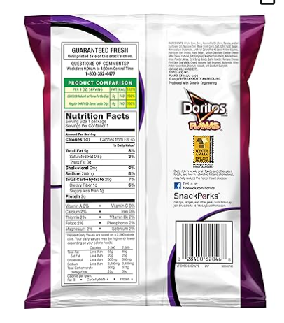
Doritos Flamas Reduced Fat

Slide 9
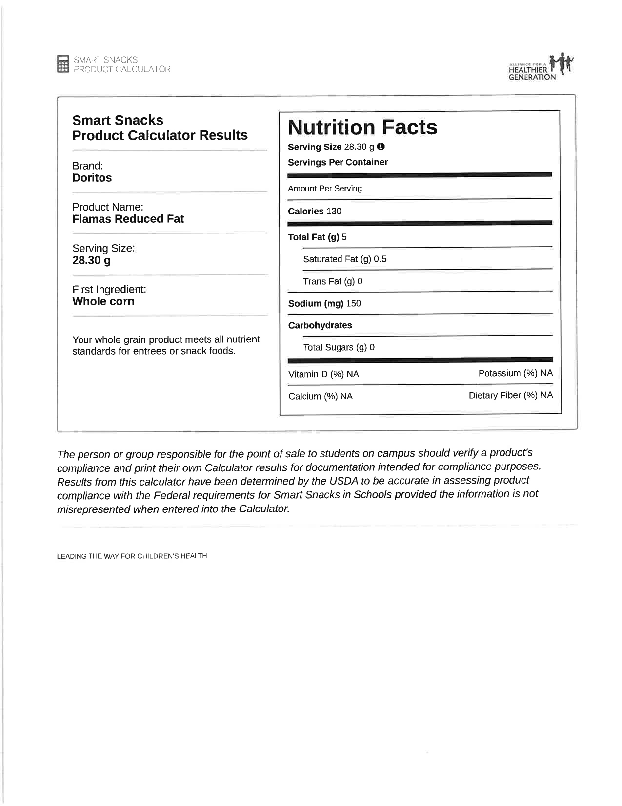
Smart Snacks Product Calculator: Doritos Flamas Reduced Fat

Slide 10
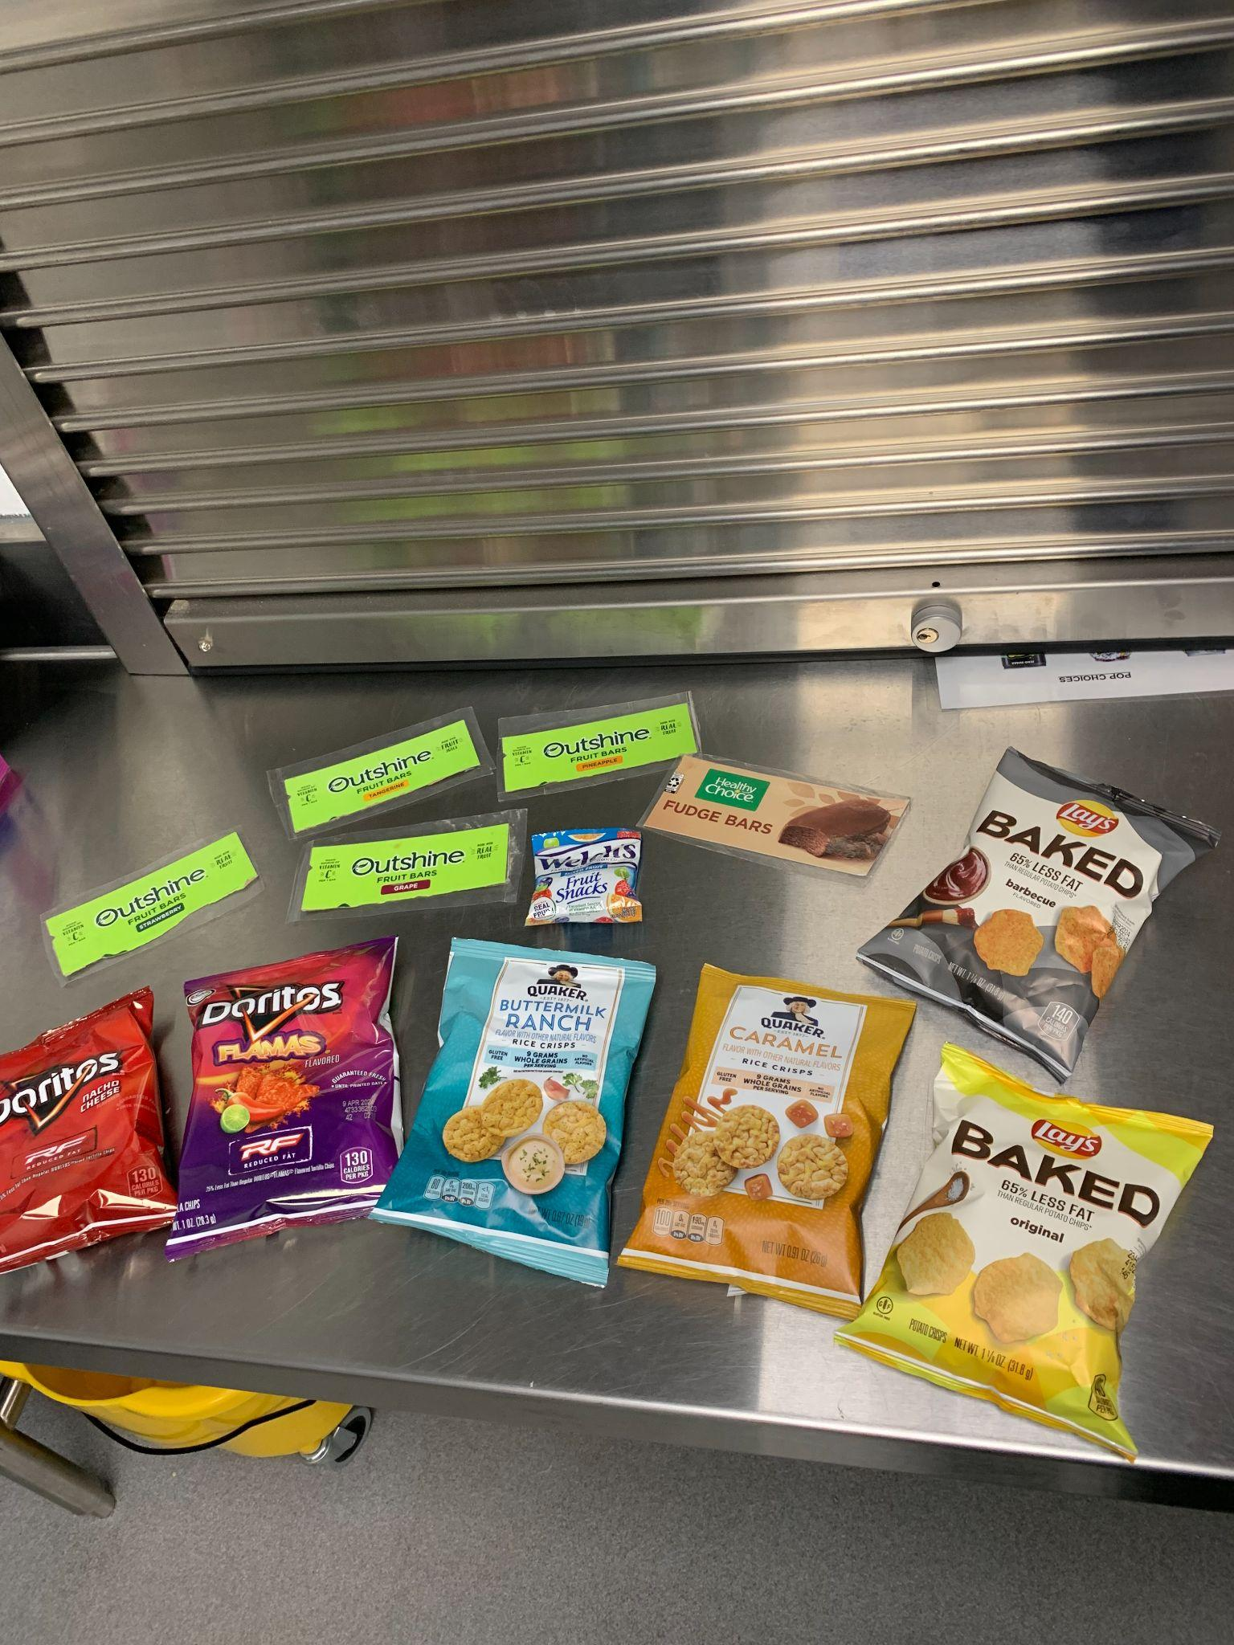
Other Pre-Packaged Compliant Snacks
Reduced Fat Nacho Doritos
Reduced Fat Flamas
Baked Lays Original
Baked BBQ Lays
Outshine Bars
Healthy Choice Fudge Bar
Pop Chips
Welch’s Fruit Snacks

Slide 11
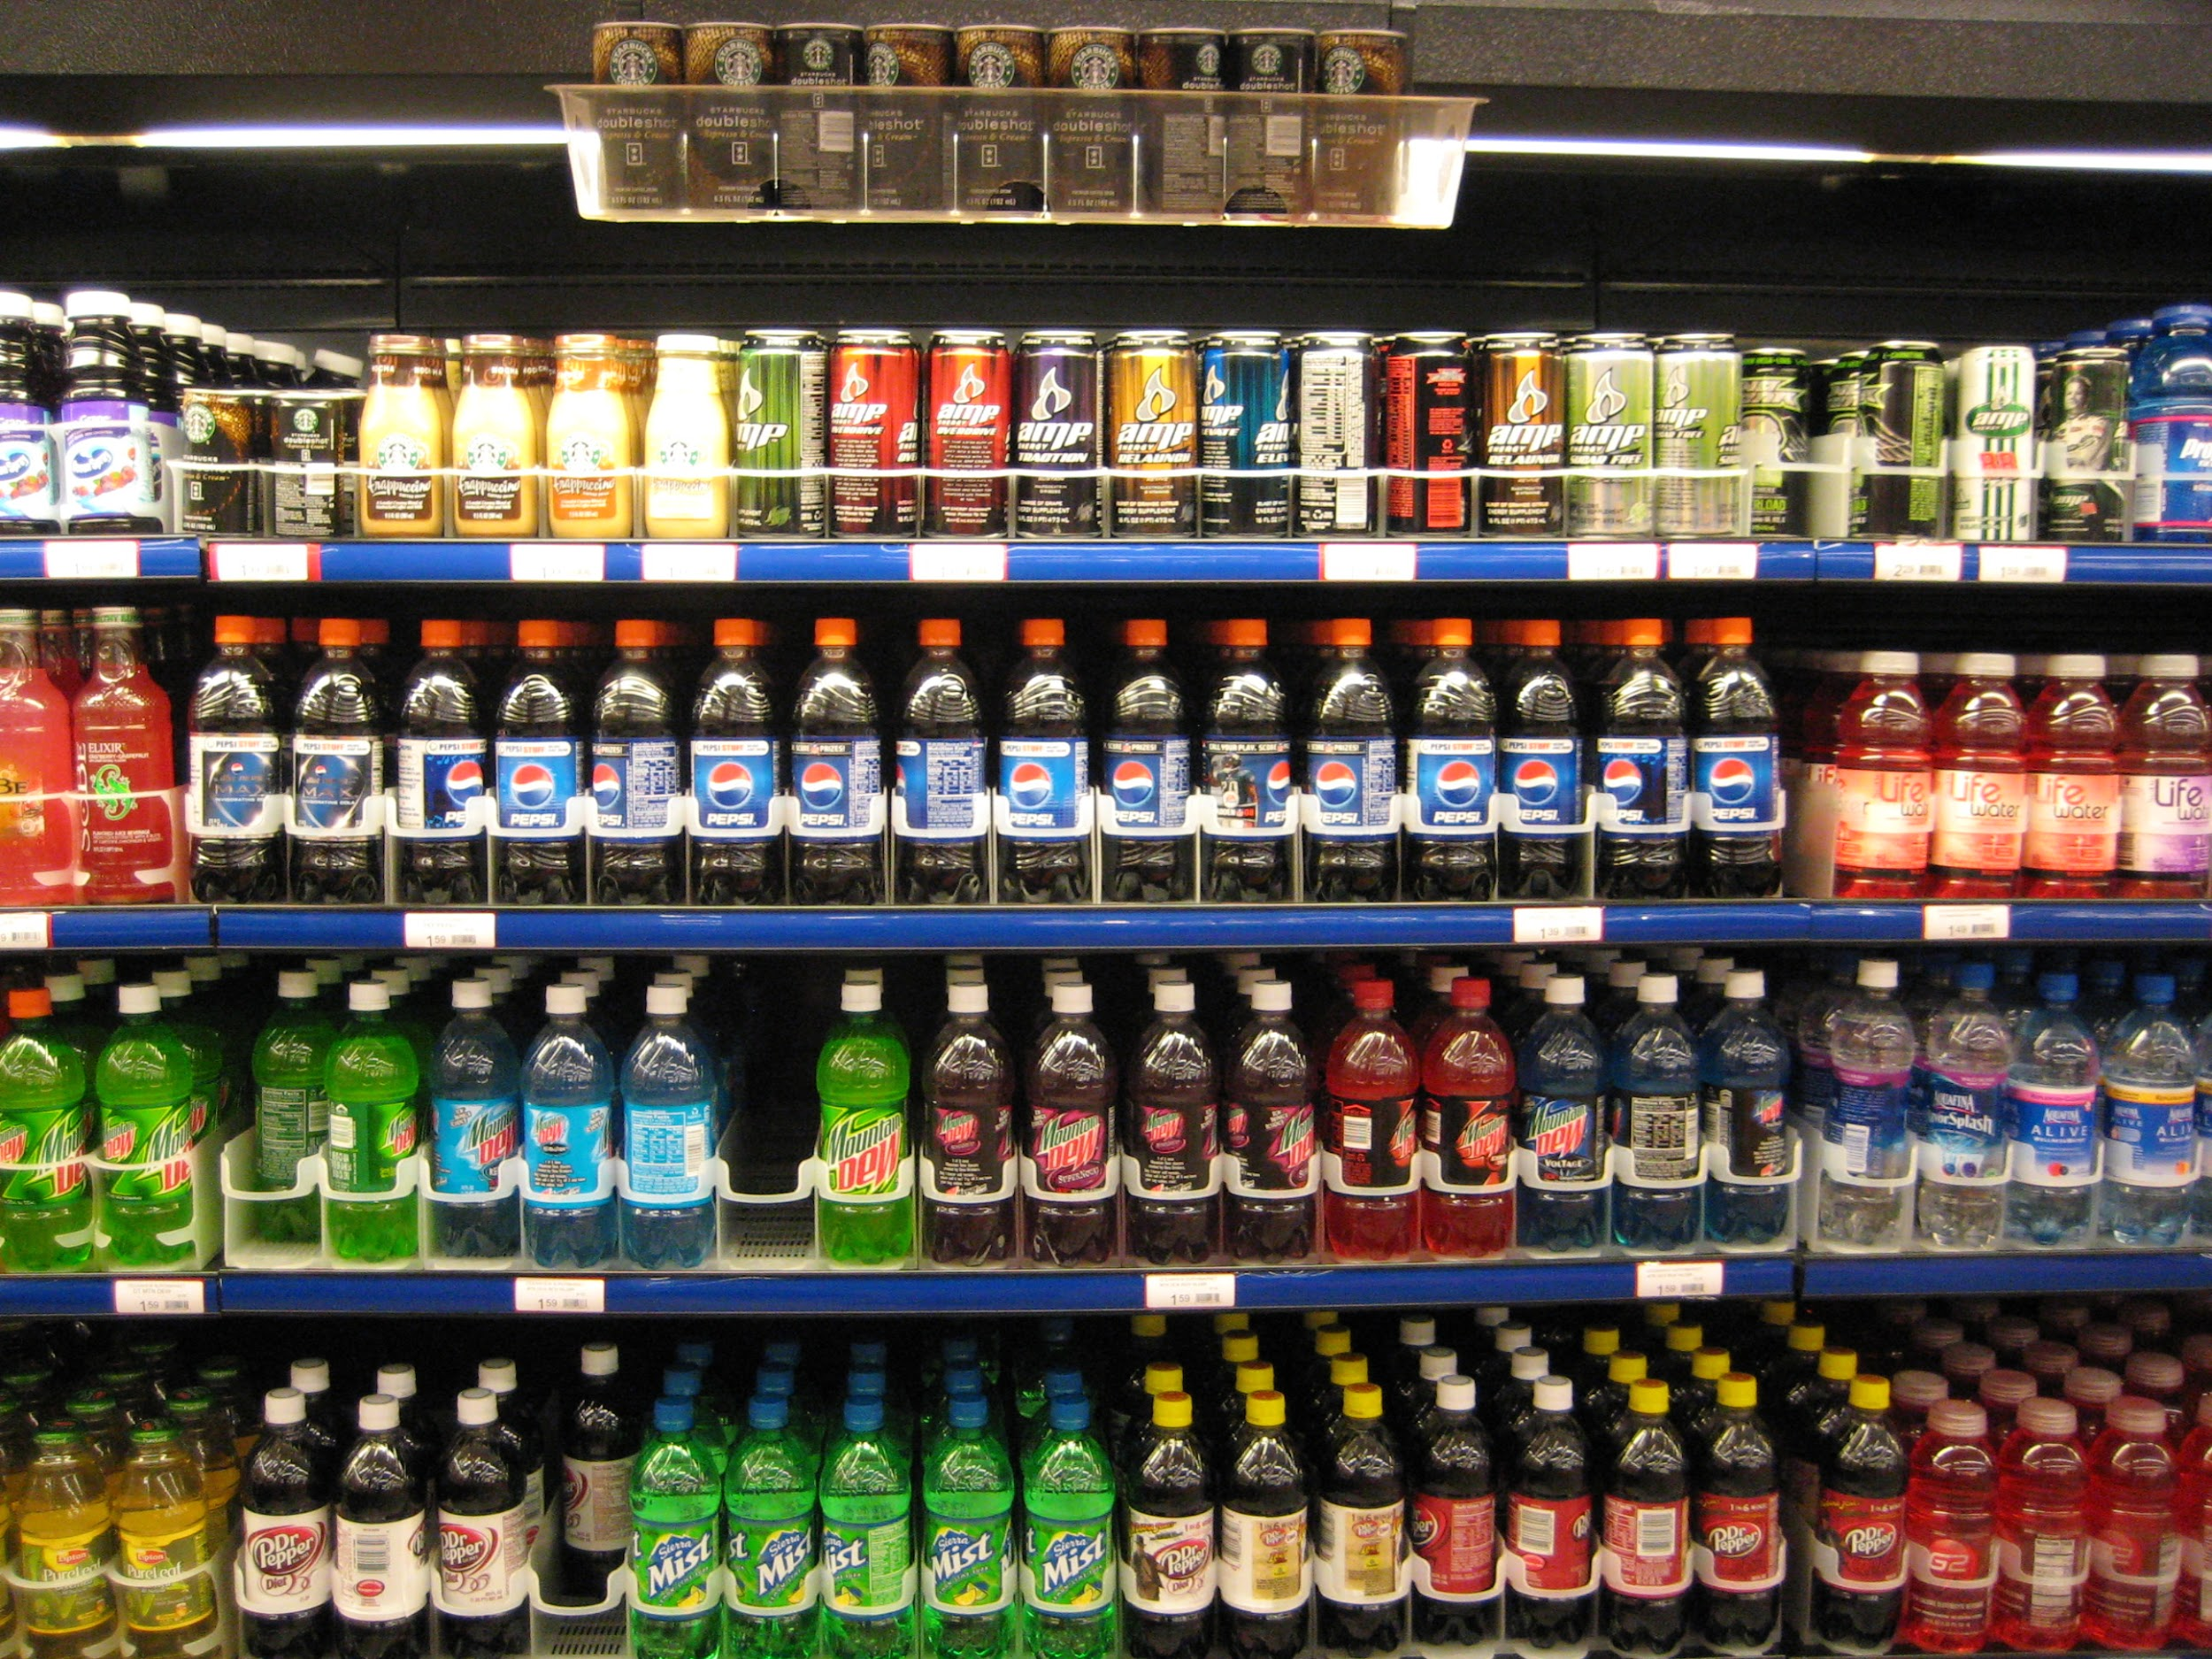
Beverage Guidelines
Smart Snacks (mn.gov)
Is it…
Age Appropriate
Middle School and Younger
Plain Water
Milk
100% Fruit or Vegetable Juice
No Added Sweeteners
High School
Serving size
20 Fluid oz. with 0 calories
12 Fluid oz. with 60 calories or less
Caffeine

Slide 12
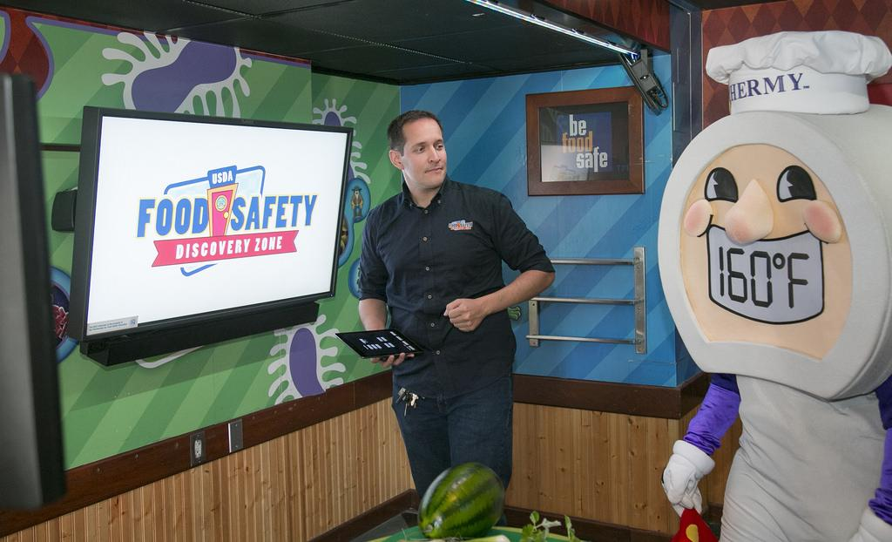
What About Inspection?
Food/Ingredient Storage
Proper Container
Placement
Dates
Food Handling
Gloves
Hairnets
Hand washing
Temperature Logs
Cooler & Freezer temperatures
Sanitation
Temperature of smoothies
Pre-packaged Snacks & Drinks
Compliance Log
Food Nutrition Audit

Slide 13
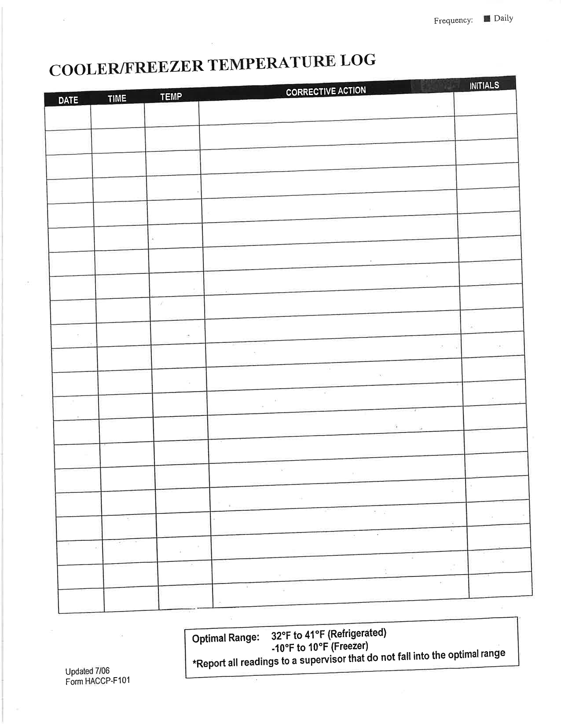
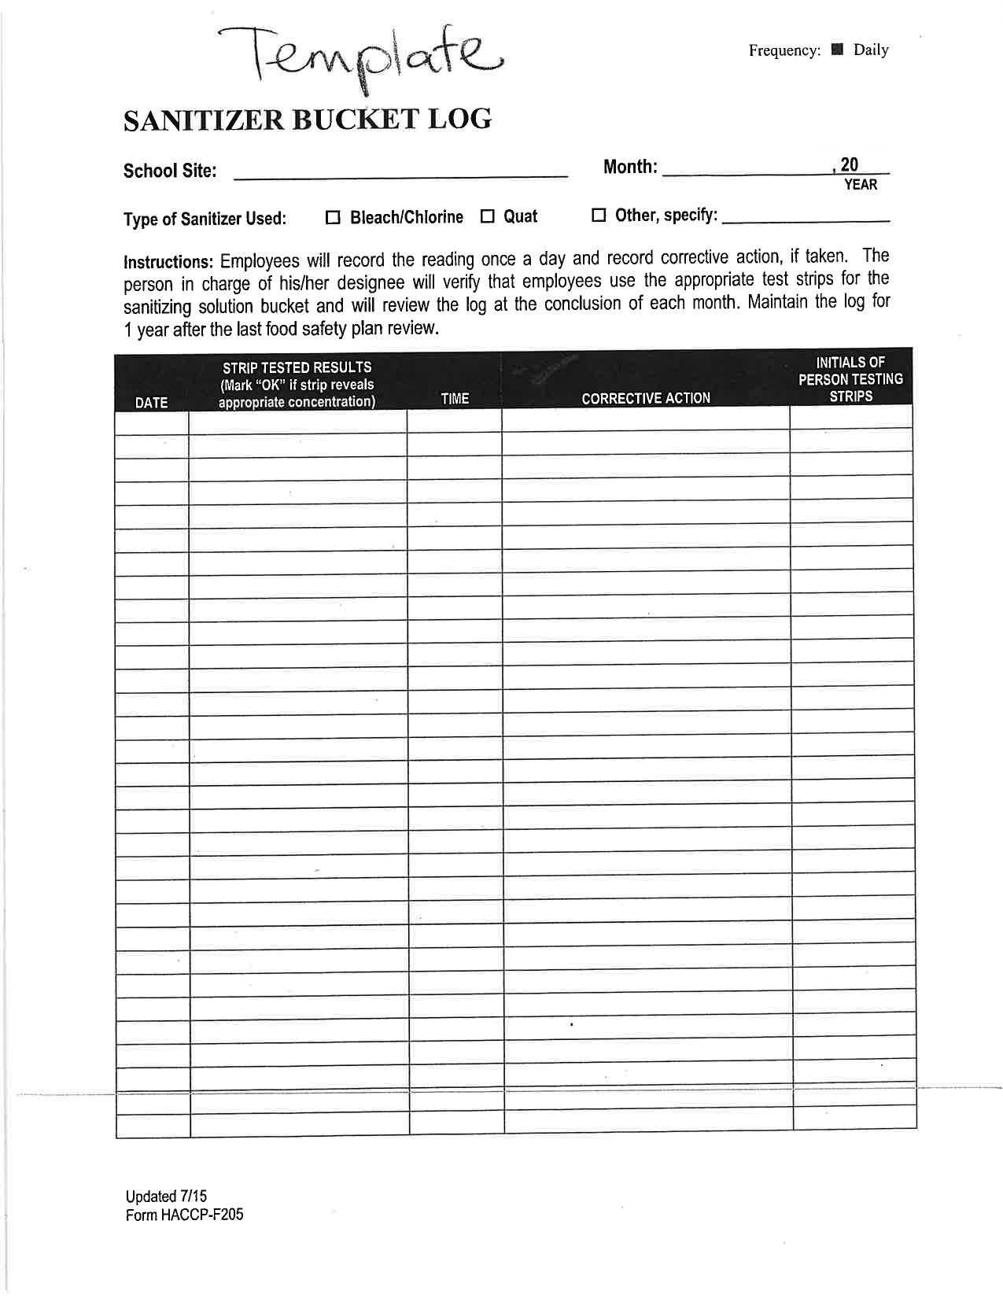
Log Templates

Slide 14
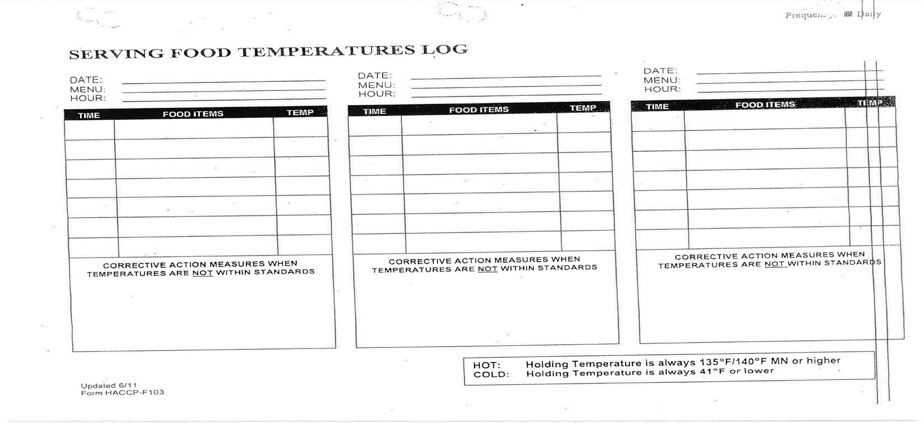
Serving Food Temperature logs

Slide 15
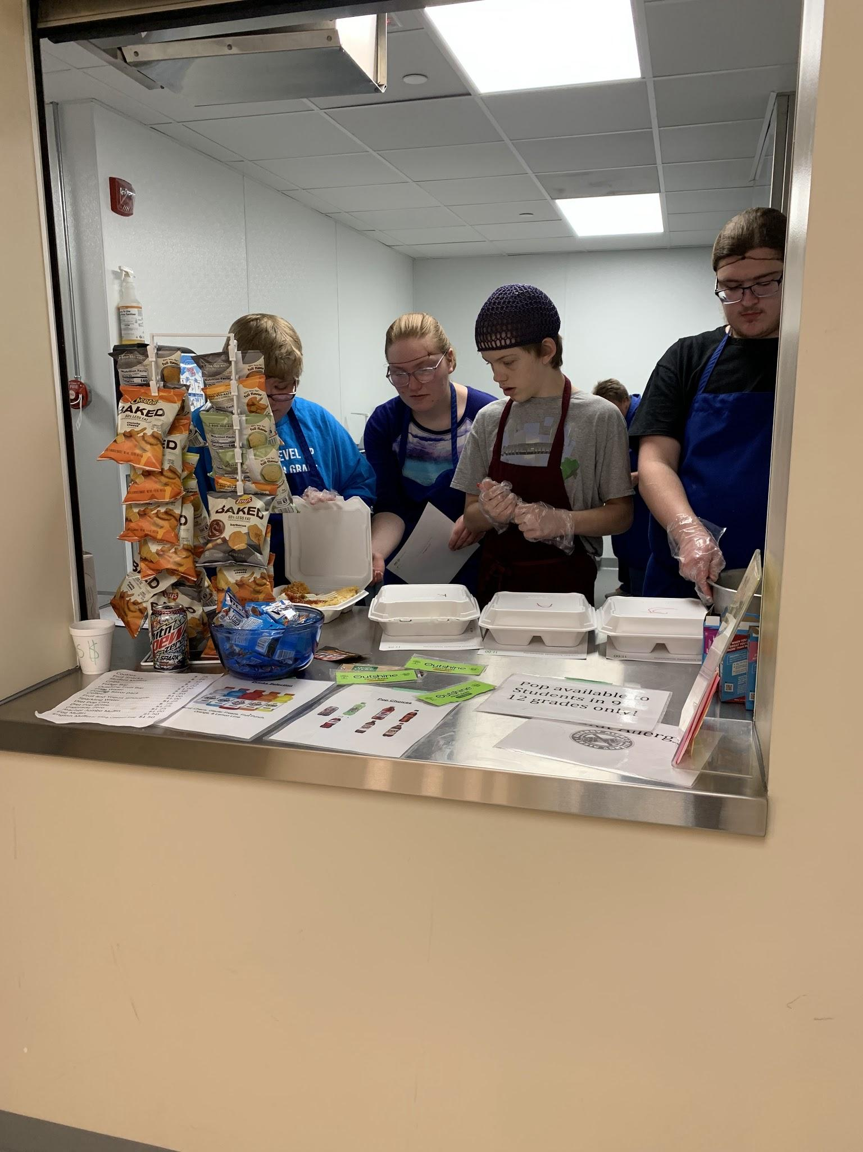
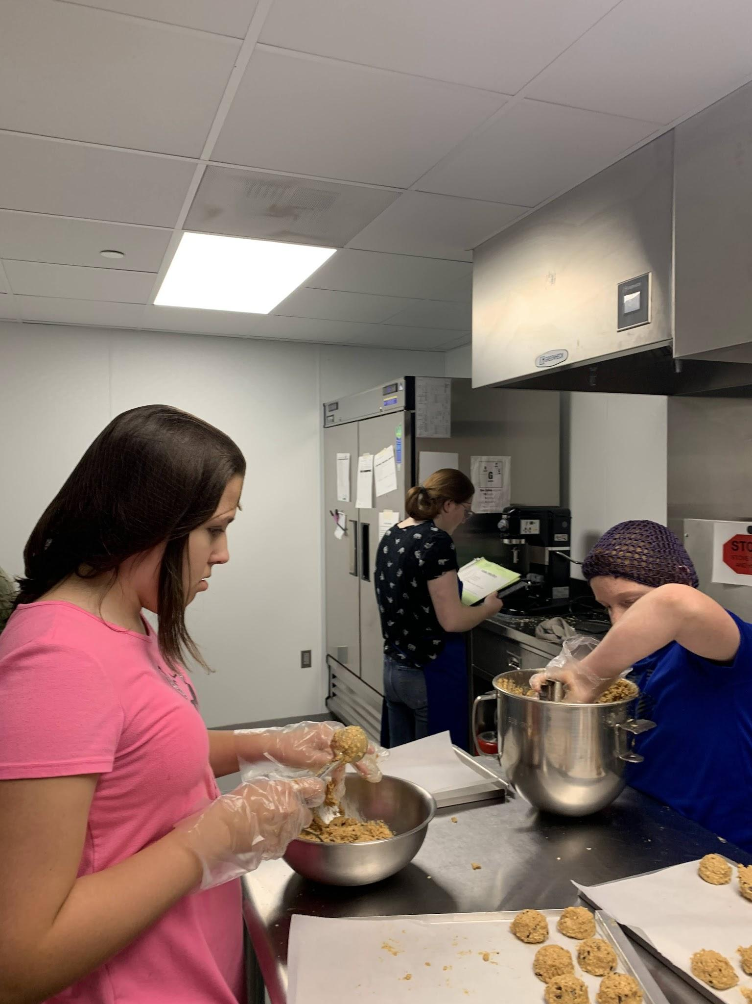
The Bulldog Cafe Now
Inside the Bulldog Cafe
Bulldog Entrance

Slide 16
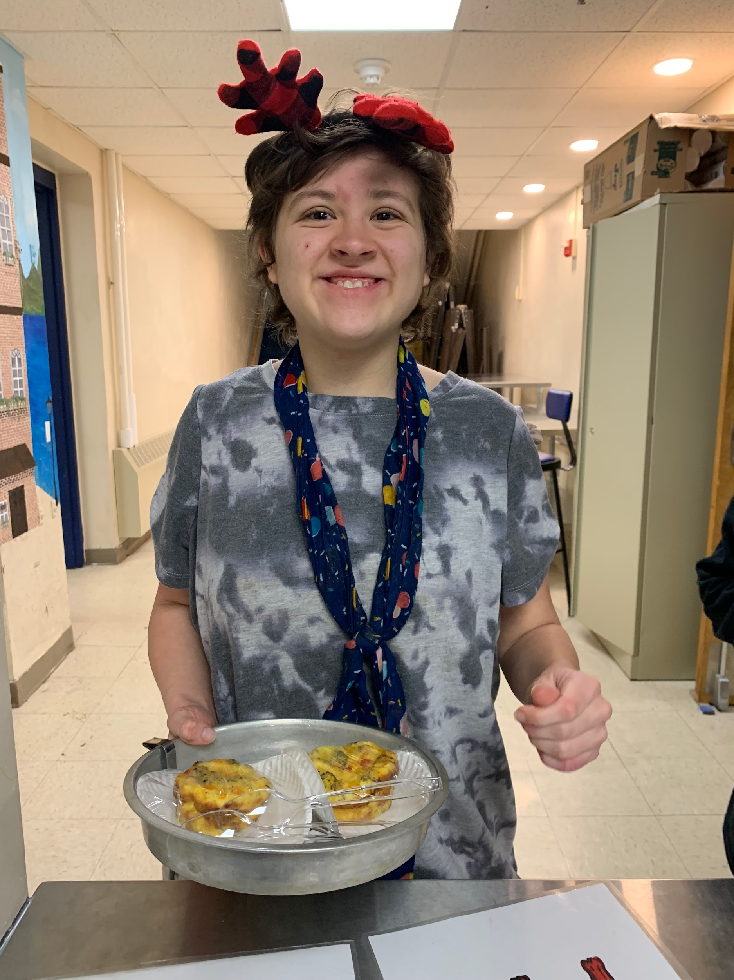
What We Are Doing Now
Student Engagement
Making Cookies
Making Smoothies
Making Student Muffins
Making Egg Muffins
Taking/Making Orders for Staff Daily at Bulldog Cafe (Google Order Form)
Delivering Food to Staff

Slide 17
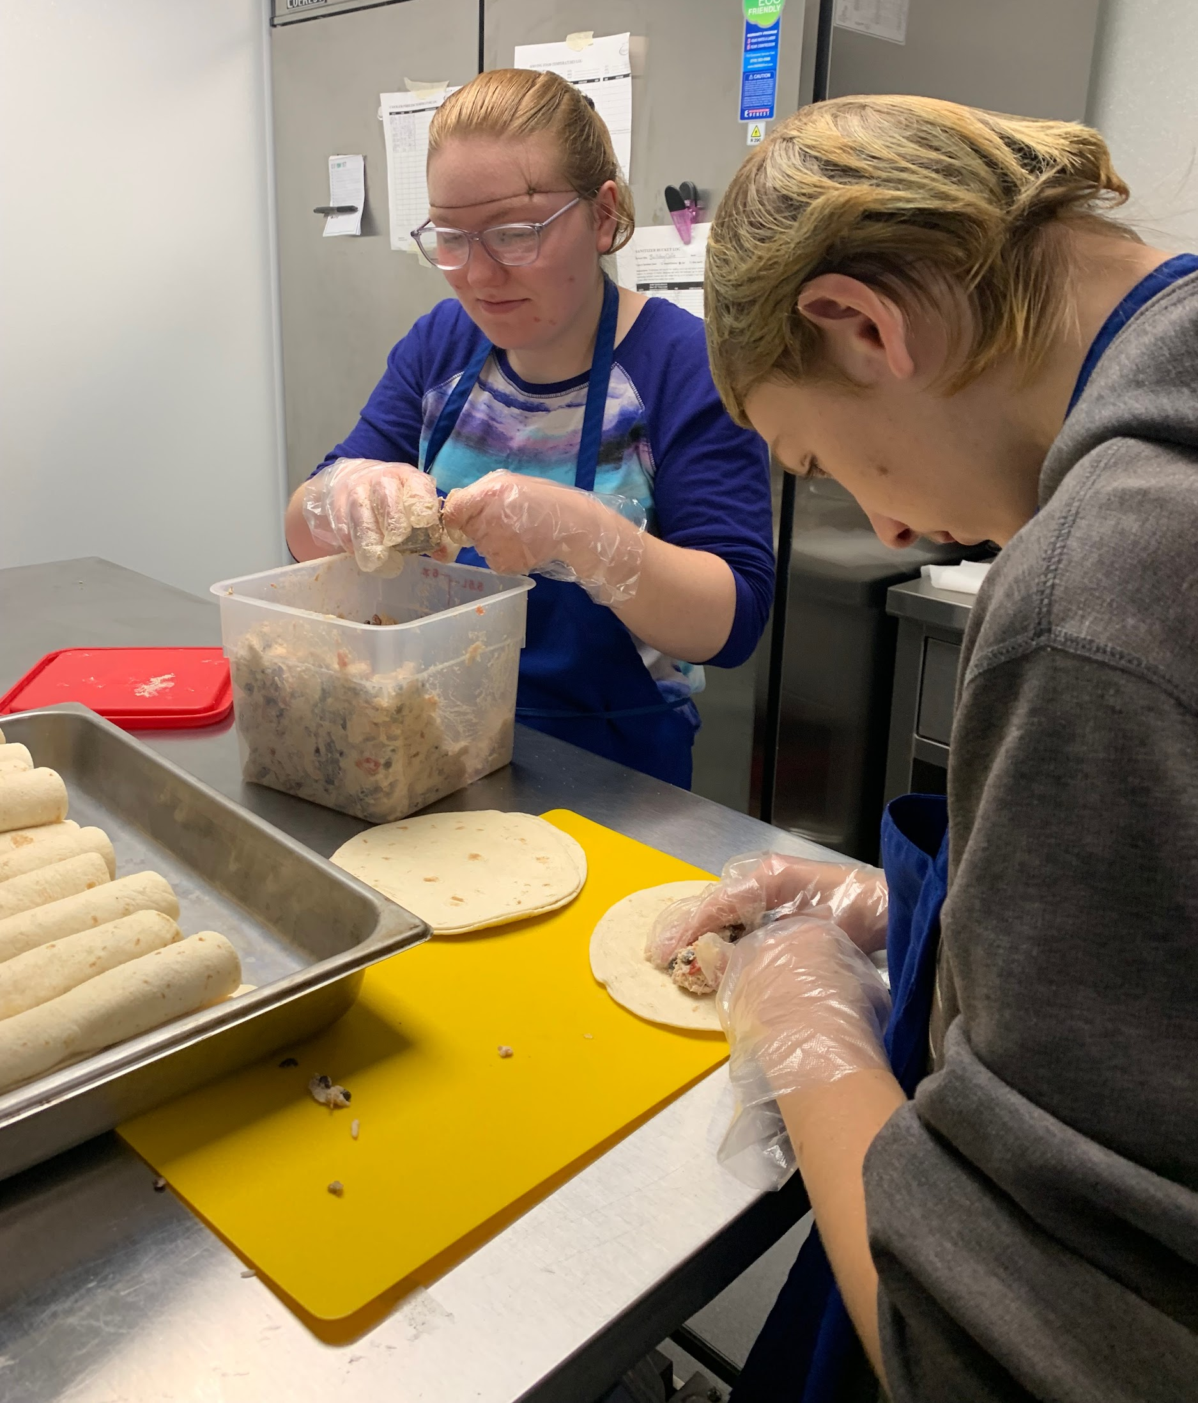
What We Are Doing Now, continued
Student Responsibilities
Hair nets, aprons, wash hands, gloves
Wrap Cookies, muffins, eggs
Check Temperature of Food
Check sanitizer level
Wash Dishes - follow steps
Stock Refrigerator
Clean up after making food
Help Prepare Food
Make Shopping List
Go Shopping
Comparison Shop
Set up Google Form for Staff Lunches

Slide 18
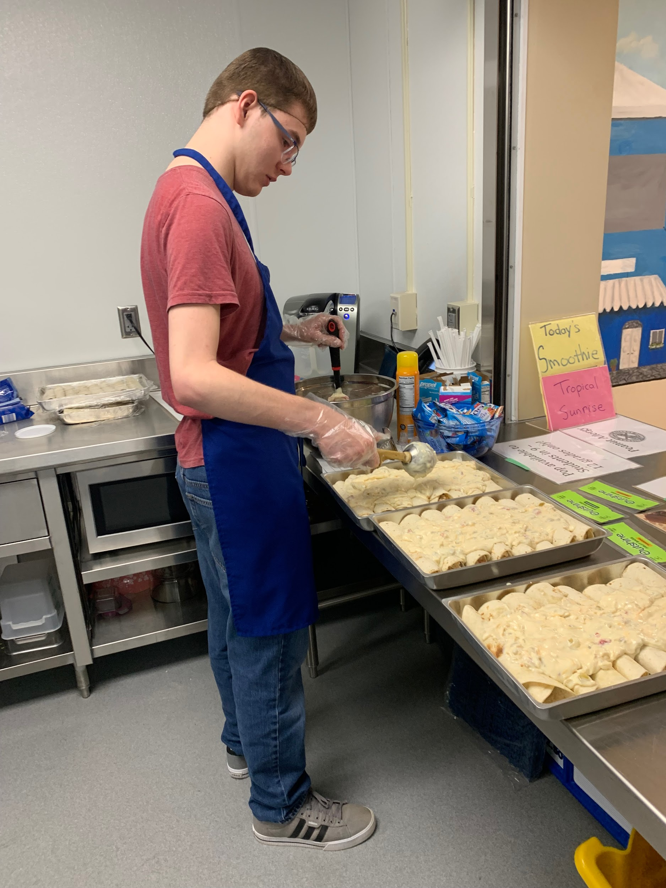
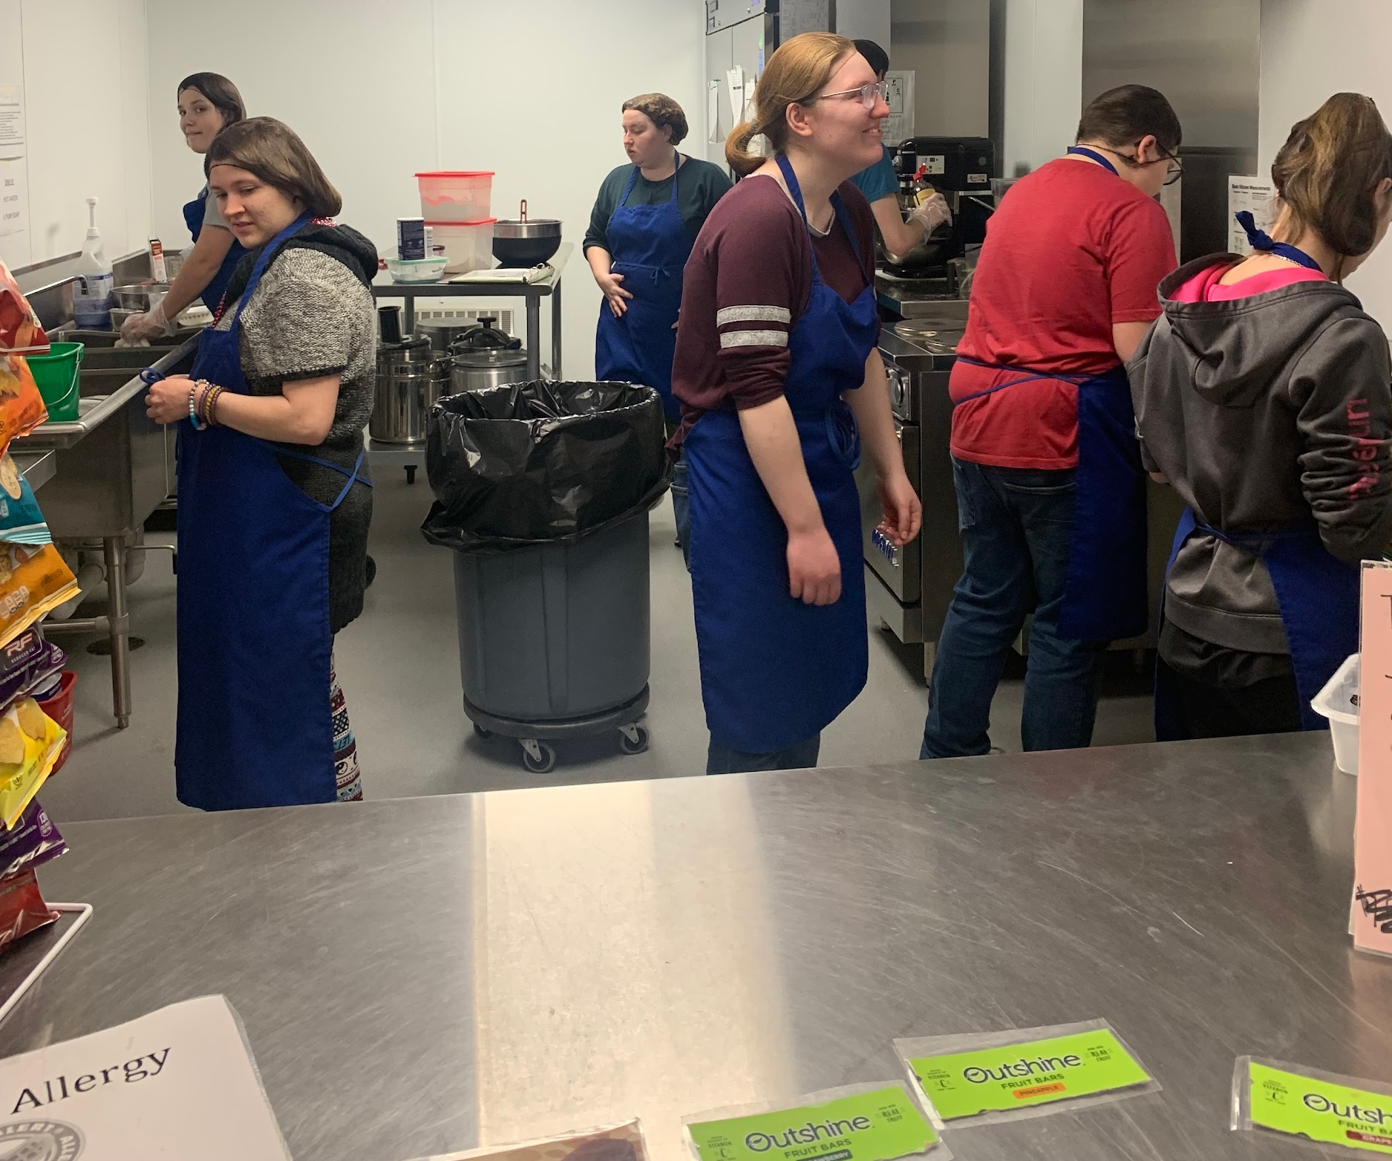
Benefits for the Students
Math Skills Practice
Sorting & Counting Money
Making Change
POS System
Calculating Unit Cost
Profit/Loss
Marketing
Pricing
Invoices
Deposit Slips
Tracking Inventory
Measuring (fractions)
Recipe Development

Slide 19
Benefits for the Students: Skills, Life Skills, Life Skills!!!Life
Social Skills
Positive Peer Interactions
Social Scripts
Increase social interaction
Independence Skills
Confidence and Self-Esteem
Advocating for themselves
Leadership
Purpose
Visibility
Real-World Application
Field Trips
Generalization of Skills
Grocery Shopping

Slide 20
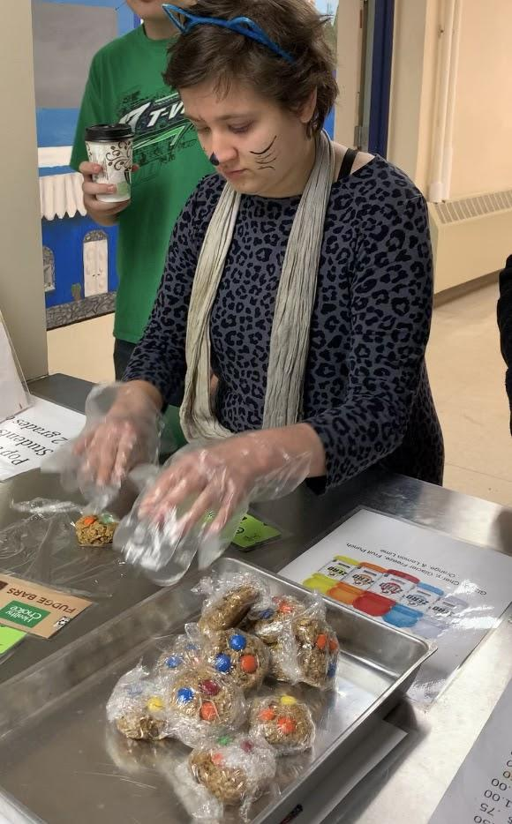
Benefits for the Students, continued.
Job Skills
Time Card Entry
Following Directions
Reading the Recipes
Food Safety Rules
Hygiene
Technology
Related Services Support
Speech/Language Pathologist
Occupational Therapist
IEP Goals

Slide 21
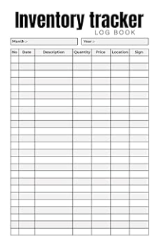
Resources
Time Card on Chromebook

Slide 22
So What If You Don’t Have a Commercial Kitchen?
Do you have a concession stand you could use?
Do you have a cart to use?
Could you use the FACS room, during the teacher’s prep time?
Could you have the FACS teacher team teach with you and your students and help them get started building their own store?
Get administration on board!!!
Any other ideas?

Slide 23
Thank you!

