Slide 1
Teach Special Education Minnesota
Provided by Paul Dols and Katie Roby
Introduction to New State Website to Support the Workforce and Low Incidence Disability Areas

Slide 2
Teach Special Education Minnesota website

Slide 3
Teach Special Education Minnesota (TeachSpEdMN.org)
TeachSpEdMN.org is a project in collaboration with our Regional Low Incidence Facilitators, BrightWorks, and Minnesota Institutes of Higher Education
TeachSpEdMN.org will serve as a resource for prospective and current special education teachers to explore, become, grow, and thrive in the teaching profession
The vision of this project is to recruit, support and retain excellent special educators and to help shift the public narrative about teaching special education

Slide 4
Explore
What is special education?
Why teach special education in Minnesota?
What are low incidence disabilities?
Current links to Minnesota Department of Education (MDE) disability category webpages, IDEA, PELSB Supply and Demand Report
Future links to MDE Disability Category Quick Cards

Slide 5
Become
Information about becoming a special education teacher in Minnesota
Licensure information including links to PELSB resources
Link to Minnesota School Jobs
Links to our Special Education Preparation Programs in Minnesota
We are working to include video introduction connecting candidates to colleges and universities with a personal connection

Slide 6
New Year! New U!
Information about our bi-annual statewide virtual event to attract and recruit special education teachers in Minnesota

Slide 7
Information and Links for Special Education Preparation Programs in Minnesota

Slide 8
Grow
Mentoring programs (Minnesota Mentor Program, New Teacher Center, National Center on Intensive Intervention)
Professional development opportunities including Charting the C’s, MN CEC, HLPs, IRIS Center, etc.
Connections to regional supports

Slide 9
Thrive
The purpose of the "Thrive" page of this site is to provide resources to enhance the leadership capacity of special education teachers in Minnesota by fostering professional growth and providing opportunities for teachers to thrive and advance in their careers. We are particularly interested in your feedback and suggestions for this portion of the site. We currently share:
Leadership opportunities
Professional memberships

Slide 10
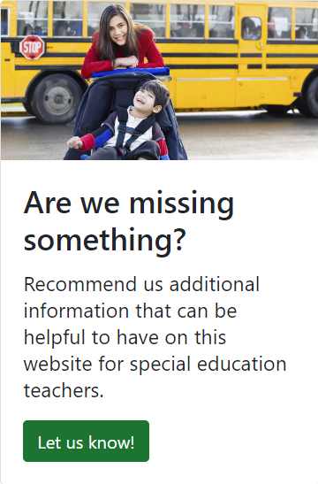
Are We missing something?

Slide 11
Feedback
How did you find the content presented? Any areas you found particularly helpful or areas needing improvement?
What are your thoughts on the usability and accessibility of our website?
Do you have any suggestions for additional resources or features that could enhance our website's support for special education teachers in Minnesota?
Are there any specific topics or tools you would like to see added or expanded upon on our website?
Thank you for taking the time to provide your feedback!

Slide 12
Thank you for your dedication to students with disabilities in Minnesota!
Contact Information:
Paul Dols, paul.dols@state.mn.us
Katie Roby, catherine.roby@state.mn.us

Slide 13
Glossary
Teachspedmn.org = Teach Special Education Minnesota
MDE = Minnesota Department of Education
IDEA = Individuals with Disabilities Education Act
PELSB = Professional Educator Licensing and Standards Board
MN CEC = Minnesota Council for Exceptional Children
HLP = High Leverage Practices

