Slide 1
Understanding and Supporting Behavior in Special Education
Kelley Foehrkolb, BCBA
Behavior Specialist, Northfield Schools
Charting the Cs - 2024

Slide 2
Kelley Foehrkolb, BCBA
Work:
BCBA 8 years, Northfield Schools
District Autism Coach, Davenport, Iowa
15+ Years Elem & Secondary Special Education Teacher
Variety of programs & settings: ASD, NB, DCD, Resource - Setting 1 - 4
Iowa and Colorado

Slide 3
Kelley Foehrkolb, BCBA, cont.
Education:
Bachelor's degree in Special Education & Elementary Ed University of Northern IA
Masters in Special Education
Morningside University
BCBA
Florida Institute of Technology

Slide 4
Understanding and Supporting Behavior in Special Education
Agenda
Foundational Principles of Behavior
Setting up the space for success
Data collection

Slide 5
Foundational Principles of Behavior
ABA and Science of Behavior
ABC of Behavior & Behavior Trap
Reinforcement

Slide 6
ABA and Science of Behavior

Slide 7
Applied Behavior Analysis
Applied Behavior Analysis (ABA) is the study of behavior.
Applied Behavior Analysis is a scientific approach for discovering environmental variables that reliably influence socially significant behavior and for developing a technology of behavior change that takes practical advantage of those discoveries (Cooper, Heron & Heward, 2008).
ABA changes the environment in order to
change the behavior.

Slide 8
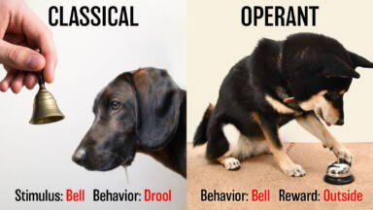
Applied Behavior Analysis, cont.
Operant Conditioning (antecedent, behavior, consequence) vs. Classical Conditioning (Pavlov and the salivating dogs)
Newer science -- Developed in the last 70 years… still being developed & researched
Notes:
2023- video link works

Slide 9
Facts about ABA
Highly researched based best practices
Works to decrease dependence on others
Focuses on reinforcement, not punishment
Manipulate the environment, not the person
Not just for autism or special needs

Slide 10
Facts about ABA, cont.
The “umbrella” or basis for many teaching and intervention strategies
Used across all curriculum areas
Use it in everyday life
STAR, LINKS, Reading and Math Curriculums, etc.
AIM curriculum, Safety Care, CPI
Prevent, Teach, Reinforce, Self & Match

Slide 11
Principles of Learning Theory
Contingent use of reinforcement to increase behaviors we want to see increase.
Demonstration of the desired behaviors is “rewarded” with positive reinforcement, maintaining high motivation for improvement.
Generalization of learned behaviors and skills.

Slide 12
What is Behavior?
Behavior is…
Learned
Communication
Has a purpose
A skill that has not been learned yet
Is related to the immediate environment

Slide 13
Understanding Behavior
BEHVAIOR is EVERYTHING we do…
Challenging behaviors are those that are dangerous or that interfere with learning and functioning
Desirable behaviors are those we would like to teach and encourage.

Slide 14
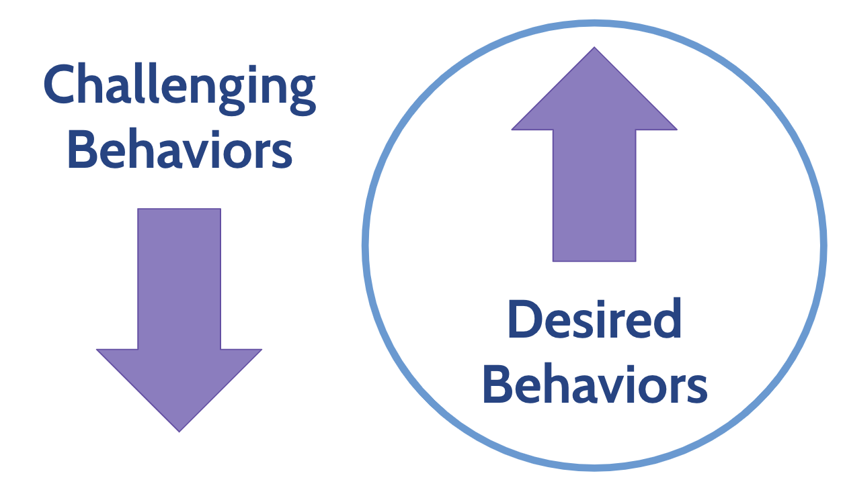
Changing Behaviors

Slide 15
ABC of Behavior and Behavior Trap

Slide 16
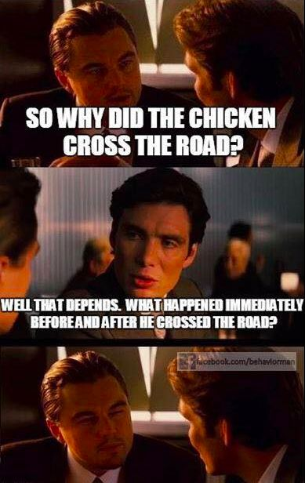
The A-B-Cs of Behavior
A = Antecedent
B = Behavior
C = Consequence
Antecedent → Behavior → Consequence

Slide 17
The A-B-Cs of Behavior, cont.
A = Antecedent – What happens just BEFORE the behavior we are focused on
Focusing on the ANTECEDENT helps prevent the behavior from NEEDING to occur
Focus on triggers in the environment
Antecedent → Behavior → Consequence

Slide 18
The A-B-Cs of Behavior, more…
B = Behavior – What the person DOES.
Important to know and understand
Only the person can change their behavior
Antecedent → Behavior → Consequence

Slide 19
The A-B-Cs of Behavior, cont.2
C = Consequence – What happens right AFTER the behavior.
We determine the likelihood of what behavior will occur in the future
What do you want to see MORE of?
Reinforcement!
Antecedent → Behavior → Consequence

Slide 20
Setting Events
Events that happen before the antecedent or trigger for the challenging behavior. It effects the likelihood that a challenge behavior may or may not occur
Influence how we respond to student behavior
Helps to understand WHY a behavior might be occurring
“Plan A” or “Plan B” response

Slide 21
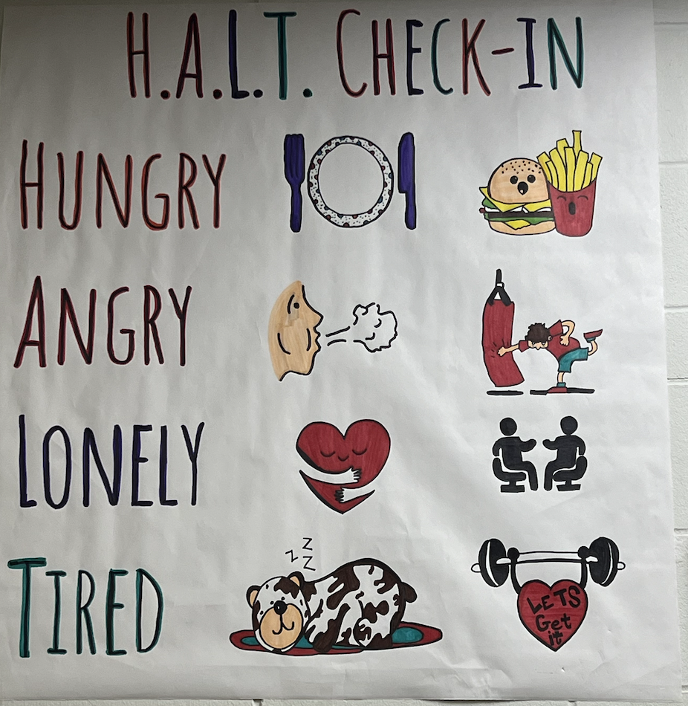
Setting Events, cont.
Examples:
TRAMA
Hungry
Tired
Medication
Coffee…or no coffee
Sick
Argument before school / work

Slide 22
The A-B-Cs of Behavior, cont. 3
Example ABC Desired Behavior:
Staff ask Tabitha to complete their work, Tabitha then completes the work. When she does, staff give her verbal specific praise.
Antecedent → Behavior → Consequence

Slide 23
The A-B-Cs of Behavior, cont. 4
Staff ask Tabitha to complete their work, Tabitha then completes the work. When she does, staff give her verbal specific praise.
Antecedent→ Behavior → Consequence
Asked to work → Completes Work. → Praise!

Slide 24
The A-B-Cs of Behavior, cont. 5
Example ABC Challenging Behavior:
When Matthew has nothing to do, he will start to yell. When he starts to yell, staff will talk to him until he is quiet.
Antecedent → Behavior → Consequence

Slide 25
The A-B-Cs of Behavior, cont. 6
Example ABC Challenging Behavior:
When Matthew has nothing to do, he will start to yell. When he starts to yell, staff will talk to him until he is quiet.
Antecedent → Behavior → Consequence
Bored → Yells → Staff talk to him

Slide 26

Behavior Trap
When want behavior to stop quickly. We have to be careful… when you can get a challenging behavior to stop quickly, you are often reinforcing something else.
When can get caught in a BEHAVIOR TRAP cycle.

Slide 27
Behavior Trap, cont.
When Matthew has nothing to do, he will start to yell. When he starts to yell, staff will talk to him until he is quiet.
Antecedent → Behavior → Consequence
Matthew:
Staff:

Slide 28
Behavior Trap, cont. 2
When Matthew has nothing to do, he will start to yell. When he starts to yell, staff will talk to him until he is quiet.
Antecedent → Behavior → Consequence
Matthew: Bored → Yells → Staff talk to him
Staff:

Slide 29
Behavior Trap, cont. 3
When Matthew has nothing to do, he will start
to yell. When he starts to yell, staff will talk to
him until he is quiet.
Antecedent → Behavior → Consequence
Matthew: Bored → Yells → Staff talk to him
Staff: Student yells → Talk to him → Yelling stops

Slide 30
Behavior Trap, cont. 4
When Matthew has nothing to do, he will start
to yell. When he starts to yell, staff will talk to
him until he is quiet.
Antecedent → Behavior → Consequence
Matthew: Bored → Yells → Staff talk to him
Staff: Student yells → Talk to him → Yelling stops

Slide 31
Behavior Trap, cont. 5
Talking to Matthew gets him to stop yelling. It will also lead to more yelling in the future.
How do we keep from letting the yelling get worse?
What do we need to focus on instead of just stopping the yelling?
Antecedent → Behavior → Consequence

Slide 32
The Behavior Trap
If you find that you are able to QUICKLY stop a challenging behavior - you are probably REINFORCING A DIFFERENT FUNCTION!
True and lasting behavior change takes TIME!
Research shows that for every YEAR a challenging behavior is in place, it takes ONE MONTH of an intervention run with consistency and fidelity to truly change the behavior.

Slide 33
Reinforcement

Slide 34
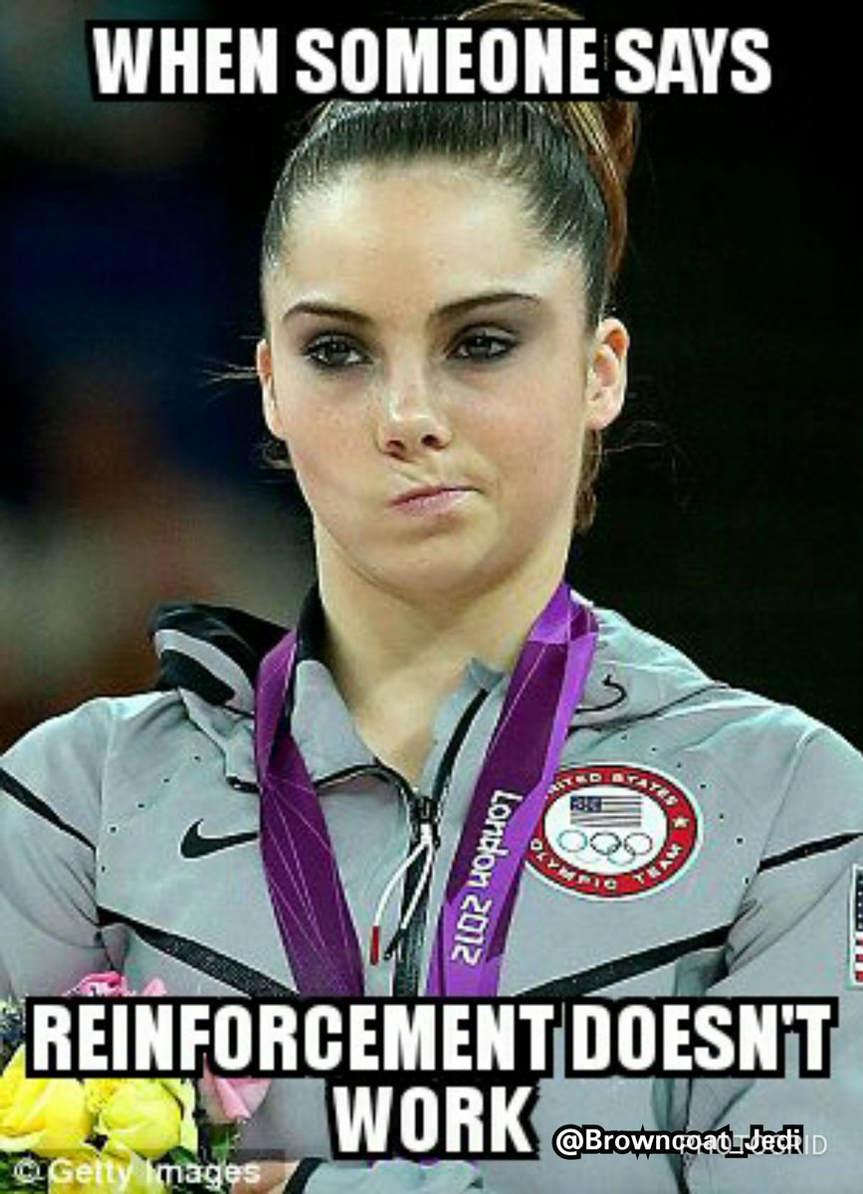
We have said or heard it all...
“I’ve tried everything, and nothing works.”
“Reinforcement doesn’t work for this kid.”
“They should just follow expected behavior.”
“We have a great relationship already.”
“I should not have to give something special to this kid but not other kids…”
“There is no time!”

Slide 35
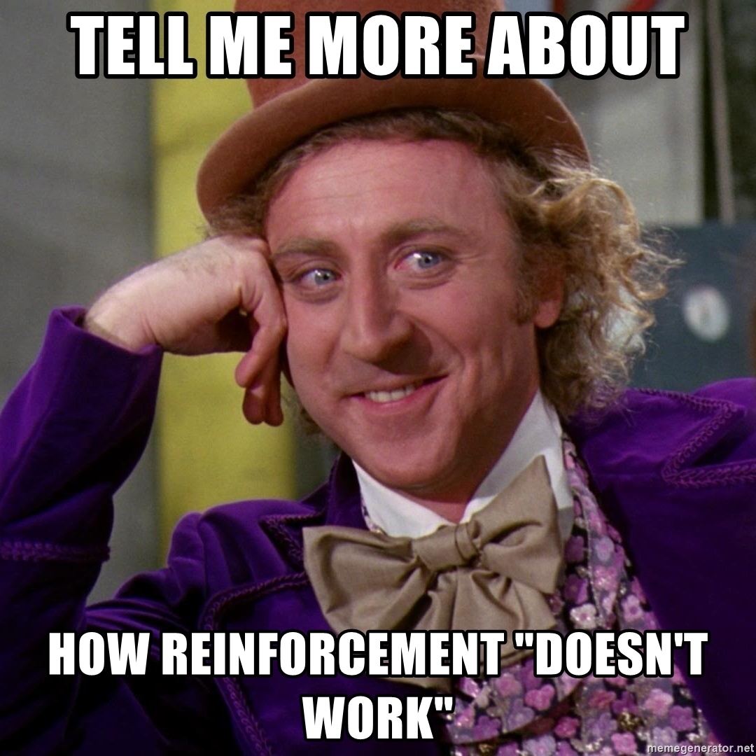
The Solution…
For MANY of the students / situations - focusing change on the reinforcement would change the situation with little other intervention!

Slide 36
Consequences
Antecedent → Behavior → Consequence
They happen after the behavior
They don’t change what already happened – they change the future likelihood of what will happen
May have no effect on whether a behavior is likely to reoccur
  That is the antecedent…

Slide 37
Reinforcement and Punishment
Reinforcement will increase the future likelihood of the behavior
Punishment will reduce the future likelihood of the behavior
REPLACEMENT BEHAVIORS!!

Slide 38
Reinforcement, cont. 6
Definition:
Adding something (positive) or taking something away (negative) that will increase the likelihood of the desired behavior occurring again!
A consequence that strengthens the behavior it follows.

Slide 39
Reinforcement
The big question….
Is it REALLY reinforcing???
How can we tell?
The BEHAVIOR CHANGES!

Slide 40
Making Reinforcement Effective
Immediate
Distinct
Descriptive
Preferred
Varied

Slide 41
Making Reinforcement Effective:
IMMEDIATE
Reinforcement should happen right have the desired behavior you want to increase.
Can use a conditioned reinforcement to delay delivery of the main reinforcement

Slide 42
Making Reinforcement Effective:
DISTINCT
Do they know what is their reinforcement?
Do they have access to it for “free other times?
Why work for something you can get for free?

Slide 43
Making Reinforcement Effective:
DESCRIPTIVE
Tell the person what behavior you are reinforcing!
Specific Praise

Slide 44
Making Reinforcement Effective:
PREFERRED
Is what they are working for liked or preferred?
Is it worth changing their behavior for?
How do you know what they prefer?

Slide 45
Making Reinforcement Effective:
VARIED
Most people don’t like the same thing over and over.
Have multiple options and provide them the opportunity to choose – even if they pick the same thing each time.

Slide 46
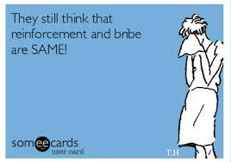
Bribery vs Reinforcement
Reinforcement needs to be set up ahead of time, before any behaviors occur, while bribery occurs in the middle of challenging behaviors.
Please learn, understand, and teach the difference between bribery and reinforcement.

Slide 47
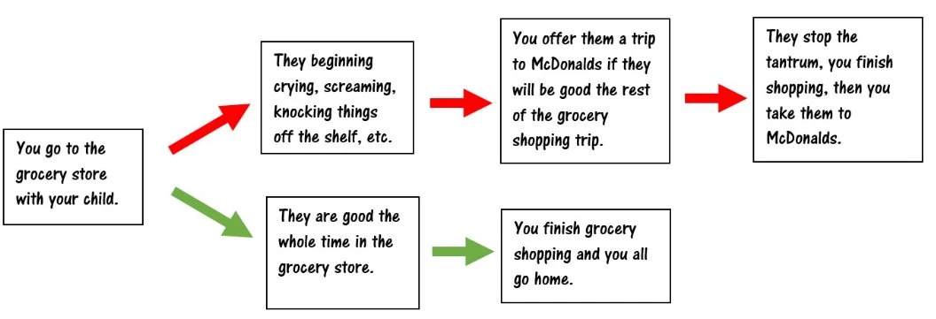
Bribery

Slide 48

Bribery, cont.
Does it work? Yes – for the short term!
What about the long-term pattern you are setting yourself and the student up for?
Bribery gets you stuck in a Behavior Trap!

Slide 49
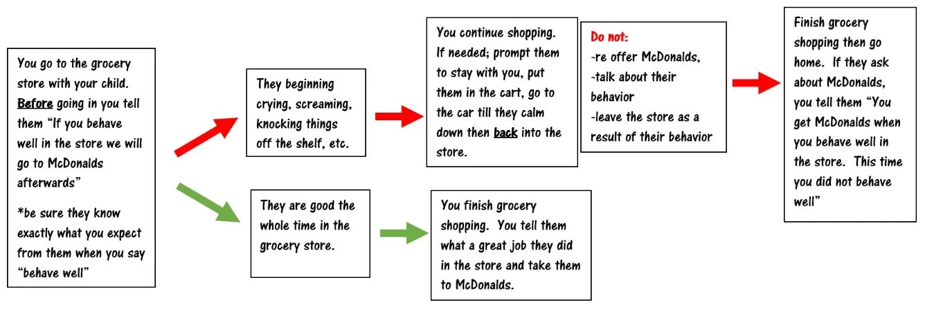
Reinforcement, cont.
Did the reinforcement work? Yes, by definition reinforcement increases the behavior it follows. Reinforcement following good behavior in the store will increase good behavior in the store. Did it immediately stop the tantrum?
No, and it’s not designed to be an immediate stop to challenging behavior.

Slide 50
Reinforcement, cont. 2
Does it work? Yes – it increased the behavior it followed!
Reinforcement following good behavior in the store will increase future good behavior in the store.
What kind of pattern of behavior are you setting up for the future?

Slide 51
Reinforcement, cont. 3
Did the challenging behavior stop immediately?
No – and it is not designed to do that.
It is designed to change the behavior for the long term and replace it with a skill that will help them get what they want/need in the future in a positive way!

Slide 52
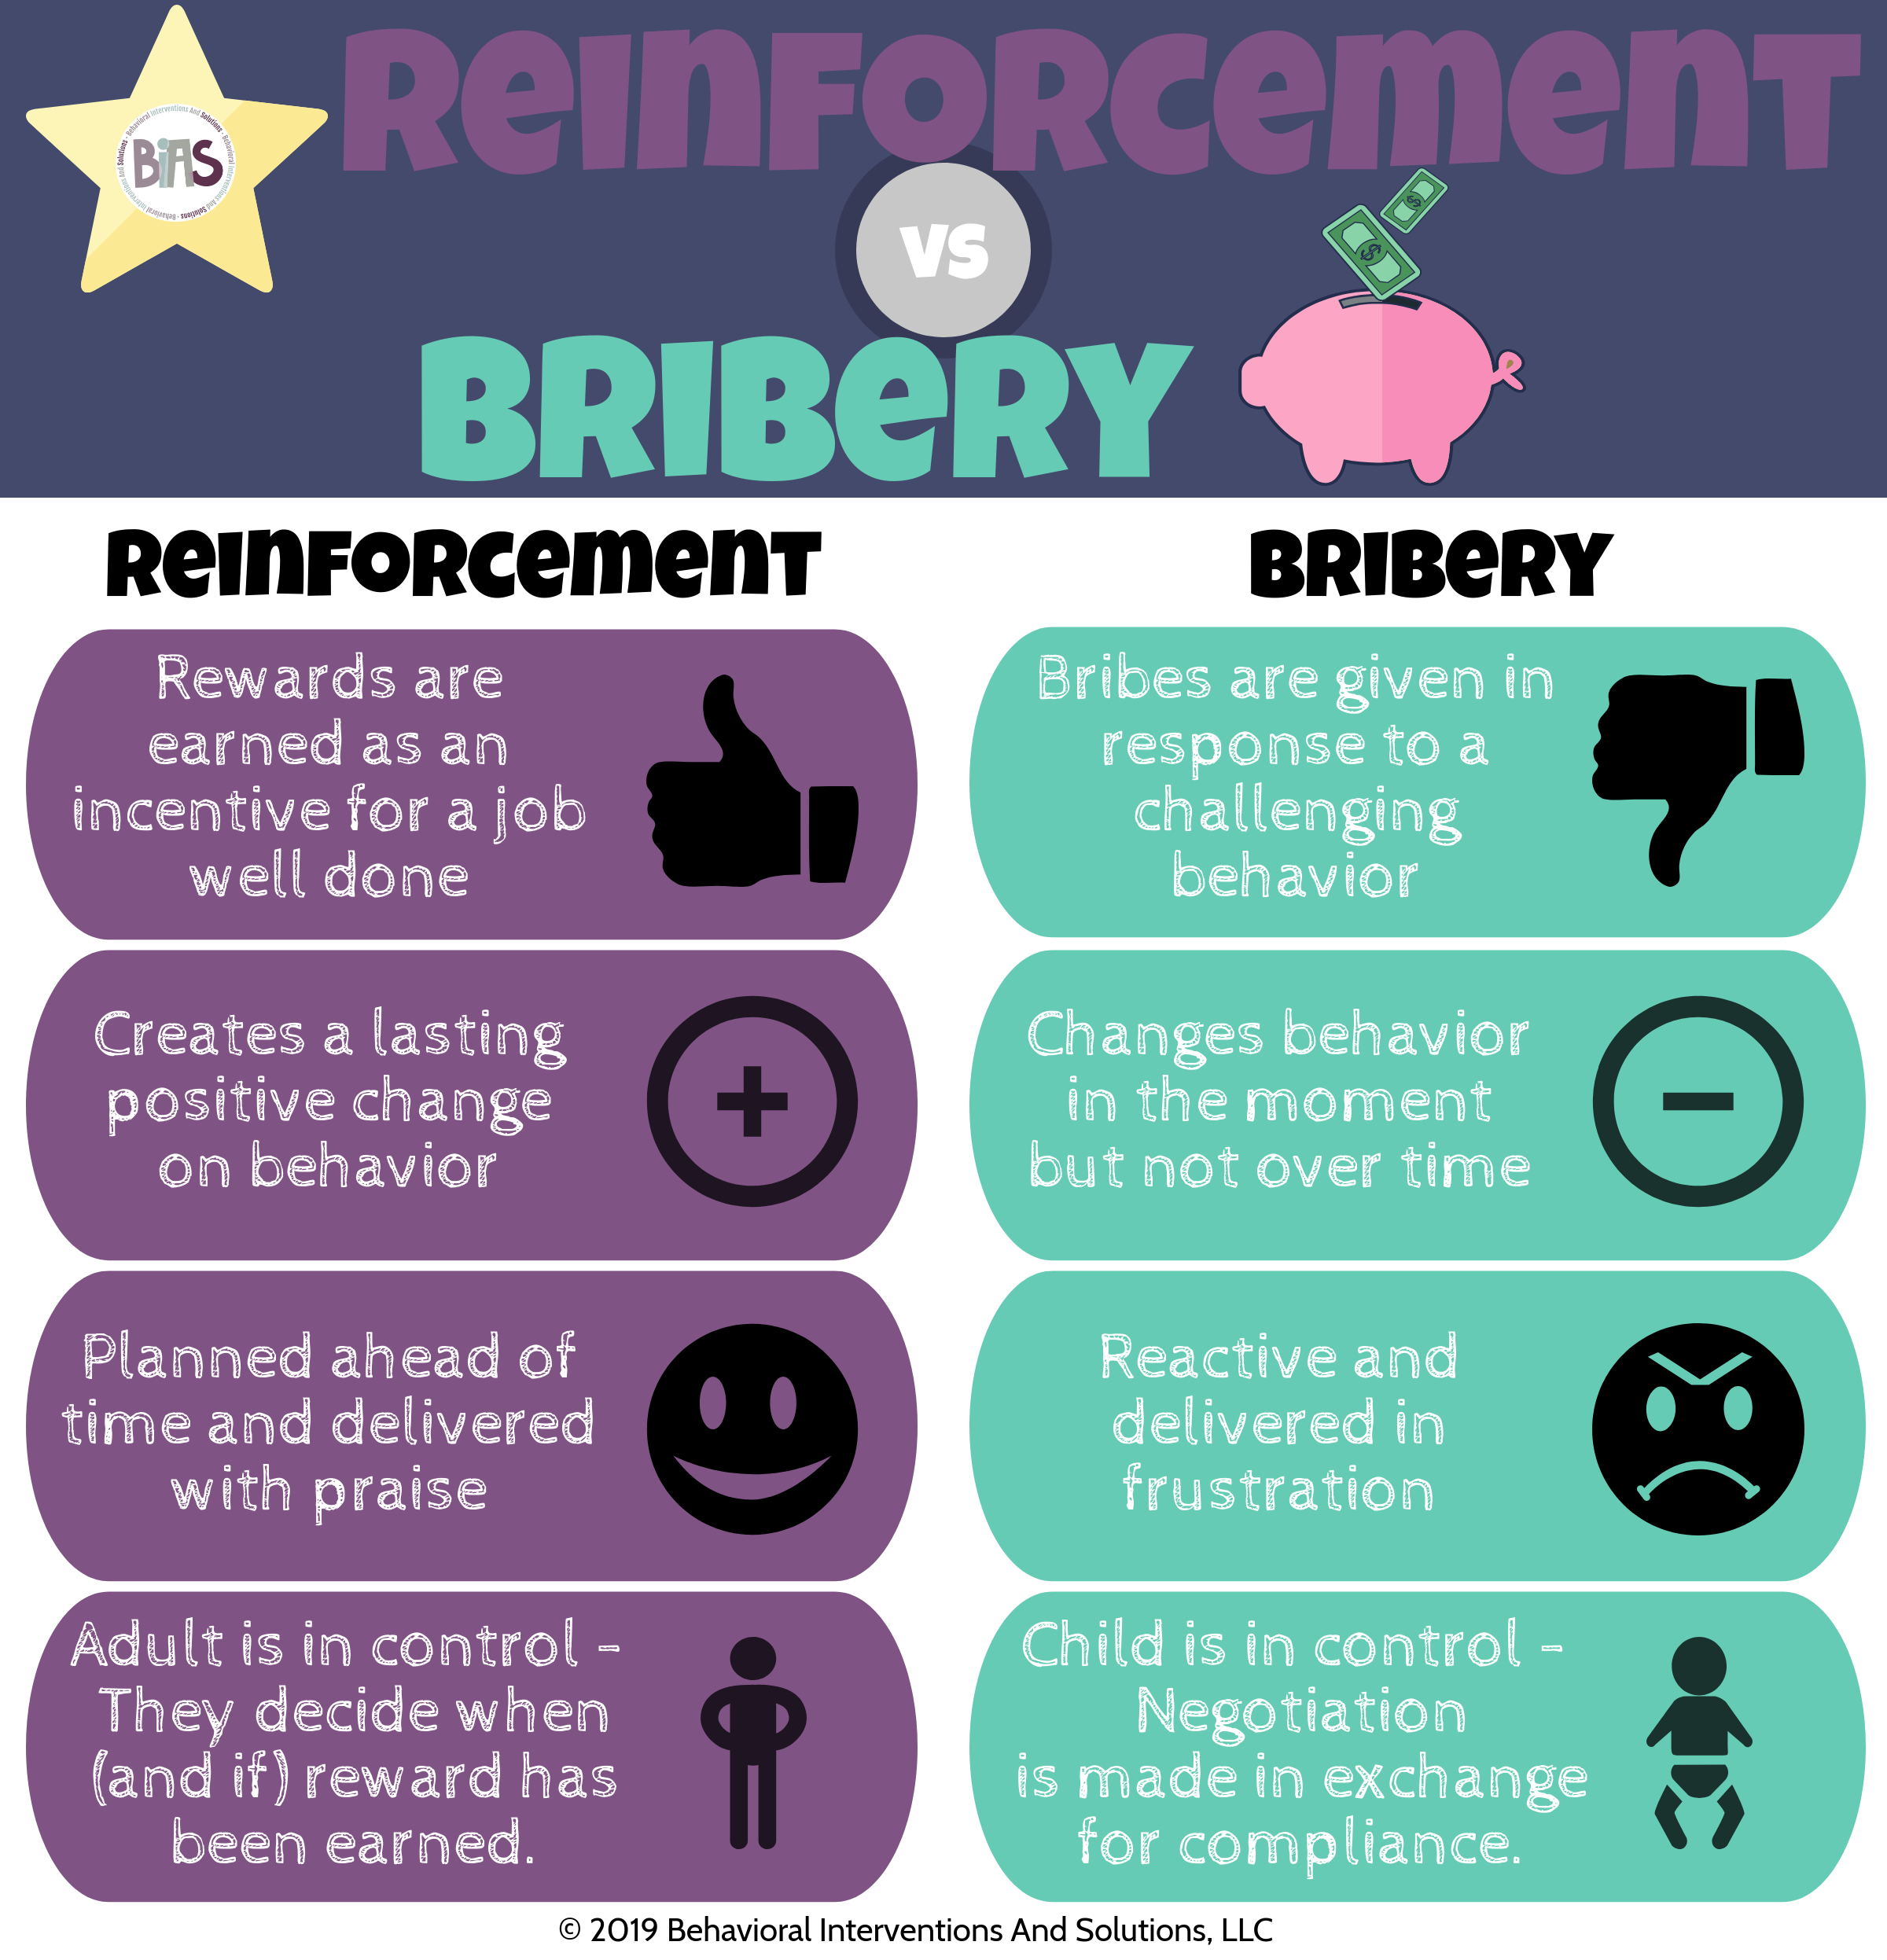
Bribery graphic

Slide 53
Understanding the difference!
Student yells when they are denied iPad.
Bribery: The student cries when iPad is denied, and work is expected. Staff says, “When you calm down, you can get the iPad”.
Behavior Trap: The student cries when denied iPad and work is expected. The staff gives the iPad to the student and to get the student to stop crying.

Slide 54
Understanding the difference!
Student yells when they are denied iPad.
Reinforcement: The student asks for the iPad. Staff says “when you complete your work, you can have the iPad”. The student may still cry, but the iPad is not delivered until the work is completed.
Planned Reinforcement: Before giving the student a direction to do their work, staff say “When you finish your work, you get iPad time!”. Student engages in work and then received iPad time immediately after.

Slide 55
Setting up the Environment for Success
10 Critical Components
Fidelity Checks

Slide 56
10 Critical Components

Slide 57
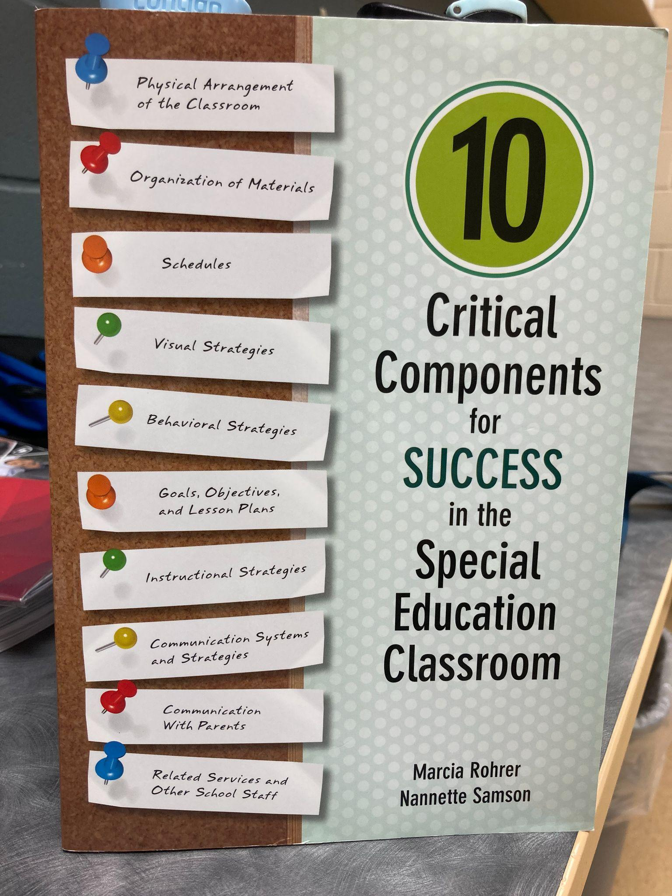
Materials to reference
10 Critical Components for Success in the Special Education Classroom
Marcia Rohrer, Nannette Samson

Slide 58

Materials to reference, cont.
Setting up Classroom Spaces That Support Students with Autism Spectrum Disorders
Susan Kabot, Christine Reeve

Slide 59
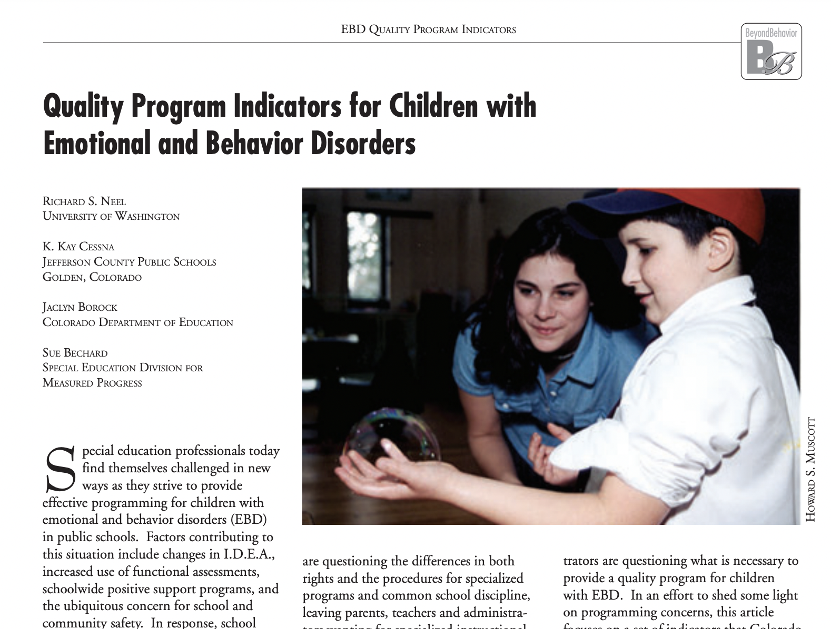
Materials to reference, cont. 2
Quality Program Indicators for Children with Emotional and Behavior Disorders
Neel, Cessna, Borock, Bechard

Slide 60
Managing the Environment
What can we do BEFORE behavior has a chance
to occur, within the environment, to help ensure success? Areas we can focus on for managing the environment:
Classroom organization
Student behavior and academic needs
Layout supports learning and needs
Emotional climate is safe
Schedules

Slide 61
CLASSROOM ORGANIZATION
Are there predictable classroom routines?
Are transitions are able to be accomplished smoothly and efficiently?
Are visual cues displayed in the room showing procedures, routines, expectations?

Slide 62
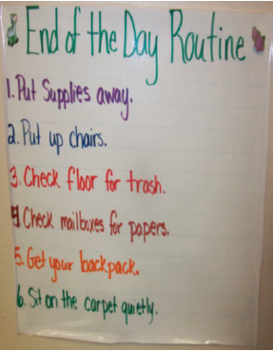
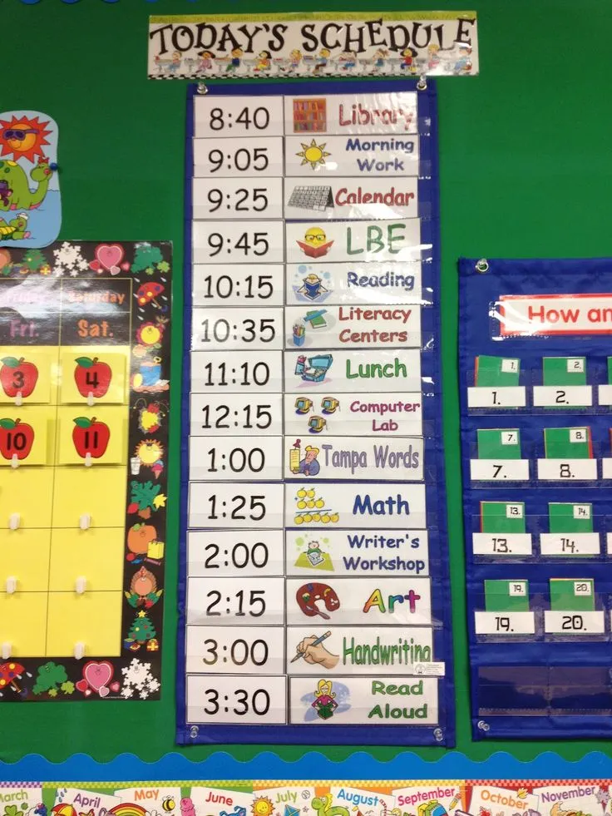
Are there predictable classroom routines?

Slide 63


Transitions are able to be accomplished smoothly and efficiently

Slide 64
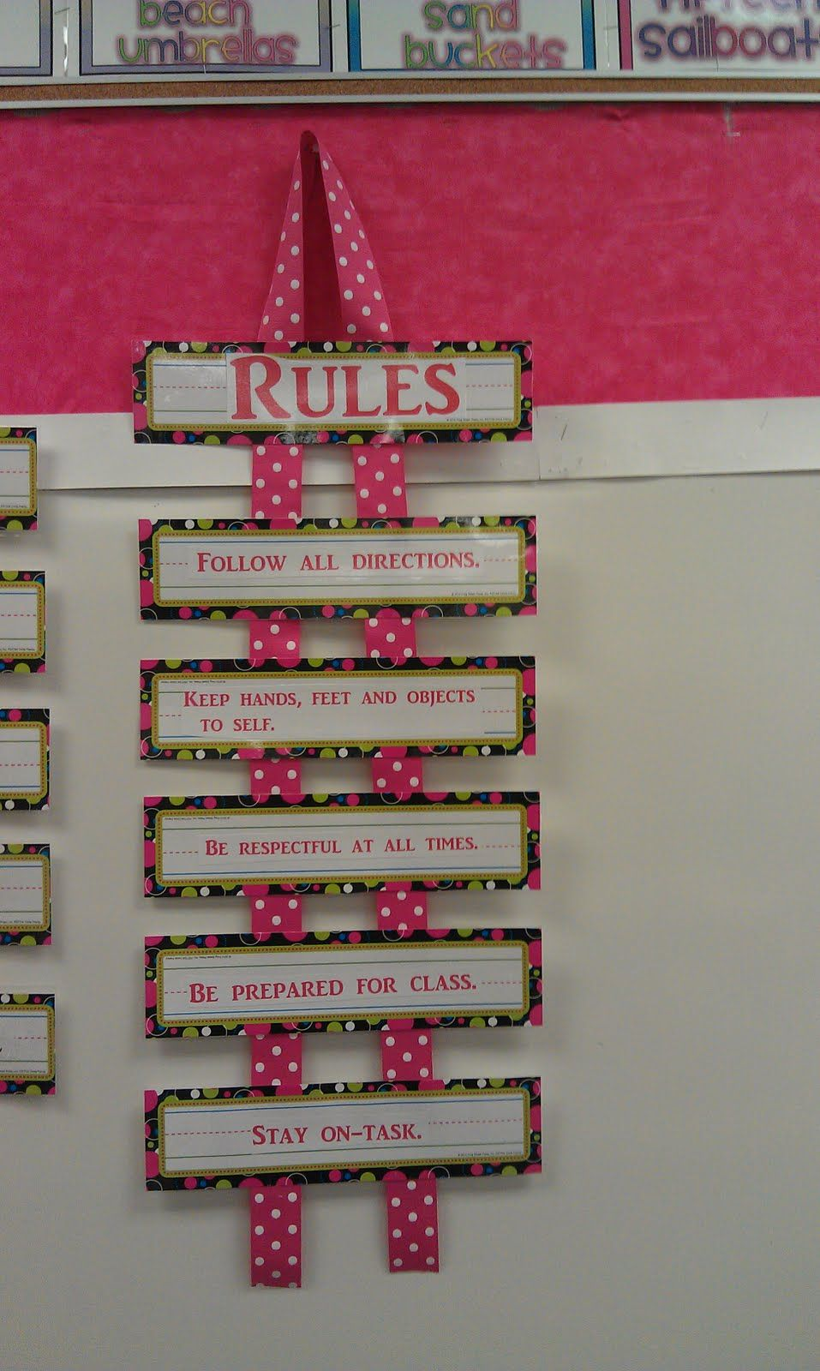

Visual cues are displayed in the room showing procedures, routines, expectations

Slide 65
PERSONAL ARE ABLE TO MEET STUDENT BEHAVIOR AND ACADEMIC NEEDS
Are you able to maintain group instruction?
Are you able to provide behavioral management to individuals without too much interference of group or classroom instruction?
Is there a variety of materials are available to meet the learning needs of all students?

Slide 66

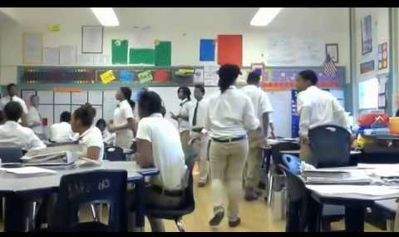
Able to maintain group instruction

Slide 67


Able to provide behavioral management to individuals without too much interference of group or classroom instruction

Slide 68


Variety of materials are available to meet the learning needs of all students

Slide 69
Layout is Intentional and Supports Learning and Behavior Needs
Is the environment free from overly distracting stimuli
Is seating is arranged for proximity control
Does the teacher has easy visual access to all students at all times

Slide 70
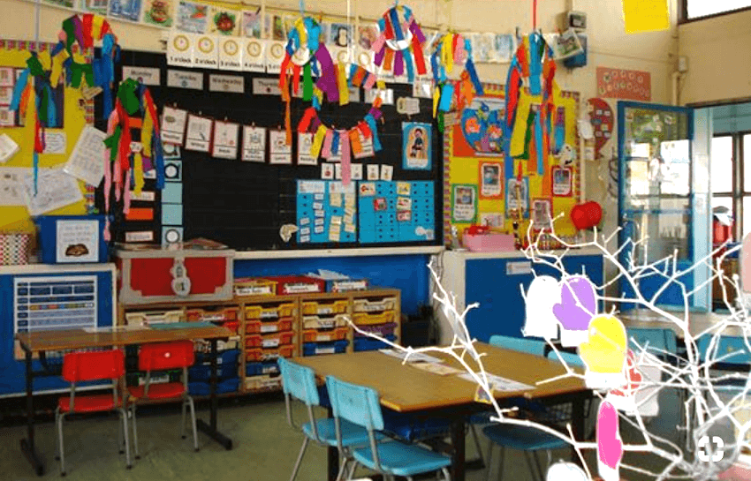
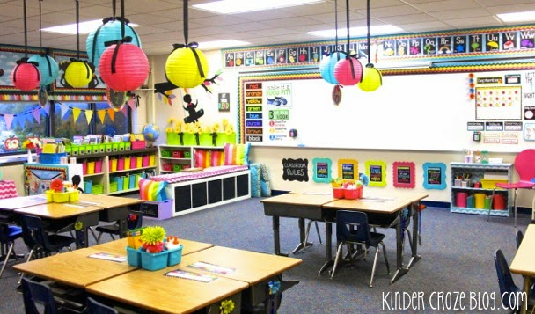
FREE FROM OVERLY DISTRACTING STIMULI
Classrooms can be colorful and decorated but done so they are not over stimulating.

Slide 71


Seating is arranged for proximity control
Having easy access to students for support, moving around the room, etc. allows for staff to help have classroom management!

Slide 72
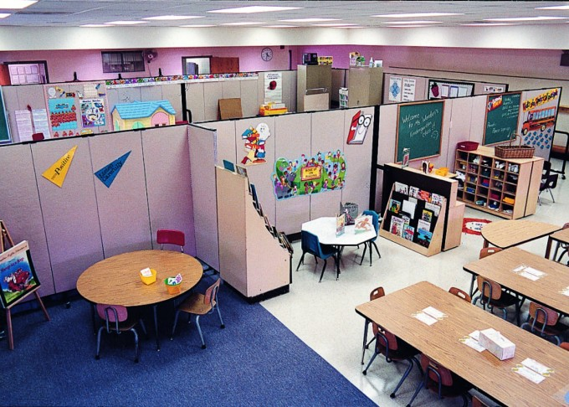
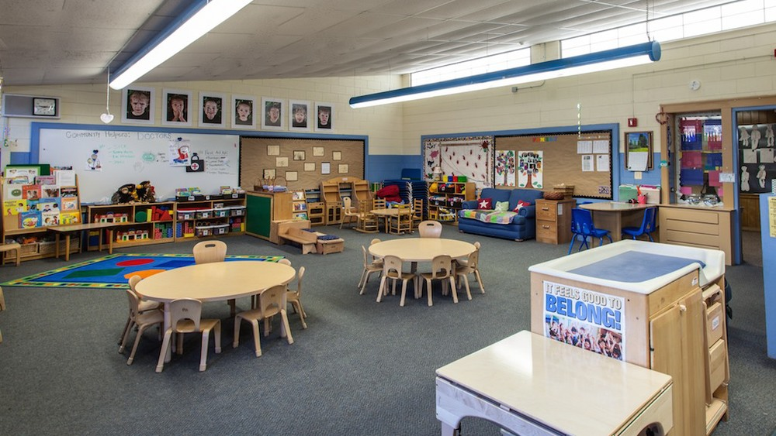
Teacher has easy visual access to all students at all times
Arrangement of furniture assures separate spaces but still allows for visual access to all students at the same time.

Slide 73
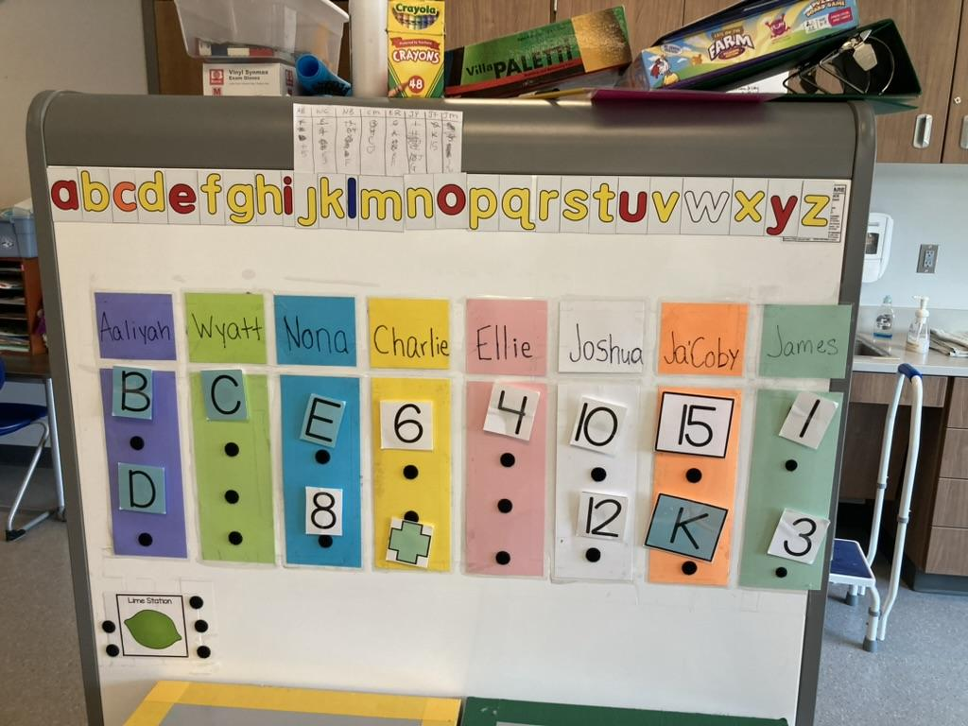
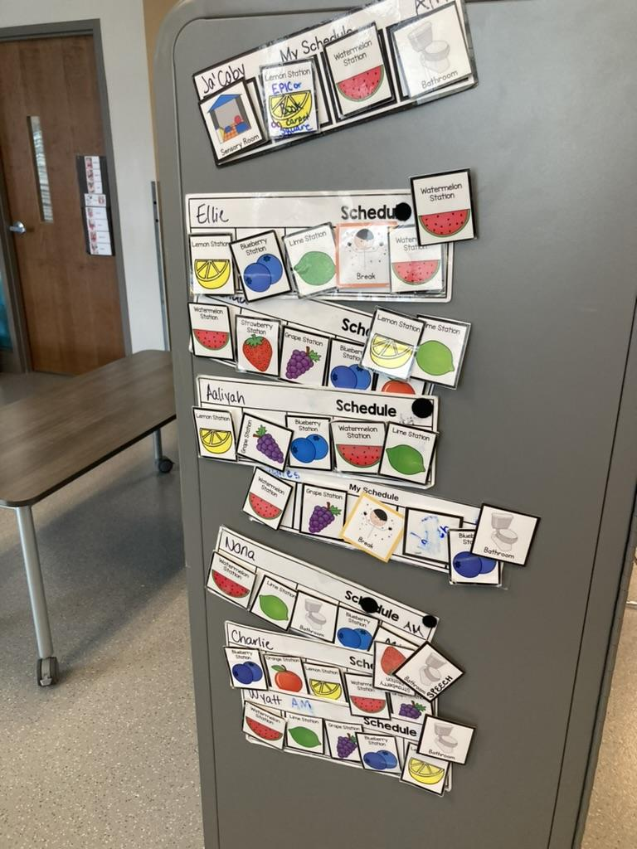
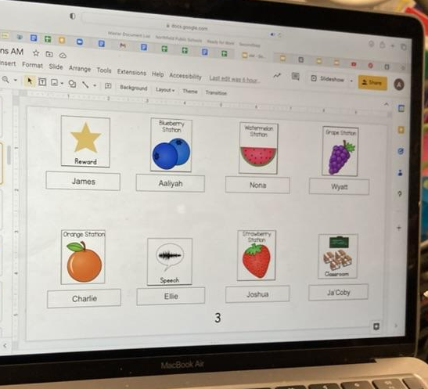
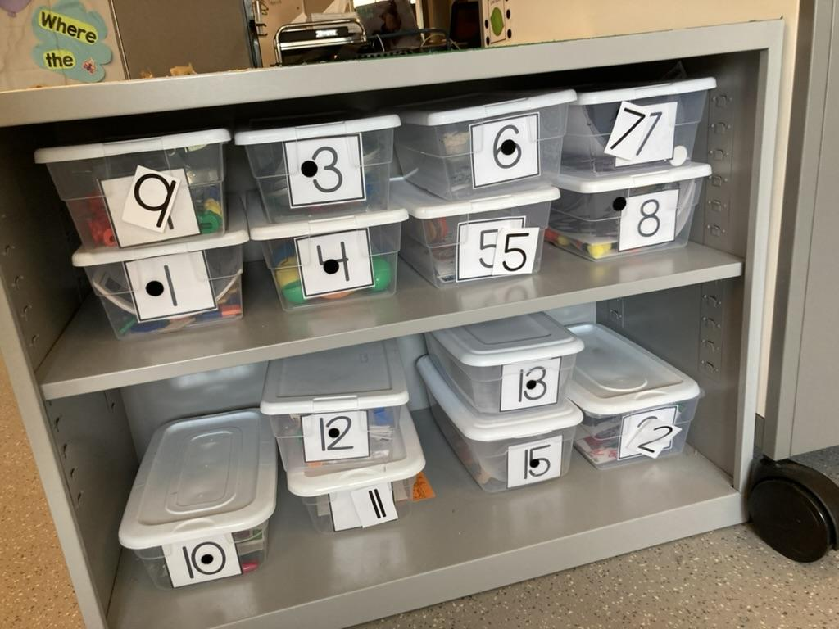
Examples

Slide 74
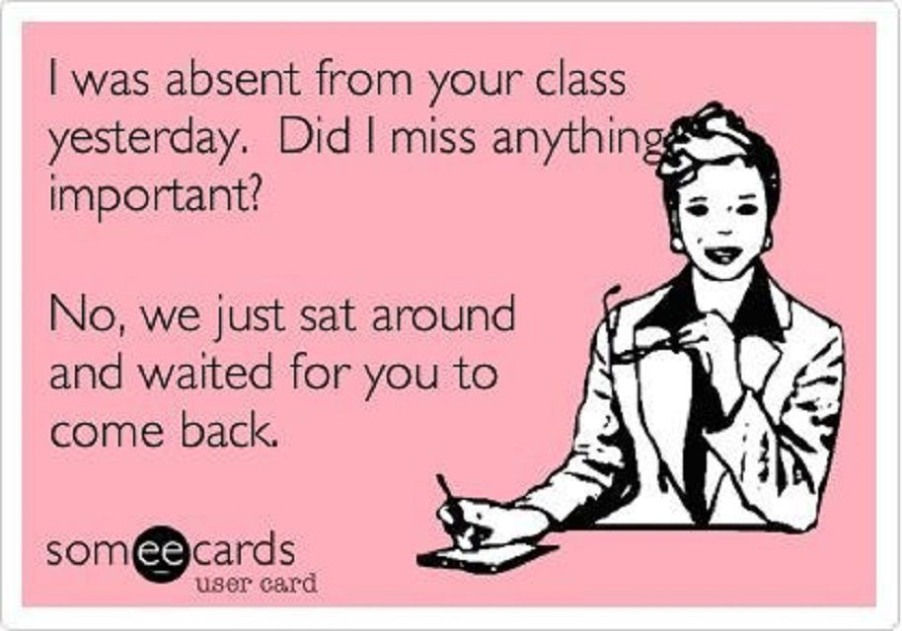
EMOTIONAL CLIMATE IS SAFE
Are interactions between student and teachers are genuine
Is Humor used appropriately and effectively
Be careful of sarcasm!

Slide 75
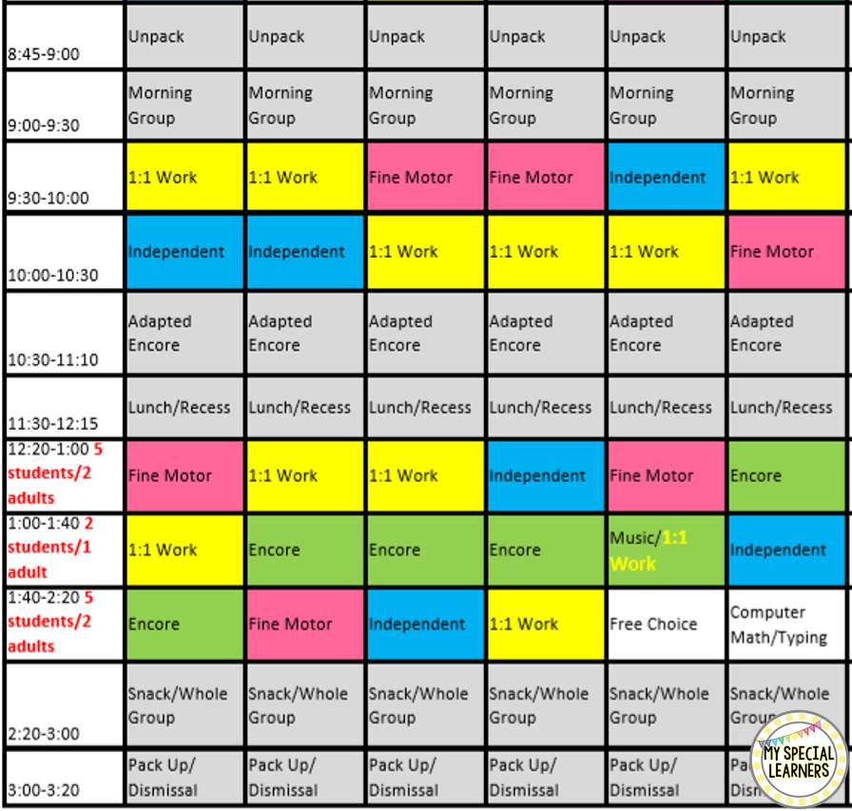
SCHEDULES ARE DONE INTENTIONALLY
Are schedules are arranged to structure students for success?
Are schedules are arranged to avoid problematic times and places?

Slide 76
ADDITIONAL QUESTIONS TO ASK ABOUT SCHEDULES
Where will schedules be stored?
Where do extra resources go?
Is the break area a safe space?
Where are teacher supplies stored?
Where are kids waiting to transition out of the room?
Where are the plugs and access to a whiteboard/smartboard?
Do you have any runners?
Where will everyday student supplies go?

Slide 77
ADDITIONAL QUESTIONS TO ASK ABOUT SCHEDULES, cont.
Will you be cooking or doing other group activities in your classroom?
Which centers are loud?
Will you have student desks, tables, etc.?
Will you have a teacher’s desk?
Where will students store personal items?
Where will staff store personal items?
Where will technology go?

Slide 78
Fidelity Checks

Slide 79
Fidelity Checks, cont.
Fidelity is the degree to which the program is implemented as intended, including quality and consistency of implementation.
Fidelity = Consistency and Accuracy
Create a system to help create open communication and feedback for teams to increase their opportunities for learning, collaboration and support.

Slide 80
Fidelity Checks, cont. 2
Who does a “fidelity check”
Administration* Case Manager
EAs / Para Educators Support Staff
District Staff
Fidelity checks can be done weekly, monthly, quarterly.
*Fidelity checks are NOT evaluative unless they are clearly designated and determined to be used for that.

Slide 81
Fidelity Checks, cont. 3
Fidelity checks are predetermined and regularly applied to ensure that evidence-based practices are integrated and sustained to support the classroom / program.

Slide 82
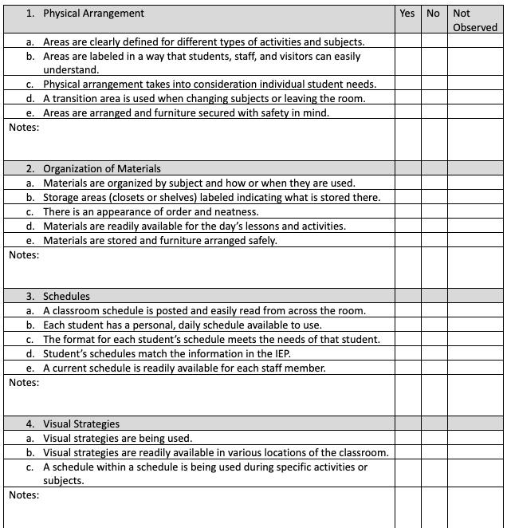
Fidelity Checks, cont. 4
Examples
POSITIVE BEHAVIOR SUPPORTS PLAN FIDELITY CHECKLIST | STAFF: _______ | STAFF: _______ | STAFF: _______
Intials ______ Time Observed ____________________
SCHEDULE
First/Then schedule with visuals and words | Y N NA | Y N NA | Y N NA
Picture schedule with words for transitions | Y N NA | Y N NA | Y N NA
Token system | Y N NA | Y N NA | Y N NA
Predictable routines | Y N NA | Y N NA | Y N NA
Transitions are planned and taught | Y N NA | Y N NA | Y N NA
Visual Prompts are used | Y N NA | Y N NA | Y N NA
Planned and fully scheduled day | Y N NA | Y N NA | Y N NA
CHOICES
When able to give options during work tasks | Y N NA | Y N NA | Y N NA
Use choice board during break and choice times | Y N NA | Y N NA | Y N NA
ADULT EXPECTATIONS
Clear and concise directions | Y N NA | Y N NA | Y N NA
High expectations are established and kept | Y N NA | Y N NA | Y N NA
Follow through with directions given | Y N NA | Y N NA | Y N NA
High adult attention when demonstrating expected behaviors | Y N NA | Y N NA | Y N NA
Minimal adult attention when demonstrating inappropriate behaviors | Y N NA | Y N NA | Y N NA
TEACHING
Appropriate cues and prompting | Y N NA | Y N NA | Y N NA
Appropriate level of work - not too high, not too low | Y N NA | Y N NA | Y N NA

Slide 83
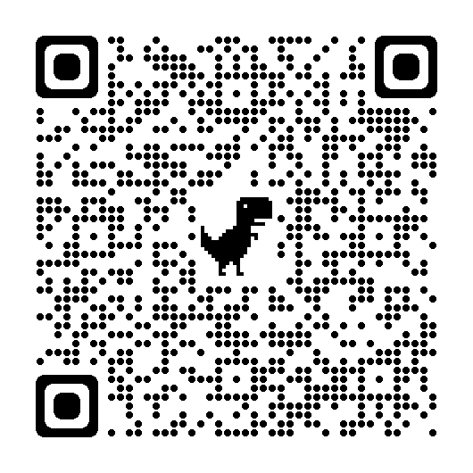
Fidelity Checklist Activity
Open the Fidelity Checklist from 10 Critical Components book.
How does your classroom currently do?
How would others score this?
How can you use this with your program?

Slide 84
Data Collection
Collecting Data
Types of Data Collection
Critical Components of a Data Sheet

Slide 85
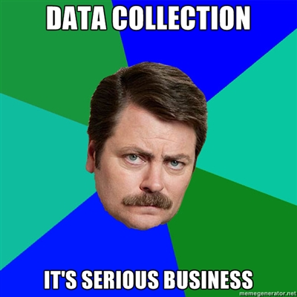
Introduction
Data collection needs to be an
important part of any educational programming
We use data collection in our jobs everyday, it is vital that you have a good understanding of what type of measurement strategies are available, and how to properly use them
We base decisions of interventions on measurement outcomes and therefore accurate data is key!

Slide 86
Get Started!
There is a lot of information and data collection can feel overwhelming.
You don’t have to do it all but learn from it, pick a spot to start then reference back as you expand and use data to drive your decision-making for students!
Don’t wait for the programming to be set and running “perfectly” - start your data collection right away, adjust it as you adjust the programming and USE the data to help you to know how to make the right changes!

Slide 87
COLLECTING DATA
Link to different data collection videos:
ABA Made Simple (YouTube)

Slide 88
Reasons for Collecting and Analyzing Data
To provide an objective and reliable method of assessing change in learning and behavior.
To improve the efficiency and effectiveness of instruction and behavior change reduction
Establishes the patterns of the behaviors
Legally required for IEPs

Slide 89
Reasons for Collecting and Analyzing Data, cont.
To document implementation of specific interventions and strategies
To provide information for resolving difficulties in making progress
To provide a common language for regular and meaningful communication of a student’s progress to other parties (parents, state, medical, etc.)

Slide 90
Considerations When Selecting Method of Data Collection
What type of skill is being assessed (handwriting, behavior, participation, reading comprehension)
How is the IEP goal / objective or curriculum skill written (measurable / observable, criteria for mastery)?
Where is the behavior or skill being demonstrated (classroom, sped, specialist, transitions, etc.)

Slide 91
Considerations When Selecting Method of Data Collection, cont.
Who is available to take the data in a given setting (one-person, multiple support staff, gen ed teacher, EA, etc.)?
Will the data collected show the change in behavior?

Slide 92
TYPES OF DATA COLLECTION
ABC Data

Slide 93
ABC DATA COLLECTION
Antecedent → Behavior → Consequence
ABC data helps to find out more about the challenging behavior. This includes discovering common antecedents that may trigger the behavior to occur, and the consequences that may be maintaining the behavior.

Slide 94
ABC DATA COLLECTION, cont.
Used in an FBA to write function-based interventions
Meant to be SHORT TERM. After this information is analyzed, we need to move on to taking data that is more likely to show effectiveness of interventions.

Slide 95
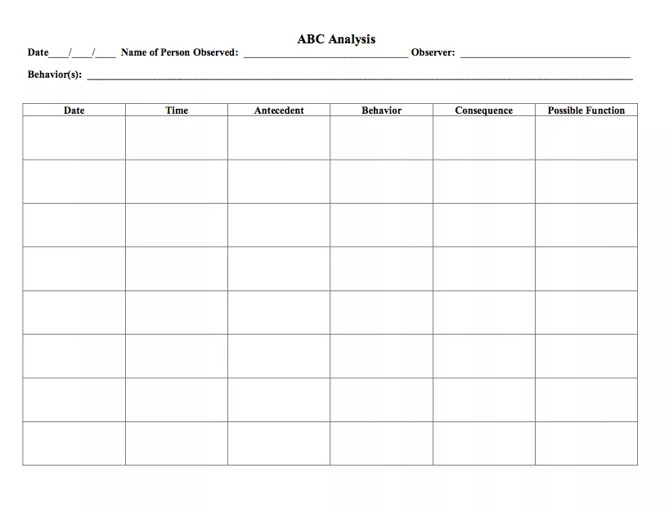
ABC Data Example

Slide 96
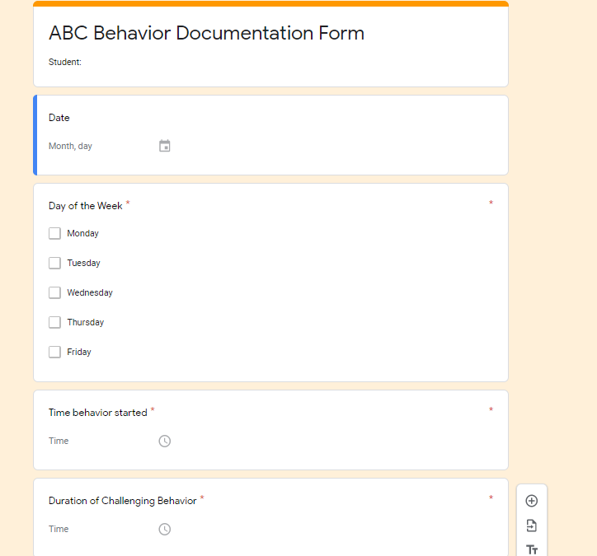
ABC Data Example, cont. 2

Slide 97
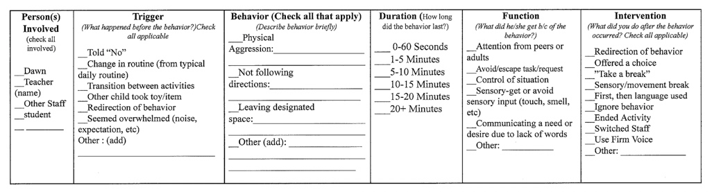
ABC Data Example, cont. 3
Teams can also use a checklist ABC sheet to reduces the amount of writing. Create lists of common antecedents, behaviors and consequences for the program or student.

Slide 98
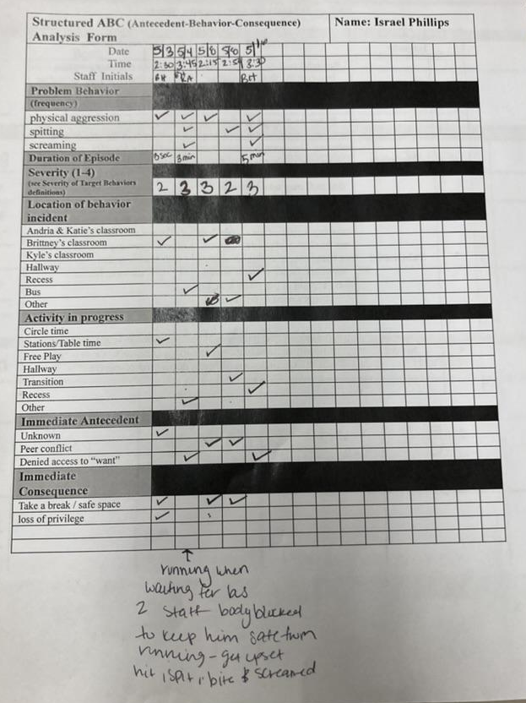
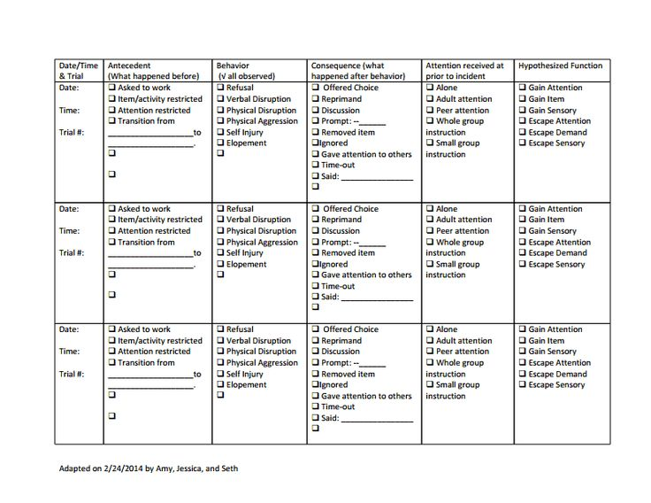
Structured ABC Checklist Example

Slide 99
TYPES OF DATA COLLECTION
Continuous Measurement

Slide 100
Continuous Measurement Procedures
Count
Rate/Frequency
Duration
Response Latency
Interresponse Time (IRT)

Slide 101
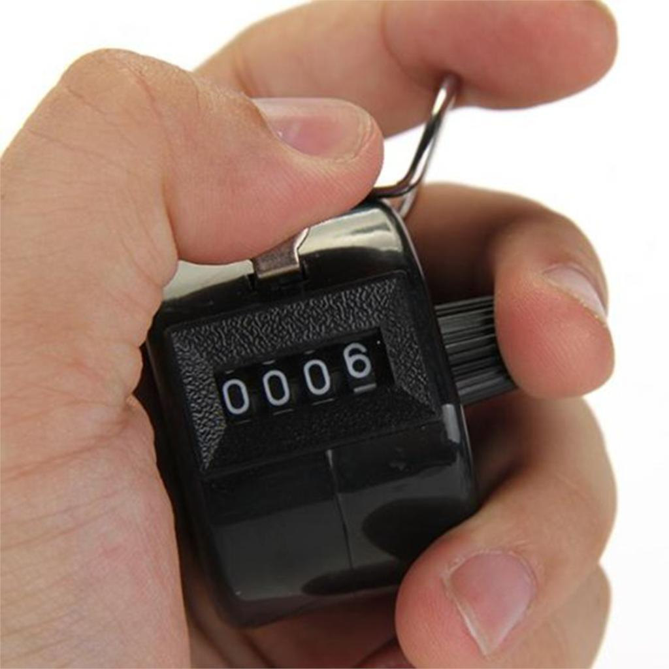
Count
Count:
How to measure:
The number of responses emitted during an observation period.
A simple tally chart.
Tally= occurrence of target behavior

Slide 102
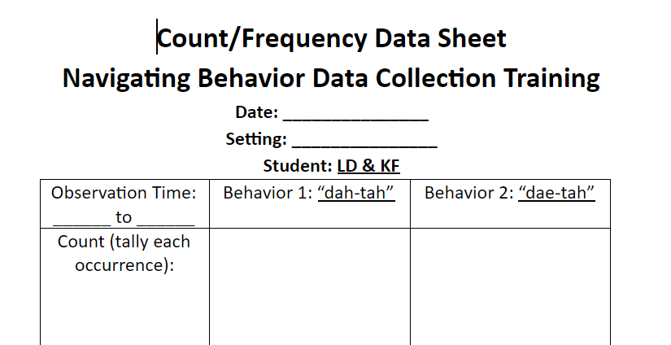
Count Data Sheet Example

Slide 103
Frequency/Rate
Frequency/Rate:
How to measure:
A ratio of count per observation time;
Often expressed as count per standard unit of time (e.g. per minute, per hour, per day)
Tally number of occurrences per time of the observation

Slide 104
Frequency/Rate Data Sheet Example
Time | Behavior (tally) | Total
8:00-9:00
9:00-10:00
11:00-12:00
12:00- 1:00
1:00-2:00
2:00-3:00
TOTAL

Slide 105
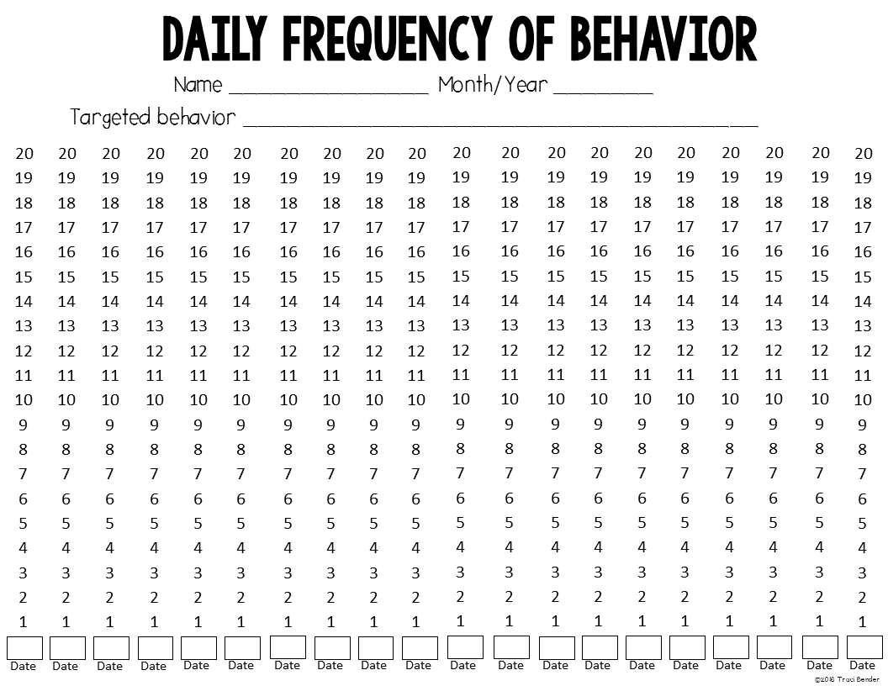
Frequency Data Sheet (self graphs)
**Consider having the student fill this out to also work on Self-monitoring

Slide 106
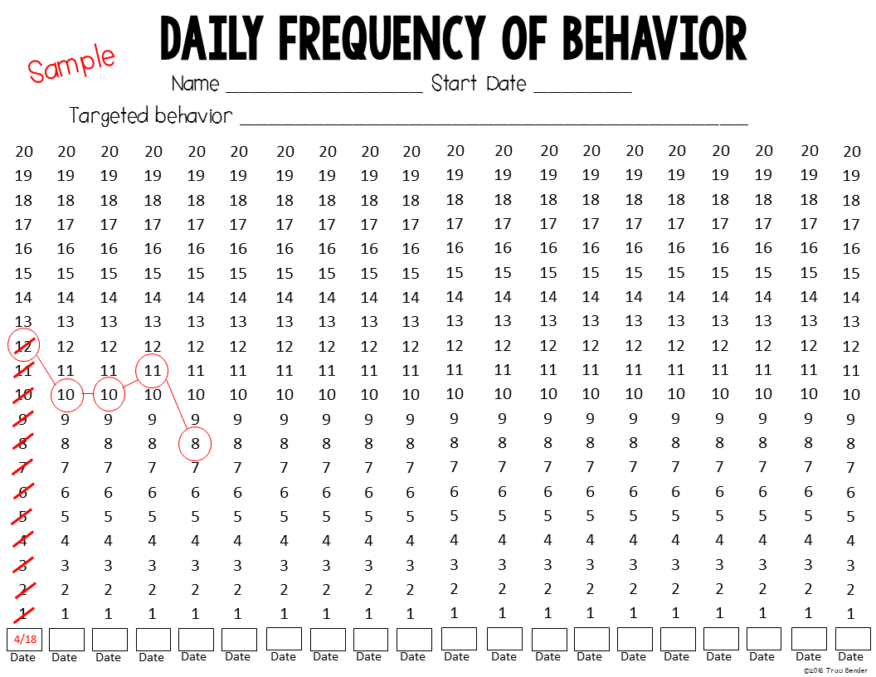
Sample of frequency sheet graphed

Slide 107

Duration
The amount of time in which a behavior occurs
Measured in standard units of time (i.e., minutes, seconds, etc)
Important for measuring HOW LONG a target behavior is taking place

Slide 108
Duration, cont.
Either measure duration in total duration per session or duration per occurrence
Total Duration per Session= measuring the amount of time an individual is engaged in a target behavior over a given period of time
Duration per Occurrence= Measuring the amount of time that a target behavior occurs

Slide 109
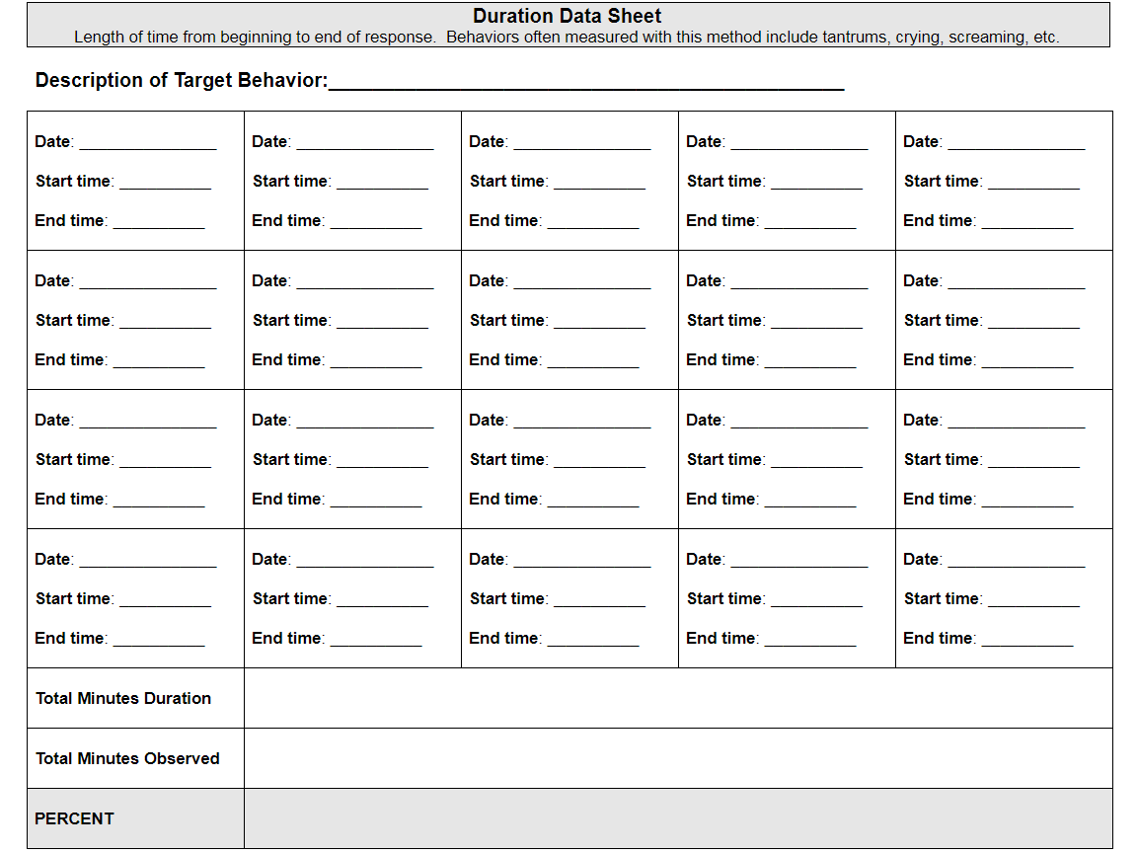
Duration Data Sheet Example

Slide 110
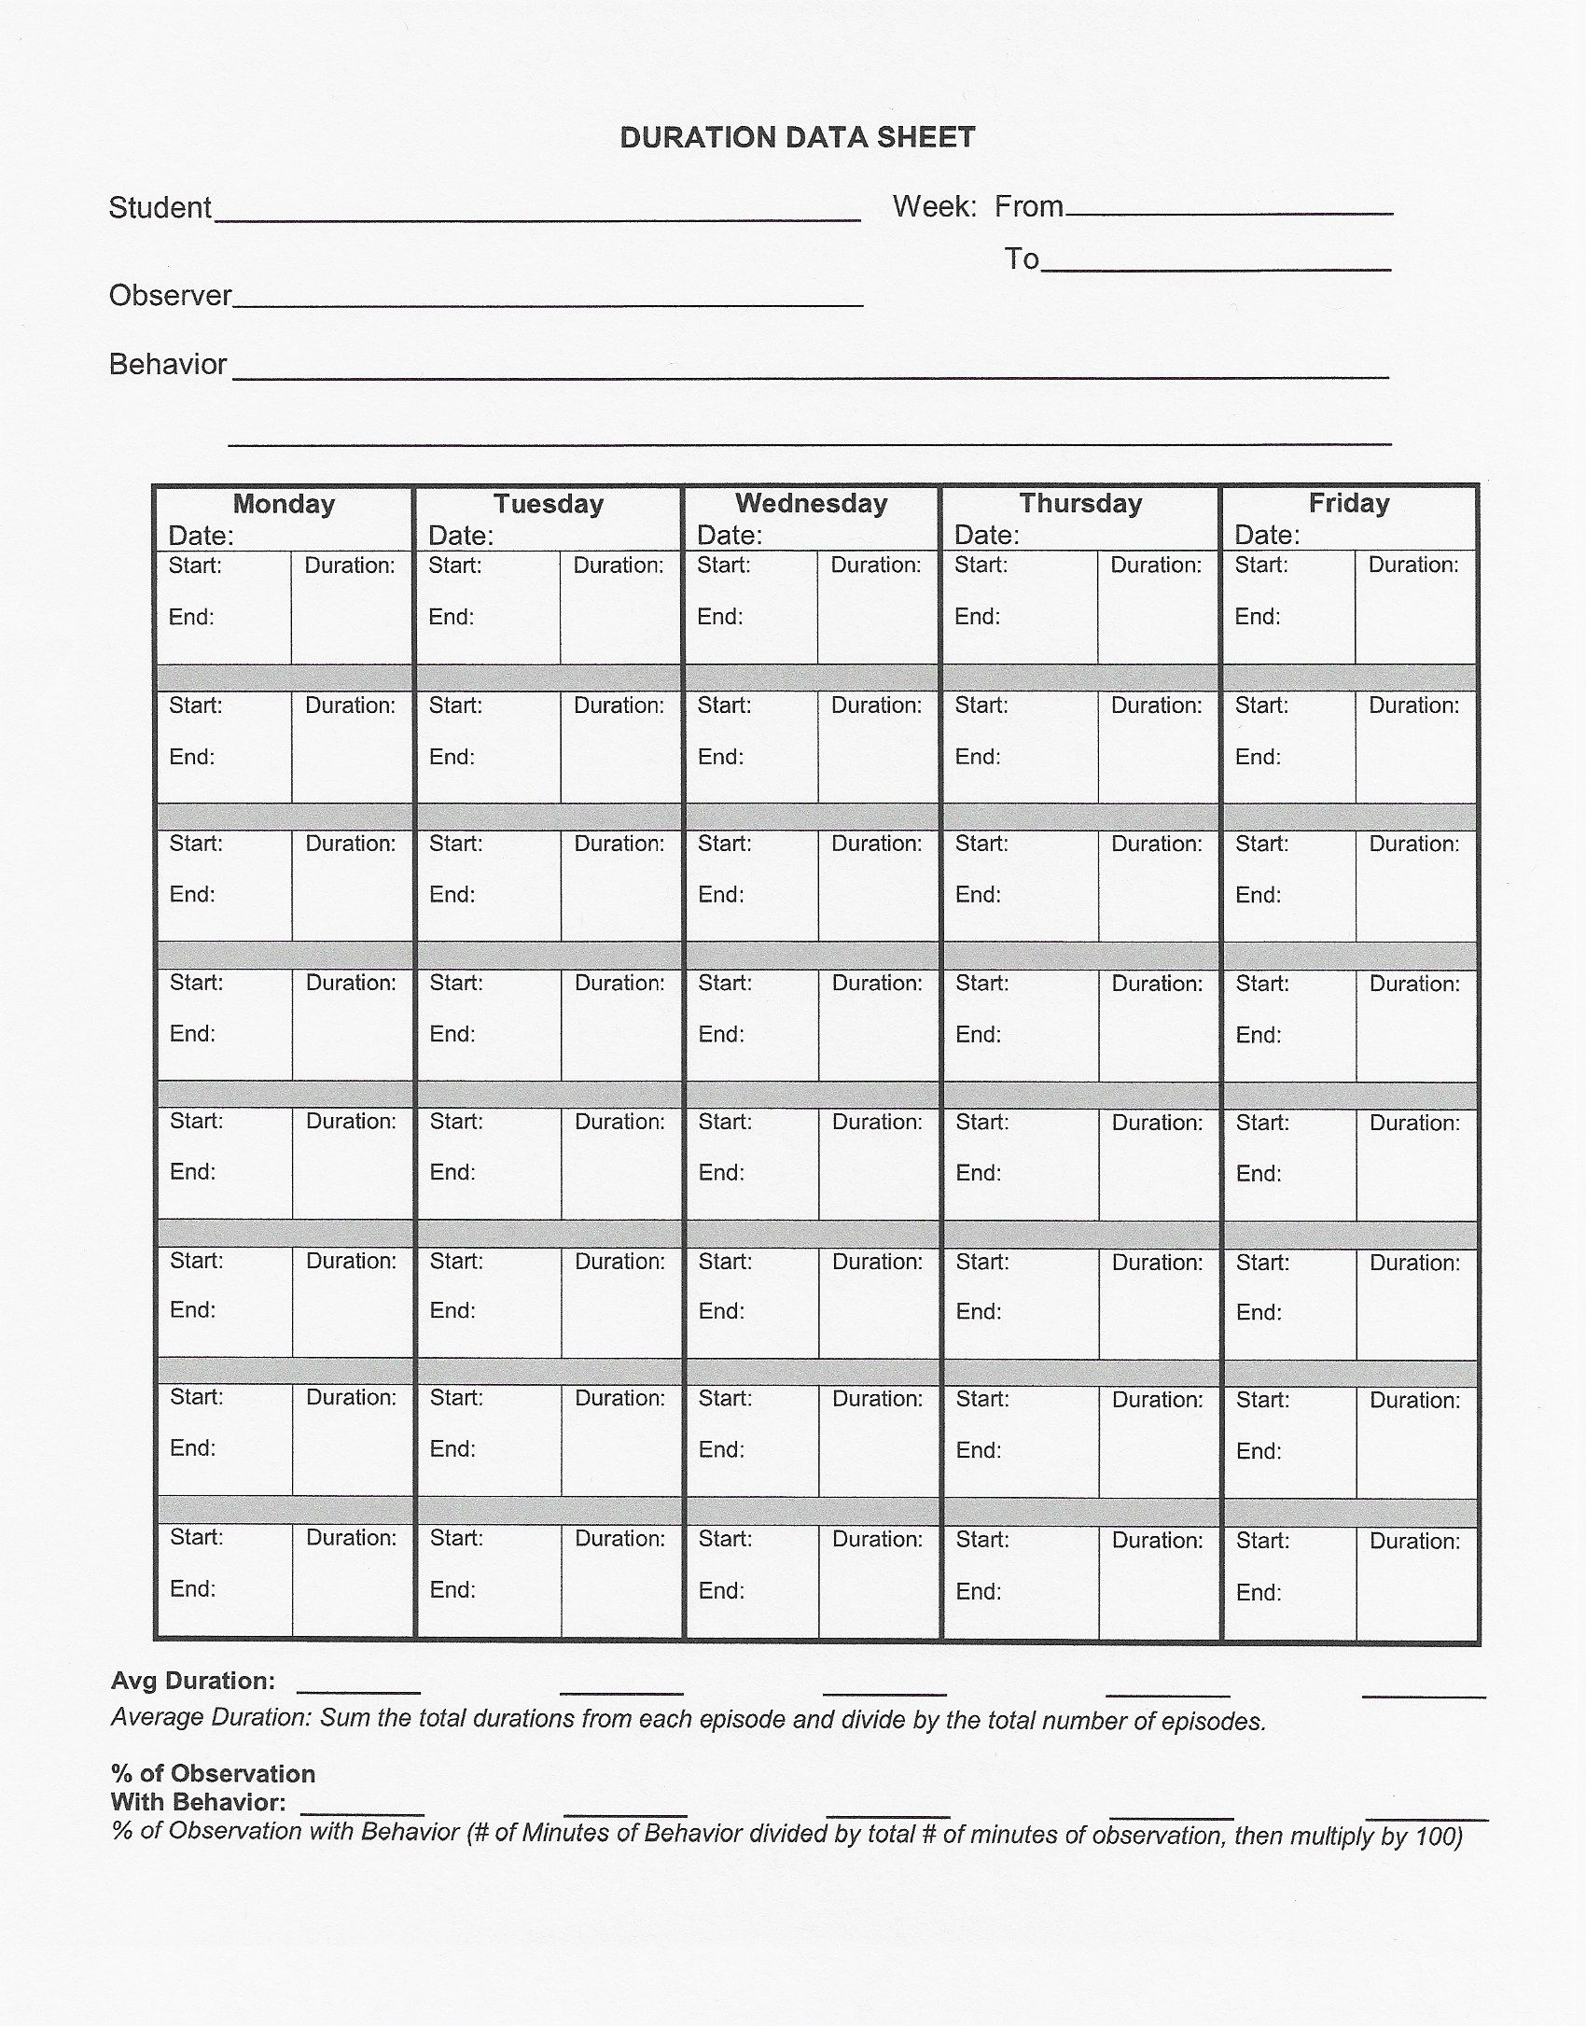
Duration Data Sheet Example, cont.

Slide 111
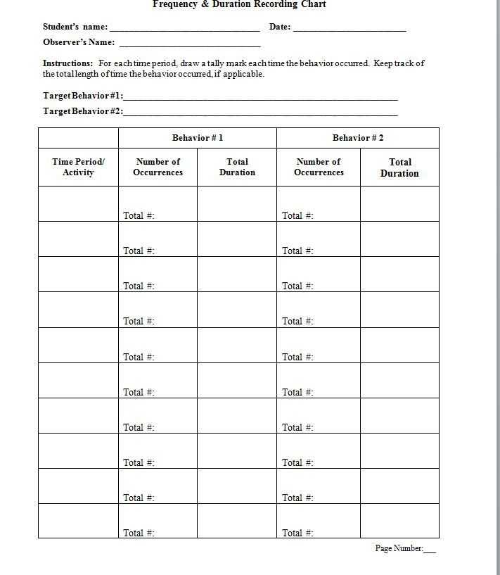
Duration and Frequency Data Collection Example

Slide 112
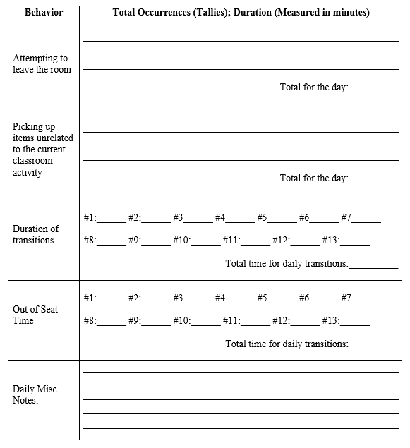
Duration and Frequency Data Collection Example, cont.

Slide 113
What measurement should we use?
Measure the impact of a child that is leaving his seat during class
Count/Frequency
Pro: Count will allow us to know how many times the child left their seat
Con: This will not give us a good measure of how much time the child is out of their seat

Slide 114
What measurement should we use? Cont.
Measure the impact of a child that is leaving his seat during class
Duration per Session
Pro: Will give us a good idea of how much time the child is spending out of their seat
Con: Does not allow us to determine how much time the child is out of their seat per occurrence

Slide 115
What measurement should we use? Cont. 2
Measure the impact of a child that is leaving his seat during class
Duration per Occurrence
Pro: This will allow us to measure repeatability AND Temporal Extent.
This will often be preferable as it will present us with the most information

Slide 116
Response Latency
How much time elapses between a stimulus or antecedent and the initiation of a response
A parent telling a child to pick up their toys (antecedent) and measuring how long it takes before the child starts pick the toys up)

Slide 117
Response Latency, cont.
The time elapsed will be beneficial regardless of if you are wanting to increase or decrease time between a response. For example, you may want to decrease the amount of time between a teacher prompt and a student response, but you may want to increase the time between a parent saying “wait” and the child making the request again.

Slide 118
Response Latency, cont. 2
The time elapsed will be beneficial regardless of if you are wanting to increase or decrease time between a response.
For example, you may want to decrease the amount of time between a teacher prompt and a student response, but you may want to increase the time between a parent saying “wait” and the child making the request again.

Slide 119
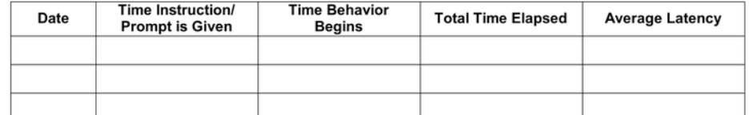
Latency Data Sheet Example

Slide 120
Interresponse Time (IRT)
The amount of time between two consecutive target behaviors
Similar method as Latency, but instead of time between prompt and behavior, it is between two occurrences of the same behavior
Example: The time elapsed between a child hitting another child in the classroom

Slide 121
Interresponse Time (IRT), cont.
Examples of when to use IRT:
The time elapsed between a child hitting another child in the classroom
Bites of food
Problems answered on worksheet
Checking phone
Blurting

Slide 122
Interresponse Time (IRT) Data Sheet Example
Date/Subject | SIB Bx Time of Occurrence | Time between Bx & Previous Bx
 | AVERAGE IRT:

Slide 123
TYPES OF DATA COLLECTION
Discontinuous Measurement

Slide 124
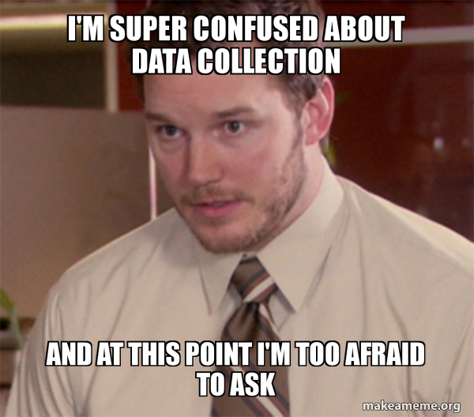
Discontinuous Measurement Procedures
Interval Recording
Whole
Partial
Momentary Time Sampling
Trials-to-criterion

Slide 125
Interval Recording
Also called Time Sampling
A method of observing behavior during intervals or at specific moments in time
Divide up the observation period into time intervals and then record the presence or absence of the behavior

Slide 126
Interval Recording, cont.
Measures obtained by these “samples” are suppose to represent the behavior during the entire time period from which the behavior was collected.

Slide 127
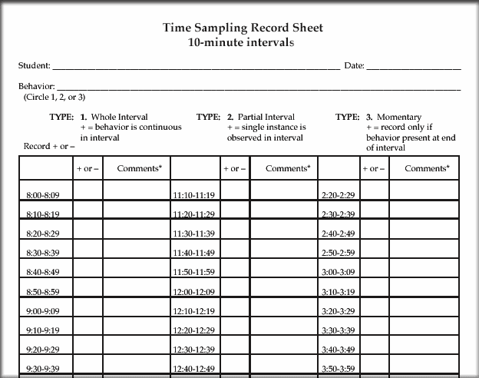
Interval Recording Example

Slide 128
Whole-Interval Recording
Typically used to measure continuous behaviors (i.e. playing) or very high-frequency behaviors (i.e., rocking)
Typically broken down into 5-10 second intervals where behaviors must occur for the entire interval to be recorded (i.e., child must be at his desk looking at his homework for the entire 5 second interval to be considered “on-task”)

Slide 129
Whole-Interval Recording, cont.
May underestimate time engaged in a behavior (i.e., would not record a behavior if it occurred for 9 out of 10 seconds)

Slide 130
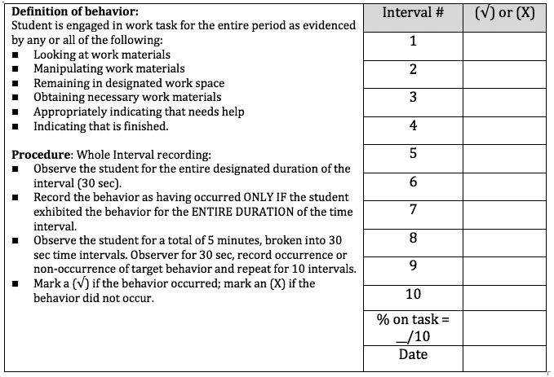
Whole Interval Data Sheet Example
*Note that most interval data sheets can be used with whole, partial, and momentary time sampling

Slide 131
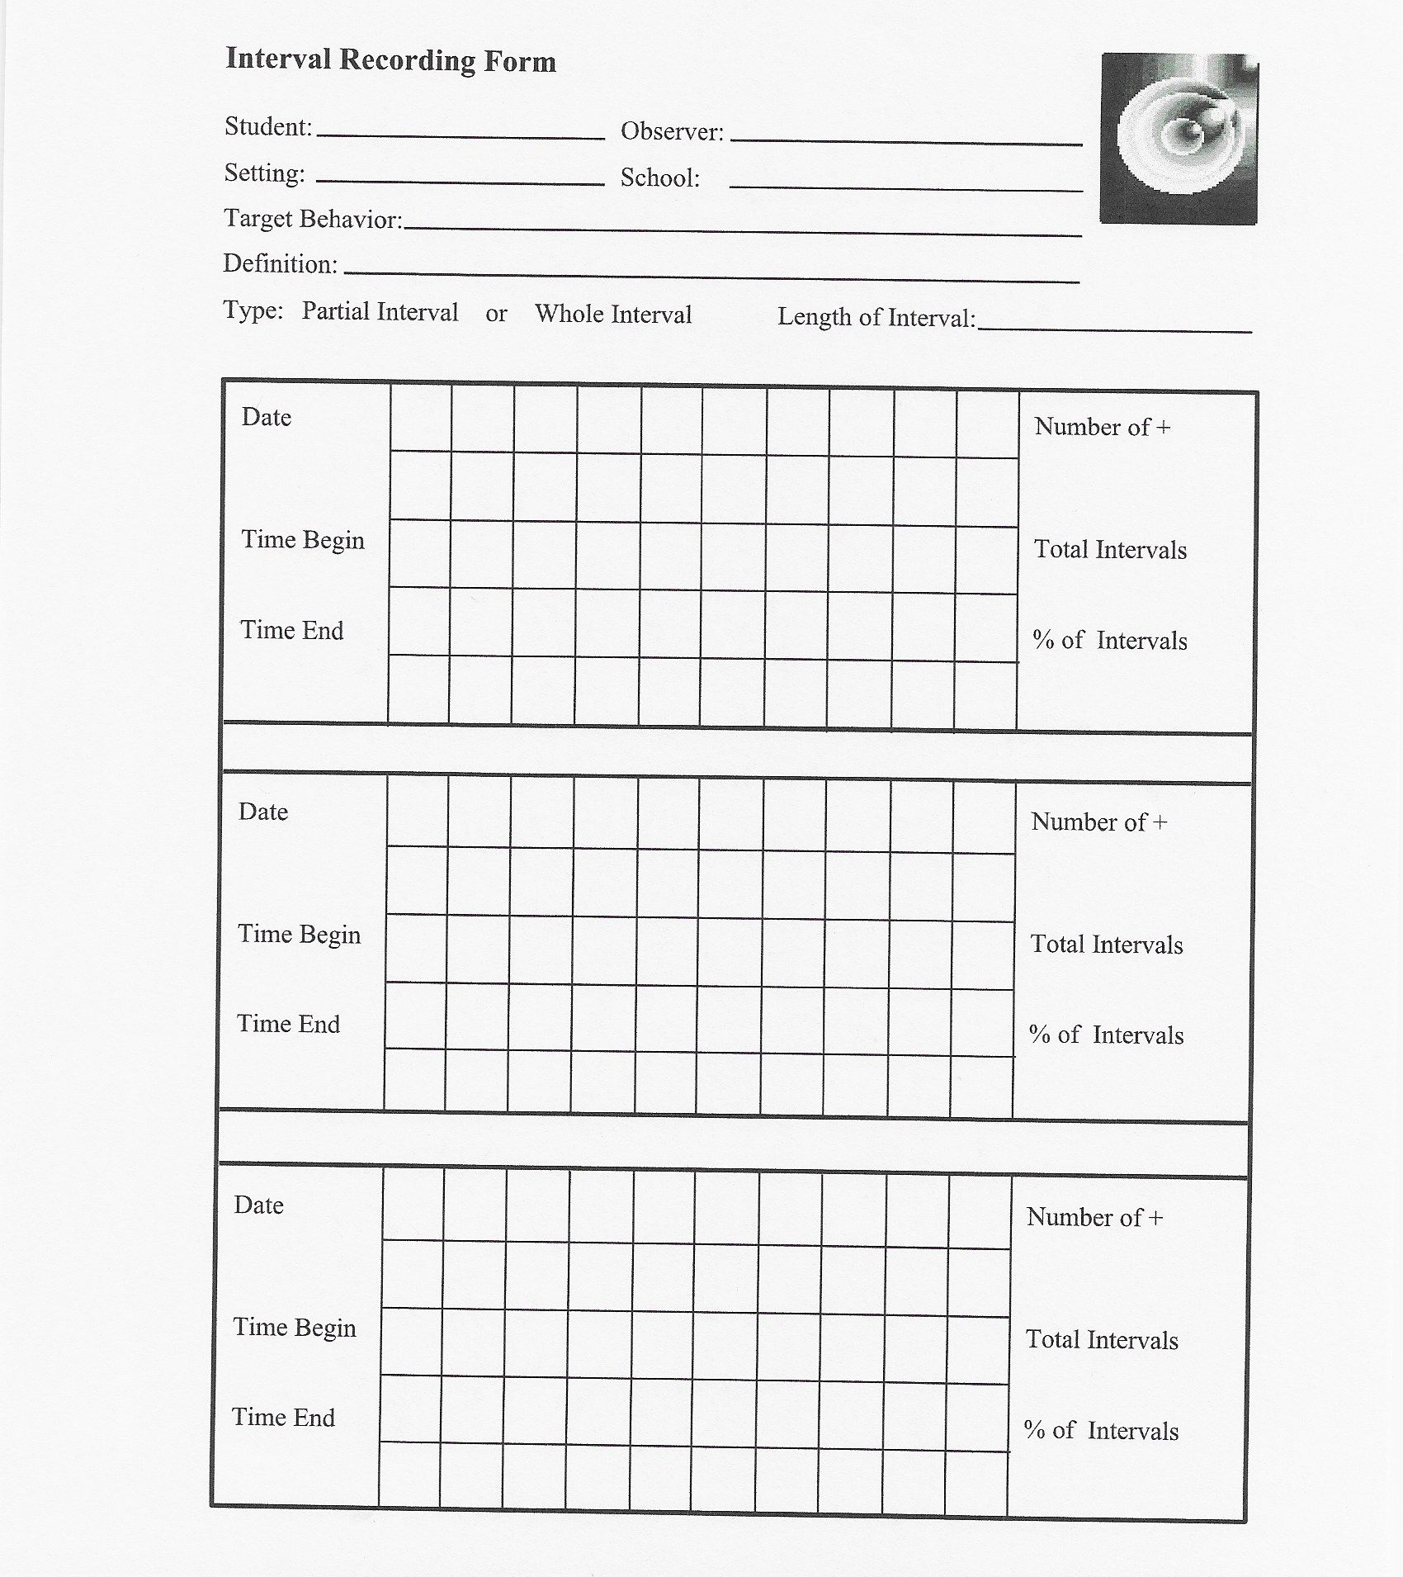
Whole Interval Data Sheet Example, cont.

Slide 132
Partial-Interval Recording
Similar to whole-interval recording, but partial-interval recording will record behaviors that take place at ANY time during a set interval
May overestimate the occurrence of behavior (i.e., If the behavior only occurred during 1 second of a 10 second interval)

Slide 133
Partial-Interval Recording, cont.
This may also under-estimate the occurrence of high frequency behavior (i.e., If a person blurts 4 times in a 10 second time-frame)
Pro: An observer is able to record several behaviors at once

Slide 134
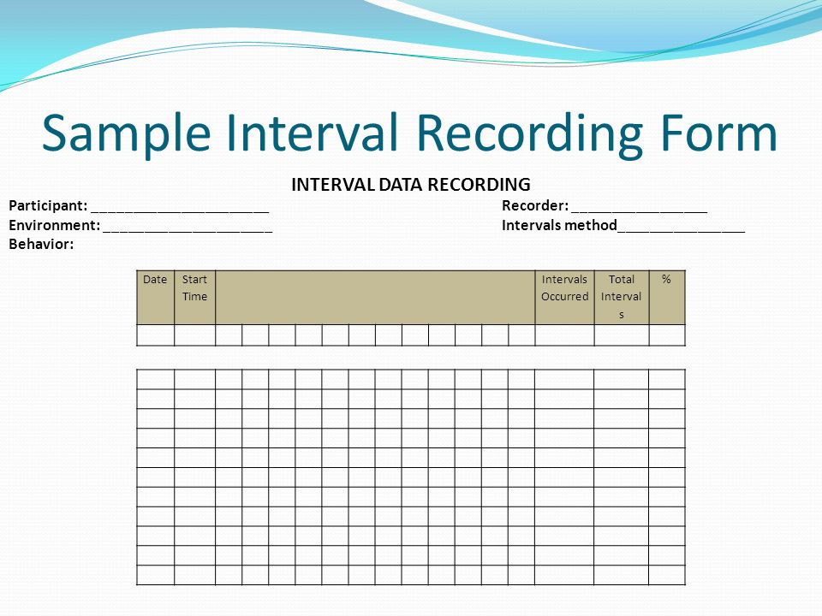
Partial-Interval Data Sheet Example

Slide 135
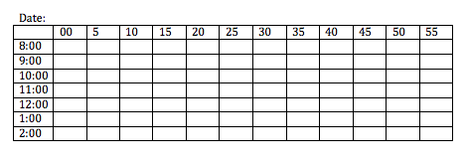
Partial Interval Data Sheet Example

Slide 136
Momentary-Time Sampling
Measuring whether or not a behavior is taking place at the end of a given interval of time
An advantage is that an observer does not need to constantly observe the individual as with whole- and partial-interval recording
A disadvantage is that a great deal of behavior will be missed

Slide 137
Momentary-Time Sampling, cont.
Typically, Momentary Time Sampling is used to measure continuous behaviors (i.e., engagement in particular activities)
Momentary Time Sampling should not be utilized when examining low-frequency behaviors

Slide 138
Momentary-Time Sampling, cont. 2
Should not have intervals over 2 minutes in length. When intervals get too long, the data does not correspond with other methods of behavioral observation

Slide 139
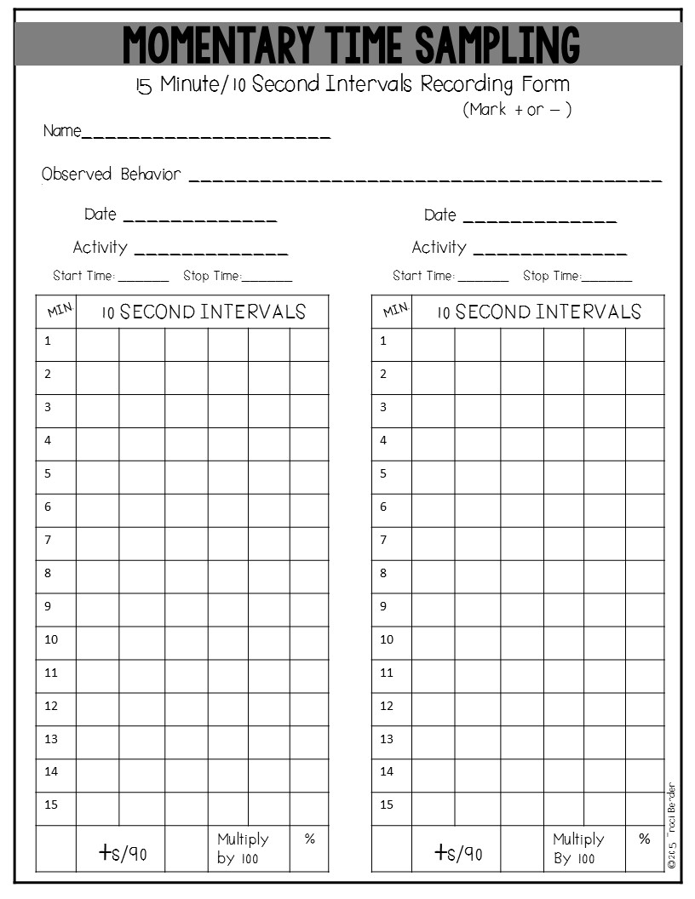
Momentary-Time Sampling Data Sheet Example

Slide 140
Planned Activity Check
Similar to momentary-time sampling, but with a group
Used to measure group behavior
Great method to track class management interventions
Uses a head count at the end of each time interval
E.g., The number of students scored on-task while completing a reading assignment.

Slide 141

Planned Activity Check Sample

Slide 142
Trials-to-Criterion
The number of response opportunities that an individual needs in order to achieve a predetermined level of performance (i.e., how many trials does it take for a student to learn to tie their shoe)
Can be reported as individual trials or by blocks of trials (i.e., how many blocks of 10 presentations did it take for a child to score 100% on a test)

Slide 143
Trials-to-Criterion, cont.
Can also be used to measure a child’s acquisition of a new skills (i.e., how many trials to teach the color red compared to subsequent trials to teach new colors

Slide 144
Trials-to-Criterion Data Sheet Example
With this example, if you set mastery criteria at independent response 80% of trials over three consecutive days, you can easily count number of trials it took to get to mastery.
The goal would be that as they learn the concept of “matching familiar objects” the trials-to-criteria would decrease with new responses.

Slide 145

Data Sheet Example, cont.

Slide 146
PERMANENT PRODUCT

Slide 147
Permanent-Product Recording
Measuring a behavior after is has occurred by measuring the effects that the behavior produced on the environment.
Does not refer to any particular measurement method or procedure
Helpful when real-time measurement is hard to obtain by the teacher/practitioner or is not needed.

Slide 148
Permanent-Product Recording, cont.
Can include natural or contrived outcomes
  Natural examples: written spelling words, Math test grade, picking up trash, broken pencil, etc.
  Contrived examples: video or audio tapes for oral read-aloud, taking pictures of block constructions

Slide 149

Permanent-Product Data Sheet Example

Slide 150

Permanent Product Data Sheet Example Filled Out

Slide 151

Choosing a Data Collection Method

Slide 152
CRITICAL DATA SHEET COMPONENTS

Slide 153

Critical Data Sheet Components, cont.
Student Name
Directions
Definitions
Staff Initials
Clear Time Frame
Data collection space

Slide 154
Data Sheet Directions
Each data sheet need to have SIMPLE and CLEAR directions written on the paper.
These directions make it clear to anyone who needs to use the sheet the expectations for why and how to use the sheet.
Don’t assume everyone knows what to do!

Slide 155
Definitions
An operational definition of behavior or a skill describes what the behavior or skill looks like in a way that is observable, measurable, and repeatable. A definition of behavior should include 4 elements:
  Label Definition
  Examples Non-Examples
Can 2 or more observes the student’s behavior and agree when it is occurring and not occurring?

Slide 156
Staff Initials
Recommendation: having a place for staff to indicate WHO is filling out the data sheet during designated times.
Can use this to add in analyzing another factor that might be affecting behavior
Helps to know staff that may need support for how / what data is being collected
Great to know who is following through with expectations and allows you to provide reinforcement to them!

Slide 157
Clear Time Frames
Make sure that it is clear when data is collected and where that should be put on the data sheet. Can break it down by:
Classes
Set intervals
Location
Day of the week
etc...

Slide 158

Sample Data Sheets
Student Name
Directions
Definitions
Staff Initials
Clear Time Frame
Data collection space
2
1
4
5
3
6

Slide 159

Sample Data Sheets, cont.
Student Name
Directions
Definitions
Staff Initials
Clear Time Frame
Data collection space
1
2
2
3
4
5
6

Slide 160

Collection Consideration Guide
Created a consideration guide for setting up data collection
Use this to think about all the “what ifs” as you develop data collection
Not all things will be necessary or relevant to you

Slide 161

Collection Consideration Guide, cont.

Slide 162
Reach out with any questions!
Kelley Foehrkolb
kfoerhkolb@northfieldschools.org

