Slide 1
Playful Possibilities Part 1: Crafting Meaningful Connections with Adapted Toys
Provided by Region 10 Assistive Technology Team
Statewide Professional Development to Support the Workforce and Low Incidence Disability Areas.

Slide 2
What is play?
What were your favorite play activities as a child?
What do you do to play as an adult?

Slide 3
Definitions of play:
Speech: Gray (2013) lists five important characteristics of play: (a) It is self-chosen and self-directed; (b) it is intrinsically motivated; (c) it is guided by mental rules; (d) it is imaginative; and (e) it is conducted in an active, alert, but relatively non-stressed frame of mind.
Occupational Therapy: Practice framework defines Play as "Activities that are intrinsically motivated, internally controlled and freely chosen and that may include suspension of reality. Play is a complex multidimensional phenomenon that is shaped by sociocultural factors''

Slide 4
"Children need the freedom and time to play. Play is not a luxury. Play is a necessity."
- Kay Redfield Jamison

Slide 5
Principles of Play
Development of skills
Independence
Communication (Social interactions)
Exploration

Slide 6
Promoting Skill Development
Sensory
Motor
Communication
Executive Functioning

Slide 7
Enhancing Independence
Explore, learn, and engage independently
Active engagement
Intrinsic motivation

Slide 8
Play is Play- regardless if a switch is involved.
We are just adapting play, not modifying the concept of play.

Slide 9
Fostering Social Interaction
Inclusion in play
Shared play experiences
Communicate and build bonds with peers
Turn-taking and sharing
Peer modeling
Build confidence

Slide 10
Encouraging Exploration
Imagination
Suspension of Reality
Offer toys that allow for open-ended play
No right OR wrong way to interact with toys
Allow for creativity and experimentation
Temporary belief that something is not true
Provide opportunities to explore new possibilities, develop creativity, & build confidence – INCREDIBLY VALUABLE for children with disabilities
Play changes across the lifespan and should be scaffolded to support development and interests over time​

Slide 11
Can you identify meaningful play?
Development of skills
Independence
Communication (Social interactions)
Exploration

Slide 12
Is this Meaningful Play?
YouTube Video Link: Playing with his switch adapted toys (0:15)

Slide 13
Watch and Score Video #2
YouTube Short Video Link: Water Squirter

Slide 14
Watch and Score Video #3
Sensory Play Video Link (1:07)

Slide 15
Adapted Play assists in UNLOCKING the Potential in children with disabilities!
Adapted Play assists with cognitive development
Adapted Play assists with communication development
Adapted Play assists with social/emotional development
Adapted Play assists with executive function development

Slide 16
Cognitive Impact
Enhances Problem-Solving Skills
Creates Opportunity for Creativity
Develops Critical Thinking
Contributes to the Enhancement of Memory and Information Retention

Slide 17
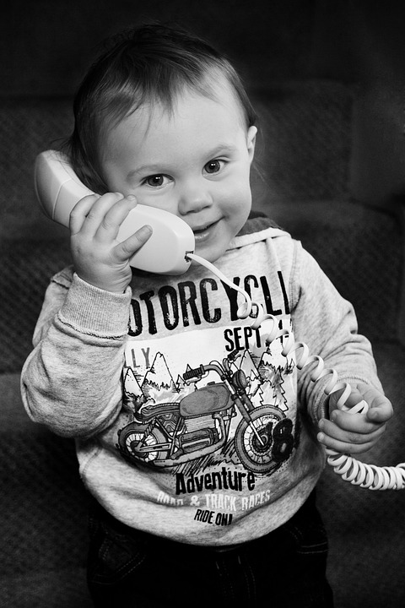
Communication Impact
Language Acquisition
Verbal & Non-Verbal Expression
Social Communication
Building Confidence

Slide 18
Social Emotional Impact
Emotional Regulation
Empathy Development
Conflict Resolution
Self-Discovery

Slide 19
Executive Function Impact
Cognitive Flexibility
Working Memory
Inhibitory Control
Planning & Organization
Problem-Solving Skills

Slide 20
Can you create Meaningful Adapted Play?
Scenario #1: Toddler Miles with a diagnosis of Down Syndrome
Scenario #2: Preschooler Payton with a diagnoses of hypoxic ischemic encephalopathy & cortical visual impairment.
Scenario #3: First Grader Carley without a diagnosis
Scenario #4: Fifth Grader Jake with a diagnosis of Cerebral Palsy
Scenario #5: Middle Schooler Brian with low vision and mobility difficulties
Scenario #6: High Schooler Alex with physical & cognitive limitations

Slide 21
Closing Slide, Thank you!
Lori Warner: lwarner@northfieldschools.org
Lori Holm: lholm@cannonvalleyspecialed.org
Christine Seeger: christine.seeger@austin.k12.mn.us
Monica Capra: capra.monica@gced.k12.mn.us
Scott Berglund: scott.berglund@msa.state.mn.us
Dani Gatzke: dgatzke@zumbroed.org

