Slide 1
Customized Employment and Visual Resumes
Presented by:
Margie Webb, MS, CRC, Customized Employment Specialist for MN Vocational Rehabilitation Services

Slide 2
What is Customized Employment
Customized employment (CE) is an interest-based negotiation between the job seeker and employer. CE is a process that allows individuals with disabilities and employers the opportunity to negotiate job tasks and/or reassign job duties to improve overall contribution in the workplace. For employers, customized employment allows an employer to examine its specific workforce needs and fulfill those needs with an employee’s specific skills.

Slide 3

Customized Employment in a “Nutshell”
Customized Employment (CE):
An alternative approach to the competitive employment process
Originally created for those with the most significant challenges to find employment, but can be used for anyone including yourself
Typically, more time intensive – truly person-centered and focused on individuals = 1 person at a time

Slide 4
Elements of Customized Employment
Negotiated job tasks with employer
Assumes all people can contribute-not are “ready” to work
Employee often requires less supports than anticipated
Job tasks are grouped and designed for one individual
Employment meets the:
Tasks, skills of job seeker
Ideal conditions of job seeker
Individual interests

Slide 5
Customized Employment Phases
Phase #1 Discovery
Phase #2 Job Development
Phase #3 Employment Supports

Slide 6
Discovery Components
Home visit
Interviews with people who know the individual
Neighborhood Information gathering
Participation in Life Activities both familiar 3-4 and one new
Theme development-reoccurring, unifying patterns

Slide 7
Discovery Components Cont.
Theme testing-making sure vocational themes meet 3 components of skills, interests, and conditions of employment
Information interviews with businesses that match themes-not jobs
Development of Visual Resume, video or marketing materials
Summary team meeting to develop CEP-Customized Employment plan for employment

Slide 8
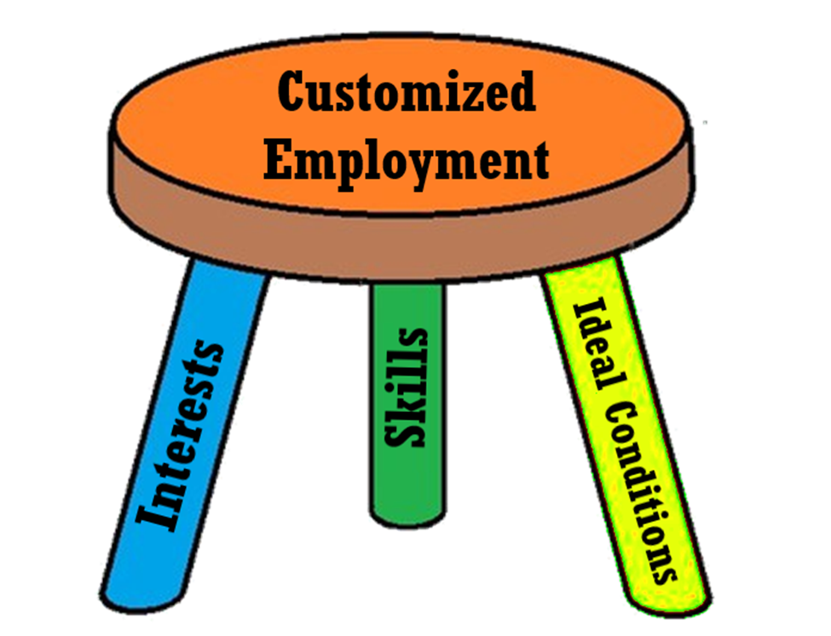
3-Legged Stool
Customized Employment finds:
The skills of the job seeker
The interests of the job seeker
The ideal conditions for the job seeker

Slide 9
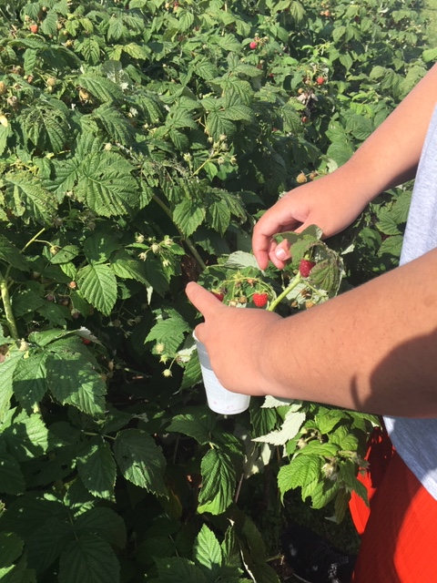
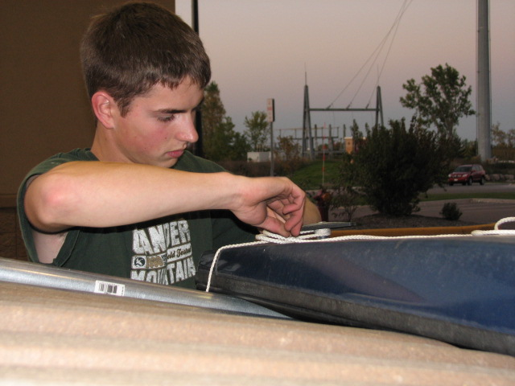
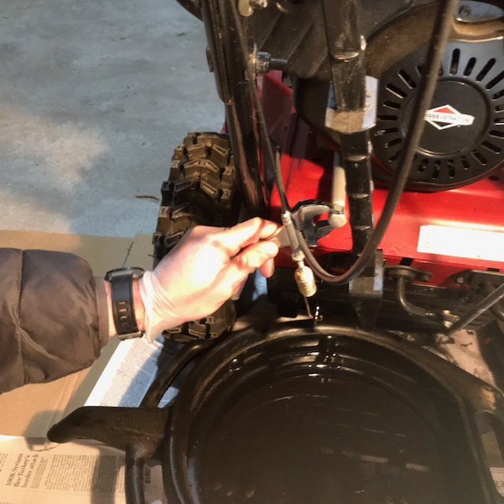
Focusing on a person’s strengths:
What they do and how they contribute

Slide 10
Timing of Discovery
Individual is stable so we get accurate information
Team is on board with the process
If individual needs supported employment those supports are available or person has funding access
Individual allows for engagement with others

Slide 11
Who is a good candidate for Discovery
An individual with significant impact of disability who requires CE
A person traditional placement has not been successful
A person who has communication challenges
People with significant intellectual abilities
When other methods of planning are not leading to employment
When there is a lack of information, employment experience, skill/interest knowledge
An individual who cannot complete job descriptions, but completes sspecific tasks
Person who can accommodate 8-10 weeks of Discovery process

Slide 12
Funding for Customized Employment
Waivers-check with county case manager
Vocational Rehabilitation Services
VRS requires all providers to obtain certification
Certification includes 40-hour course certificate & pass a Competency Review Process (submitting an approved work sample and visual resume/marketing materials)
Private pay

Slide 13

Why We Create Visual Resumes
  Breaks down biases and barriers
  Shows skills that do not translate from a paper resume
  It’s a low stress way of bragging about skills (non-verbal, slow processing, interviewing is high stress)
  Traditional resumes do not work for many of our job seekers (lacking references, experience and previous job loss)

Slide 14

Types of Visual Resumes
PowerPoint
Video resume
Pictures of actions
Portfolio- Examples of completed work

Slide 15

Key Components of Visual Resumes
Cover page- portrait photo & name
Skills & attributes page
Quality photos- 3-5 photos of task engagement
Where I am at my best page- ideal conditions
Potential contributions
Conclusion/contact page
Typically, 8-12 pages

Slide 16

Coyote Gym
An employee who will get the job done!

Slide 17
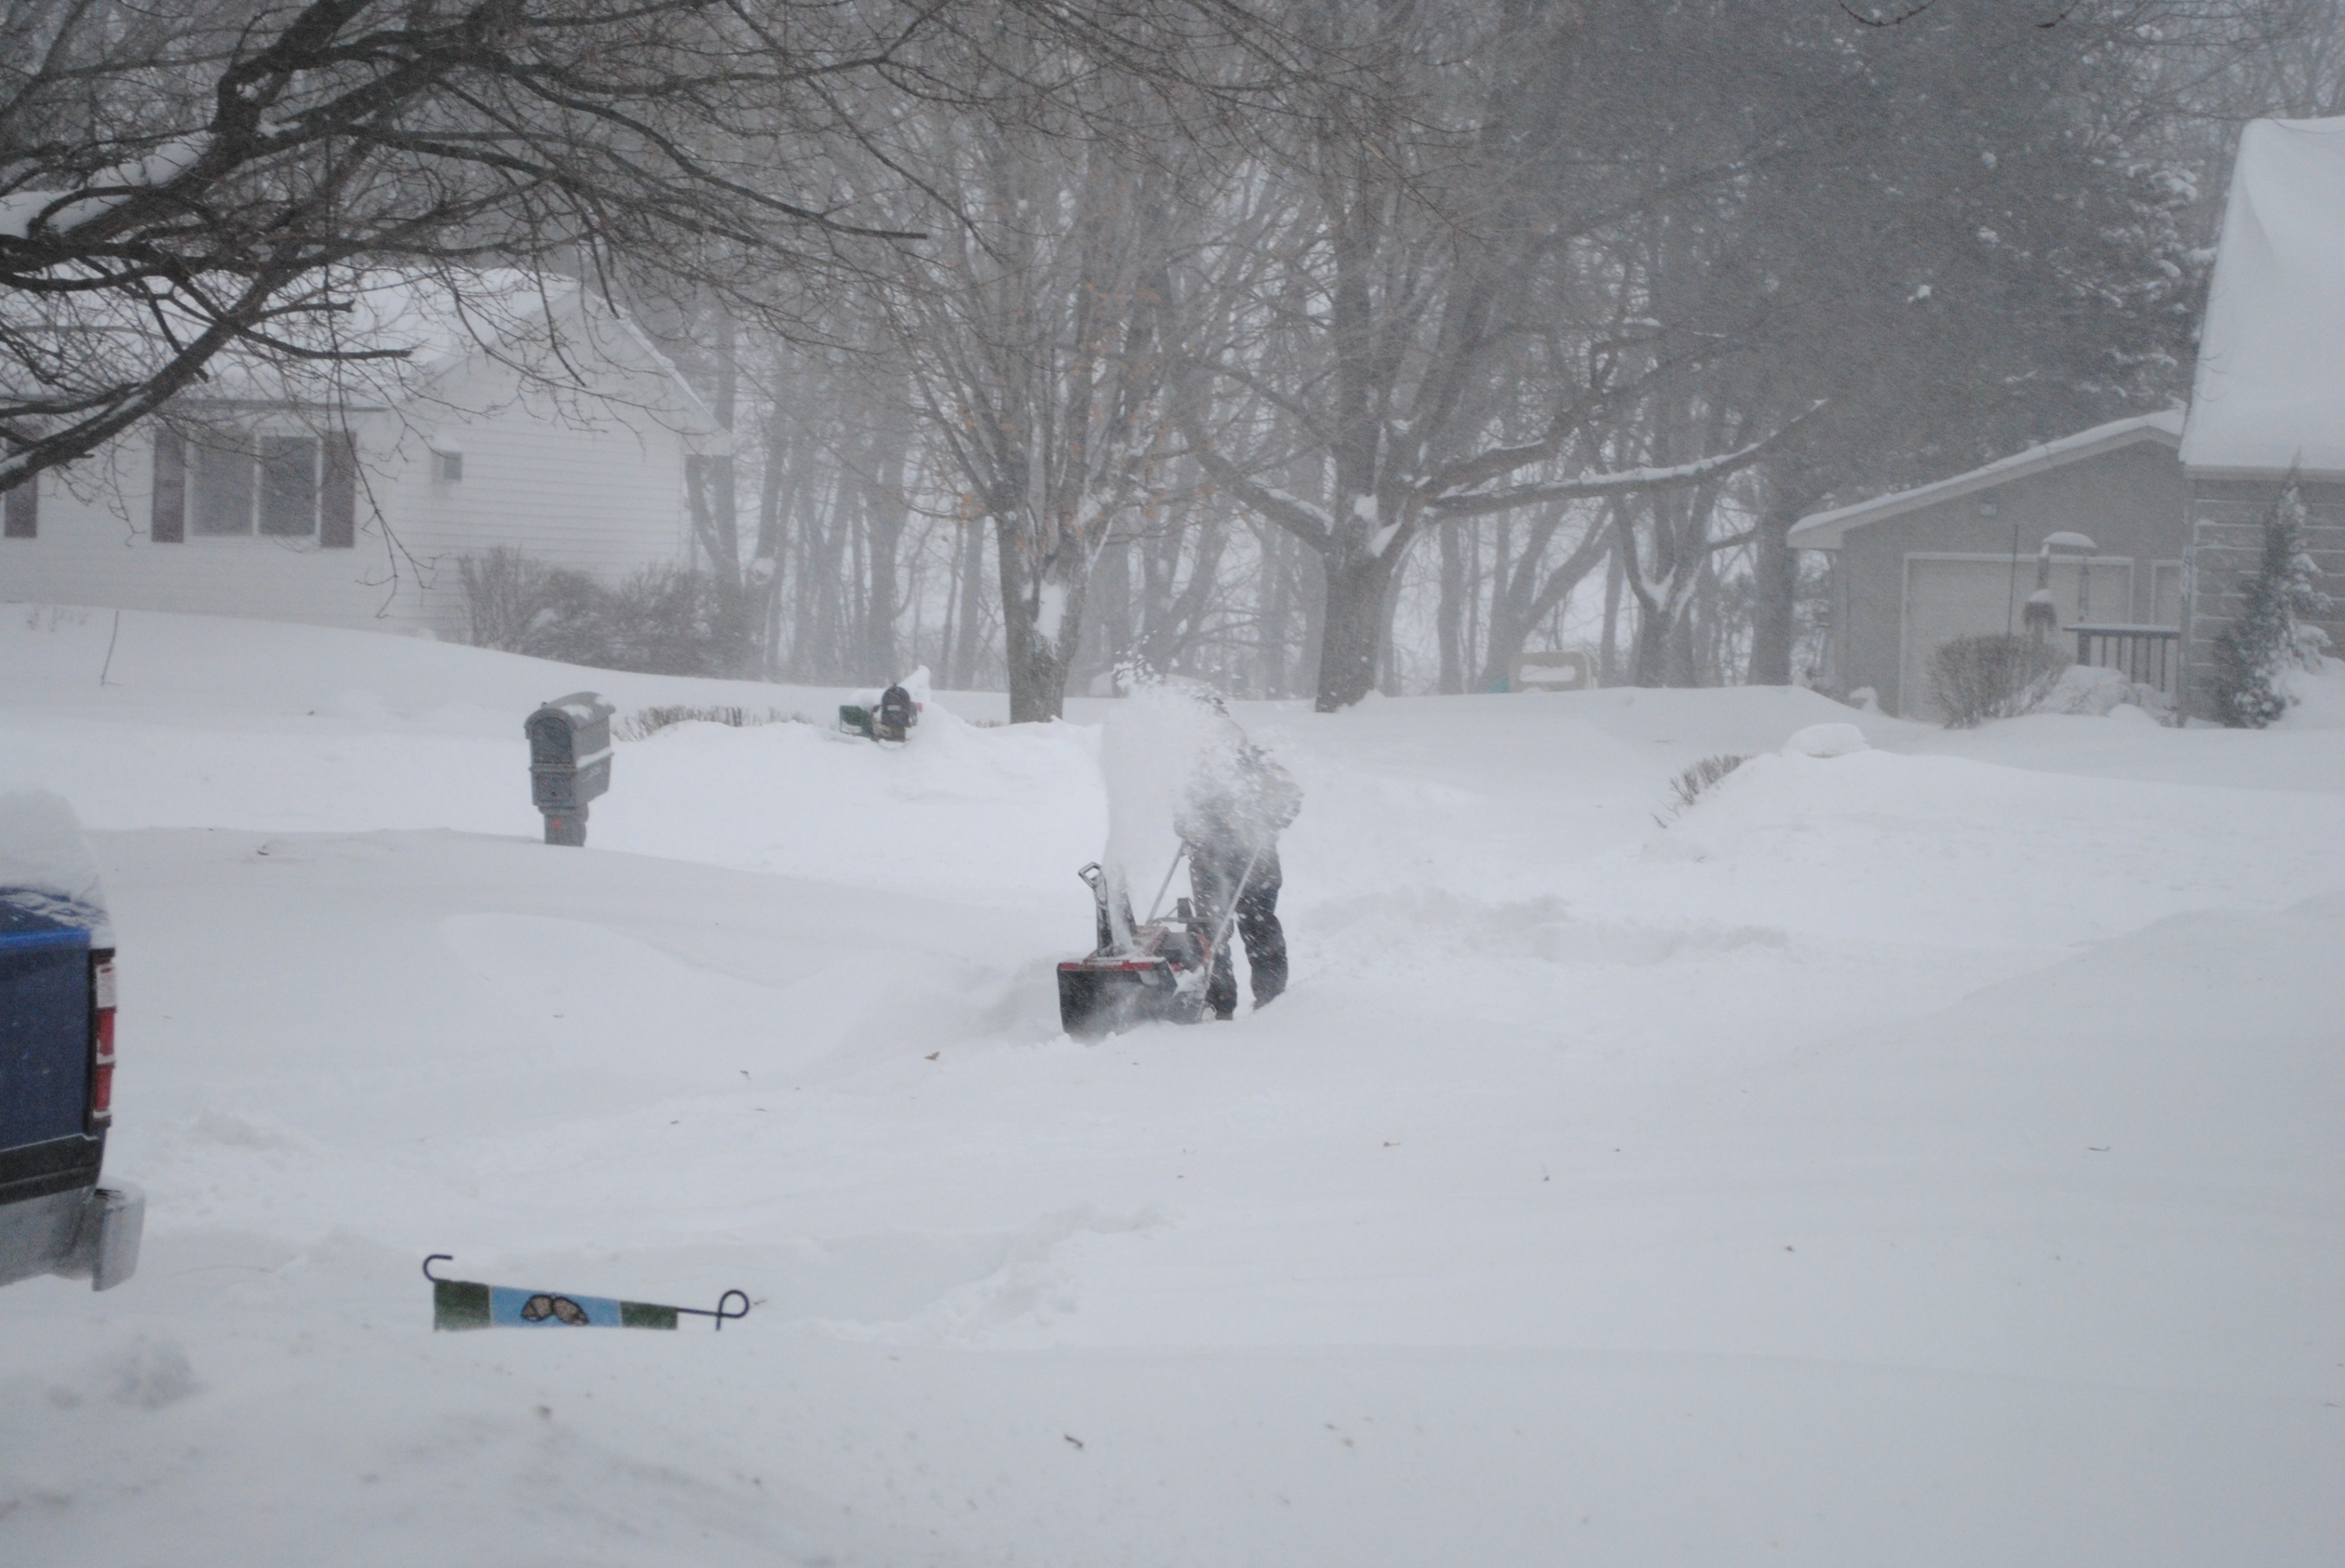
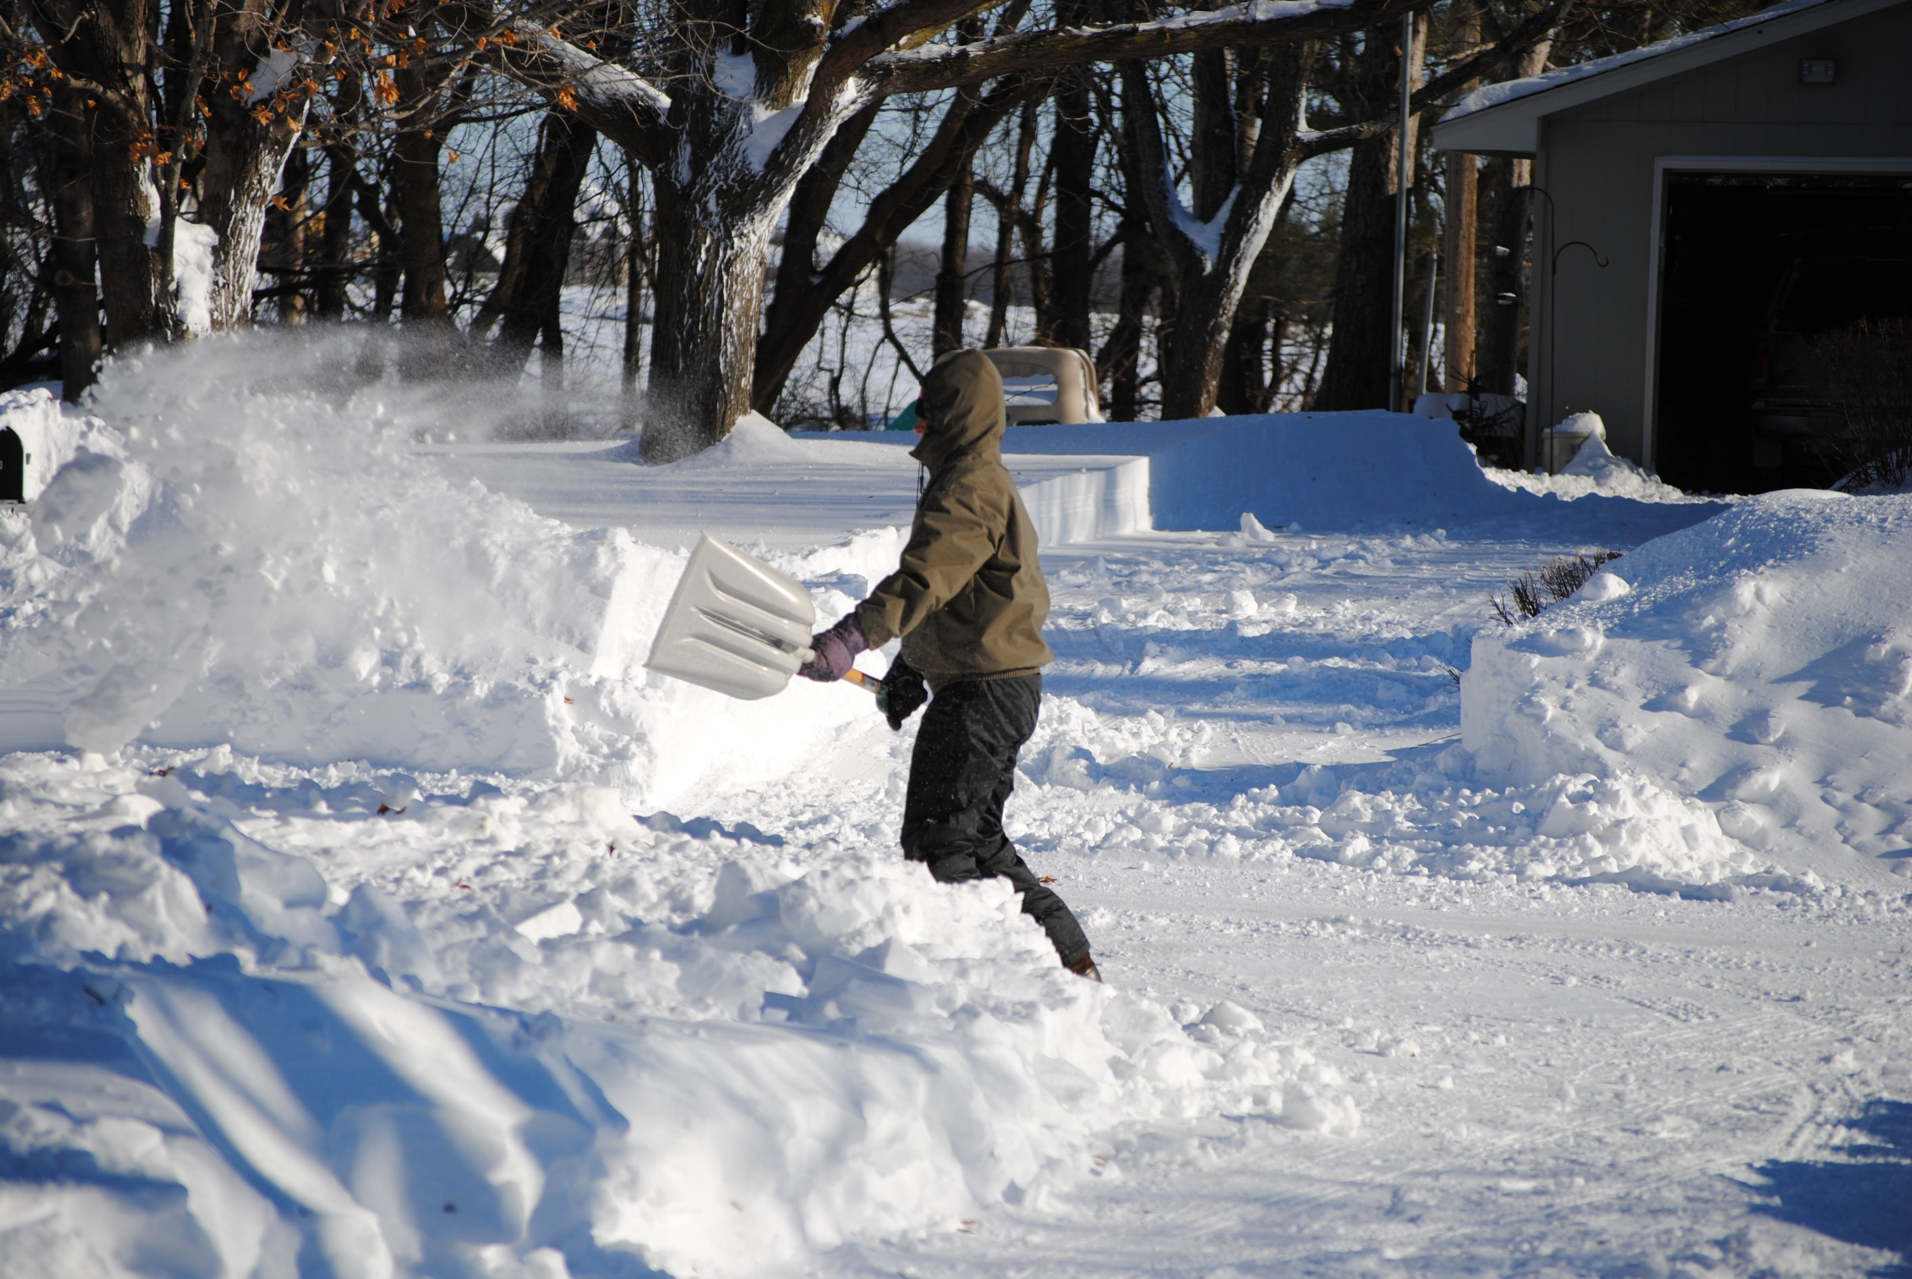
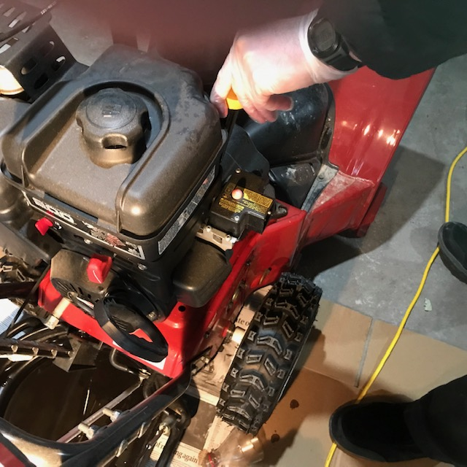
Snow Removal
Shovel Operate snow blower Check oil & gas, add any fluids

Slide 18
I’m at my Best when..
Working outdoors
Work materials are accessible to me, in my area
Completing physical tasks
Contributing to preserve our natural environment
Reusing or repurposing items and materials to minimize waste
Working on my own or in a small group with few public interactions required

Slide 19
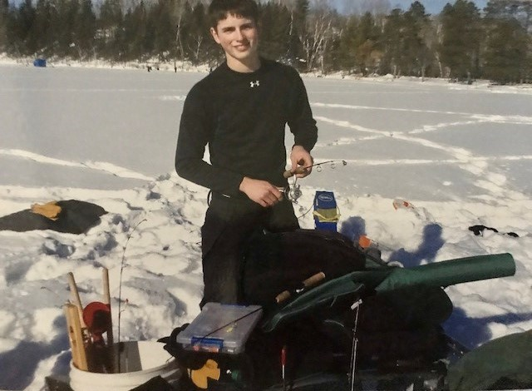
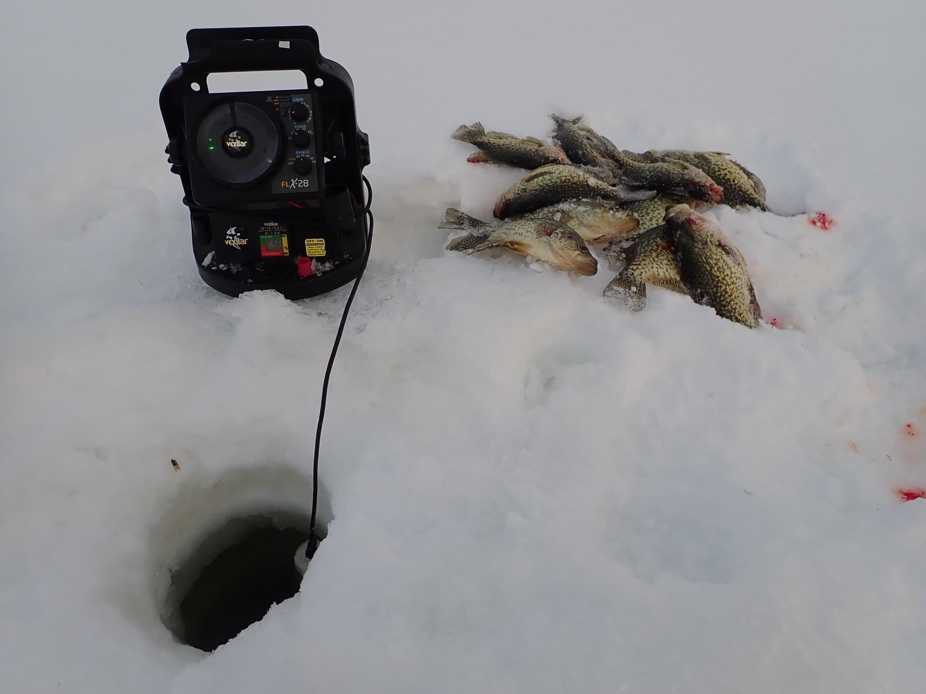
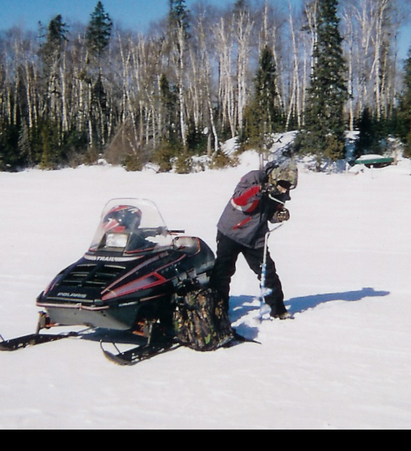
Ice Fishing
Use hand ice auger
Set up depth finder
Set up fish locater
Tie jigs on lines
Catch fish
Fillet & eat fish

Slide 20
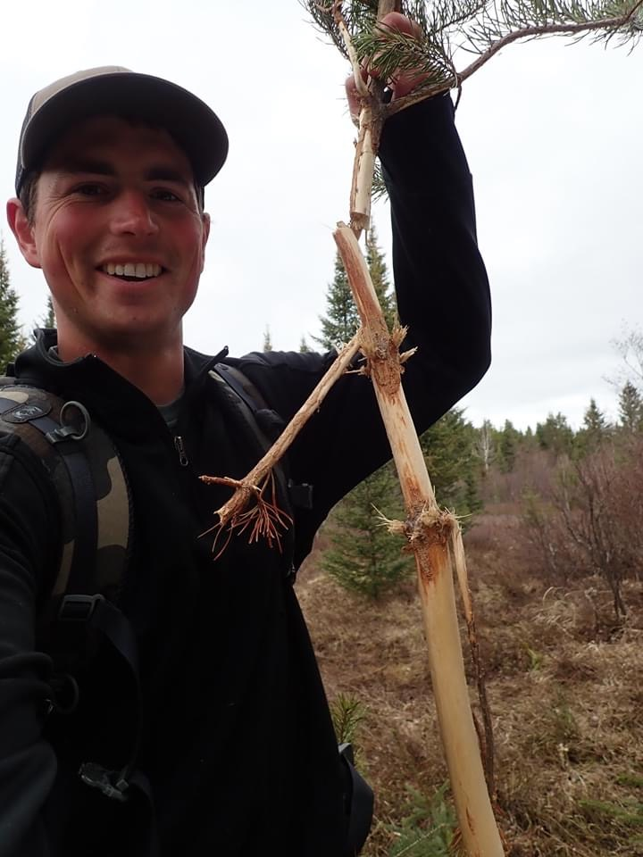
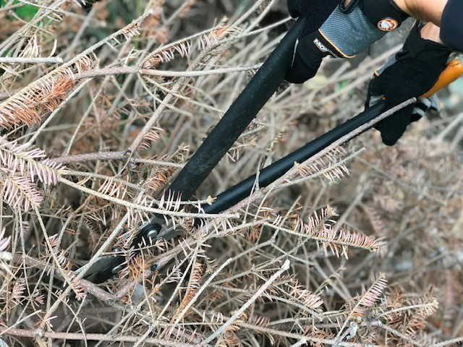
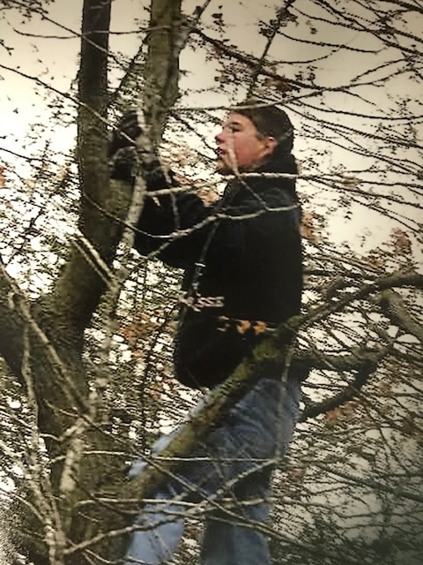
Tree Pruning at Three Rivers
Checking trees for disease by inspecting the bark
Removing damaged limbs
Trimming branches that have grown into trail areas
Removing debris from trails
Pruning extra growth to promote health in trees and shrubs in the park

Slide 21
Skills and Attributes
Artistic
Follows directions
Gets assignments completed
Eye for detail
Safety conscious
Trained in First Aid & CPR
Attained rank of Eagle Scout
Checks and maintains equipment
Environmentally conscious
Enjoys being outdoors
Designs and crafts hand made gifts

Slide 22
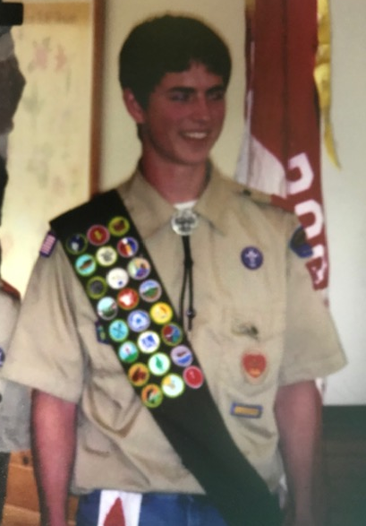

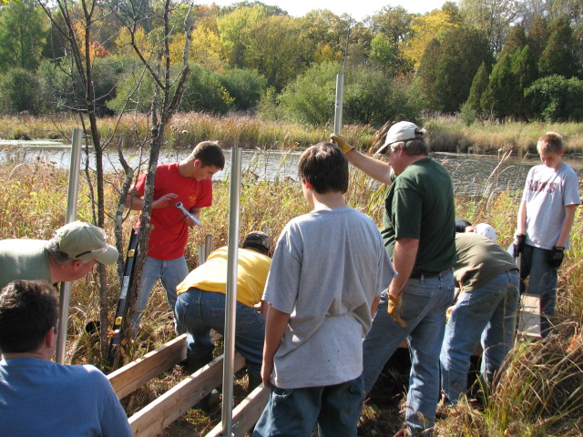
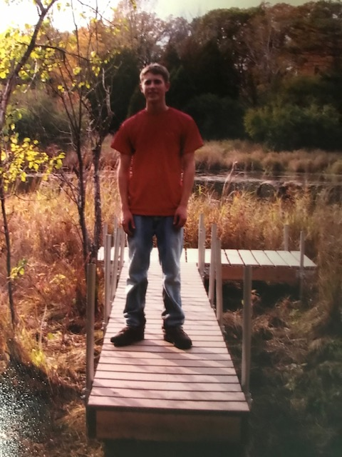
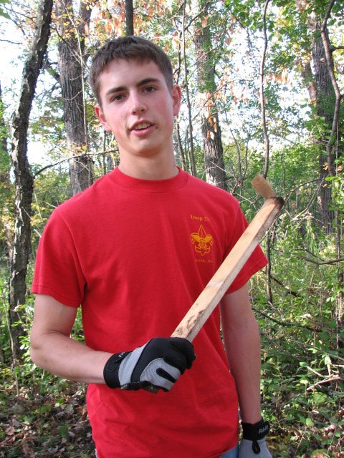
Eagle Scout Project
Planned Pier Nature Observation deck
Obtained donations from Lowes
Planned pier project
Organized scout crew for construction
Built nature pier at the Marine on St. Croix in Stillwater

Slide 23
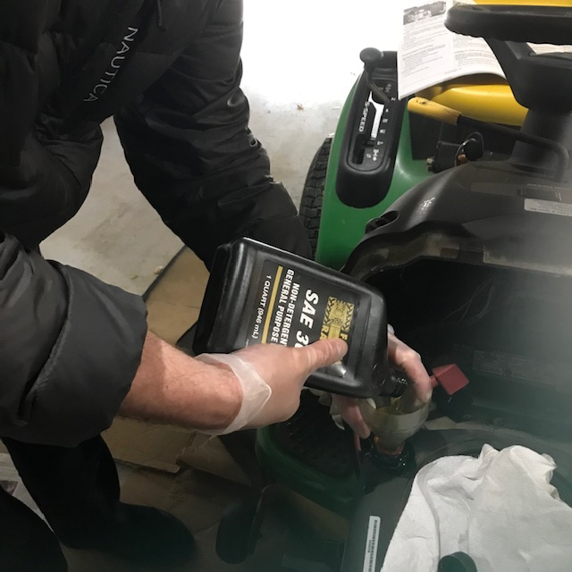

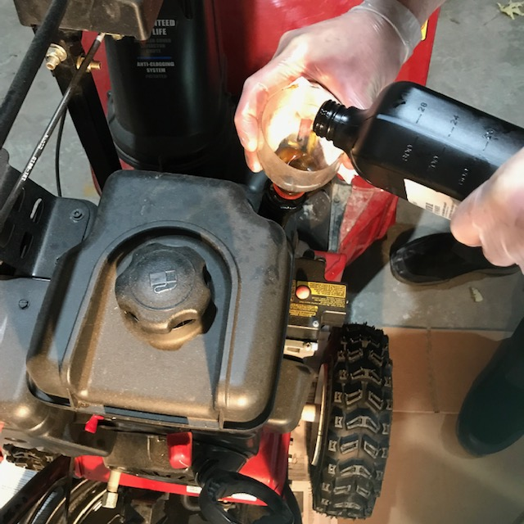
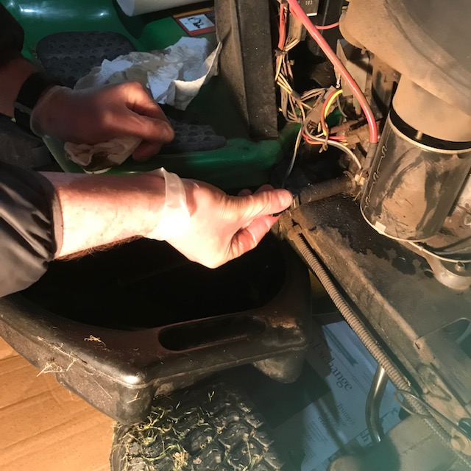
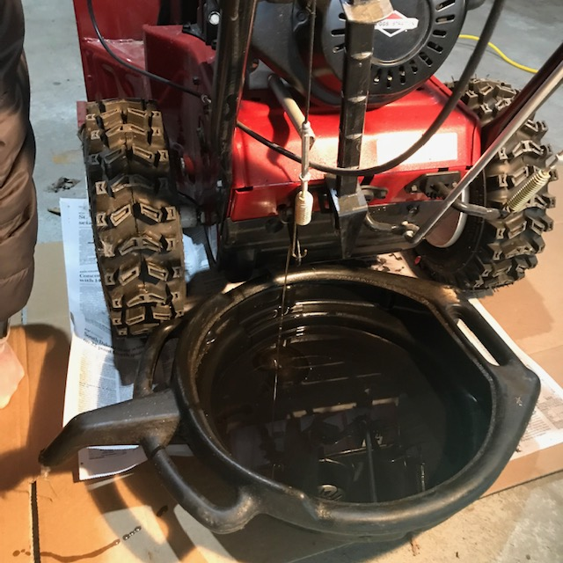
Engine Maintenance
Unscrew drain bolt Drain oil Refill oil to full Unscrew plug to drain oil Refill to full

Slide 24
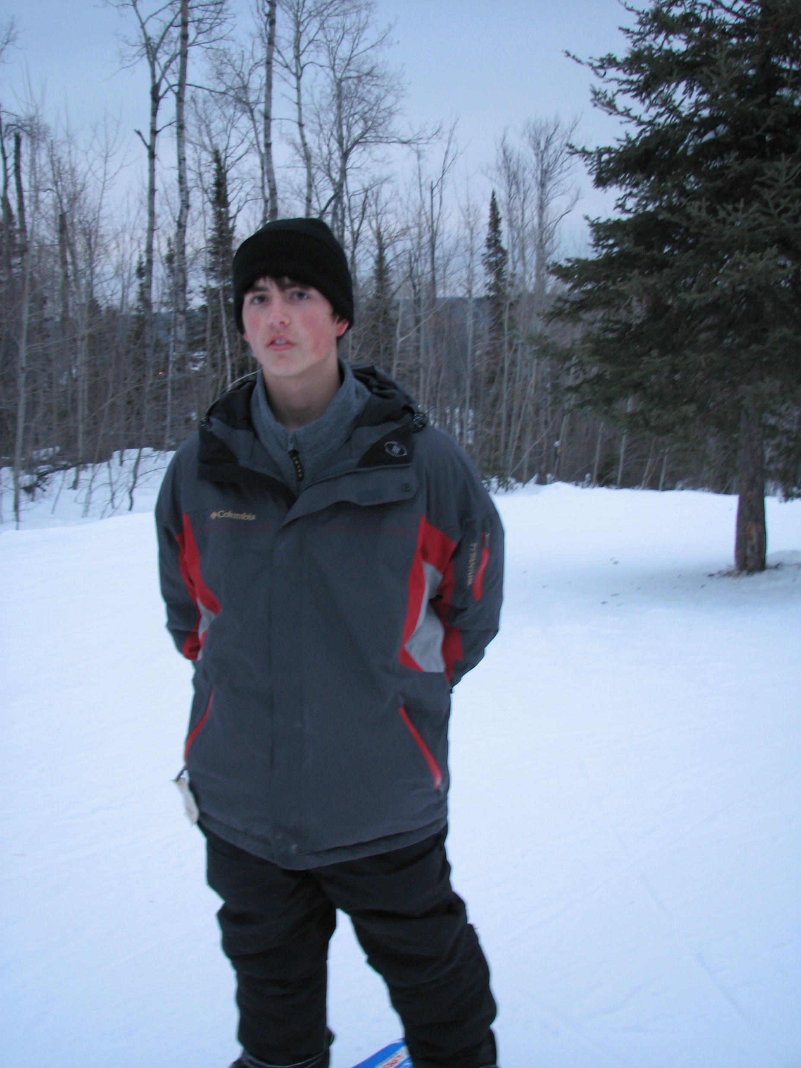
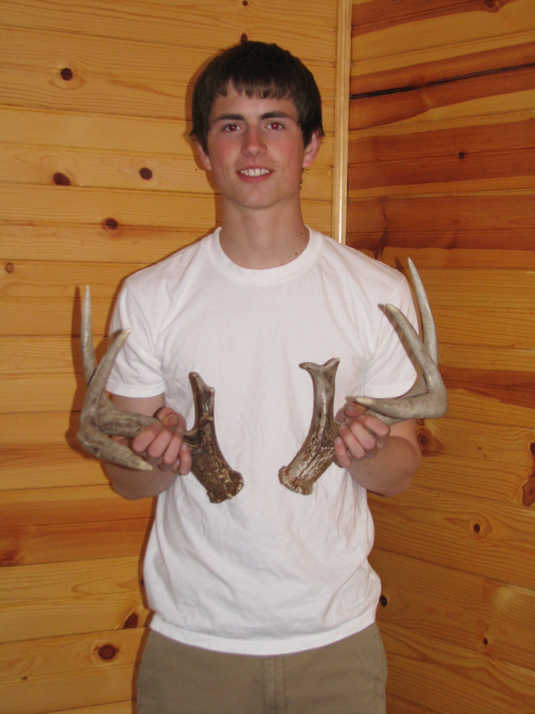
Snowshoe trail tour at Lebanon Hills
Snowshoe 1.5-mile trail
Coyote pointed out various tree types by name
Found matching set of deer antlers just off the trail lying in the snow
Picture of Coyote in the lodge with the antlers, which he donated to the nature center for education purposes

Slide 25
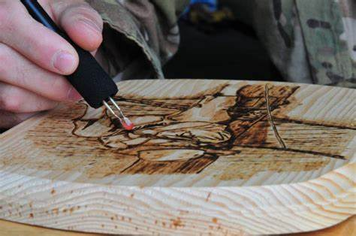
Wood burning
Practice and warm up board
Use electric wood burning tool to create intricate wood nature sketches
Manipulate tool to create sketch patterns
Apply protective coating on wood
Canoe paddle Coyote made as a gift for his father

Slide 26
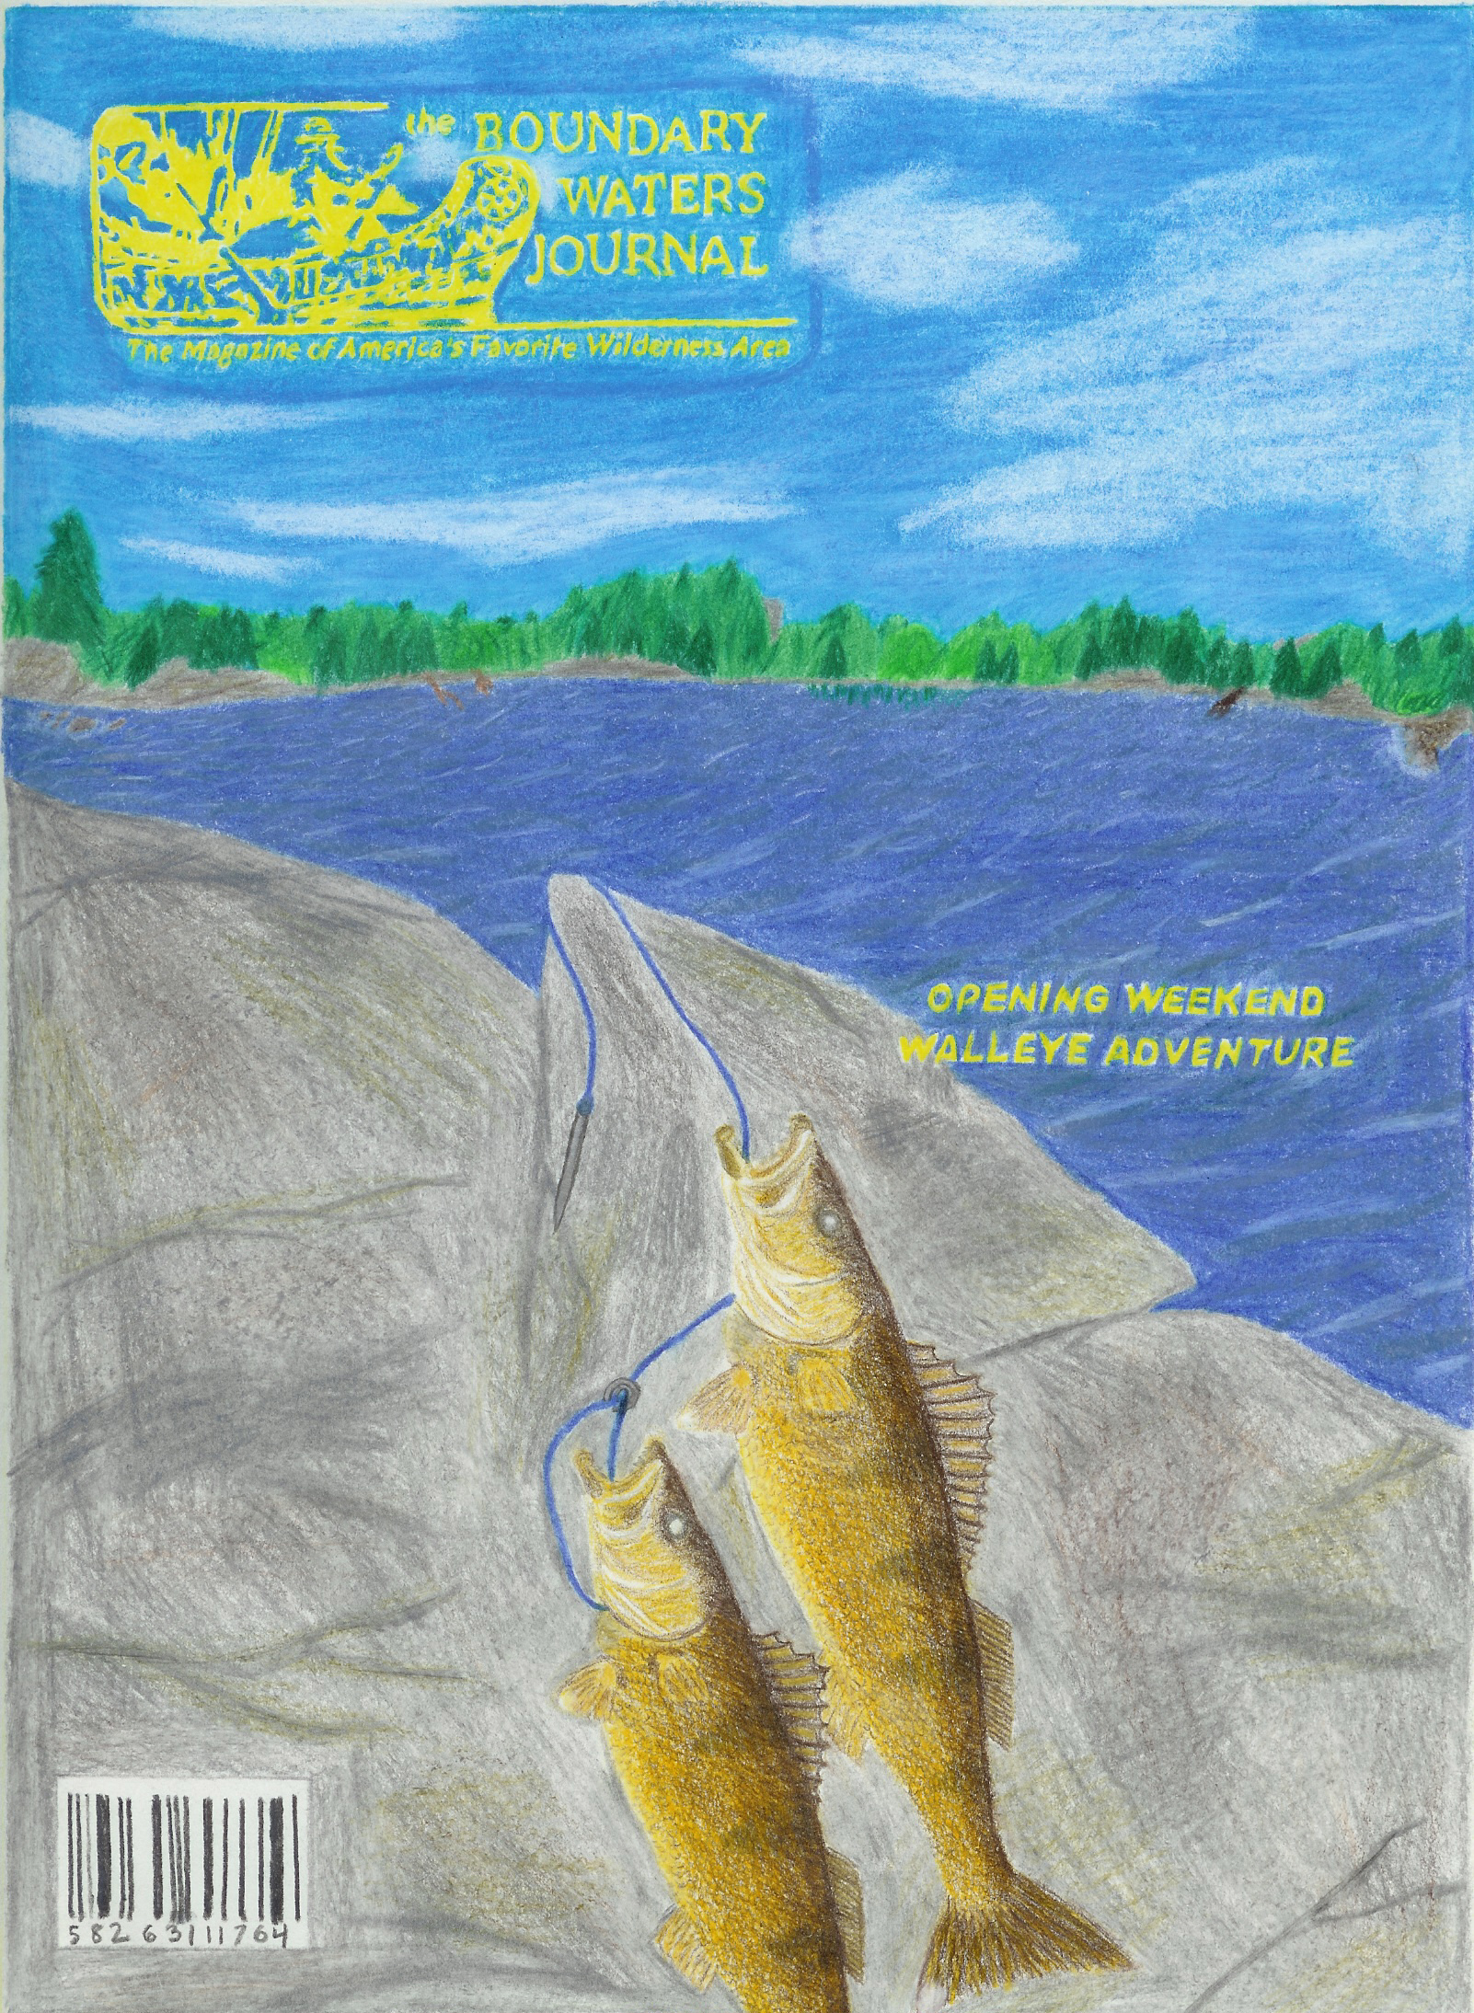
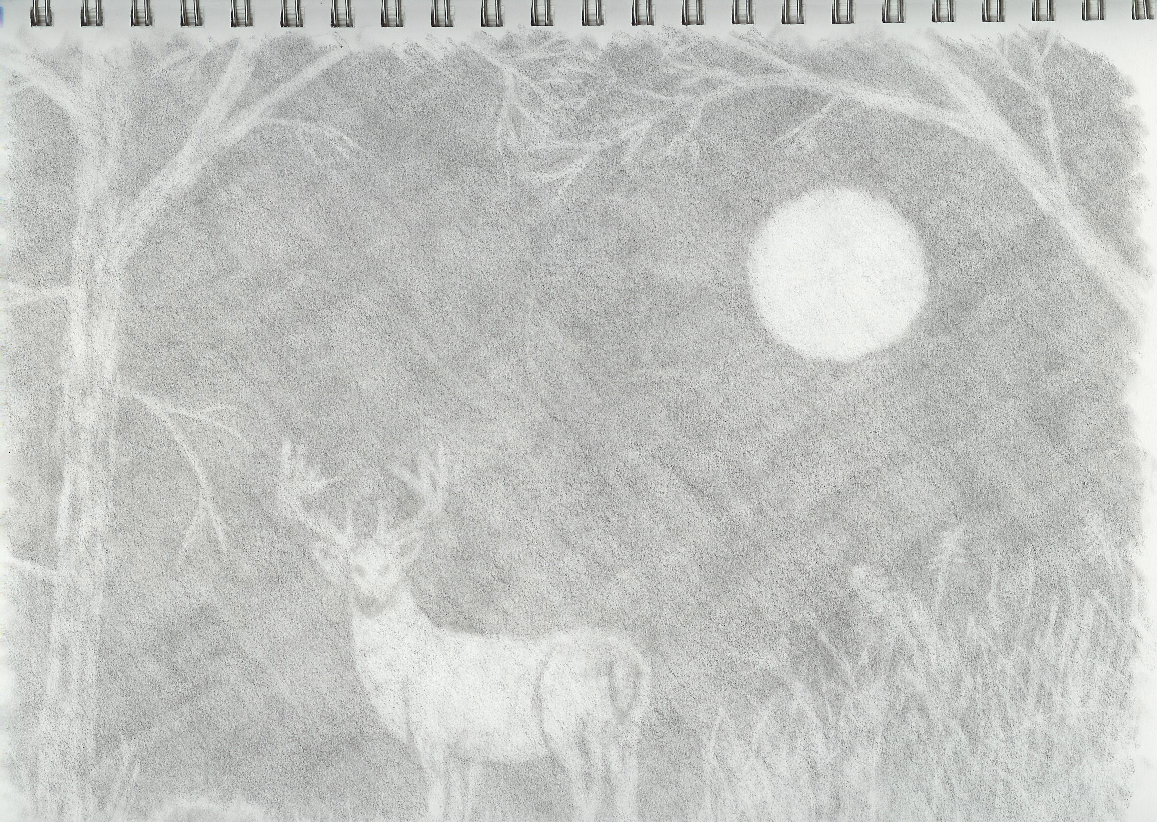
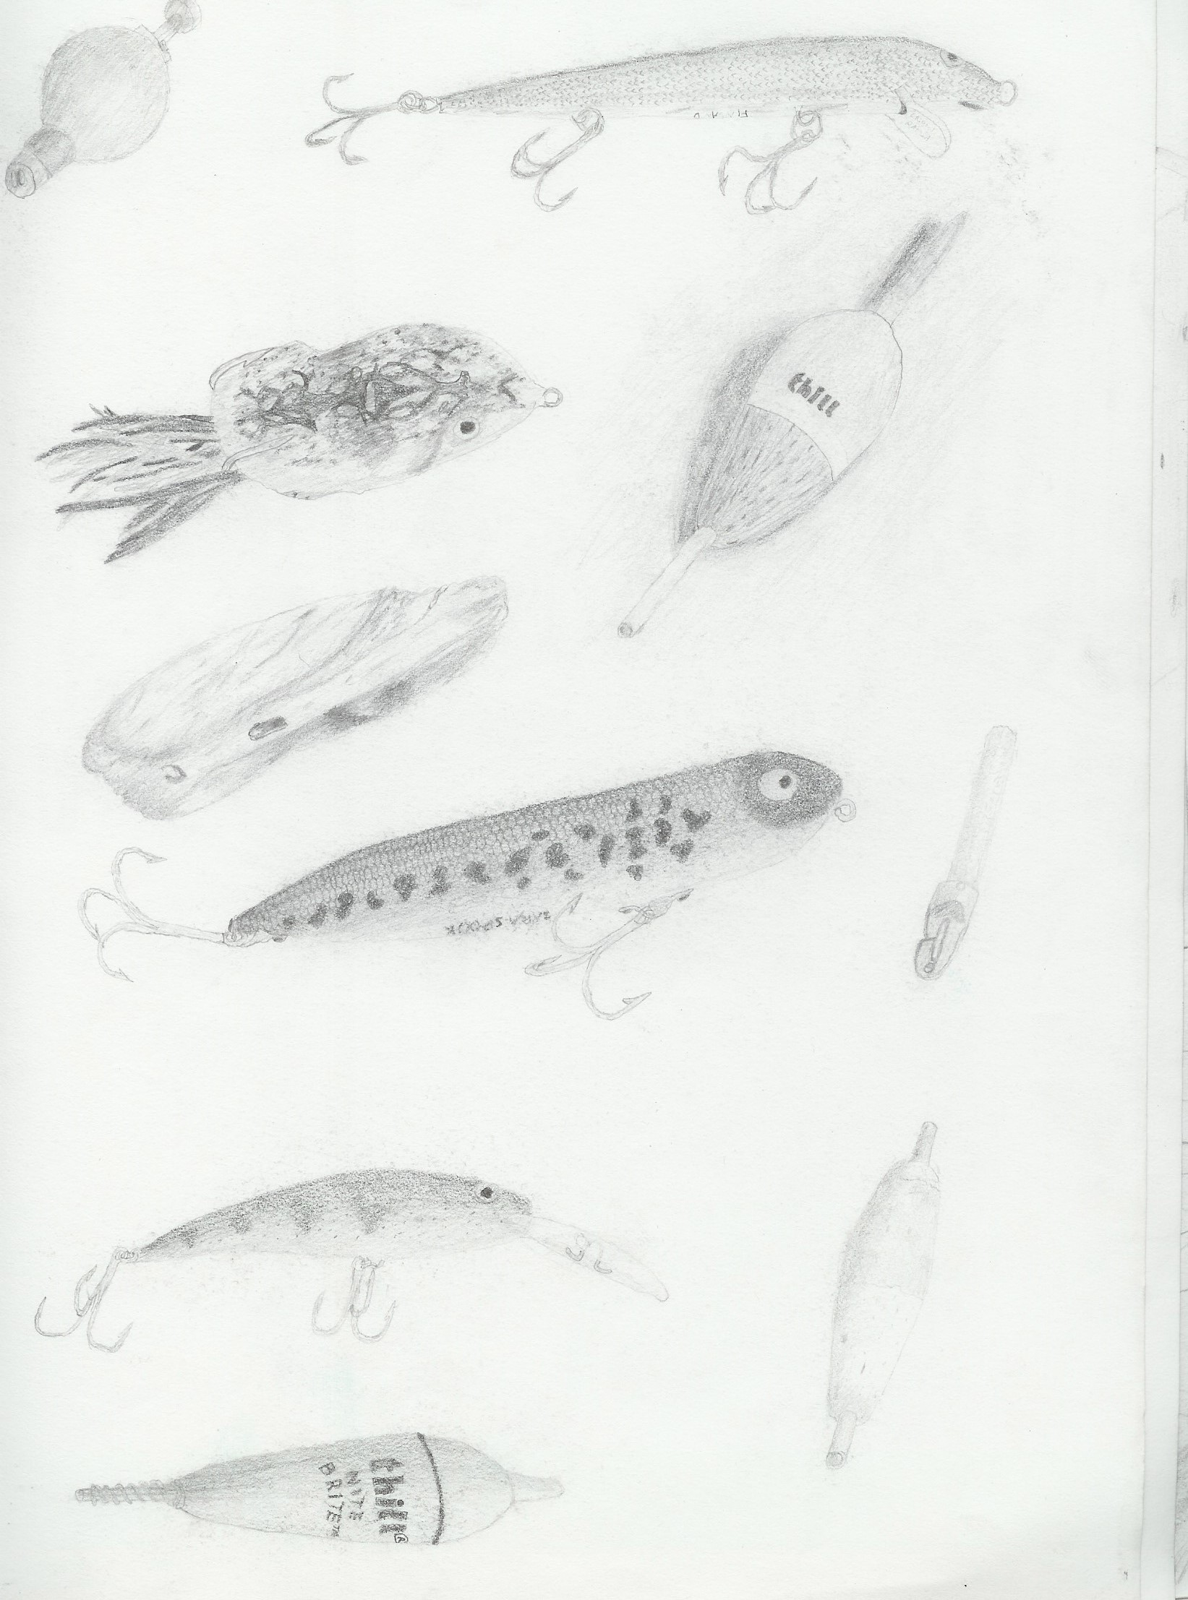
Pencil Sketching

Slide 27
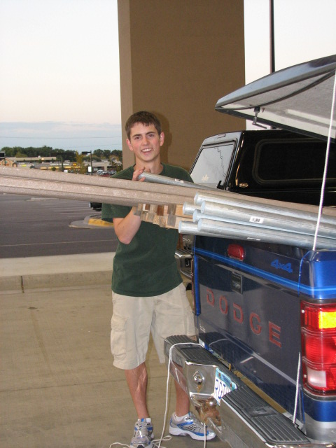

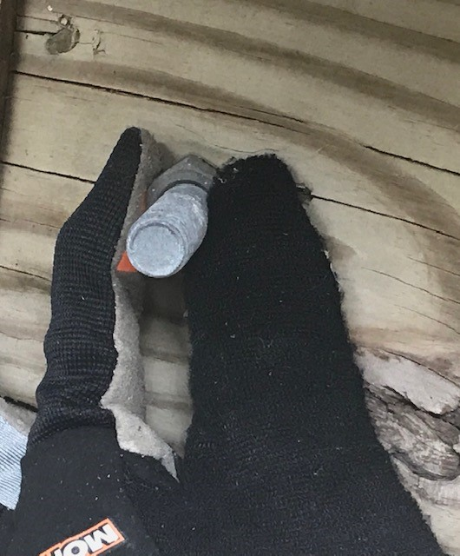
Deck Construction
Load and unload materials for deck construction into shop
Measure deck boards for cutting
Assemble metal support brackets by inserting and tightening bolts
Screw decking boards to base

Slide 28
Contributions to Your Business
Plant, tree, nature identification
Safety skills, first aid training
Use of small hand & power tools
Trim, prune, extract invasive trees, bushes, and shrubs
Physical strength and stamina in all weather conditions
Operate, maintain lawn & snow equipment
Load, unload, move raw materials
Pencil drawings, wood burning
Accurately measure lengths
Eye for detail and observations

Slide 29
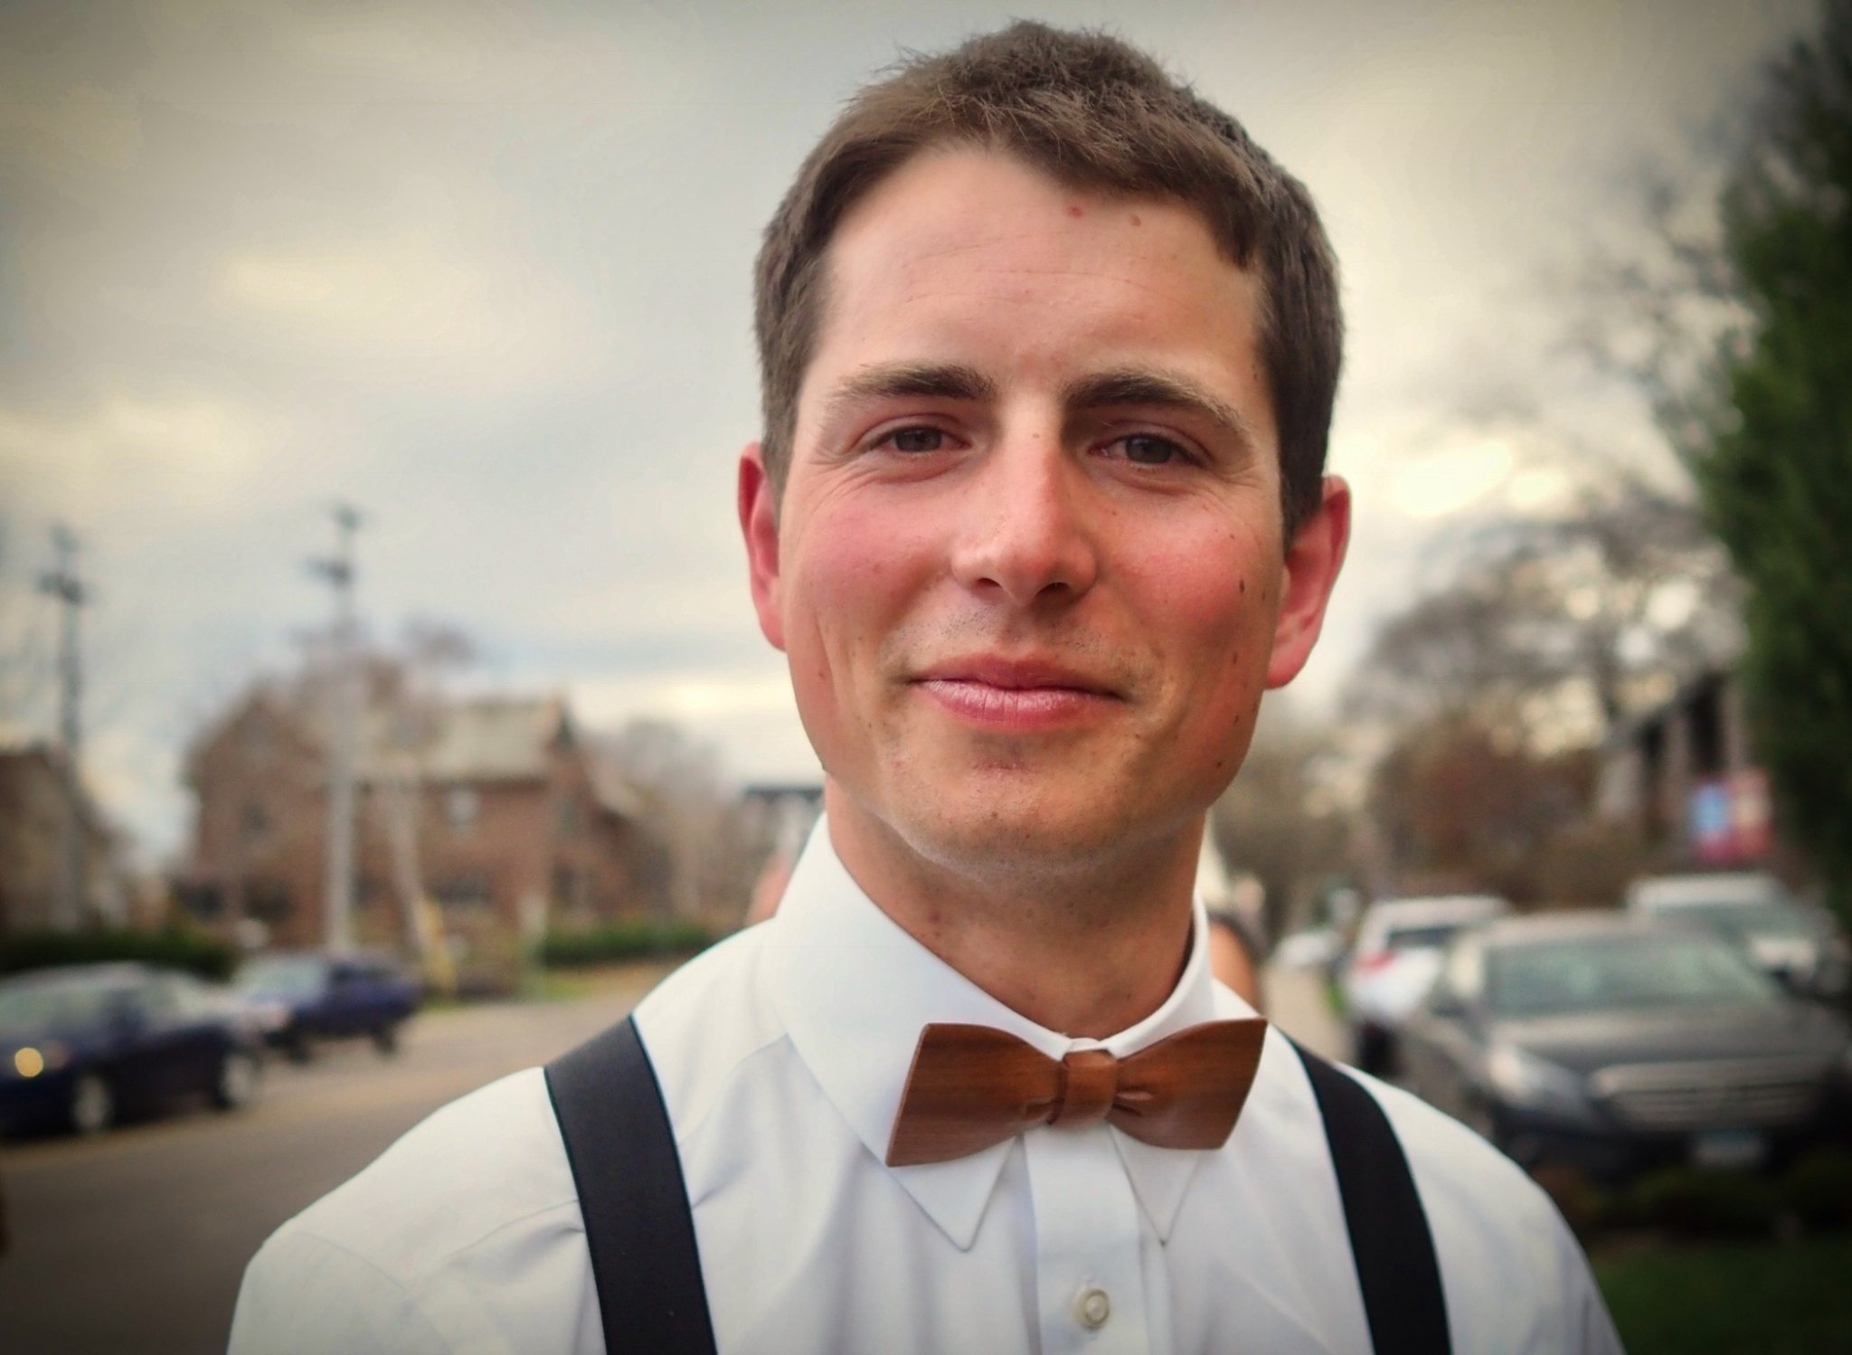
Explore employment options with Coyote!
Please contact my assistant
Margie Webb Margie.webb@state.mn.us
612-799-8776

Slide 30
Closing Slide, Thank you!
Margie Webb, MS, CRC, Customized Employment Specialist for MN Vocational Rehabilitation Services, margie.webb@state.mn.us

