Slide 1
Improving Sensory Integration and Processing Practices by Using a Social Emotional Learning Framework
Dr. Jennifer Brady-Johnson, OTD, OTR/L

Slide 2
Welcoming Activity The Audience Today
  Special Education Teachers
  General Education Teachers
  Speech and Language Pathologists
  Physical Therapists
  Occupational Therapist
  Other Specialists

Slide 3
Course Objectives:
Realize the high level evidence in Social Emotional Learning (SEL) that changes regulation for students (and teachers).
Learn evidence-based practices in Sensory Modulation and Mental Health.
Understand the neuroscience of how sensory modulation and emotional regulation require relationships.
Explain SEL Lessons Used to Teach Self-Regulation.

Slide 4
Agenda
  Social Emotional Learning and Regulation
  Evidence Based Practices in Sensory Modulation & Mental Health
  The Importance of Relationships for Regulation and Learning
  Regulation and the Autonomic Nervous System
  SEL and How it can Supports Sensory Modulation and Emotional Regulation.
  Examples of Sensory Modulation SEL Lessons

Slide 5

Outcomes from SEL Research Describe Regulation

Slide 6
The Background of SEL
A Mental Health Intervention
Uses mental health promotion and prevention principles and follows the Collaborative for Academic Social Emotional Learning Standards (Bazyk, et al., 2013; CASEL, n.d.)

Slide 7
Social Emotional Learning Evidence
SEL develops classrooms that are psychologically safe.
SEL develops student’s social emotional skills

Slide 8
Social Emotional Learning Evidence, continued
SEL Teaches students social-emotional problem-solving skills.
SEL improves teachers experience of her teaching and classroom management skills.

Slide 9
Social Emotional Learning Evidence, continued 2
SEL develops classrooms that are psychologically safe.
SEL develops student’s social emotional skills

Slide 10
Incorporating Evidence Based Practices in SEL Lessons
When SEL is delivered by OT, or other therapists, the unique knowledge based and practices that are part of the profession are the foundation of the lesson.
SEL Lessons are based on the evidence in occupational therapy.
Evidence Based Practices in Sensory Processing
Evidence Based Practices in Mental Health
SEL lessons support student’s autonomic nervous systems

Slide 11

Evidence Based Practices in Sensory Modulation
Parent and teacher coaching/education;
The use of cognitive and occupation based interventions.
Environmental Modifications and specific sensory techniques.
This Photo by Unknown Author is licensed under CC BY-SA

Slide 12


Evidence-Based Practices
Strong to Moderate Evidence
Moderate Evidence
Not enough information to determine Evidence
Practice that should not be used.
This Photo by Unknown Author is licensed under CC BY-NC-ND
This Photo by Unknown Author is licensed under CC BY-SA-NC

Slide 13

Engaging Activity

Slide 14

Evidenced Based Practices in OT
Mental Health:
Mental Health of 0-5 yr olds
Mental Health Promotion, Prevention, and Intervention for Children and Youth
Review of Yoga Interventions for Anxiety
Early Intervention in Mental Health

Slide 15


Evidence-Based Practices, continued
Strong to Moderate Evidence
Moderate Evidence
Not enough information to determine Evidence
Practice that should not be used.
This Photo by Unknown Author is licensed under CC BY-SA
This Photo by Unknown Author is licensed under CC BY-NC

Slide 16

Engaging Activity, continued

Slide 17

SEL Lessons Support the Autonomic Nervous System
This Photo by Unknown Author is licensed under CC BY

Slide 18
Supporting the Autonomic Nervous System through SEL Lessons
Brain Reactivity and the Stress Response of Students

Slide 19
Architecture of Self-Regulation
Controlled Executive Functioning (working memory, inhibitory control, attention flexibility)
Attention (alerting, orienting, executive)
Emotional Reactivity and Regulation (positive and negative emotions)
Stress physiology (sympathetic, parasympathetic, and HPA)
Automatic Genes (neuromodulator receptor functions). (Durlak, et al., 2015).

Slide 20
SEL Uses the Neurobiology of Connection
Regulation, relate, and reason, co-regulation and emotional supports from teachers needed for social participation.

Slide 21
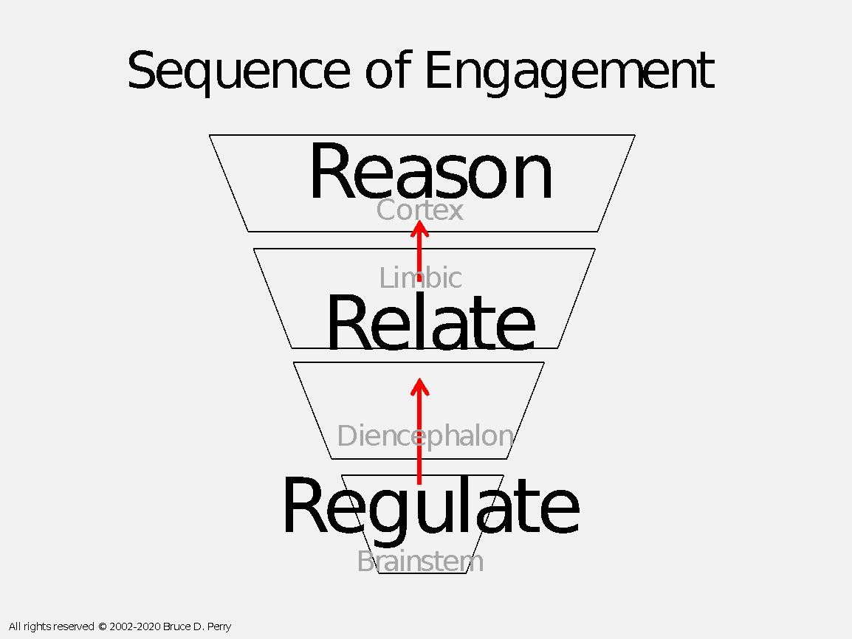
Up and down the pyramid
Bruce Perry

Slide 22
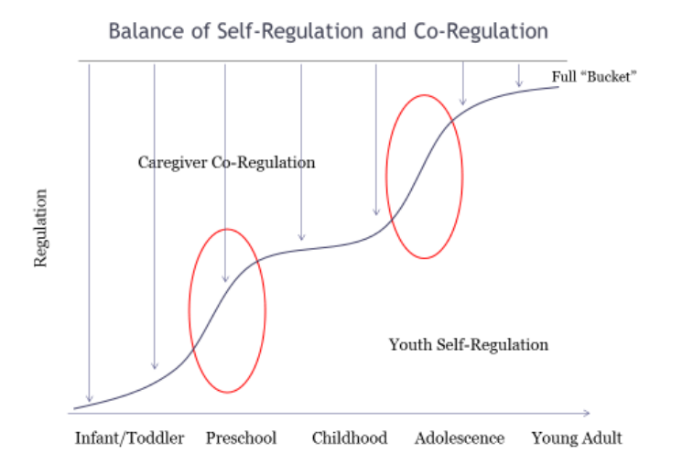
Co-Regulation from Birth to Young Adulthood

Slide 23
Teachers Impact Sensory Modulation and Mental Health
Developing Self-Awareness of own sensory needs
Use of Co-regulation (Relationship building)
Use of Social Emotional Learning Curriculum (Culture of the classroom)
Use of Connection over Compliance (classroom discipline and management framework)
Using Brain-Aligning Discipline
Accessing the Occupational Therapist
Desautels (2021); Domitrovich (2015); Gobble (2021); Parham (2021)

Slide 24
Using SEL Signature Practice (Framework) to create Sensory Modulation Learning
SAFE Practices
Use of Welcoming Activity, Engaging Activity, Optimistic Closure

Slide 25
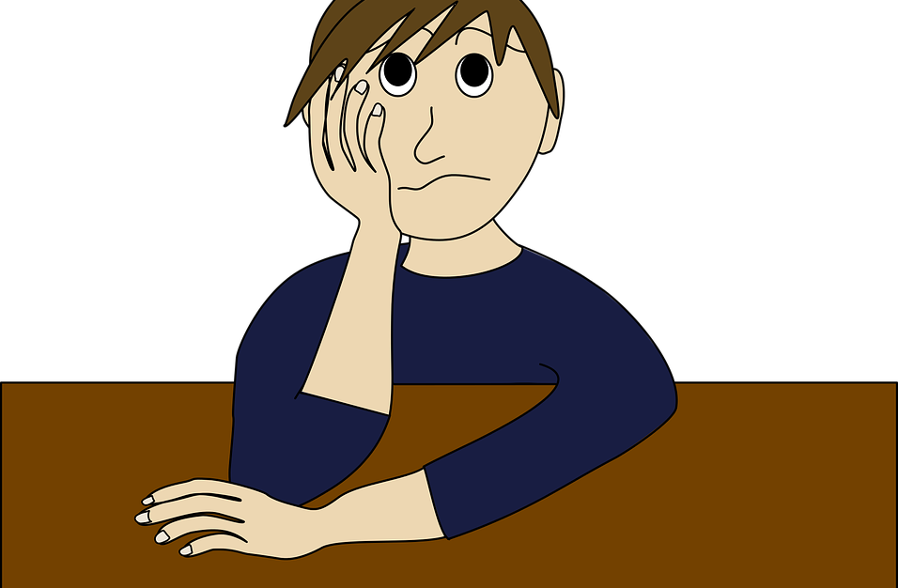
Using SEL Lessons in Sensory Modulation Learning
Based on Lauren Brukner’s Self-Regulation Curriculum
Wiggly, Emotional, Tired, Just Right

Slide 26
Feeling Just Right: SEL in Sensory Modulation
Staying Just Right: Learning Anywhere Body Breaks
Staying Just Right: Touch
Staying Just Right: Movement

Slide 27

Optimistic Closure
This Photo by Unknown Author is licensed under CC BY

Slide 28
Optimistic Closure, continued
This Photo by Unknown Author is licensed under CC BY

Slide 29
References
Available Upon Request

Slide 30
Thank you!
Dr. Jennifer Brady-Johnson, OTD, OTR/L
jjbradyjohnson@district287.org
www.linkedin.com/in/jennifer-brady-johnson-3b226629

