Slide 1
From Highway to Hallway:
Unpacking Lessons Learned in Itinerant Teaching
Ann Vail, Itinerant Teacher for Deaf/Hard of Hearing , Zumbro Education Districts & Albert Lea School District
Lyndsey Raffelson, Itinerant Teacher for Deaf/Hard of Hearing , Austin Public Schools

Slide 2
Back to School
List of students on your caseload in all districts and buildings
Gather ALL school district(s) and ALL building calendars
Revise your BACK TO SCHOOL letter
Request general education classroom teacher schedules, classrooms, preferred mode to connect
Request service provider schedules
(OT, PT, SLP, VI)
Request Due Process Paperwork access
(Sp Ed Forms)
Send out Back to School Letter to all Team members per student
Set up your student files

Slide 3
Teacher for the Deaf Hard of Hearing (TDOHH) Toolbox

Slide 4
Device Distribution Week
Coordinate ‘Drop Off’ date and time
Student toolboxes
Resources and Cheat Sheets
Include your business card

Slide 5
Resources to send to team Members
BACK TO SCHOOL LETTER
RESOURCE SHEETS
VIDEO LINKS

Slide 6
Back to School Welcome Letter

Slide 7
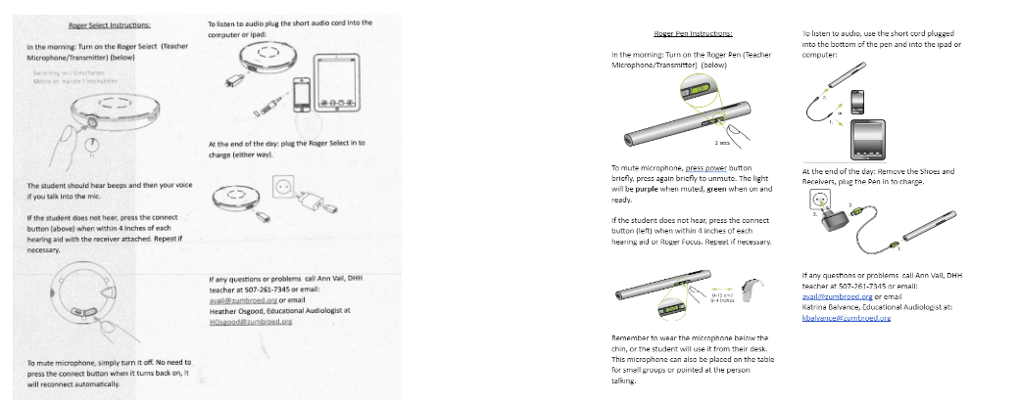
Wireless Remote Microphone System (WRMS) Team Resources

Slide 8
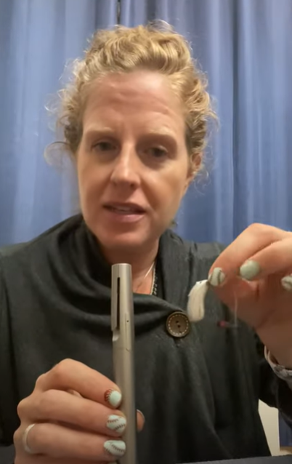
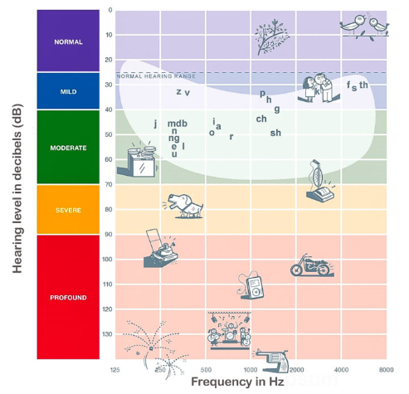
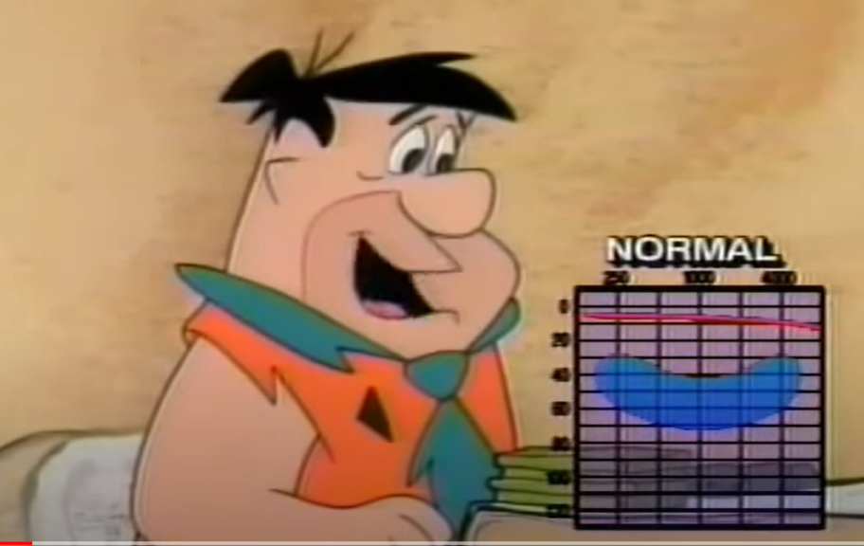
Video Links (YouTube)
Katrina - Roger Pen with Marvel aid (4:27)
The Flintstones - Hearing Loss Example (0:39)

Slide 9
Student Files
Recent audiogram
Classroom Schedule
List of Service Providers
Devise information
Recent ROI
ER/IEP/BIP/FBA
Session Notes
Device Resources

Slide 10
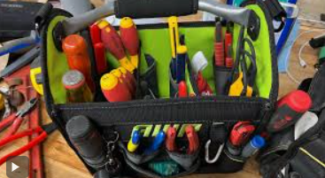
TDHOH Resources
Parent/teacher conference dates and times
Progress Report due dates
Evaluation due dates
IEP due dates
State and District(s) testing schedules
BAG of TRICKS! ☺
Parents, Teachers and Building Secretary cell phones
Online Assessment Folder

Slide 11
Impromptu Real Life! ☺
Finding a space to work for successful sessions
Finding an APPROPRIATE assessment space
Finding the student!
Unknown schedule changes, field trips and classroom incentives
Weather and School days! SNOW and ICE
Finding a space to answer a phone call, reply to emails, eat your lunch, go to the bathroom…

Slide 12
Preparing for the End of The School Year

Slide 13
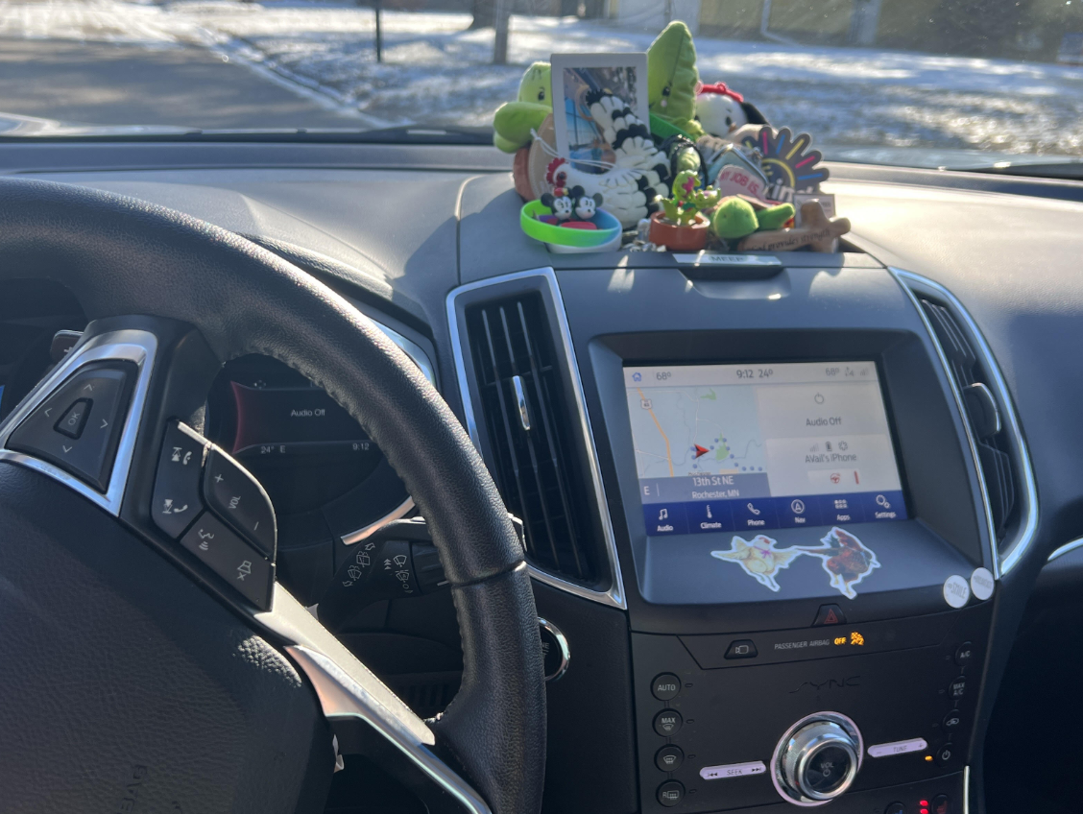
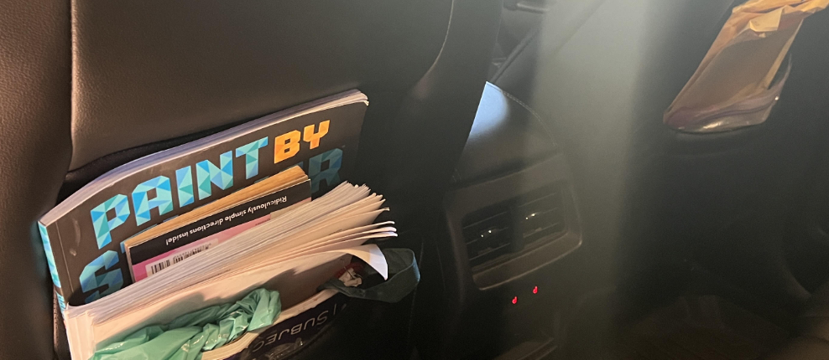
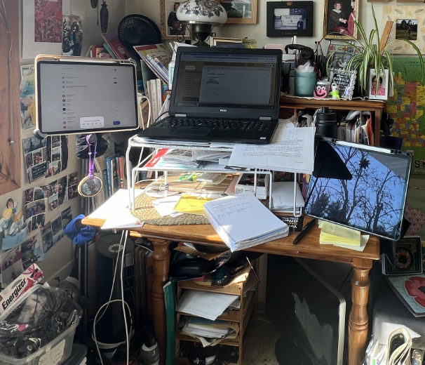
Additional SURVIVAL Guides for TDHOH
The Online Itinerant.com
Find what works for YOU!
Healthy Boundaries ☺

Slide 14
Thank you!
Lyndsey Raffelson, lyndsey.raffelson@austin.k12.mn.us
Ann Vail, avail@zumbroed.org

