Slide 1
Partnering with VRS in Providing Transition Services
Provided by Heather Kosec and Alyssa Klein

Slide 2
What is Vocational Rehabilitation Services (VRS)?
State employment services agency that serves people with disabilities
Division of the Department of Employment and Economic Development (DEED)
State Services for the Blind (SSB) is a sister agency that serves those who are blind, low vision or DeafBlind
Partner in the CareerForce system
50 CareerForce locations in the state
VRS serves youth and adults: Any Age 14+!

Slide 3
“Student with a Disability” for VRS
Has an IEP (in special education); or
504 plan; or
Other medical/mental health documentation

Slide 4
Bringing Services and Supports Together for Students with Disabilities

Slide 5
Services VRS Provides
Career Counseling
Job Training
Job Placement
Services to Keep a Job
Pre-Employment Transition Services
And more!

Slide 6
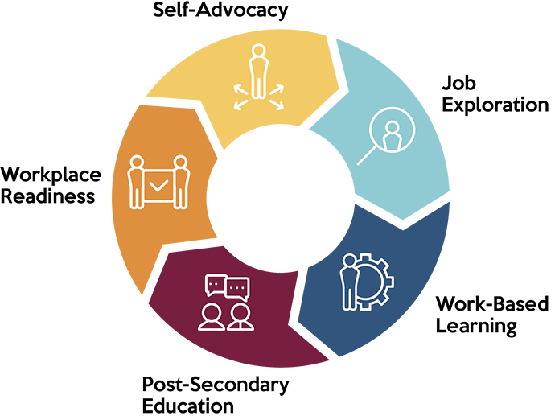
Pre-Employment Transition Services (Pre-ETS)
Job Exploration Counseling
Work-Based Learning Experiences
Postsecondary Education Counseling
Workplace Readiness Training
Instruction in Self-Advocacy

Slide 7
Definitions of Pre-ETS
View Definitions of Pre-Employment Transition Services - Full version

Slide 8
Pre-ETS Availability
Are provided in collaboration between schools and VRS
Must be made “available” statewide to all students with disabilities
Any student with a disability who is age 14-21 can receive Pre-ETS

Slide 9
Two VRS Staff Assigned to Every School
VR Counselor and Pre-ETS Representative
No wrong door: Send referrals to either staff person
Find the staff assigned to your school

Slide 10
2 Levels of VRS Support
VRS Student Career Services: Two Levels of Support
Introductory Career Services
VRS staff: Pre-ETS Representative
Typical starting point for 9-11th graders
**We need: “Verification” of disability**
VR Career Services
VRS staff: VR Counselor
Typical starting point for 12th graders and age 18-22 transition students
**We need: “Documentation” of disability**

Slide 11
Steps for Accessing VRS Services
Contact one of the VRS staff assigned to the student’s school
They will set up a meeting to explain services and provide an application packet
Ideally the student’s parent(s)/guardian(s) are there
VRS verifies student eligibility for services
Planning for services begins…

Slide 12
Planning Services Together
Ideally a team meeting is held with student, parent(s)/guardian(s), school staff (i.e. IEP case manager)
Discuss:
Pre-ETS needs and what VRS will provide
How services will be coordinated with school services
How and when services will be provided
How communication will take place
Follow-up meetings

Slide 13
VRS Contracts with Community Agencies
Community Rehabilitation Programs (CRPs)
Centers for Independent Living (CILs)
CareerForce partners

Slide 14
Flyer and Video for Students and Families
Pre-Employment Transition Services - Video (2:36)
Connecting Students to Work - Flyer

Slide 15
Adults: Accessing VRS
Complete an interest form
A VRS staff person will respond shortly

Slide 16
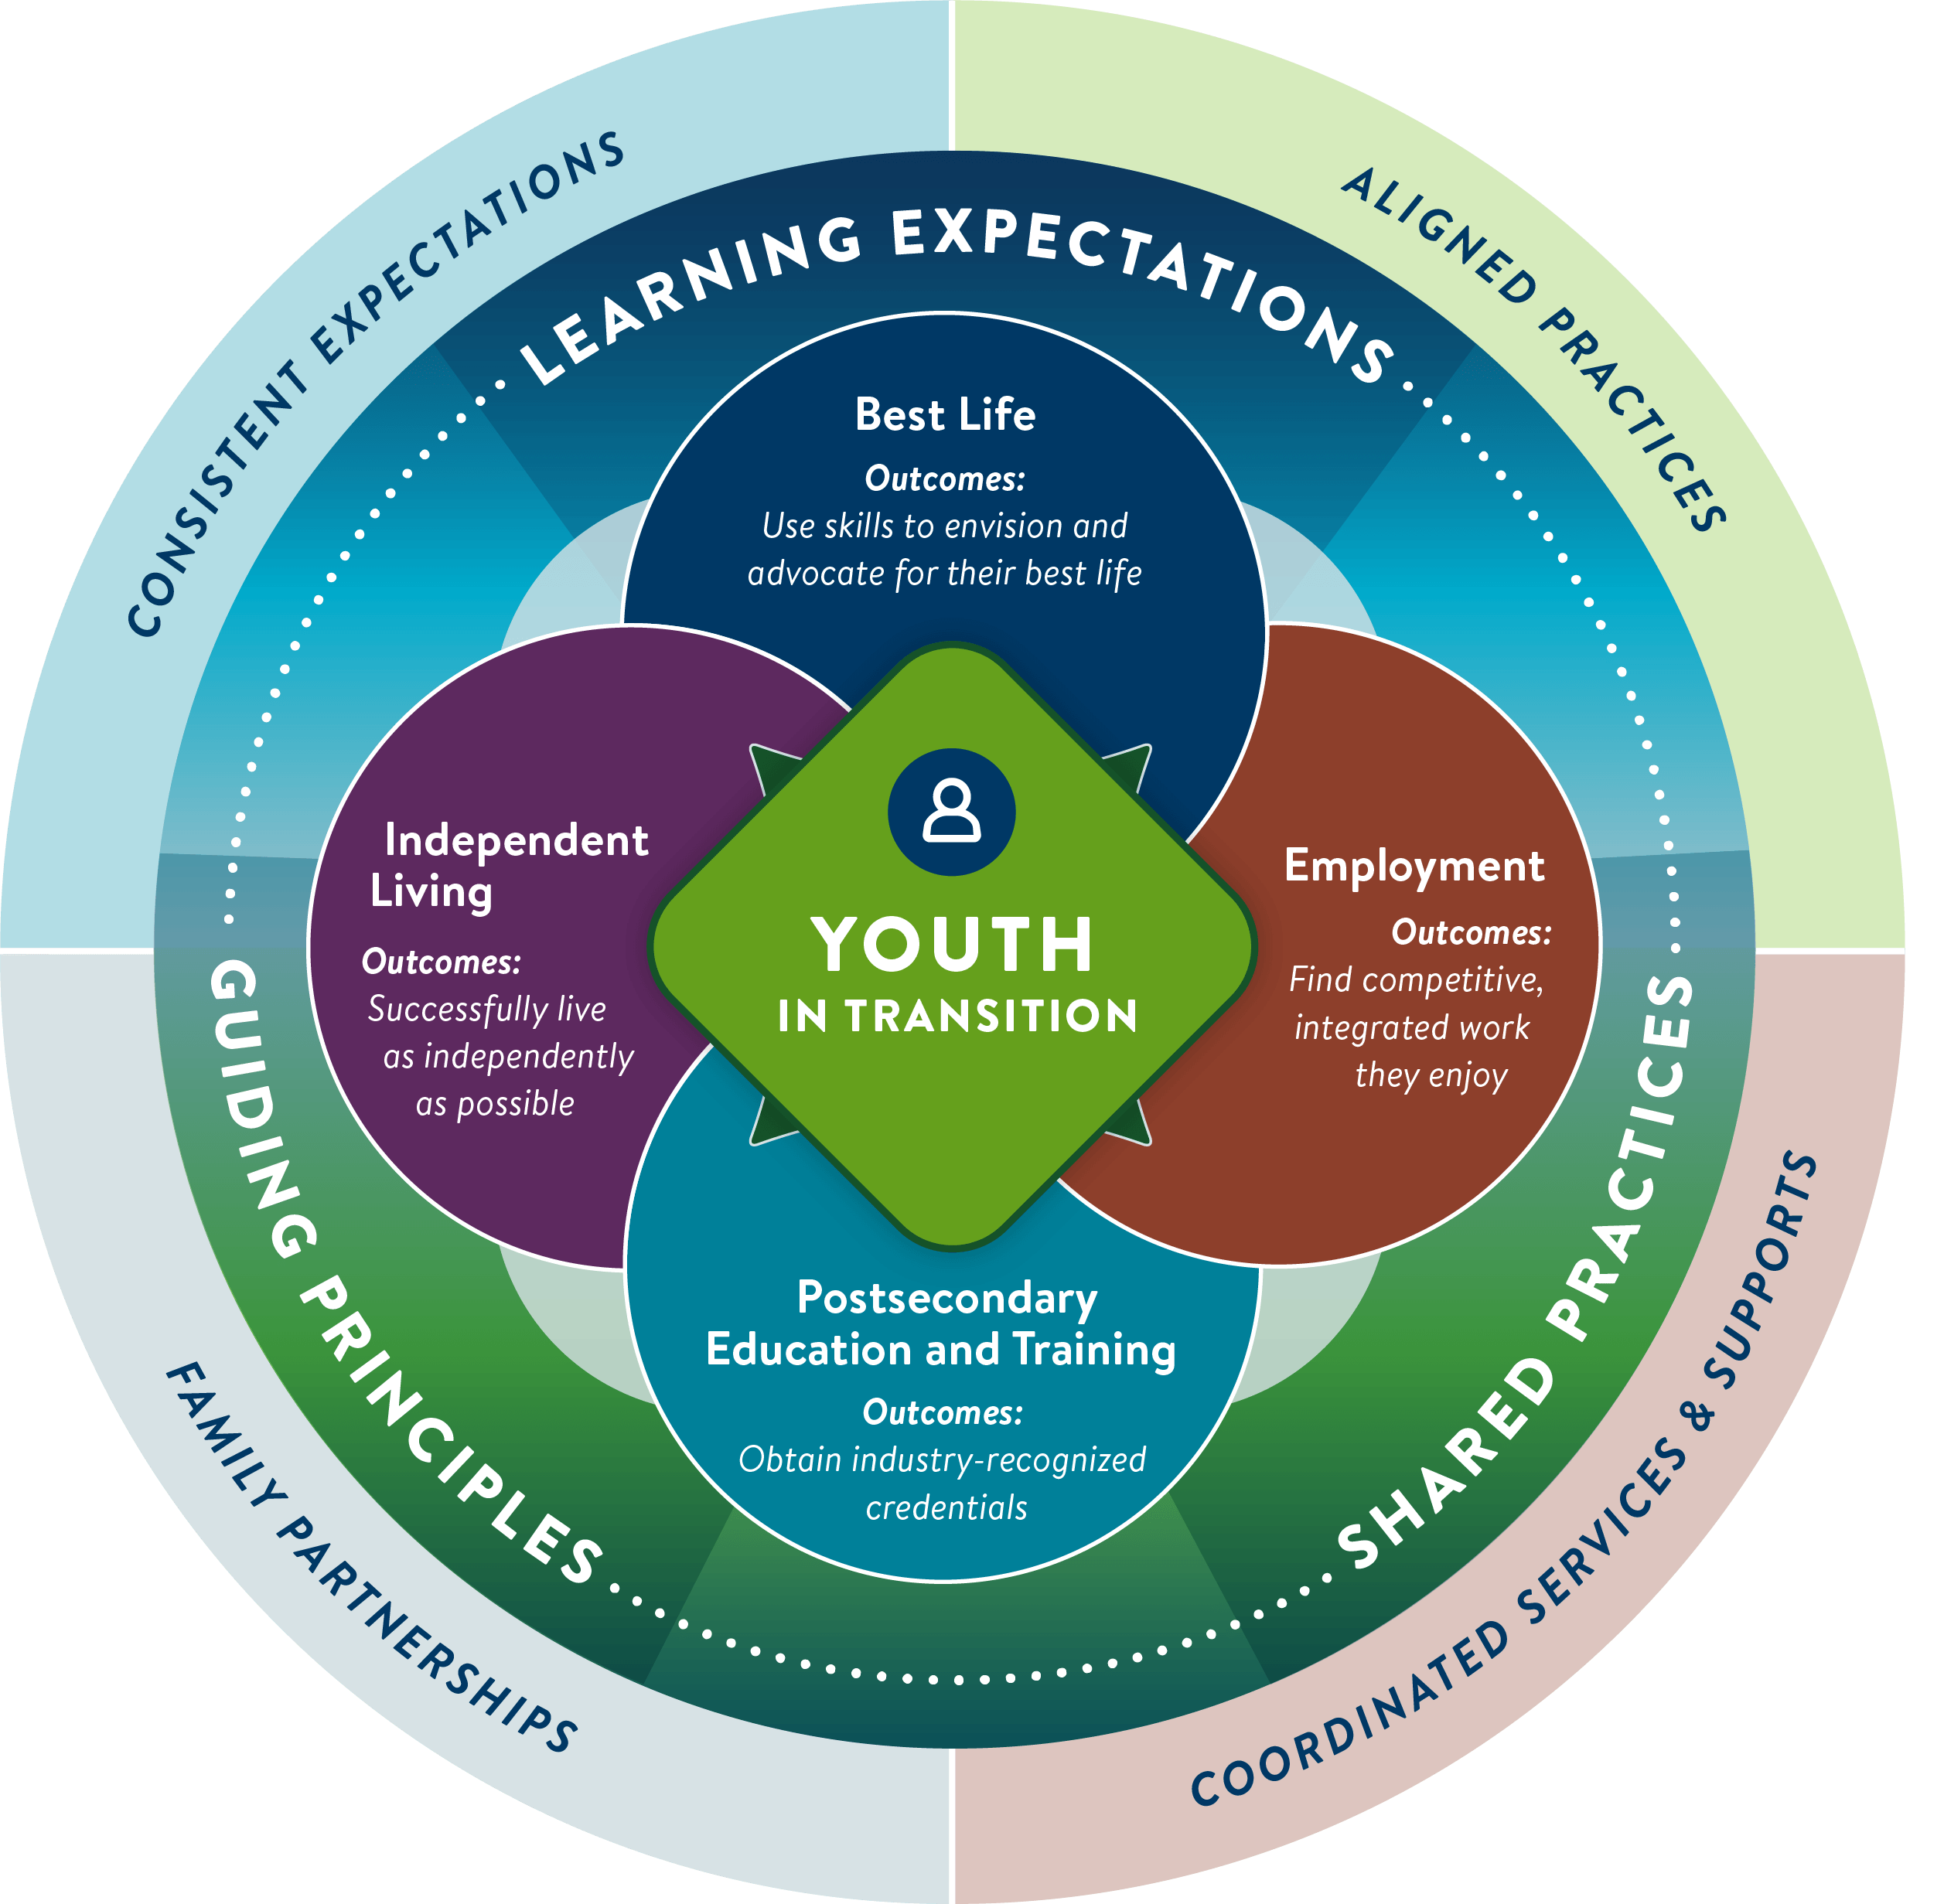
Be sure to attend our upcoming sessions…
Minnesota’s NEW Transition Framework: Keynote, 8:30 on Wednesday April 17
Resources in Minnesota’s Transition Framework: 11:50 on Wednesday April 17

Slide 17
Discussion
What questions do you have?
What successes in partnering with VRS can you share?
What ideas do you have for increasing the partnership between schools and VRS/
How can our youth team help you

Slide 18
Thank you!
Heather Kosec, Youth Services Manager
Heather.Kosec@state.mn.us
Alyssa Klein, Youth Services Coordinator
Alyssa.Klein@state.mn.us

