Slide 1
Fostering Self-Determination
Dr. Mary Lindell
Associate Professor and Special Education Program Director
Dawn Allen
Founding Director Bethel University BUILD Program

Slide 2

Introduce Yourself
What is your name?
What role brings you to this conference?

Slide 3
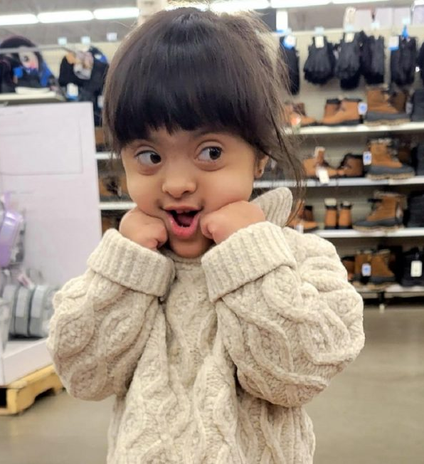
Session Goals
Explore the implications of presuming competence and moving towards a position of valuing all individuals, including those with disabilities.
Discuss the complexity of the concept of self-determination and implications for individuals with disabilities.
Imagine possibilities to increase opportunities across settings for individuals with disabilities to grow in self-determination and enhance adult outcomes.
Explore pathways for students with ID to attend and succeed in college.

Slide 4



3 Keys of My Work
Presume Competence
Move Toward Valuing
Foster Self-Determination

Slide 5
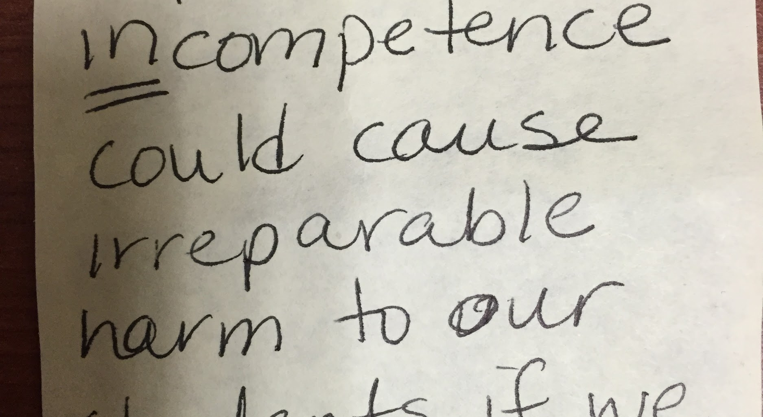
Why Presume Competence?

Slide 6
(New) Assumptions Matter
(Jorgensen, 2018)
Intelligence is not a single measurable characteristic;
All people have different talents and skills;
People learn and perform best when they feel valued, when others have high expectations, and when they are taught and supported well (this can be accomplished in inclusive settings);
When someone cannot currently communicate that they are smart, assume that they are.

Slide 7
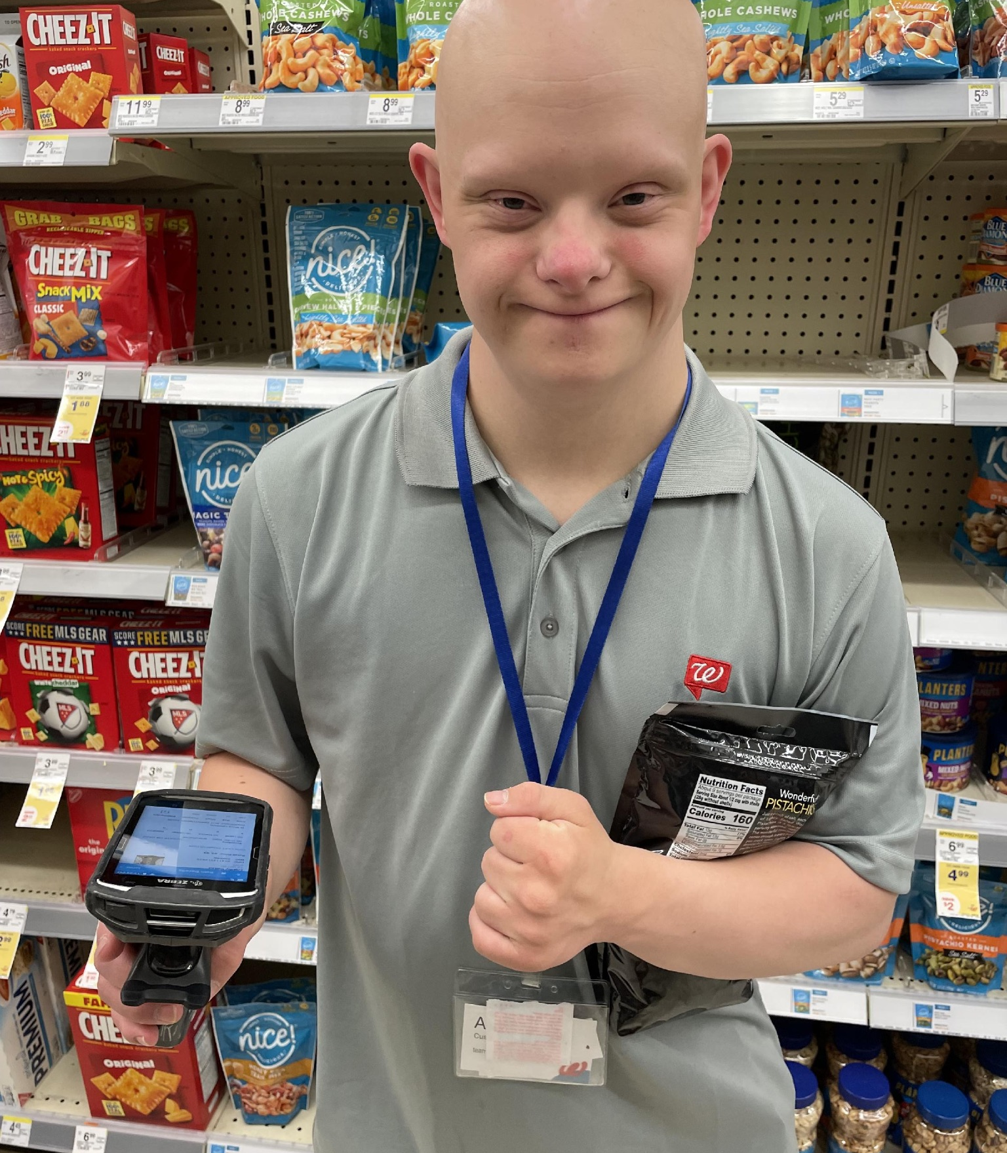
That Means (in part) …
Commit to helping each person develop a reliable communication system.
Bring supports to the “general environment” where all individuals belong.
Individuals do not need to develop skills to bring to the “general environment” before they can benefit from learning there.
Carefully monitor and withdraw supports as individuals become more independent.

Slide 8

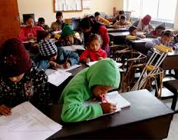
Responses to Disability
(Van Der Klift & Kunc, 2019)
MARGINALIZATION
Segregation
Aggression
Death
REFORM/REHABILITATION
Minimize the disability
Assimilation
“You can be with us when you are like us.”

Slide 9
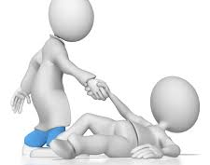
Responses to Disability continued
(Van Der Klift & Kunc, 2019)
TOLERANCE/BENEVOLENCE
Resignation
False belonging
“We will do it because it is the right thing to do for those unfortunate people.”
VALUING
Diversity is typical
Reciprocal relationships
Equal worth
Mutual benefit
Belonging

Slide 10
Self-Determination
SD is linked to quality of life
SD is a personal characteristic that empowers individuals to act with intention - causal agency
Environment impacts the development and exercise of SD
SD learning occurs when a person encounters an obstacle to his/her goal

Slide 11
Connecting this to college
What do you think is the best part of going to college?
Who should go to college?
How about students with intellectual
disabilities?

Slide 12
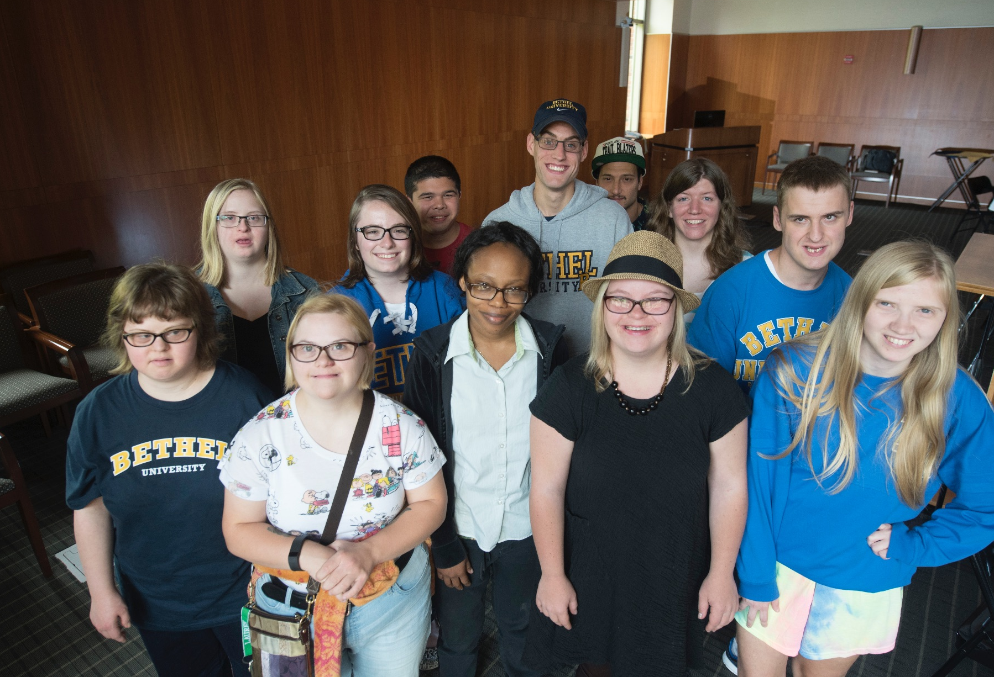
College as a model for fostering self-determination
College doesn’t give anything special to students with intellectual disabilities, instead… it gives them something that everyone else who goes to college gets; the opportunity to learn about yourself, get a better job, and... grow up a little bit.
Think College! Postsecondary Education Options for Students with Intellectual Disabilities Meg Grigal & Debra Hart (2010)

Slide 13
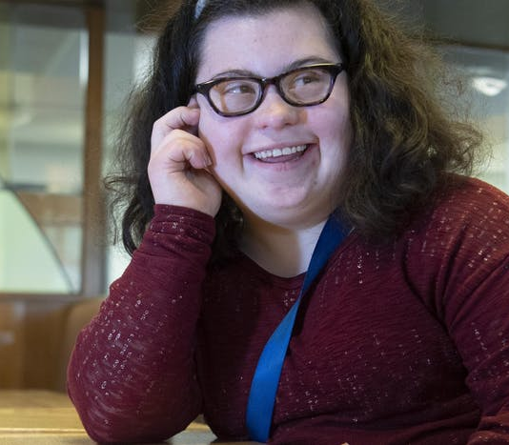
Bethel University Integrated Learning and Development (BUILD) Program

Slide 14
Academics
Comprehensive Transition and Postsecondary (CTP) Program
Career Pathways:
  Arts & Communication
  Business
  Human Services

Slide 15
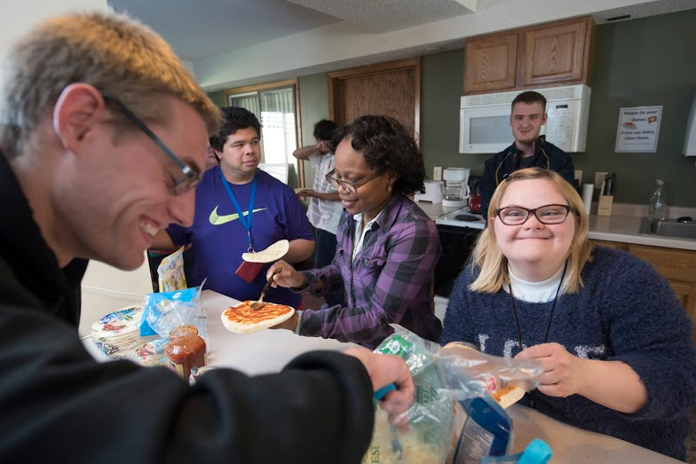
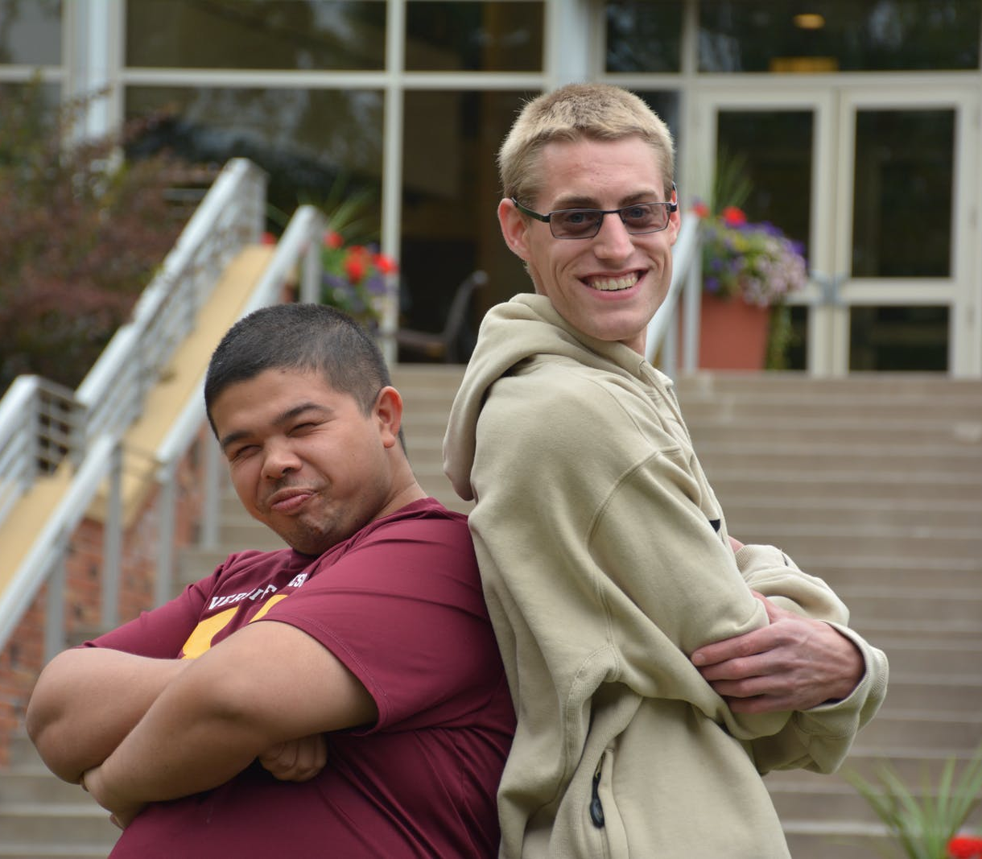
Expected Outcomes
Increase in independent living skills
Secure and maintain integrated employment
Develop personal growth

Slide 16

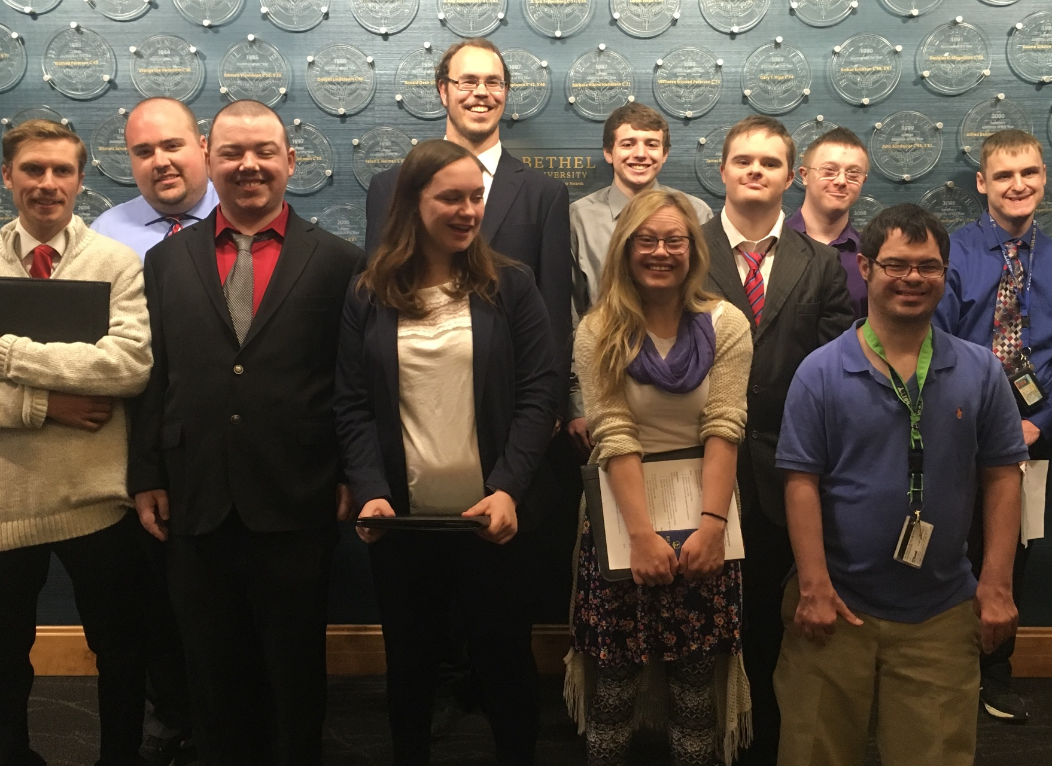
Core Curriculum
Independent Living
Jobs and Employment Skills
Bible
Independent Study

Slide 17
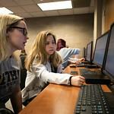

Elective Courses
More than 30 elective course options available
Faculty trained in Universal Design for Learning.
Student mentors

Slide 18
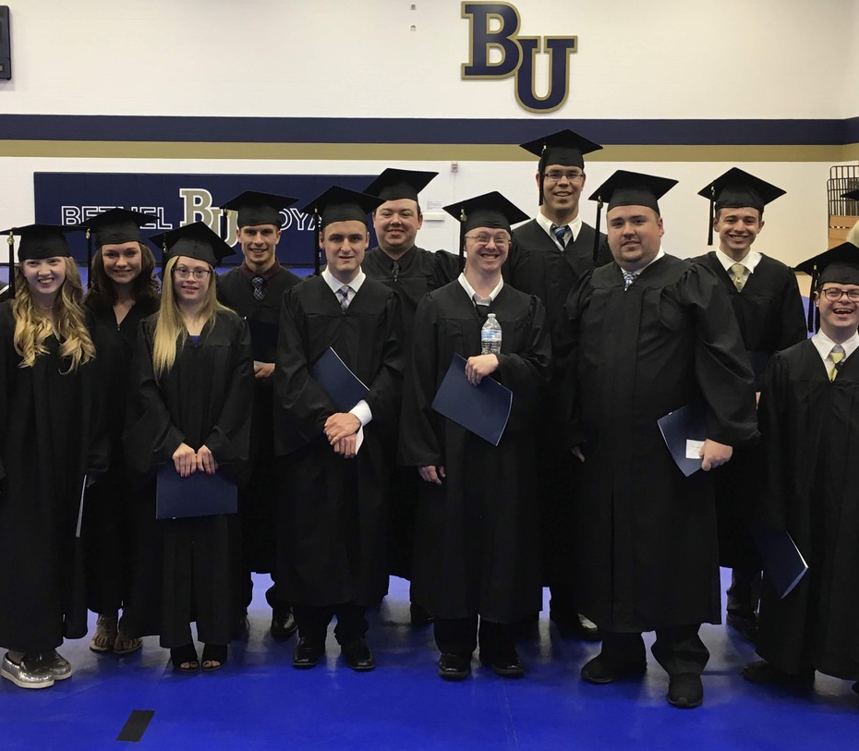
Certificate in Applied Studies
Students can earn a Certificate in Applied Studies upon completion of the program.

Slide 19
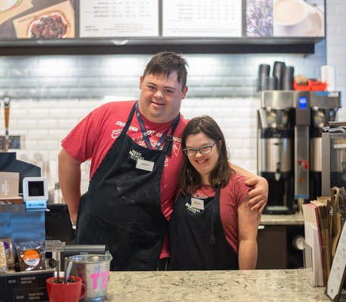
Internships
Meaningful, supported work experiences in an area of interest and skill to prepare students for independent employment.

Slide 20
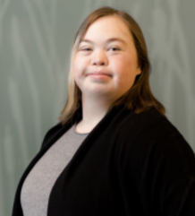

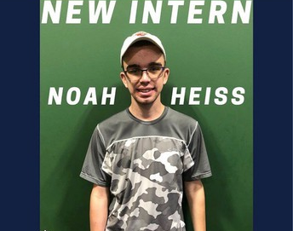
Career Development
Jobs and Employment courses
Independent Study
Life at Bethel and Internships

Slide 21

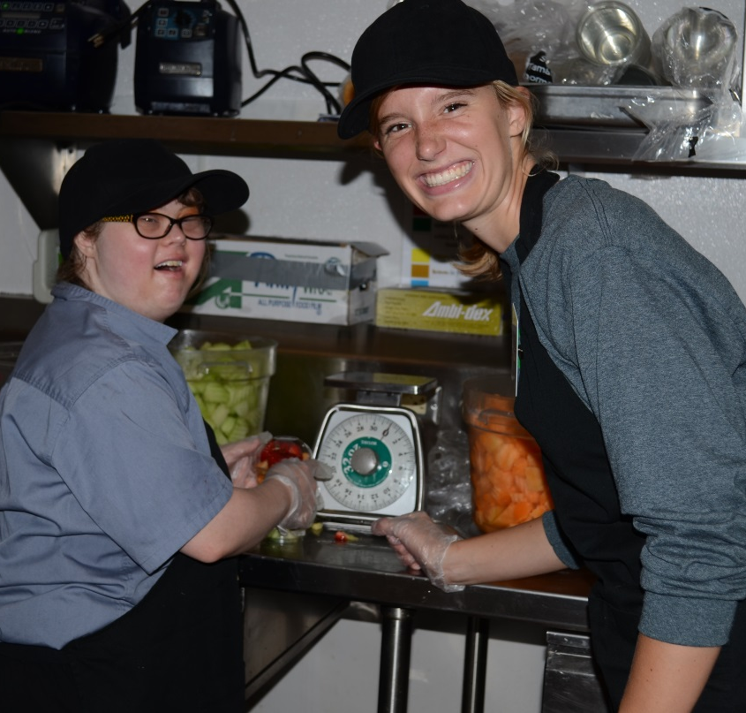
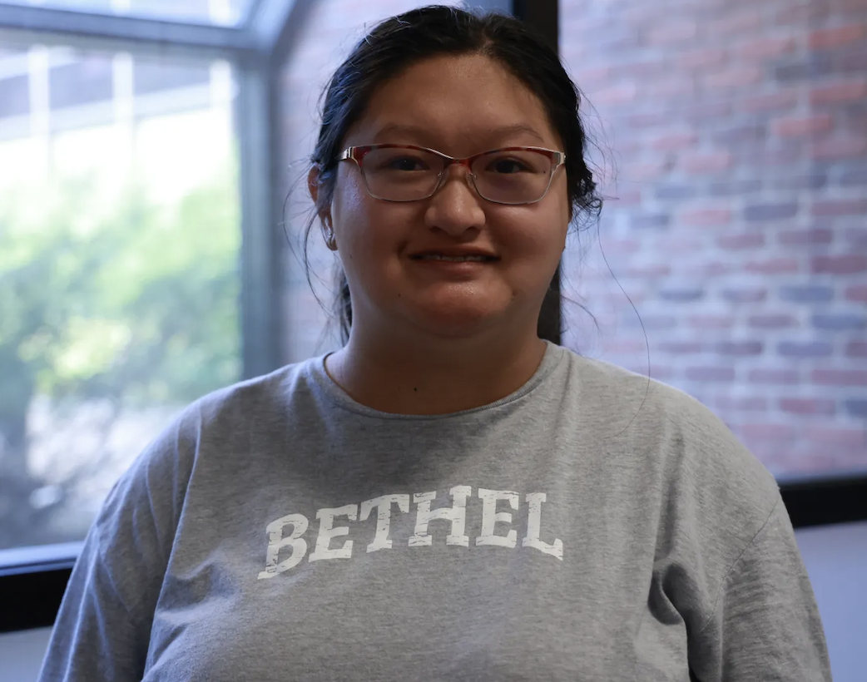
BUILD Mentors
Housing mentor
Student mentor
Job mentor
Social mentor

Slide 22
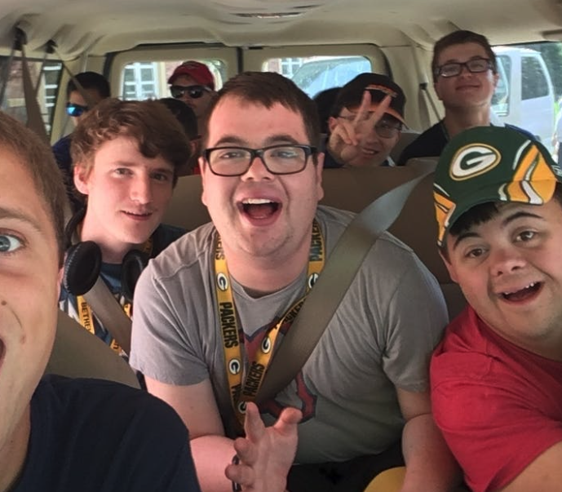
Residential Experience
Integrated living experiences in traditional residence halls

Slide 23
Residential Experience continued
1st Year Freshman Hall
2nd Year North Village
Traditional Dorm Room with two students
Roommate in BUILD Intentional integration
Care for self and part of room
Prepare one meal per week
Housing mentors
On-campus apartments with two to four students
Roommate(s) in BUILD
Intentional integration
Increased responsibilities to care for self and living space including kitchen, bathroom, etc.
Housing mentors

Slide 24
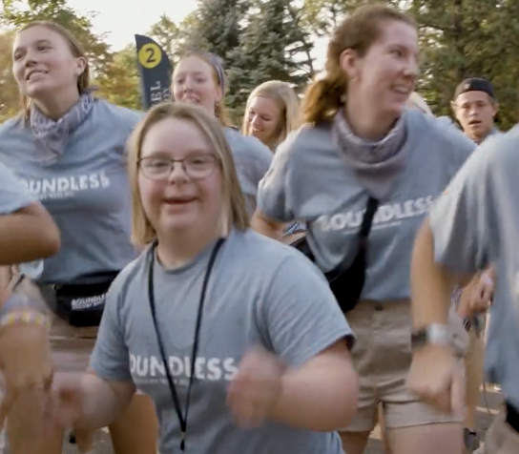

Students in BUILD are Bethel University Students

Slide 25
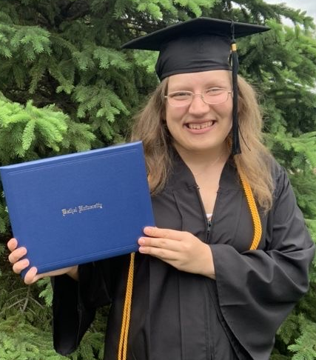
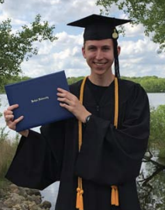
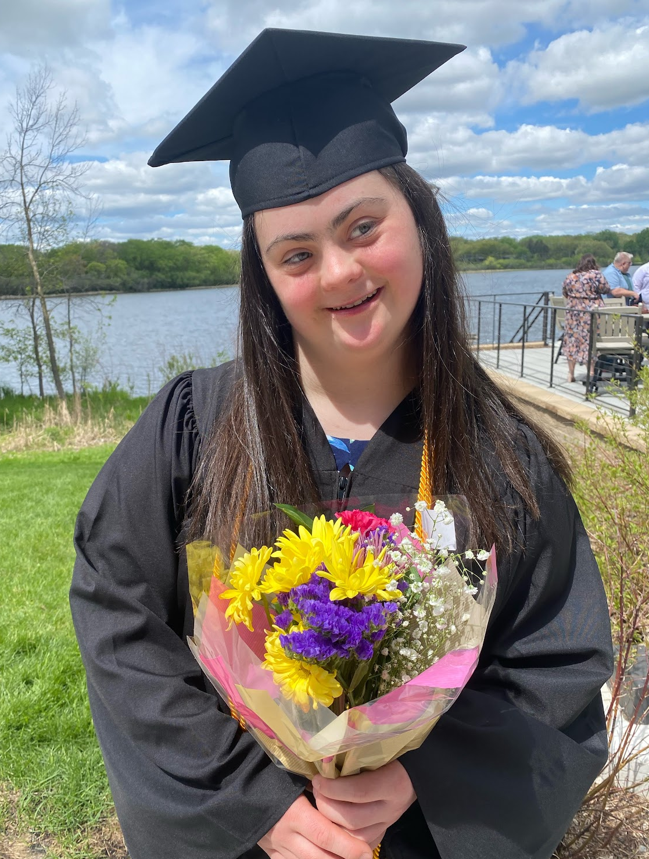
Research Studies

Slide 26
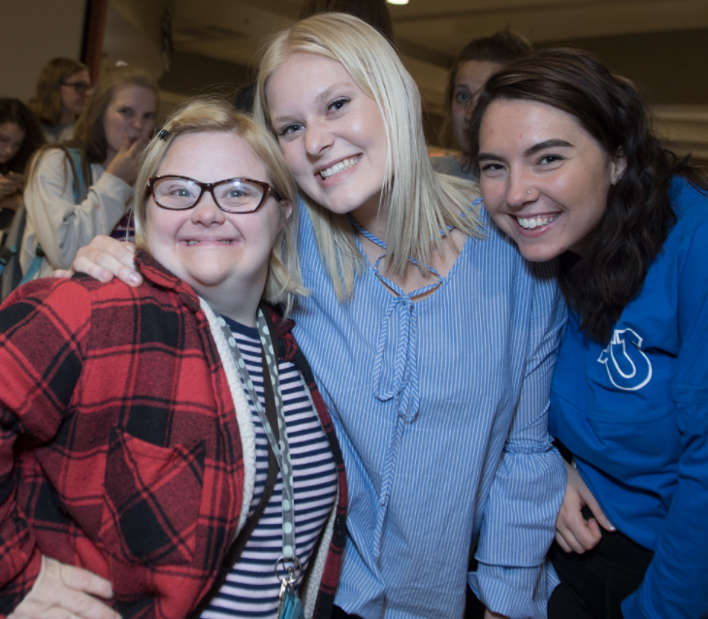
Longitudinal Study
Quality of life (QOL) survey
6-year longitudinal study
3 time-points

Slide 27
BUILD Student Outcome Conclusion
It is difficult to compare incoming PSE students with “others.”
Based on this small sample size, students entering the BUILD program are similar to other young adults with disabilities on many key QOL measures.
Employment was the biggest area of difference; past employment impacts current and future employment of adults with disabilities (although this was NTLS-2 comparison data).
These results support the practice of researchers comparing the outcomes of individuals with ID who complete a PSE program to “others” with ID.

Slide 28
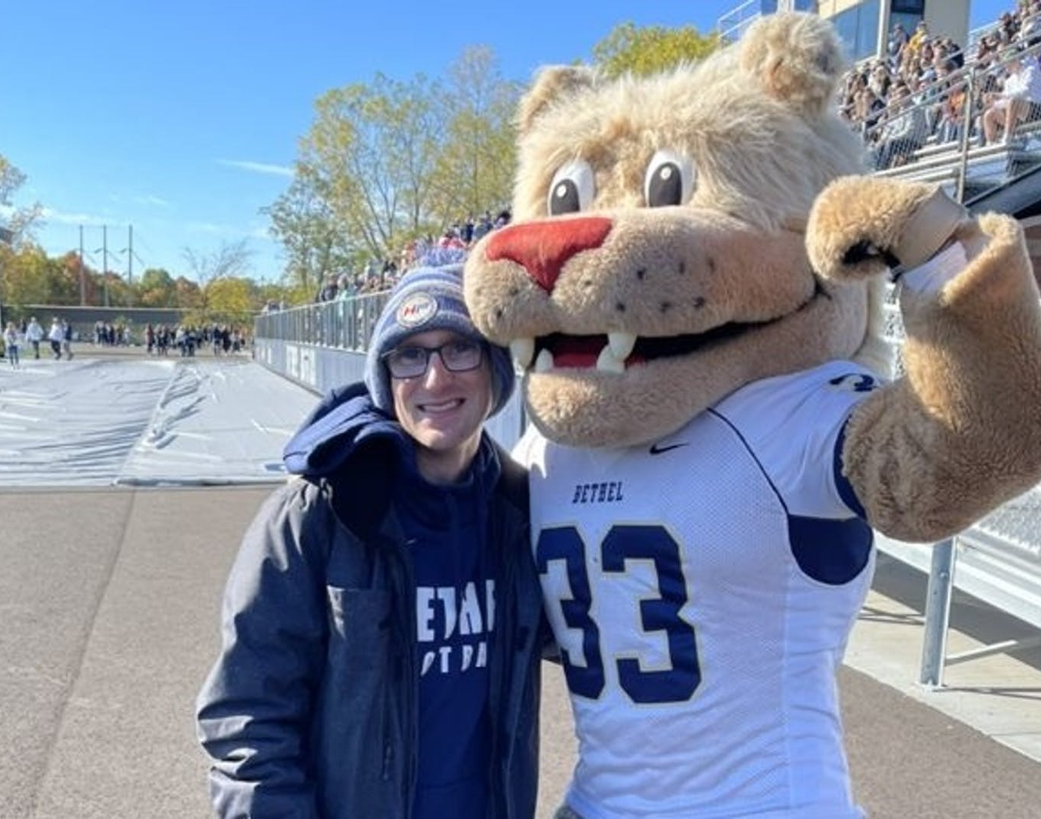
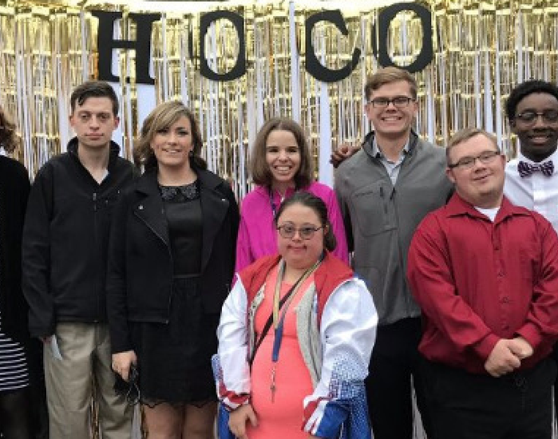
Student Experience Study
Phenomenological study
Semi-structured interviews
6 students completing BUILD program
Self-determination lens

Slide 29
Phenomenological Study Conclusions
Participants exercised self-determination in choosing to go to college (Wehmeyer, 2003)
Setting and attaining goals
  Making decisions
  Developing “causal agency” - a person’s ability to impact, direct, or cause events
The college experience provided an innovative environment or intervention with a context that positively impacted the participant’s self-determination (Walker et al., 2011)
Key components of the college environment/intervention
  Opportunity-rich environment,
  Network of supports, and
  Community of belonging.

Slide 30
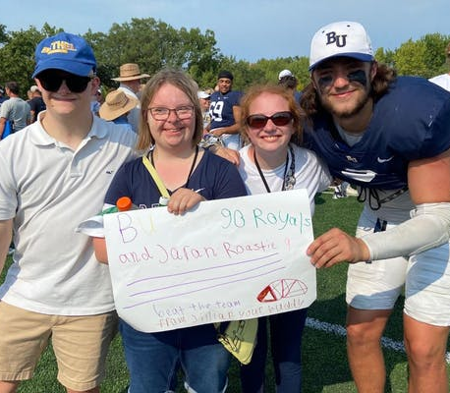
Campus Impact Study
Case study design
Semi-structured interviews
15 administrators, faculty, staff, traditional students

Slide 31
Campus Impact Conclusions
The BUILD program has impacted the university comprehensively, encompassing traditional students, faculty and staff, classroom experiences, policies and structure, and organizational culture.
community member experience and identity development (students, faculty, staff),
organizational policy and systems,
culture and subcultures of the university.
Minute and mundane changes accumulated to richly change the “fabric of the community”

Slide 32
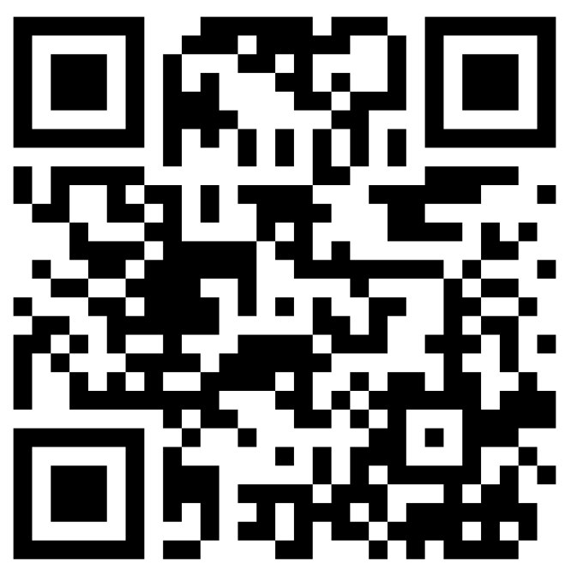
Questions and Answers
www.bethel.edu/build
Dr. Mary Lindell, Associate Professor and Special Education Program Director mlindell@bethel.edu
Dawn Allen, Founding Director
Bethel University BUILD Program
d-allen@bethel.edu
Thank you!

