Slide 1
Universal Screening for Congenital Cytomegalovirus (cCMV) in Minnesota:
The Importance of Early Identification and Special Education Programming
Provided by
Gina Liverseed – Minnesota Department of Health, CMV Nurse Specialist
Jess Moen – Minnesota Early Hearing Detection and Intervention Statewide Specialist

Slide 2
Session Objectives
Understand the basics of Cytomegalovirus (CMV) and congenital Cytomegalovirus (cCMV), including strategies to reduce the risk of infection.
Discuss the implementation of universal cCMV testing in Minnesota.
Review the considerations for follow-up and referral of children with cCMV.
Understand the impact for a family with a child with cCMV.
List resources to support early educators working with children who have cCMV and their families.
Describe strategies to promote early intervention recommended practices.

Slide 3
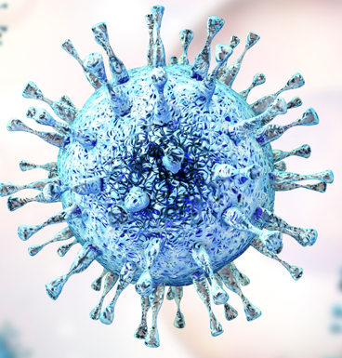
What is CMV?
CytoMegaloVirus
Widespread and common virus
It’s not new!
Nearly 1/3 children are infected with CMV by age 5
50-80% of adults are infected with CMV by age 40
Stays in body for life and can reactivate
Multiple strains of CMV = potential for reinfection

Slide 4
How is CMV Transmitted?
Direct contact with body fluids containing the virus
saliva, urine, nasal mucus, tears, blood, semen, vaginal fluids, stool, and breast milk
Commonly spreads in households and childcare settings
Especially from direct contact with the urine or saliva of babies and young children
Higher viral loads in bodily fluids than adults
Shed virus in secretions for up to 1 year
People who work closely with small children or have children in the home are at higher risk of a CMV infection than those that don’t

Slide 5
What are the symptoms of a CMV infection?
Most healthy people do not know they’ve had a CMV infection
usually asymptomatic
sometimes cold/flu-like symptoms
generally harmless
Infections can be very serious for people who are immunocompromised and for babies who were infected before birth

Slide 6
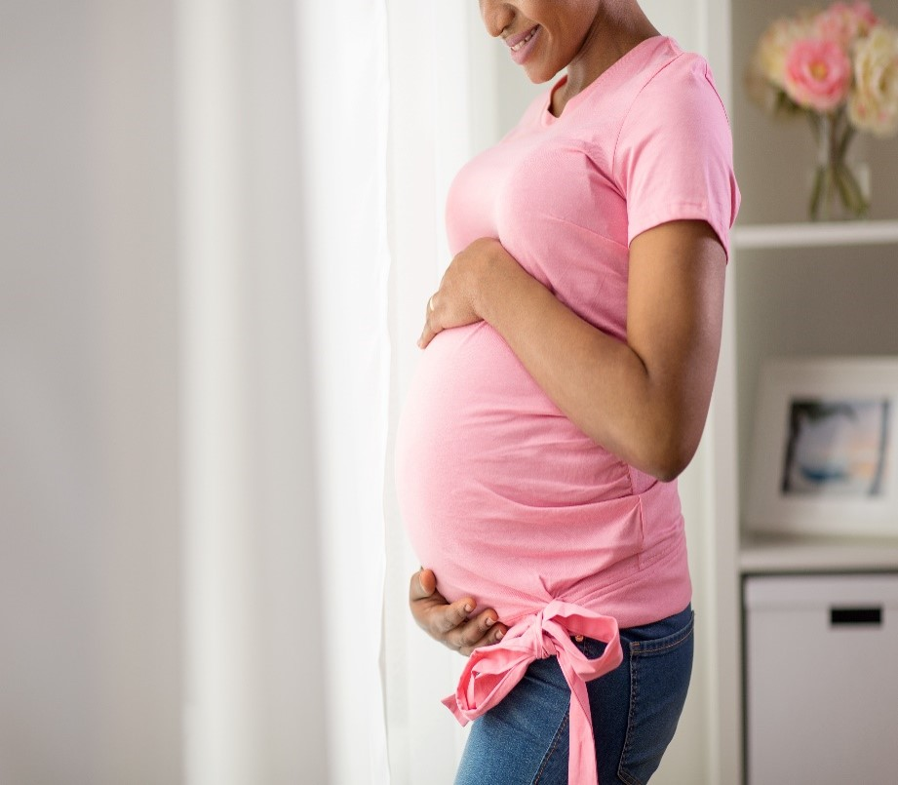
Why is CMV important?
Pregnant people who develop an active CMV infection can unknowingly pass the virus to their growing fetus
When a baby is infected before birth, the infection is known as congenital CMV (cCMV)
CMV acquired in utero can damage the brain, eyes, inner ears or other organ systems of the fetus
1/200 babies in U.S. is born with cCMV
1/5 babies with cCMV will experience long-term health concerns
Most common infectious cause of birth defects in the U.S.

Slide 7
Potential Impacts on Neurodevelopment
Cerebral palsy
Epilepsy
Hearing loss (cCMV = most common cause of non-hereditary hearing loss in childhood)
Vestibular dysfunction
Intellectual disability
Motor planning disorders
Behavior disorders
Autism

Slide 8
Categorization of Severity at Birth
10 % “Symptomatic”
90% “Asymptomatic”
≥ 1 Sign at birth
Small for gestational age
Microcephaly
Petechiae
Jaundice
Enlarged liver/spleen
No signs at birth
May still be identified with hearing loss

Slide 9
Spectrum of cCMV Sequalae
https://www.nationalcmv.org/overview/outcomes
Born Symptomatic
Born Asymptomatic
Death
Miscarriage, stillbirth, infant or child loss
Medically fragile
Cerebral palsy, seizures, failure to thrive, hearing loss, vision loss
Multiple impairments
Cerebral palsy, vision loss, hearing loss
Developmental delays
Cognitive delays, learning issues, feeding and sleeping issues, vision loss, hearing loss
Hearing loss
Hearing aids, cochlear implants, communication and learning issues, mild vision disorders
None
No visible delays or impairments
Severe
Moderate
Mild

Slide 10
Long-term Outcomes in “Asymptomatic” cCMV
∼ 20% hearing loss by 18 years
∼ 45% vestibular and gaze stability dysfunction
30% balance difficulties
Autism risk
Learning disabilities
Developmental delays
(Pinninti et al., 2019)
Photo Credit: NOAA

Slide 11
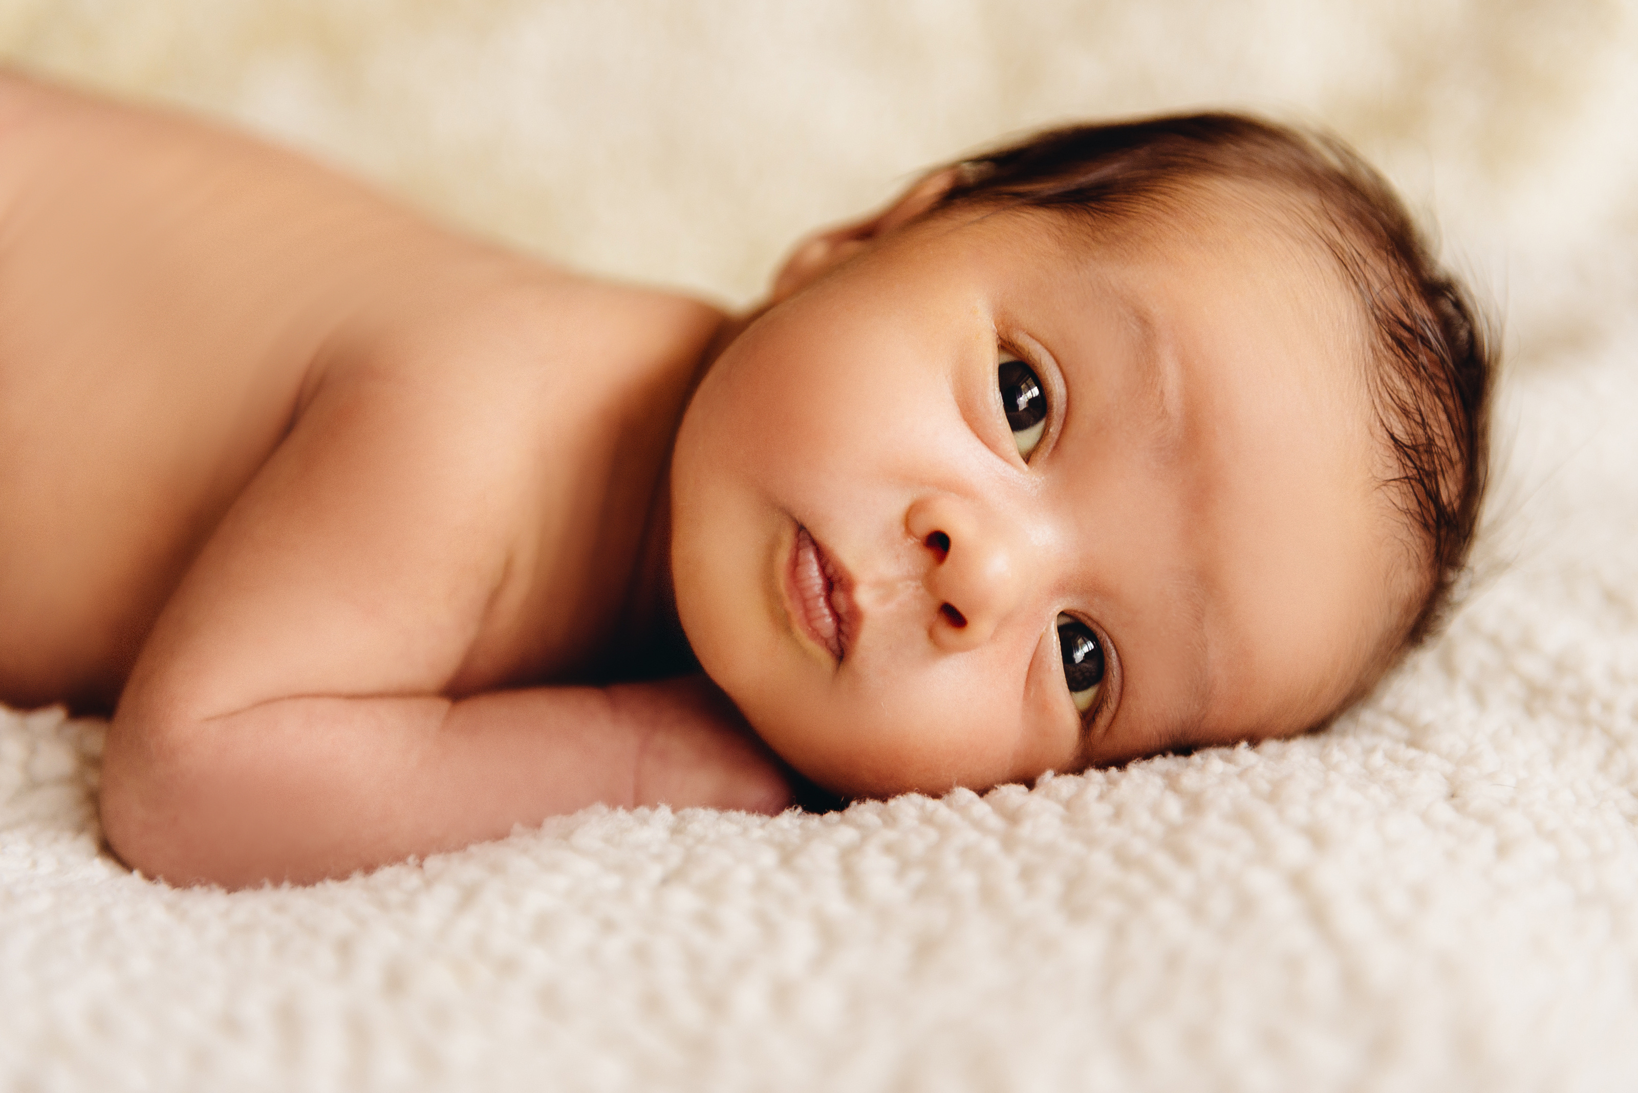
Treatment Options
Antiviral medication
Manage existing signs
Monitor for new signs
Early intervention
Family Support

Slide 12
Diagnosis of cCMV
Must be diagnosed from a sample collected within 21 days of age (congenital vs. post-natal)
Urine (gold standard) or saliva to detect CMV DNA
Dried blood spot
Blood collected from infants 24-48 hours after birth for newborn screening
Testing on current specimens – confirmation with urine recommended
Parents can request release of stored specimens for testing
75% sensitivity

Slide 13
MN CMV Legislation – The Vivian Act (2021)
Education
Newborn Screening
Make information about CMV available to health care providers, women who may become pregnant, expectant parents, and parents of infants.
Establish a CMV outreach program to educate women who may become pregnant, expectant parents, and parents of infants.
Raise awareness for CMV among health care providers.
Advisory Committee on Heritable and Congenital Disorders to review CMV for possible inclusion on Minnesota's newborn screening panel. Recommendation approved by Commissioner of Health.
Minnesota became the first state to screen every newborn for cCMV – February 2023.

Slide 14
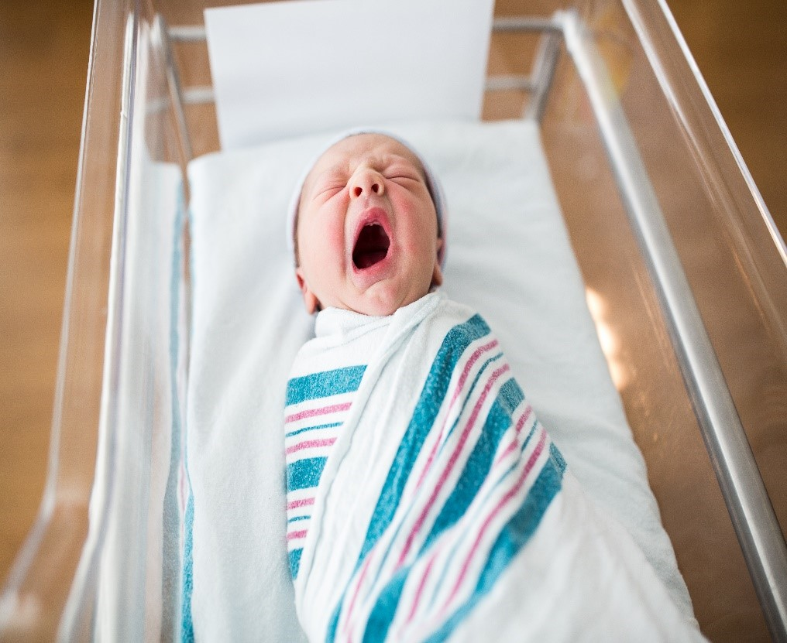
Universal Newborn Screening for CMV
Purpose:
Follow-up:
Identify the infection and any health or developmental concerns as early as possible
Offer interventions that can help minimize the impact of the disease
Initial medical evaluation and treatment
Letter and information booklet from MDH
Ongoing hearing monitoring
Public health longitudinal surveillance

Slide 15
Connections to Resources
Local Public Health
Parent Support
Growth and Development
Contact family and complete a nursing assessment to identify needs and refer to services
Pilot program in with MN Hands and Voices for 1:1 support for parents of “symptomatic” children
National CMV Foundation
Encourage providers to use Help Me Grow for early intervention referrals
Promote the Follow Along Program

Slide 16
cCMV Cases (born 2/6/23 – 1/31/24)
185 babies identified with a cCMV infection and in longitudinal follow-up
27% of babies with available follow-up information had signs at birth that may be related to cCMV
11 babies identified with cCMV and sensorineural hearing loss
3 babies had “passed” their initial hearing screening in both ears
Wide geographic distribution within the state

Slide 17
Understanding the impact for a family with a child with cCMV.
"Caring for a child with cCMV can be costly for families not only in terms of out-of-pocket expenses, but also in terms of caregiver time, relationships, career trajectories, and mental health, to name a few."
Zappas, Devereaux, & Pesch (2023)

Slide 18
Understanding the impact for a family with a child with cCMV (continued 2)
Psychological impacts
Caregiver Health
Stress about the past (sense of guilt or self-blame)
Present day stressors
Anticipatory grief and stress
Stigma
Resources for other children
Impact on the marital/partnership relationship
Social relationships
Family financial impacts

Slide 19
Cadie's story
Cadie describes her early years caring for her daughter with cCMV.
Link to YouTube video (:39 sec) Cadie (MN DeafBlind Project)

Slide 20
Julie's story
Julie describes the impact of her daughter, Elenora's, doctor visits in her first year of life.
Link to YouTube video (1:02 min) Julie (MN DeafBlind Project)

Slide 21
Available resources to support early educators working with children who have cCMV and their families
Help Me Grow referral to local school district
Part C screening and/or evaluation
Minnesota Low Incidence Projects
Refer a Child
Developmental Milestones
Diagnosed conditions affecting development
MDE Part C and Part B Resources (mn.gov)
Congenital Cytomegalovirus

Slide 22
Eligibility
Potential eligibility under Part C IDEA with congenital Cytomegalovirus (cCMV) diagnosis
A cCMV diagnosis should have continued monitoring for progressive sensory loss.

Slide 23
Available resources to support early educators working with children who have cCMV and their families (continued 2)
Gather medical information
Review MDH Audiology Guidelines for Infants with cCMV and consider how to utilize information already being collected.
Document comprehensive developmental history
Review MDH Tips to reduce your risk of getting CMV
Review National CMV Foundation's Early Interventionist Flyer

Slide 24
A Common Question
Should people who are pregnant or planning to become pregnant avoid working with babies with congenital CMV?

Slide 25
Answer
No.
Young children are a common source of CMV and many in school or childcare settings will be shedding the virus already. Practice universal precautions with all children.

Slide 26
Tips to Reduce your Risk of Getting CMV
Wash your hands often, especially after wiping a child’s nose/mouth or changing diapers.
Try to avoid contact with saliva when kissing a young child.
Avoid putting things in your mouth that have just been in a young child’s mouth.
Don’t share food or drink with a young child.
Properly clean and disinfect toys, changing tables, and other surfaces that may have a child’s urine or saliva on them.

Slide 27
Possible resources to share with caregivers
MN Department of Health: Resources for Parents/Caregivers about Congenital Cytomegalovirus
Information about their local program early intervention process
Local Public Health
MN Hands & Voices
Deaf Mentor Family Program
MN DeafBlind Project
CMV Foundation
CMV Social Media Groups

Slide 28
Strategies to promote early intervention recommended practices
Part C Intervention Services for Infants and Toddlers with Sensory Loss: Recommended Collaborative Practices
Service Coordination
Awareness for all team members that cCMV might manifest as the child grows
Shared understanding of the importance of language acquisition and impact of language deprivation
Document cCMV on each IFSP or IEP
Recognize the complexity of coordinated supports and the strains this can place on families

Slide 29
Jess' story
Jess shares their family experiences with early intervention services for her son, Jackson, who was born asymptomatic with cCMV.
Link to YouTube video (45 sec) Jess (MN DeafBlind Project)

Slide 30
Questions

Slide 31
Reflection

Slide 32
Thank you for expanding your awareness and knowledge of cCMV.
Gina Liverseed, GGina.Liverseed@state.mn.us
Jess Moen, jess.moen@brightworksmn.org

Slide 33
Presentation links and resources: Medical Focus
Pinninti S, Christy J, Almutairi A, Cochrane G, Fowler KB, Boppana S. Vestibular, Gaze, and Balance Disorders in Asymptomatic Congenital Cytomegalovirus Infection. Pediatrics. February 2021; 147 (2): e20193945. https://doi.org/10.1542/peds.2019-3945
Zappas MP, Devereaux A, Pesch MH. The Psychosocial Impact of Congenital Cytomegalovirus on Caregivers and Families: Lived Experiences and Review of the Literature. International Journal of Neonatal Screening. 2023 May 26;9(2):30. https://doi.org/10.3390/ijns9020030
Minnesota Department of Health Early Hearing Detection and Intervention Section 4: Audiology Guidelines for Infants with Congenital Cytomegalovirus. https://www.health.state.mn.us/docs/people/childrenyouth/improveehdi/audiogdlnccmv.pdf

Slide 34
Presentation links and resources: Education Focus
Help Me Grow, https://helpmegrowmn.org/HMG/index.htm
Minnesota Department of Education
Part C and Part B Resources, https://education.mn.gov/MDE/dse/early/ecse/bc/
Part C Intervention Services for Infants and Toddlers (Birth-Age 3) with Sensory Loss: Recommended Collaboration Practices, https://education.mn.gov/mdeprod/groups/educ/documents/hiddencontent/cm9k/mdm0/~edisp/prod034482.pdf
Minnesota Low Incidence Projects Congenital Cytomegalovirus, https://mnlowincidenceprojects.org/cCMV/index.html

Slide 35
Presentation links and resources: Education Focus (continued)
Minnesota Department of Health, Information for Child Care and Education Professionals Tips to Reduce Your Risk of Getting CMV https://www.health.state.mn.us/diseases/cytomegalovirus/childcareeduc.html
National CMV Foundation, https://www.nationalcmv.org/
Early Intervention Flyer, https://www.nationalcmv.org/getattachment/Resources/educational-downloads/downloads/Download-2/Early-Intervention-Flyer.pdf.aspx?ext=.pdf

Slide 36
Presentation links and resources: Family Focus
Minnesota Department of Health Resources for Parents, Families, and Caregivers about Congenital Cytomegalovirus, https://www.health.state.mn.us/diseases/cytomegalovirus/families.html
Minnesota Hands & Voices, https://www.lssmn.org/mnhandsandvoices/
Minnesota Deaf Mentor Family Services, https://www.lssmn.org/services/families/deaf-hard-of-hearing/mentor-services
Minnesota DeafBlind Project, https://www.dbproject.mn.org/
National CMV Foundation, https://www.nationalcmv.org/

