Slide 1
DeafBlind: A Disability of Access
Provided by Ann Mayes, Statewide DeafBlind Specialist.
Statewide Professional Development to Support the Workforce and Low Incidence Disability Areas.

Slide 2
Goals for Today’s Session
Describe the impact of combined hearing and vision loss on learning, communication, people, and the environment.
Explain why combined hearing and vision loss (DeafBlind) should be considered primary for those who also have multiple disabilities.
Identify resources for assessment materials and impact statements for evaluation summaries.

Slide 3
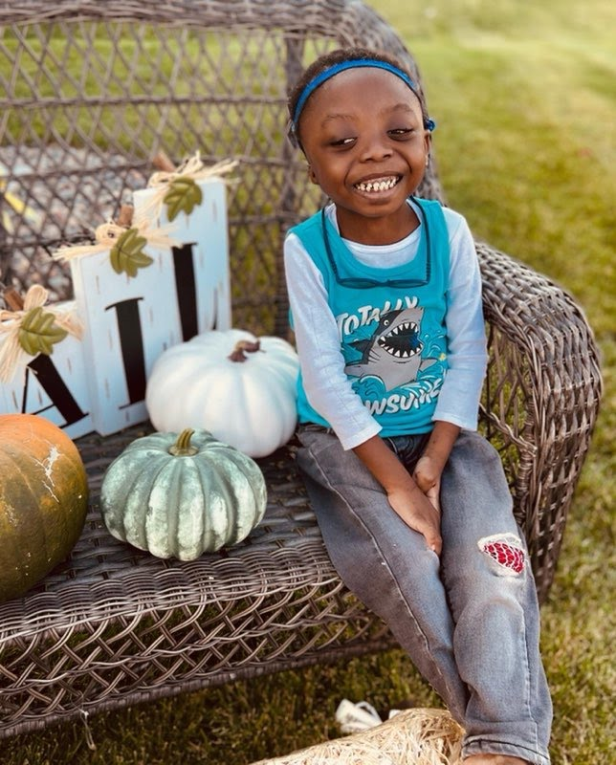
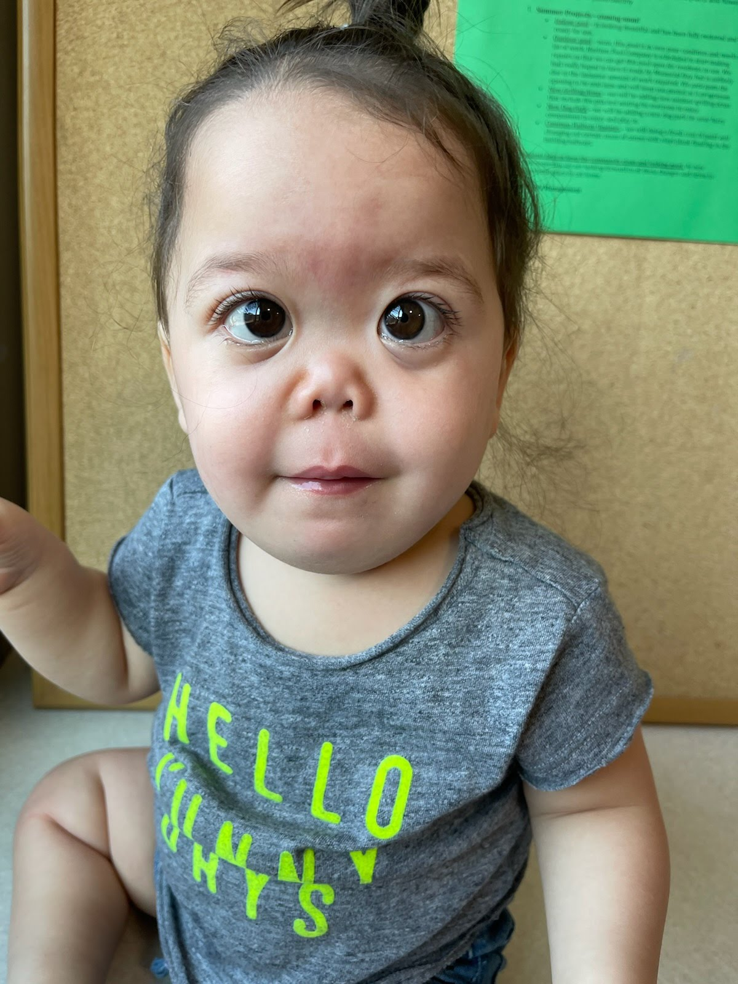
Who Is DeafBlind?

Slide 4
How Would Being DeafBlind Affect Your Life?
“It’s not about what you cannot do, it is all about what you can do, if given the right supports and environment.”
Dr. Jerry Petroff, 2012
Link to video 2:18: NCDB (YouTube.com)

Slide 5
How Do You Access and Learn Information?
How do you experience the world?
How do you learn?
How do you gain knowledge?
Credit: Dr. Jerry Petroff, 2012

Slide 6
Accessing Information Through Senses
Percent (%)
100
Hearing 20%
Vision 70%
Touch 5%
Smell 3%
Taste 2%
50
0
Hearing Vision Touch Smell Taste

Slide 7
Critical Understanding #1
Approximately 80-90% of sensory information is compromised or missing for children who have combined hearing and vision loss.
Credit: Dr. Jerry Petroff, 2012
Students with deafblindness often experience additional disabilities. More than 80% of deafblind students in Minnesota have additional disabilities.
However, it is deafblindness that must always be considered as their primary challenge to access for communication and learning.

Slide 8
Definition and Examples of Deafblindness
Deafblindness is when a person experiences loss in both hearing and vision. The levels at which hearing, and vision are affected vary greatly.
Only 1% of children identified as deafblind are completely deaf and completely blind. The other 99% have different levels of combined hearing and vision loss. Even when children have the same syndrome, they may be impacted differently. Each person is unique.

Slide 9
Critical Understanding # 2
Hot
Dog
Hot Dog
Deafblindness does not equal deaf plus blind.

Slide 10
Some Etiologies of Deafblindness
Etiologies of Deafblindness
Complications of Prematurity
Congenital Prenatal Causes
Congenital Cytomegalovirus (cCMV)
Hydrocephaly
Microcephaly
Fetal alcohol syndrome
Maternal drug abuse
Congenital Rubella
3. Hereditary/Chromosomal Syndromes
CHARGE
Usher
Down
Stickler
4. Postnatal Causes
Asphyxia
Head injury/trauma
Meningitis

Slide 11
Congenital Deafblindness
Deafblindness can occur at birth or soon after. This is called congenital deafblindness.
Children with this type of deafblindness may struggle to with concept development, language, and many other areas.
Credit: National Center on Deafblindness OHOA Intervener Learning Modules

Slide 12
Acquired Deafblindness
Combined hearing and vision loss can also occur later in life. This is called acquired deafblindness (i.e., when a student’s hearing or vision levels change.)
Note: Tracking hearing and vision levels is important, especially for children and youth with certain etiologies.
Credit: National Center on Deafblindness OHOA Intervener Learning Modules

Slide 13
Unduplicated Child Count: Primary Disability on IEP
The Minnesota Department of Education tallies their child count numbers in special education by the primary disability on the IEP.
2022-2023: DeafBlind – 119 students
2022-2023: Severely Multiply Impaired – 1,626 students

Slide 14
Minnesota DeafBlind Child Count = 363 2022-2023
Additional Disability | Total Numbers | Percentage of Minnesota Students with Combined Hearing and Vision Loss
Developmental Cognitive Delay | 245 out of 363 | 67%
Physical Impairments | 247 out of 363 | 68%
Complex Health Care Needs | 226 out of 363 | 62%
Cortical Visual Impairment (CVI) | 110 out of 363 | 30%

Slide 15
DeafBlind as the Primary Disability
Students with combined hearing and vision loss (deafblindness) often may present with additional disabilities.
However, it is strongly encouraged that deafblindness be considered as the primary disability because deafblindness impacts access to people, the environment, communication, language, and learning.
** At least 80-90% of sensory information is compromised or missing. **

Slide 16
Simulations
Disclaimer: There is debate about the value of short simulation activities for participant understanding. Note that these short clips are not the experience of every person with combined hearing and vision loss.
Goal of this activity: To encourage reflection and consideration of the impact of combined hearing and vision loss on infant, child and youth access to learning.

Slide 17
What is it Like to have Cortical Visual Impairment?
Link to YouTube video 1:05: The New Face of Blindness

Slide 18
What Do Children with CVI See?
CVI simulation
Figure 1: Children with Cortical Visual Impairment (CVI) have delays in recognition of what the image represents.

Slide 19
What Do Children with CVI See?
Figure 2: Children with Cortical Visual Impairment (CVI) still searching for the recognition of what the image represents.

Slide 20
What Do Children CVI See?
Figure 3: Children with Cortical Visual Impairment (CVI) can recognize better images representation if the outline of pictures is highlighted.

Slide 21
Spelling Test: Directions:
Write down the five words that you hear.
Review for accuracy.
Link to YouTube videos:
School Sound Effects (Ambience World)
Unfair Spelling Test 5 words

Slide 22
Simulations for Combined Hearing and Vision Loss Produced by SKI-HI Institute
Link to YouTube videos:
Scattered Blind Spots and Severe Hearing Loss (1:03)
20/200 Visual Acuity and Sloping Hearing Loss (1:04)
Cataracts and Mild High Frequency Hearing Loss (0:59)
Cochlear Implant Simulations Auditory Implant Service

Slide 23
Active Learning and Access for DeafBlind Children
When a DeafBlind child has access, his energy levels, motivation, interactions, and engagement increase.
Link to video 0:09: Before Active Learning
Link to video 0:31: In Active Learning

Slide 24
Critical Understanding #3: Access of the Hula Hoop

Slide 25
Journal of Visual Impairment & Blindness: An Examination of Interstate Differences in Eligibility Criteria for Deafblindness, June 6, 2023
Journal of Visual Impairment & Blindness
…miscategorizing a student with deafblindness prevents the Individualized Education Program (IEP) team from conceptualizing the immediate and long-term needs of the individual with specific consideration given to the student's level of functional vision and functional hearing. The student's combined hearing and vision must always be a primary consideration; it may not be the focus without the label of deafblind.

Slide 26
What About Severely Multiply Impaired (SMI) as the Primary Disability for Students with Combined Hearing and Vision Loss and Additional Disabilities?
Current MN SMI Criteria Checklist:
MN Department of Education SMI Checklist Link
IDEA's Multiple Disabilities Criteria excludes Deafblindness and recognizes it as a separate disability category.
Most importantly, recognize ACCESS.
The primary disability highlights the access needs. It does not mean the child does not have co-occurring disabilities and does not need other special education services. The need for access is highlighted.

Slide 27
Resources for Assessing Students with Combined Hearing and Vision Loss (Deafblindness) with Multiple Disabilities
Google Site: DeafBlind Resources for Educators – Assessments
Google Site: DeafBlind Resources for Educators – Writing Impact Statements for Combined Hearing and Vision Loss in the IEP

Slide 28
Interveners
Individuals with specialized training to work with children and youth who have combined hearing and vision loss (deafblindness) and work in a one-on-one relationship with children/youth who are deafblind.
Intervener Information on the MN DeafBlind Project Website

Slide 29
Comparison of Interveners and Paraprofessionals
Link: Comparison of Interveners and Paraprofessionals Document
Find more information about interveners on the Minnesota DeafBlind Project website under the Interveners tab.

Slide 30
Clarification of Roles of Contracted Nurses, District Health Staff, and Interveners in Educational Settings
Link: Clarification of Roles of Contracted Nurses, District Health Staff, and Interveners in Educational Settings
Find more information about interveners on the Minnesota DeafBlind Project website under the Resources for Interveners tab.

Slide 31
Professional Learning Opportunities
Understanding Deafblindness and the Role of the Intervener Virtual Workshop – August 2024
Open Hands, Open Access Asynchronous Facilitated Cohorts with CEUs, begin mid-September 2024 for educators, educational interpreters, and trained interveners.

Slide 32
Contact Information and Thank you!
Ann.Mayes@brightworksmn.org
612-638-1527

