Slide 1
Empowered to Make Change: My Journey as a Person with a Disability
Provided by Vicki Stewart

Slide 2
Personal Story
Breaking Down Barriers Achieving Success Awareness and Advocacy Motivation and Inspiration

Slide 3
My Personal Story
2 Years Old – When I could walk
2 Years Old – in traction with two broken legs

Slide 4
Fast Facts about Osteogenesis Imperfecta
Definition: Genetic disorder characterized by bones that break easily, often from little or no apparent cause. A classification system of different types of OI is commonly used to help describe how severely a person with OI is affected.
Prevalence: Exact number is unknown, but the best estimate suggests a minimum of 20,000 and possibly as many as 50,000.
Diagnosis: Caused by genetic defects that affect the body’s ability to make strong bones.

Slide 5
Clinical Features
Type III
Bones fracture easily
Fractures often present at birth
X-rays may reveal healed fractures that occurred before birth
Short stature
Sclera have a blue, purple or gray tint
Loose joints and poor muscle development in arms and legs
Barrel-shaped rib cage
Triangular Face
Spinal curvature
Respiratory problems possible
Bone deformity, often severe
Brittle teeth possible
Hearing loss possible
Collagen improperly formed

Slide 6
Small Town USA
In 1980 the population of Larchwood, IA was 700 people.
Notable People:
Cheri Blauwet – Paralympic Athlete
Kyle Vanden Bosch – Defensive End for the Detroit Lions
LeVar Woods – Special Teams football coach for University of Iowa

Slide 7
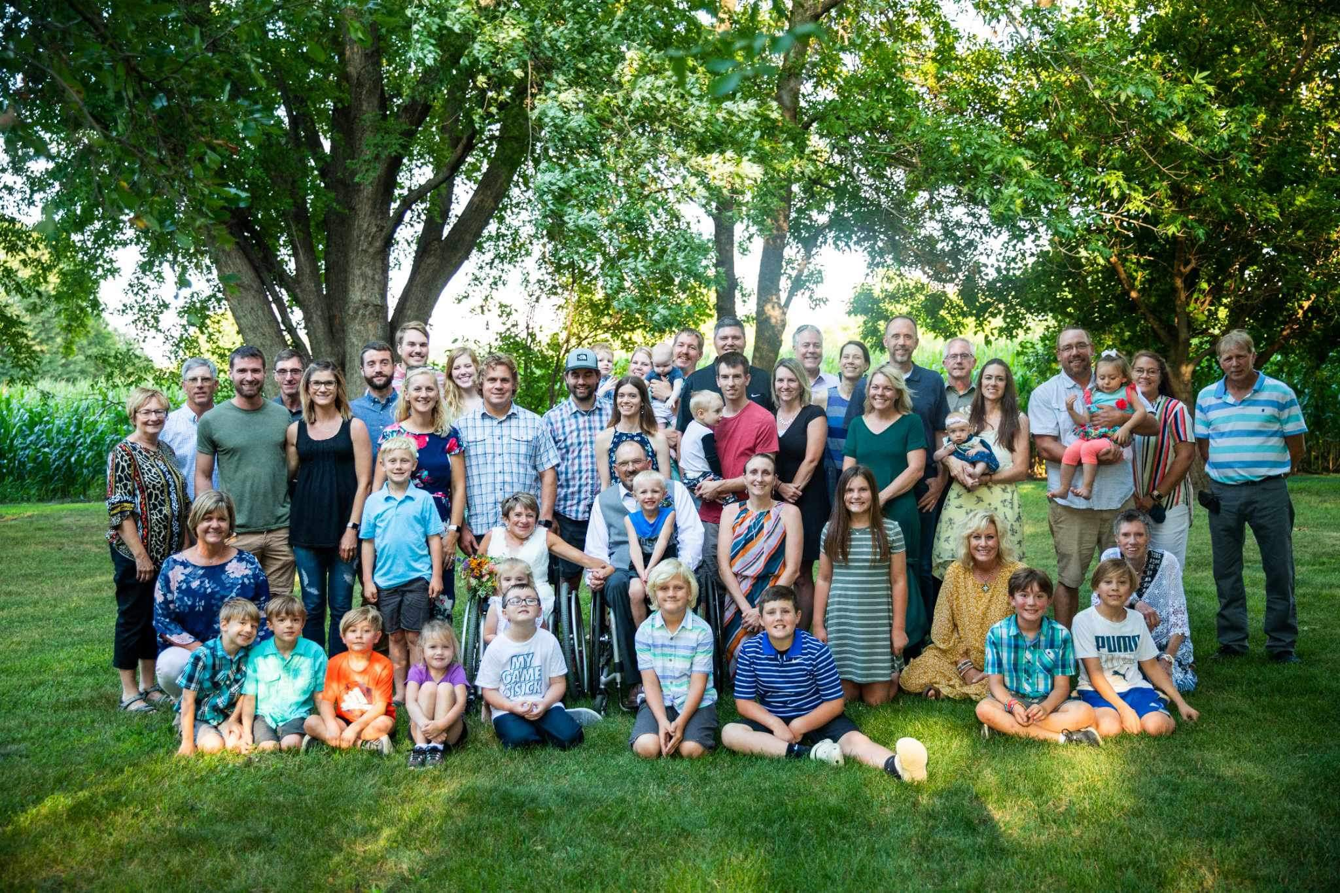
Family
Family Photo - 1972
Annual Big Sioux River canoe trip
Extended Family Photo - 2020

Slide 8
Education
Country School – made up of 4 towns, built in 1975, all one level, K-12
Not on an IEP
Accommodations:
Family/Friends drove me to school
Used nurses' office for bathroom
Had helper for recess and between classes
Did not participate in PE classes
West Lyon School

Slide 9
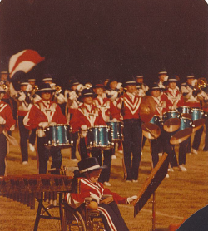
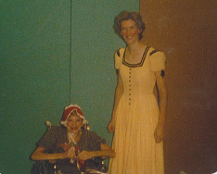
Extracurricular Activities
Band
Vocal
Volleyball Manager
Future Homemakers of America
School Plays
Speech Club
National Honors Society
Vicki with her cousin in their school play “Tumbleweeds”.
Vicki in Marching Band playing the bell tree.

Slide 10
Breaking Down Barriers
Accessibility
Attitude
Acceptance

Slide 11
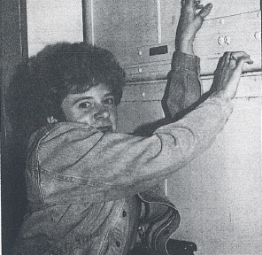
Daily Living
College
Independent Living
Driving
Employment
Community
Vicki’s Home made with specific modifications for accessibility.
A photo from the Augustana student newspaper showing Vicki using the freight elevator in the Commons.

Slide 12
Attitude
Not receiving sign of peace at church
Ordering for myself at a restaurant
Business Owner asking, “Do I have to hire those kind of people?”

Slide 13
Acceptance
Five Stages of Grief (Kubler-Ross)
Denial and Isolation
Anger
Bargaining
Depression
Acceptance

Slide 14
Achieving Success
Personal
Professional

Slide 15
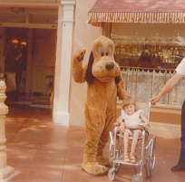
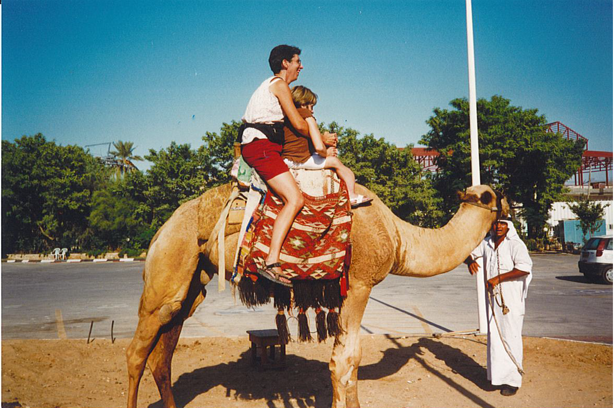
Personal
Right: Vicki at Disneyland with Pluto.
Travel
Marriage
Circle of friends
Music
Owning own home
Right: Vicki riding a camel in Jericho with a fellow tourist.
Vicki and Alma on their wedding day.

Slide 16
Professional
Employment History
Board Involvement
Windmills Certification
Ms. Wheelchair South Dakota
Remarkable Women 2023
Governor’s Award 2000
Stewart holding her Remarkable Women 2023 Award.

Slide 17
Awareness and Advocacy
Representation
Accessibility
Inclusion for All

Slide 18
Representation
Rare by Design
Style Show: A Runway to Empower
Refocus
Local Media Outreach
Keloland Living
“Tradition of Caring” Commercial
Other News Stories
Vicki with her husband, Alma, backstage at the Style Show.

Slide 19
Accessibility
ADA Assessments
ADA Celebration
Vicki with ADA Celebration Planning Committee at the 31st Anniversary Celebration.

Slide 20
Inclusion for All
Human Relations Commission
“Pathways to Inclusive and Equitable Workplaces”
National Disability Employment Awareness Month Events
2024 NDEAM poster

Slide 21
Motivation and Inspiration
Sharing resources to create a more inclusive society
Inspiring others to reach for their dreams, no matter their circumstances

Slide 22
Sharing Resources
Disability Etiquette Presentations
Encouraging groups to include people with disabilities as panelists, board members and volunteers, etc.
Disabilities don’t define us, but they are an integral part of us!

Slide 23
Inspiring Others
Push your students to achieve
Remember you are a strong voice in your students’ lives…use it well!
The student is your best teacher – learn from them and encourage them to share their experiences!
Let them make mistakes and learn from them.
Help them to know their strengths (volunteering, extracurricular activities, work, chores at home & mentoring)
Encourage interaction, not isolation.
You are changing the world, one student at a time.

Slide 24
Q&A?

Slide 25
Thank you!
Vicki Stewart, Executive Director
Employment Disability Resources
Phone: 605-215-1760
Website: edrsd.org
Email: Vicki@edrsd.org

