Slide 1
Looking Through a Trauma Sensitive Lens
Lonna Housman Moline, Ed.D
Council for Exceptional Children-President Elect Division of Emotional and Behavioral Health
University of St. Thomas
April 2024

Slide 2
Overview and Objectives
Information and specific examples will be shared regarding trauma, self-awareness, relationships, belief systems, responsibility, regulation, and self-care.
Define various forms of trauma
Explore personal beliefs and perspectives around trauma
Define relationship strategies for building positive connections
Review strategies with a focus on resilience
Identify personal needs when working with students who have experienced trauma
Establish strategies for self-care and grace

Slide 3
Resources
Fostering Resilient Learners: Strategies for Creating Trauma Sensitive Classroom, Kristin Souers
Relationship, Responsibility, and Regulation: Trauma Invested Practices, Souers and Hall
The Deepest Well: Healing Long-term Effects of childhood Trauma, Nadine Burke Harris
The Body Keeps the Score, Bessel Van Der Kolk
Building a Trauma-Informed Compassionate Classroom, Jennifer Bashant
Morgart, K., Harrison, J.N., Hoon, A.H., Jr and Wilms Floet, A.M. (2021), Adverse childhood experiences and developmental disabilities: risks, resiliency, and policy. Dev Med Child Neurol, 63: 1149-1154.

Slide 4
The Spectrum of Trauma Practices
Trauma Inducing: a setting that lacks safety and is actively unsafe for students/adults
Trauma Indifferent: a setting that does not take childhood trauma into account in its policies and practices
Trauma Informed: a setting where stakeholders have acquired some knowledge about childhood trauma and are versed in related strategies
Trauma Invested: a setting where stakeholders have consented to act on their knowledge, truly working together to enhance safety across the board

Slide 5
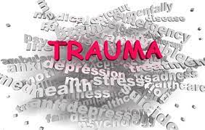
Acknowledge Fundamental Truths
Trauma is real
Trauma is prevalent
Trauma is toxic to the brain and can affect development
We need to be prepared to support students who have experienced trauma, even if we don’t know who they are
Children are resilient and with a positive environment they can grow and succeed

Slide 6
Trauma is a Continuum
war, torture, rape, natural disaster, divorce, poverty, serious illness, abuse
Definitions focus on the IMPACT of the event, not the nature of the event.
We all respond to trauma differently.
“Trauma is an exceptional experience in which powerful and dangerous events overwhelm a person’s capacity to cope.” (Rice & Groves, 2005)

Slide 7
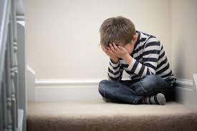
Trauma and Development
Given a confusing event, children have a need to give meaning to what is happening to them by creating a narrative or story. When there is no clear explanation, they make one up.
The intersection of trauma and the developmentally appropriate egocentrism of childhood often leads a little kid to think, “I made this happen”.

Slide 8
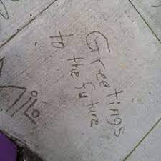
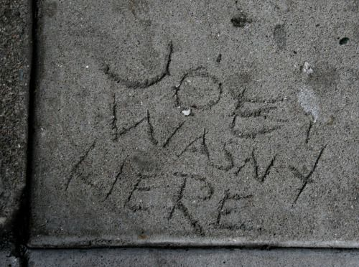
Children are like wet cement.
Whatever falls on them makes an impression. -Haim Ginnot

Slide 9
ACEs: Adverse Childhood Experiences
Vincent Felitti and Robert Anda (Felitti et al, 1998)
Medical doctors
Collaborative project between Centers for Disease Control and Department of Preventive Medicine
17,000 subjects, middle class San Diego, 70% college educated, 70% Caucasian
Explored the relationships between children’s emotional experiences and subsequent mental and physical health as adults

Slide 10
Strong correlation and more prevalent than previously thought, regardless of income, race, or access to health care.
RESULTS
WHAT WE KNOW
67% had at least one ACE
12% had 4 or more ACE
People with 4 or more had 2 times the rate of heart disease and cancer and 3 and a half times more chronic obstructive pulmonary disease (COPD)
Trauma and risky behavior
Trauma and heart disease, cancer, obesity, asthma, failure to grow, sleep disorders

Slide 11
Adverse Childhood Experiences
Initial 8 ACEs
What about…
Substance abuse in the home
Parental separation
Mental illness in the home
Witnessing domestic violence
Suicidal household member
Death of parent or loved one
Parental incarceration
Experiences of abuse or neglect
Natural disaster
Criminal behavior in the home
Terminal or chronic illness
Military deployment
Homelessness
Victimization

Slide 12
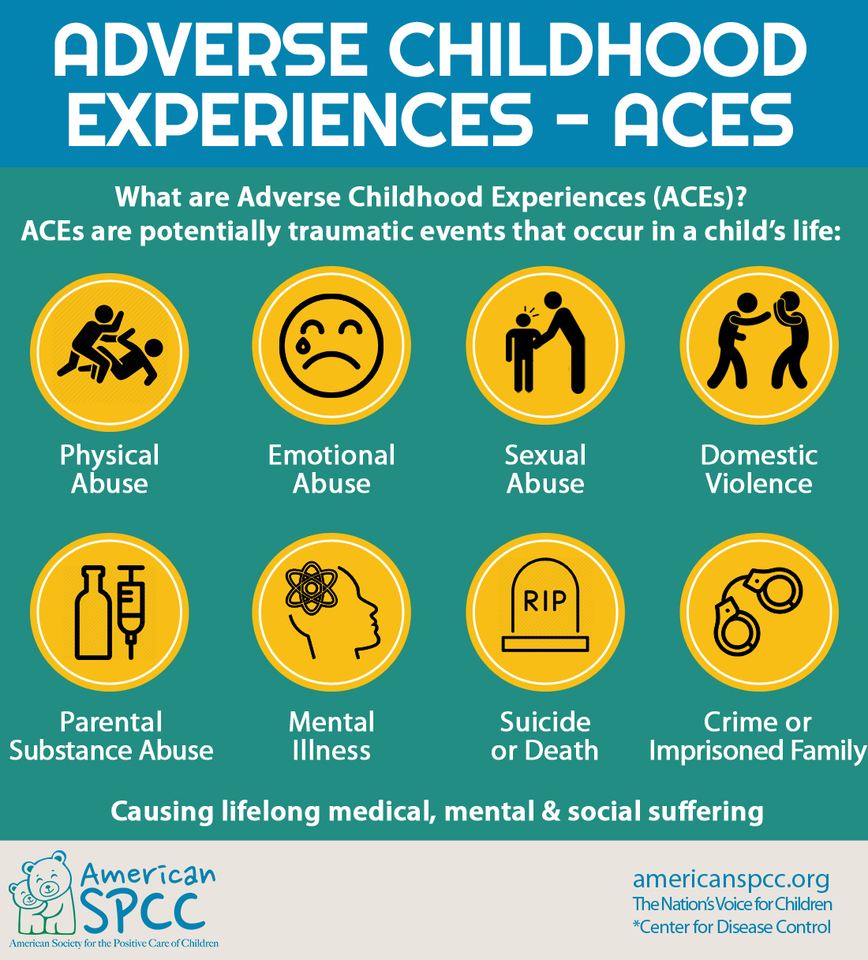
Adverse Childhood Experiences - ACES

Slide 13
Current Data
Current data on how many children and adolescents experience ACEs are limited. This hinders understanding how often ACEs occur, tracking ACEs changes over time, focusing prevention strategies, and measuring community prevention effort success. (Center for Disease Control)

Slide 14
MN Surveillance activities include:
Continuing to include ACEs information on the 2022 Minnesota Student Survey to provide state and local ACEs estimates for Minnesota students in grades 5, 8, 9, and 11.
Partnering with Minn-LInK, a research project investigating the effects of policies, practices, and programs on Minnesota families, to combine county and city data from multiple sources, including Child Protective Services, the Minnesota Department of Education, and the Minnesota Department of Human Services. These data will be used to develop indexes to understand how social determinants of health impact ACEs and associated risk and protective factors in each county.

Slide 15
Adverse childhood experiences and developmental disabilities: risks, resiliency, and policy.
Harrison, Hoon, & Floet (2021)
A fundamental question change from ‘What is wrong with you?’ to ‘
What happened to you?’
Modern neuroscience has extended the understanding that human life has no precise beginning or end, with both genetic changes and actual cells persisting through generations. Furthermore, adverse events in life, beginning even before conception, during in utero development, and into childhood can have deleterious consequences on physical and mental health in adulthood.

Slide 16
Adverse childhood experiences and developmental disabilities: risks, resiliency, and policy.
Harrison, Hoon, & Floet (2021)
Maltreatment of children with disabilities is higher than for the general pediatric population. Neglect is the most common form of maltreatment, as is true for typically developing children. At the highest risk for all types of maltreatment are children with behavioral disorders.

Slide 17
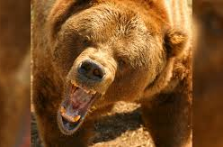
Stress Response...you are walking in the woods
Your amygdala sounds the alarm:
Release stress hormones! Adrenaline! Cortisol!
Heart pounds, pupils dilate, airways open up, blood is sent to your skeletal muscles, shuts down your thinking brain
Stress thermostat called feedback inhibition that triggers stress response to turn off

Slide 18
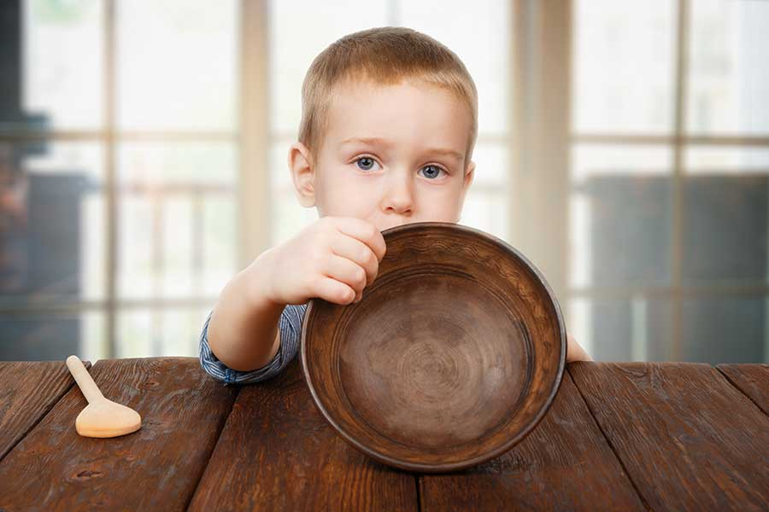
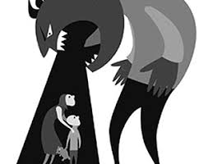
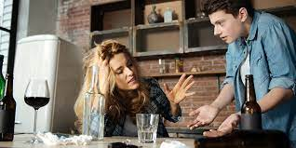
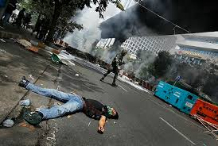

But what if your stress looked like this…

Slide 19
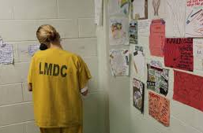
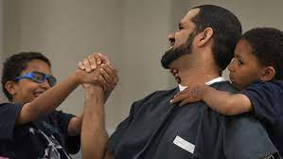
More than their story...change your focus
Learn their story as a means to understanding their behavior
We see the story’s effects, even if we don’t know the story
Monitor the effect of the event instead of preoccupation with details of the event

Slide 20
How trauma affects the brain
Fight, Flight, Freeze Fawn
Brain shifts from development to stress mode
Early brain sensitive to chronically elevated levels of stress hormones
High levels toxic
Affects: learning, memory, mood, relational skills, executive functioning

Slide 21

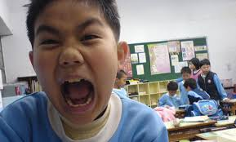
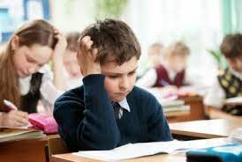
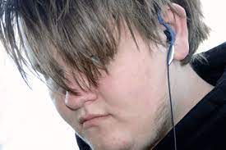


How does it look in the classroom?

Slide 22
Classroom: Flight, Fight, Freeze
FLIGHT | FIGHT | FREEZE
Withdrawing | Acting out | Exhibiting numbness
Fleeing classroom | Behaving aggressively | Refusing to answer
Skipping class | Acting silly | Refusing to get needs met
Daydreaming | Defiant | Blank look
Avoiding others | Hyperactive | Feeling unable to act or move
Wandering | Arguing
Disengaged | Screaming/yelling

Slide 23
Scenario and Typical Staff Responses (scenario in book p. 28)
Offer one more chance to get started, if not, send her to classroom next door
Invite her to your classroom at lunchtime to talk
Send them to the office
Leave them alone
Arrange a parent meeting asap

Slide 24
Typical thought process behind staff responses...
Offer one more chance to get started, if not, send her to classroom next door
Expectation that they can pull themselves together
Invite her to your classroom at lunchtime to talk
Willingness to connect and help person underneath the behaviors
Send them to the office
Requires immediate consequence and through discipline you can change behavior
Leave them alone
Low expectation for academic and personal growth
Arrange a parent meeting asap
Needs more help than you can provide

Slide 25
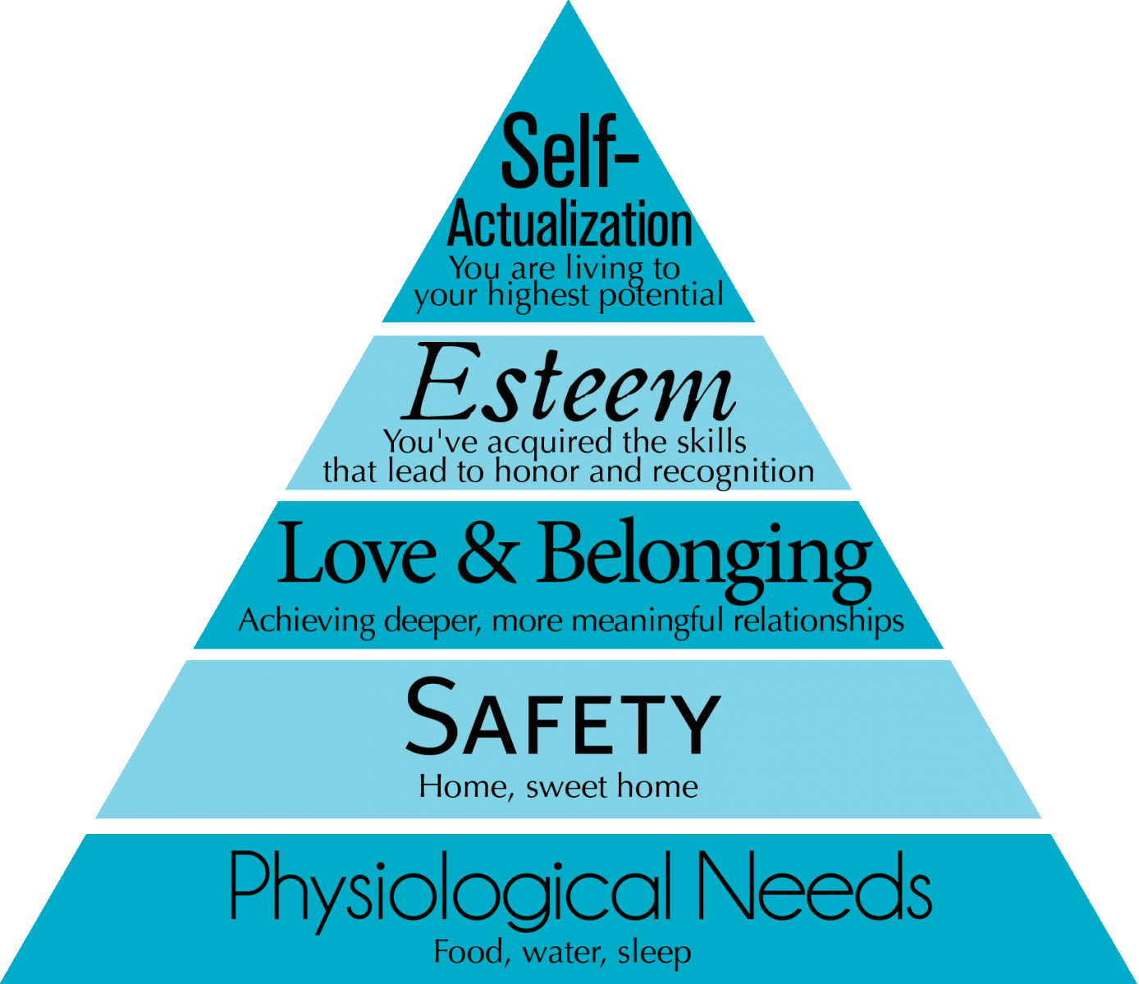
Culture of Safety

Slide 26
Are we creating a physically and emotionally safe environment?
We often use assumptions to help us manage or make sense of a situation. We use them to enhance our understanding of something or affirm our beliefs about an event or person.
Our assumptions can become barriers for students who are in desperate need of help.
“Spoiled and entitled”
“Had a rough life”
“Just wants attention”

Slide 27
Systems of Meaning
Looking at behavior through 3 explanatory lens:
Lack of safety or unmet need-brain is designed for survival (limbic area)
Actual brain development-many children have not developed fully due to trauma, genetics, toxic stress, negative environmental exposures, pre and postnatal care.
Impacted systems of meaning-interpretations based on past experiences, what we have been taught to believe, and thoughts influenced by others

Slide 28
Systems of meaning, continued
Not always conscious of this process because it’s become automatic
Implicit bias
We access our systems of meaning when in a state of stress and become dysregulated
Keep doing the same thing over and over
We are human
Positive and negative
(examples p.34-38 RRR)

Slide 29
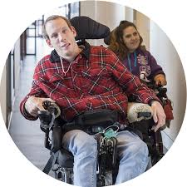

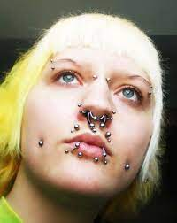



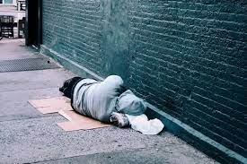

What are your systems of meaning telling you?

Slide 30

When we are regulated, we are more open to positive thoughts and less likely to access our systems of meaning.

Slide 31

Availability and Accountability

Slide 32
Walking a fine line
Making ourselves available to others AND holding others accountable
Availability: emotional investment, nurturing, encouragement, empathizing, being there for the students as they go through life
Accountability: insisting students meet standards for learning, behaving, and choices.
Clash between accountability and availability

Slide 33
What do we do?
Shuts down, refuses to learn, defiant
They are showing us the only thing they know.
Forced compliance does not teach accountability
Removal from the classroom or school does not induce learning
We are overwhelmed by their intensity and needs and at a loss as to how to respond
Students need to be held responsible for respecting themselves and others. We need to teach them how and show them another way.

Slide 34
Availability and Accountability, continued
Experiencing trauma does not excuse unsafe or harmful behavior
Healthy or not, ways of managing stress are learned patterns of behavior
CHANGE IS HARD!
Learning and practicing a different way is not easy or comfortable
Envisioning different means of seeing a caregiver in a new light takes a lot of courage

Slide 35

Out of Balance: Overly Sensitive
Only see the trauma
Provide empathy and availability
Strictly relational
Struggle holding students accountable for the way they manage their intensity
Don’t jump in and save them
  Empower them
Teach them healthy ways to navigate through troubled waters
  Have faith in their abilities

Slide 36
Too Focused on Accountability
Ignore relational piece
Regardless of adversity
Expected to meet strict standard of behavior and self-management

Slide 37
Availability and Accountability, continued 2
Validate student feelings
Reassure them they are safe
After they are regulated-
Help them see the big picture, not just the experience
Explore what self-respect and respect for others looks like
Explore alternative ways to manage intensity

Slide 38
CONTROL VS INFLUENCE
What can we actually control?
Provide safe and predictable environment
Provide caring, trusting relationship
Help stay focused despite distractions
Sometimes the students crave control at school because only place they can get it

Slide 39
I can’t...but I can...
  I can’t control that the student stole something out of my desk today, but I can control my emotional response to it and I can keep my door locked when I’m not in the classroom and I can talk to the student and determine why he thought stealing was a good option and I can influence him to take responsibility and I can teach them to see this from someone else’s perspective.

Slide 40
I can’t...but I can... continued
  I can’t control whether Oscar will come to class today, but I can control….

Slide 41
I can’t...but I can... Continued 2
  I can’t control whether Janet will pass this test, but I can control…

Slide 42
I can’t...but I can... Continued 3
  I can’t control whether Joe has experienced adversity and trauma at home, but I can control …

Slide 43
Times of crisis and conflict
  Healthy communication is difficult enough when dealing with our own defenses and triggers. Adding our students’ experiences of trauma, trust issues, and past letdowns magnifies the challenge.

Slide 44
SELF AWARENESS
What shifts you and disrupts your flow?
TRIGGERS
Exhaustion
Previous bad experiences
Challenges to our belief systems
Preconceived notions
Fear

Slide 45
Student Behaviors and Attributes
Ideal Student | Least Favorite Student

Slide 46
Student Behaviors and Attributes, continued
Ideal Student | Least Favorite Student
Polite
Helps others
Participates
Thanks me
Turns work in
Clean

Slide 47
Student Behaviors and Attributes, continued 2
Ideal Student | Least Favorite Student
Polite | Spits
Helps others | Challenges me
Participates | Doesn’t participate
Thanks me | Disrupts
Turns work in | Teases others
Clean | Not truthful

Slide 48
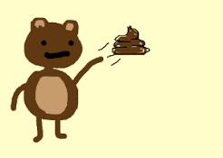
What can you do when you know it’s coming?

Slide 49
What is your belief?
Look at the NEED, not just the behavior.
It's fundamental you understand the NEED.
Relational need: safe and consistent connection; triggered when not feeling connected
Emotional need: emotional regulation; triggered when feeling unsafe
Physical need: basic biological survival; triggered when HALT, sick, anxious
Control need: have a say and feel power; triggered when needing control
Identify the need behind the behavior (p. 52 RRR)

Slide 50
Clues a RELATIONAL need
Requires you to be in close proximity. You help with regulation
Seeks you out often. Looks for advice
Display dramatic mood swings. Needs 1-1 connection to soothe
Thrive from simple touch. Calms down with physical touch
Use personal keywords. Simple expressions to invite connection

Slide 51
Universal Trauma Invested RELATIONSHIP Enhancing Strategies
Say Good Morning
Smile
Ask questions
Listen
Say the person’s name
Say something kind
Give hug, high five, handshake
Whisper wish “Did my wish come true?”
Work as a team
Offer tangibles

Slide 52
RESPONSIBILITY
A sense of self-worth, efficacy, and competence.
Living in chaos and stress lead children to learn early on to doubt themselves and blame themselves for their circumstances.
Students from families with trauma are constantly driven to cue off their environment to determine whether it's safe or unsafe, healthy or unhealthy-an external focus that has deprived them of the opportunity to pay attention to their internal states and gain insight into how they might be influencing their environment.
This hinders their development of responsibility.
They lack the ability to self-reflect and gain insights into their own attitudes and behaviors.

Slide 53
Cues to an unmet RESPONSIBILITY need
Crave control. Students who believe external influences are in in charge, who feel their lives are out of control, who attempt to regain a sense of control and predictability.
See predictability. Many students cue off of their environment. Seek safety in predictability.
Have fractured interpersonal relationships. Students that have been let down by humans. Safe way to establish trust and relationship.
Engage in negative self-talk. Lacks self-esteem.
Uses the exit strategy. Avoid tasks. Escape behaviors. Haven’t built a connection between the value of a goal and perseverance...yet.

Slide 54
Universal Trauma-Invested RESPONSIBILITY Developing Strategies
Say YET
Provide clear expectations and rubrics
Set goals, create action plans, monitor progress often
Let students choose where to work
Assign seating
Teach grit
Assign jobs
Forecast changes
Attend to cause and effect
Use positive self talk

Slide 55
REGULATION...most essential
The ability to take in stimuli and manage emotional and behavioral responses accordingly.
Regulated students can access reason in their upstairs brain.
Cause and effect connection

Slide 56
Cues to unmet REGULATION needs
Tough transition times.
Fidget constantly. Quick to agitate
Shut down. Freeze
Flips their lid suddenly. Slightest incident can be trigger
Be on an emotional roller coaster. Wild fluctuations

Slide 57
Universal Trauma-Invested REGULATION-Establishing Strategies
Weighted pencil
Weighted lap pad
Soothing music
Stress ball or worry stone
Play catch
Let them choose where to work
Keep their hands busy
Offer brain breaks

Slide 58
Regulation
When incorporating regulation strategies and tools, do not attempt anything that will send YOU to your lizard brain.
Start slow and partner with your students to identify what you can all consent and commit to.
Communicate the purpose.
Explain the why.
Consent is essential.
Example: p. 159 RRR

Slide 59
Resilience (Harrison, Hoon, & Floet, 2021)
Resilience in children can be defined as ‘the process by which the child moves through a traumatic event, utilizing various protective factors for support, and returning to “baseline” in terms of an emotional and physiologic response to the stressor’.
Resilience, an essential component in effectively overcoming ACEs, can be considered a trait, outcome, or process.
As a process, it includes both internal and external factors that can redirect a negative experience or series of stressful events into an outcome of positive personal development.

Slide 60
Resilience and Coping Skills (Harrison, Hoon, & Floet, 2021)
Coping skills are essential for successfully overcome stressful or traumatic events.
Children have two types of coping strategies that can be examined in relation to ACEs, problem-focused and avoidant emotion-focused coping.
Problem-focused coping concentrates on resolving the problem. It can be evaluated using three subscales: positive reinterpretation and growth; active coping; and planning. A favorable outcome of problem-focused coping is that the problem is successfully resolved while promoting competence and self-efficacy.

Slide 61
Resilience and Coping Skills, continued
(Harrison, Hoon, & Floet, 2021)
The second strategy, emotion-focused coping, is an avoidant strategy. This uses strategies such as denial, venting, or behavioral disengagement to diminish the negative affective response to the stressor.
This might diminish the immediate negative effects for the individual, however it is temporary and the problem is unresolved.
This type of coping helps in the moment or the immediate future.

Slide 62
Resilience and Relationships (Harrison, Hoon, & Floet, 2021)
Safe, stable, and nurturing relationships during childhood are important protective factors, which can diminish long-term physical and mental health problems in adulthood.³³ The external support of having an adult who helps to make the child feel safe is an effective protective factor that may build resilience and ultimately help mitigate the impact of ACEs.

Slide 63

Not Perfect. Enough.
Human beings are complicated
Emotions are dynamic influences
Trauma brings variable needs
Every day is different
Practice what we preach
Good role modeling
Healthy way to live

Slide 64
Thank you!
Lonna Housman Moline
lonnamoline@gmail.com
TEXT: 612-812-2221

