Slide 1
Using Person-Centered Practices for the Many Transitions, from Infanthood to Adulthood
Garrett Petrie | Person-Centered Thinking (PCT) trainer and coach trainer
Mary Cashman-Bakken | Deaf and Hard of Hearing (DHH) specialist
Person-Centered Practices in Education Leadership Team | Minnesota Department of Education

Slide 2
Takeaways for Participants
Know how to access the most current person-centered practice resources available in Minnesota for students, educators and family members.
Develop at least 1 One-Page Description for yourself before trying out with others.
Sign-up to receive direct technical assistance and professional development opportunities available as they are announced.

Slide 3
What are Person-Centered Practices?
Continuum of strategies and activities that support the informed choice of students and families to make or have input into both
Major transitions, and
Everyday life decisions.
Focus on the interests and needs of the person receiving instruction or support.
Emphasize each person’s strengths and dreams rather than weaknesses or deficits.

Slide 4
Why use Person-Centered Practices?
Ensure that all students and their families have teams that use the most current information about their strengths, interests and needs
Make informed choices about learning, working, living and playing in the most integrated settings possible
Students can be even more active members of their
Home,
School, and
Local community

Slide 5
Resources Available

Slide 6
Core Features of Person-Centered Practices
The Minnesota person-centered practices in education leadership team focuses on supporting educators to implement person-centered practices that have the following core features:
Strengths-based.
Person and family-led.
Involves people from across the home, school and community.
Awareness and sensitivity to issues of culture, race, age, sexual orientation and gender identity.
Information about student and family preferences to ensure each team member’s preparedness.
Informed choice that balances information that is both important to and for the person.

Slide 7
Person-Centered Practices in Minnesota
Access the most current person-centered practice resources (https://education.mn.gov/MDE/fam/sped/person) available in Minnesota for students, educators and family members, which include:
Examples of person-centered practices with demonstrated evidence, usability and implementation supports for school settings in Minnesota
Training opportunities provided by the Minnesota Department of Education (MDE), funded partners and other state departments like the Department of Human Services
Invitation to share experience and student/family outcomes with MDE’s leadership team (mde.person-centered@state.mn.us) for other person-centered practices
(https://education.mn.gov/
MDE/fam/sped/person)

Slide 8
One-Page Descriptions (OPDs): A positive introduction to a person

Slide 9
The Learning Community for Person Centered Practices
The Learning Community for Person Centered Practices envisions a world where all people have positive control over the lives they have chosen for themselves. Our efforts focus on people who have lost or may lose positive control because of society's response to the presence of a disability. We foster a global learning community that shares knowledge for that purpose.

Slide 10
Opening Round – 3 Steps
Let us know in chat (personal to Garrett or to all) if you are either [pick one]:
Listening to gauge interest - or -
Fully participating to try out the skills

Slide 11
How do we get to know students… Sources of information for students…
Evaluation Report (ER), sometimes called Evaluation Summary Report (ESR)
Functional Behavioral Assessment (FBA)
Individualized Family Service Plan (IFSP)
Individualized Education Program (IEP)
Present levels of academic achievement and functional performance (PLAAFP)
Progress report (PR)
Limited English proficiency (LEP) impact on learning and progress
Assistive Technology (AT) devices and services considerations
Personal Learning Plan (PLP) process (grades 9–12)
Individual Service Plan (ISP)
Summary of Performance (SOP)

Slide 12
If technical information is our first introduction, it may look like the following …
‘Communication skills are significantly different from typically developing peers…’
‘Referred to public school by pediatrician…’
‘Presenting concern with delay of speech…’
‘Responds to the word ’stop’ and ’no’ and follows routine cues…’
‘Makes wants and needs known by pulling adult to items or pointing…’
‘Fine motor skills during functional activities observed to be discrepant from same-age peers…’
‘High level of distractibility…’
‘Able to use a neat pincer grasp…’
‘Impairments in joint attention, reciprocal, social/emotional skills and limited peer interactions appropriate to age…’
‘Does not spontaneously respond to greeting/goodbye initiated by others…’
‘Safety concerns in the community…’
‘Delayed expressive/receptive communication and sensory processing skills…’
‘Hand-to-hand transfer…’

Slide 13
What do we know about Chandran?
How do we feel about this as an introduction to him?
Are we excited to meet him?
Are we excited to support him?
Please enter your thoughts in the chat
Is there another way?

Slide 14
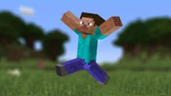
Chandran’s One-Page Description

Slide 15
Now—What do we know about Chandran?
How do we feel about this as an introduction to him?
Are we excited to meet him?
Are we excited to support him?
Please enter your thoughts in the chat.

Slide 16
Objectives
To understand the purpose of a One-Page Description (OPD)
To understand the core headings always included in an OPD
To identify where you can use creativity and judgment in creating an OPD
To develop an OPD for yourself or a student
Hopefully, you have a student in mind
Important to practice with yourself
It’s not necessarily that easy to do for ourselves

Slide 17
Purpose of One-Page Description
Descriptions are used for a specific purpose to introduce someone (e.g., new job, at the front of personal records, orientation for new staff, etc.)
Know the purpose before you create one
They are an at-a-glance, positive source of information about the person

Slide 18
Purpose of One-Page Description (continued)
They can also be used:
As a way to introduce someone across different settings like school, home and community.
When moving to a new school.
When meeting new people, like a new Intervener.
At the front page of a student’s records to share when paperwork is transferred.
As the beginning of a more detailed Person Centered Description.
As the basis for action—going from an OPD to then asking what is working and not working from different perspectives and acting on this.
Or … They can be used throughout the lifespan and always support positive control for people

Slide 19
Maxwell 3 Months

Slide 20
Liam’s One Page Introduction
©TLCPCP 2016 www.tlcpcp.com

Slide 21
Elizabeth Kate’s One-Page Description
©TLCPCP 2016
www.tlcpcp.com

Slide 22
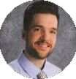
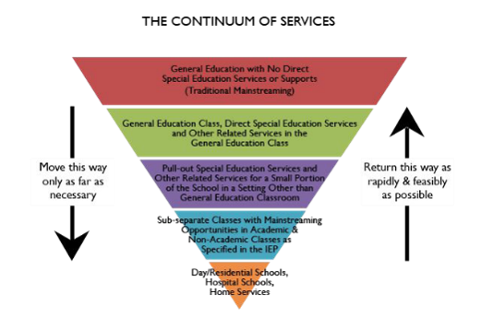
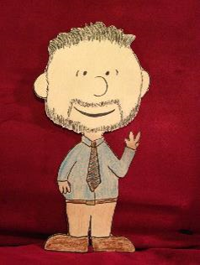
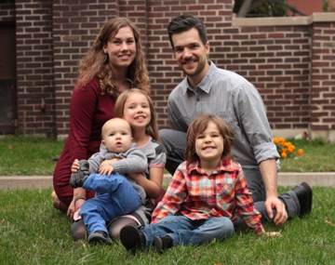
Garrett Petrie: Special Education Teacher, Grades 2-4
This is Important To Garrett:
Paperwork time when students are not in school
Ability to focus on family after a solid workday
...and this keeps him fulfilled:
Focusing on support and interactions with students and team members while at school
People Like & Admire
these things about Garrett:
Calmness
Tie-day Tuesday & Tie-dye Friday
Optimistic
Doggedly persistent
Has a vision
Supports that Garrett needs to be
Healthy, Safe & Fulfilled:
Grade-level curriculum (modifiable)
Daily schedules
Skinny Crayola markers
Laminator and dry-erase markers
Cloud-based data entry/access
Flex time for paperwork
LAPTOP!! to travel to classrooms
People who best support Garrett:
Highly rational
Believe all students have a right to integration
Not easily flustered

Slide 23
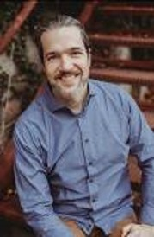
One-Page Description for Garrett Petrie, Ed Spec
Introduction to Garrett Petrie
Garrett Petrie is an Education Specialist (Ed Spec) for the State of Minnesota. You can find information about the position purpose from Garrett’s position description in the last section.
People Like & Admire These Things about Garrett
Calmness
Relentlessly positive
Doggedly persistent
‘Big picture’ thinking
Has a vision

Slide 24
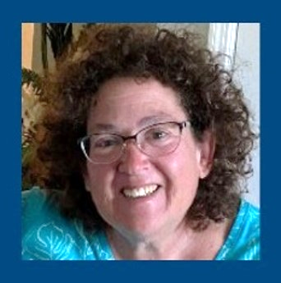
One-Page Description for Mary Cashman-Bakken
Introduction to Mary
Mary is the Deaf and Hard of Hearing (DHH) Specialist for the Minnesota Department of Education. You can contact her by email at Mary.Cashman-Bakken@state.mn.us.
People Like & Admire These Things about Mary
She herself is Deaf and knows what she is talking about.
She is knowledgeable about Deaf, Hard of Hearing and Deaf Culture.
She has lots of experience. Taught DHH for 10 years; in education for 40 years.
She is logical and practical.
She is a good listener.

Slide 25
Mary Cashman-Bakken Deaf and Hard of Hearing (DHH) Specialist | Minnesota Department of Education
People like and admire these things me:
I am Deaf and know what I am talking about.
Knowledgeable about DHH and Deaf Culture.
Lots of experience. Taught DHH for 10 years and been in education for 40 years.
Logical and practical
Good listener
What’s most important to me:
We continue to make strides in educating DHH students
We provide accessibility for all—I myself prefer ASL interpreters and captioning for accessibility.
We seek to determine the best way for students who are DHH to learn
We continue to educate ourselves so we can be better
People who best support me:
My family supports me the best. I support them. They are the best. My best friend Jon is my husband and we have 2 daughters. I have friends that I laugh with and share life with too! I am blessed.
For work, I need:
People who clearly identify in writing what it is that they want.
Ideally, they would provide a sample of what they need.
People who strive to make things better and are open to new ideas.
Supports that Mary needs to be Healthy, Safe and Fulfilled:
I need balance and the non-work side of me—books, sports and golf.
I love books by James Patterson, John Sanford, Lee Childs, Nicholas Sparks, Carla Neggers, Sandra Brown, Kat Martin, David Baldacci, and Elizabeth Lowell… I am an avid reader!
I support the Gophers, Twins, Vikings, Wild and my husband’s football teams!
I am thrilled and smile when I get pars and birdies in golf!
DHH Position Purpose: Mary provides disability-specific information and knowledge in the area of Deaf/Hard of Hearing.
Email Mary.Cashman-Bakken@state.mn.us for questions. Email Aaron.Barnes@state.mn.us for a copy of the DHH Specialist position description.

Slide 26
Conejo Team One-Page Description
©TLCPCP 2016
www.tlcpcp.com

Slide 27
One-Page Descriptions Must Include
What must be included:
What people like and admire
What is most important to
How to best support the person

Slide 28
What people like and admire
A proud list of people’s positive qualities, strengths, gifts and talents
What are the cool things about you or your student?
Be clear and avoid words like usually or sometimes
Do not use jargon words—socializes with peers well
What would you say about other people around this age?
Find out from the person the things they are proud of and ask their team members.
This is a positive list. What makes the person unique?

Slide 29
What is most important to me
This section should have enough information that someone that does not know you well would know what is important to you. If you took the names out, would people know it was you?
Include things about your life
Include enough detail, so people know who you are and what you value most

Slide 30
How to best support me
Include what is helpful and what is not
Be specific – What does support or help mean?
Think about environment
Learning vs. social environments
Classroom vs. non-classroom settings
Think about routine and comfort
How do we help the person be their best

Slide 31
One-Page Descriptions May Also Include
What might be included:
Hopes and dreams for the future
How I communicate with you
Characteristics of people who best support me
My story/history
Things I don’t like
What is important to my family
For some students, this may be a required element
Other

Slide 32
Who may have the best information for the description?
If you are looking for people who may be able to contribute, ask them:
What do you like about the person?
What do you admire about the person?
When was the last time that you had fun with the person?
Recommendation: If they can answer these three questions, and add even more details, then prioritize them for the person to consider reviewing their info to add/update their One-Page Description over time.

Slide 33
One-Page Description templates
Google Drawing template (http://bit.ly/opdtemplate - all lowercase)
If you want to use and adapt this template, go to:
File
Make a copy
Rename and save to your Google Drive
PowerPoint version (provided with examples)
Word document version (provided by trainer) – Two pages with headings
Charting the LifeCourse Profile Page (https://disabilityhubmn.org/media/u5nnccvn/hub_lifecourse_myprofilepage_fillable.pdf)

Slide 34
One-Page Description for [INSERT NAME AND ROLE/PURPOSE] (Age, Grade or Team)
People like and admire these things me:
What’s most important to me:
How to best support/comfort me:
How to best support/comfort me:

Slide 35
Questions

Slide 36
Resources
Minnesota Gathering YouTube video: OPDs for Children 2021 (https://youtu.be/7gPbUQf5K5Y)
The Learning Community for Person Centered Practices (https://tlcpcp.com)
Support Development Associates: Go-To Guide for Person-Centered Thinking (PCT) Skills webpage (https://sdaus.com/tool-kit-templates-examples)
Helen Sanderson Associates: One-Page Profile Templates webpage (http://helensandersonassociates.co.uk/person-centred-practice/one-page-profiles/one-page-profile-templates)

Slide 37
Resources (continued)
It’s My Choice (https://mn.gov/mnddc/extra/publications/Its-My-Choice.pdf)
Minnesota Department of Education (MDE) Person-Centered Thinking webpage (https://education.mn.gov/MDE/fam/sped/MDE032791)
Positive Supports Minnesota (https://mnpsp.org)
Minnesota Department of Human Services (DHS) Person-Centered Practices webpage (https://mn.gov/dhs/partners-and-providers/program-overviews/long-term-services-and-supports/person-centered-practices)

Slide 38
Person-Centered Practice Examples in Minnesota Schools: Contract Opportunity
Purpose: Provide additional opportunities for schools and districts to share current information and video stories about person-centered practices in Minnesota schools and programs.
MDE is offering contracts to schools and districts to develop approved, student or family-centered stories.
Provide examples of person-centered practices that have demonstrated evidence, implementation supports and usability across a range of school, home and community environments.
Stories may include, but are not limited to:
Description of the person-centered practice used with the student or family
How the person-centered practice was implemented
Available professional development opportunities for the practice
How it may have improved graduation rates, employment opportunities, increased integration or other specific outcomes of your focus
A student success story about how it impacted the student
Person-Centered Practice Examples in Minnesota Schools contract proposal page (http://s.alchemer.com/s3/Person-CenteredExamplesMN)

Slide 39
Interested in Receiving Email Updates?
Email the Minnesota Department of Education's leadership team (mde.person-centered@state.mn.us) to be added to the list of upcoming person-centered practice professional development opportunities.

Slide 40
Share Your One-Page Description
Email Mary Cashman-Bakken (mde.person-centered@state.mn.us) to share your first draft of your One-Page Description.

Slide 41
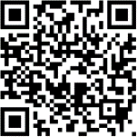
Thank you!
Minnesota Department of Human Services Disability Services Division
PositiveSupports@state.mn.us
Minnesota Department of Education Person-Centered Practices in Education Leadership Team
MDE.Person-Centered@state.mn.us
(https://education.mn.gov/MDE/fam/sped/person)

