Slide 1
Executive Function:
The Gateway to Success!
Tracy Mail, Educational Consultant
State Support Team Region 8 – Ohio
tracym@sst8.org

Slide 2
OBJECTIVES
Participants will:
Understand the connection between executive functioning and being successful in education, work, relationships, and life
Understand how executive functions manifest into observable management areas and are foundational to everything we do
Discuss and practice addressing executive disfunction with multiple strategies

Slide 3

PLANNING A TRIP - ACTIVITY
You receive an email inviting you to attend your family reunion that is happening in 6 months at an out of state location. You, your partner, and 3 children decide to attend. You have a dog and 3 cats.
Make a list of all the things that need to be done to plan and take this family reunion trip.
Type in chat the top 5 to-do actions and possible barriers to following through.

Slide 4
IN THE WORLD BEYOND SCHOOL…
What are the characteristics of a successful independent learner and productive citizen?
At home? At work? In College? In relationships?
(TYPE IN CHAT)

Slide 5
SUCCESS IN SCHOOL
Top 10 Skills as identified by a survey of 8,000 teachers (Elliot & Grisham, 2006)
Listen to others
Follow the steps
Follow the rules
Ignore distractions
Take turns when you talk
Ask for help
Get along with others
Stay calm with others
Be responsible for your behavior
Do nice things for others

Slide 6

PREPARES YOUNG PEOPLE FOR SUCCESS IN ADULTHOOD
Common list of soft skills employers want:
Social skills, interests, involvement
Communication skills
Interpersonal abilities
Problem solving
Teamwork
Adaptability/flexibility

Slide 7
EXECUTIVE FUNCTIONS DEFINED
Cognitive processes that enable individuals to engage in goal-directed or problem-solving behavior
(Council for Exceptional Children, 2011)
Allow us to organize our behavior over time and override immediate demands in favor of longer-term goals
(Dawson & Guare, 2010)

Slide 8
EXECUTIVE FUNCTIONS (Dawson & Guare)
Executive Function | Definition | Signs of Difficulty
Emotional Control | Regulates emotion to be appropriate to situation | Easily upset or excited, overreacts, frequent mood changes
Inhibit | Delays certain activities or response for sake of others | Distractible or impulsive, cannot delay gratification
Goal Setting/ Planning | Setting goals and identifying steps to take | Sets unrealistic goals, starts work at last minute, fails to anticipate consequences
Organize | Establishing order in a place or activity | Scattered, disorganized approach to solving problems, materials
Initiate | Begin a task or activity | Trouble getting started, may appear defiant
Executive Function | Definition | Signs of Difficulty
Working Memory | Holding information in mind while performing other tasks | Forgets assignments, materials, classroom procedures, remembers only part of directions
Shift | Smoothly transitioning from one task to another | Difficulty coping with changes in routine, thinking “outside of the box”
Self-Monitor | Assessing progress toward goal or effect on others | Doesn’t notice how others react to behavior, asks for help rather than trying first, avoids problem-solving games

Slide 9
EXECUTIVE FUNCTIONING…
Is sharply reduced when:
executive functioning capacity must be devoted to managing “lower level” (cognitive) skills and responses which are not automatic or fluent thus the capacity for “higher level” (metacognitive) functions is taken; (takes up mental desk space)
executive capacity itself is reduced due to some sort of higher- level disability or to lack of fluency with executive strategies.
    UDL Guidelines

Slide 10
EFFORTS TO EXPAND EXECUTIVE CAPACITY…
In two ways:
by scaffolding lower level skills so that they require less executive processing; and
by scaffolding higher level executive skills and strategies so that they are more effective and developed.
UDL Guidelines

Slide 11

NEURONS THAT FIRE TOGETHER, WIRE TOGETHER
ALL BRAINS can develop executive function skills
Brain pathways only get better at something by doing it repeatedly
Myelin sheaths grow in the brain by DOING
THIS MEANS…
Our planning and teaching must be intentional
Strategies need to match challenges
Repetition of strategies must be planned

Slide 12
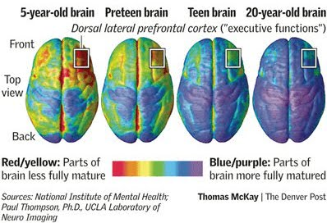
HOW DO EXECUTIVE FUNCTIONS DEVELOP?

Slide 13
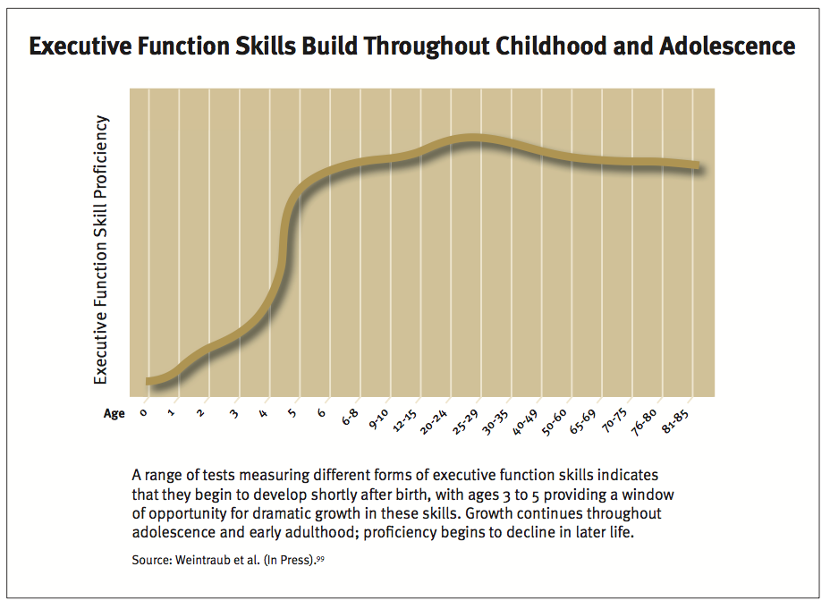
Executive Function Skills Build Throughout Childhood and Adolescence

Slide 14
RESOURCE: LEARN MORE ABOUT EF DEVELOPMENT
“Executive function and self-regulation skills are like an air traffic control system in the brain—they help us manage information, make decisions, and plan ahead. We need these skills at every stage of life, and while no one is born with them, we are all born with the potential to develop them.”
A Guide to Executive Functioning
Center on the Developing Child, Harvard University

Slide 15
WHO STRUGGLES WITH EXECUTIVE DYSFUNCTION?
Difficulties with Executive Functioning are associated with learning challenges and a greater likelihood of behavior problems, and they are a prominent feature of many emotional and behavioral disorders (EBDs); neurodevelopmental disorders (e.g., attention deficit hyperactivity disorder (ADHD); autism spectrum disorders (ASD); and specific learning disabilities that interfere with children’s education. Executive Functions: Implications for Education
“Some children may need more support than others to develop these skills.”
“Adverse environments resulting from neglect, abuse, and/or violence may expose children to toxic stress, which disrupts brain architecture and impairs the development of executive function.” Developing Child – Harvard University
Temporary Executive Dysfunction can be the result of concussions and other head injuries

Slide 16
HOWEVER, the good news is…
Executive Function skills are malleable, meaning they can change and are influenced by both positive and negative experiences. For example, stress, poverty, and disadvantage are associated with worse Executive Function skills. However, supportive caregiving, high quality early education, and even practice can help improve Executive Function skills.

Slide 17

HOW EXECUTIVE FUNCTIONS MANIFEST
Self Management
Time Management
Materials Management
Information Management

Slide 18
MANIFESTATION AREA: SELF-MANAGEMENT
Taking responsibility for your own behavior, actions, and well-being
  Self-regulation
  Sensory regulation
  Social competence
  Impulse control
Executive Functions:
Emotional Control
Inhibitory Control
Initiating
Shifting
Self-Monitoring

Slide 19
MANIFESTATION AREA: TIME-MANAGEMENT
Ability to use time effectively and productively
  Understand the abstract concept of time
  Chunk routines/projects into pieces and know how long each piece will take
  Know when to start, how long to work, when to stop
Executive Functions:
Goal Setting
Planning
Initiating
Working Memory
Shifting
Self-Monitoring

Slide 20
MANIFESTATION AREA: MATERIALS-MANAGEMENT
Ability to manage the “stuff” of school
  Having the right materials at the right time
  Knowing everything has a place
  Remembering to keep things in their place
Executive Functions:
Organizing
Initiating
Working Memory
Shifting
Self-Monitoring

Slide 21
MANIFESTATION AREA: INFORMATION-MANAGEMENT
Ability to acquire, retain, and use information
  Can take notes
  Can organize facts, information
  Can manipulate information in creative ways
Executive Functions:
Goal Setting
Organizing
Initiating
Working Memory
Shift
Self-Monitoring

Slide 22
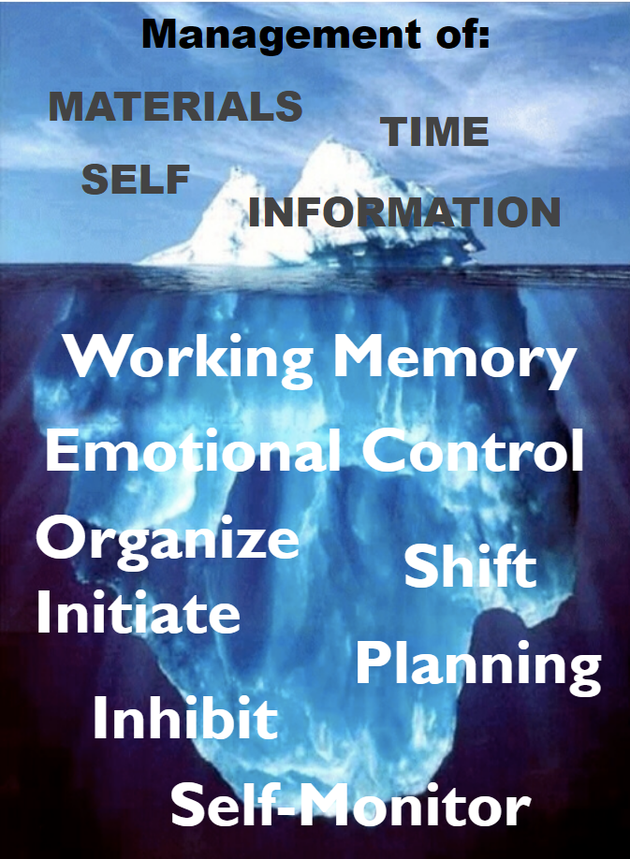
WHAT YOU SEE ON A DAILY BASIS…
might really be impacted by what is happening below the surface.

Slide 23
ASSESSING EXECUTIVE FUNCTION
“Can’t do, or won’t do?”
Be an Executive Function detective: find out what the child is capable of, and under what circumstances.
Informants can include parent, teachers, past teachers, coaches, student (observation, work samples, interview)
Be comprehensive using standardized and informal assessments

Slide 24
ASSESSING EXECUTIVE FUNCTION Table
Assessment Approach | Informal Method | Formal Method
Indirect | Interviews of parents and teachers Review of school records Interpretation of parent and teacher ratings and self-reports | Parent behavior ratings Teacher behavior ratings Self-report ratings
Direct | Child interview Systematic and nonsystematic behavioral observations Interpretation of standardized tests Administration and classroom work samples | Individually administered standardized tests
McCloskey

Slide 25
CONSIDERATIONS WHEN TEACHING EXECUTIVE FUNCTION SKILLS
Consider the developmental progression of skills: What is an age-appropriate expectation?
Consider whole group, small group, individual:
Could this support help everyone?

Slide 26
HOW TO MANAGE EXECUTIVE FUNCTION CHALLENGES
Modify the environment
Teach the skill
Use incentives
  Dawson & Guare, 2010

Slide 27
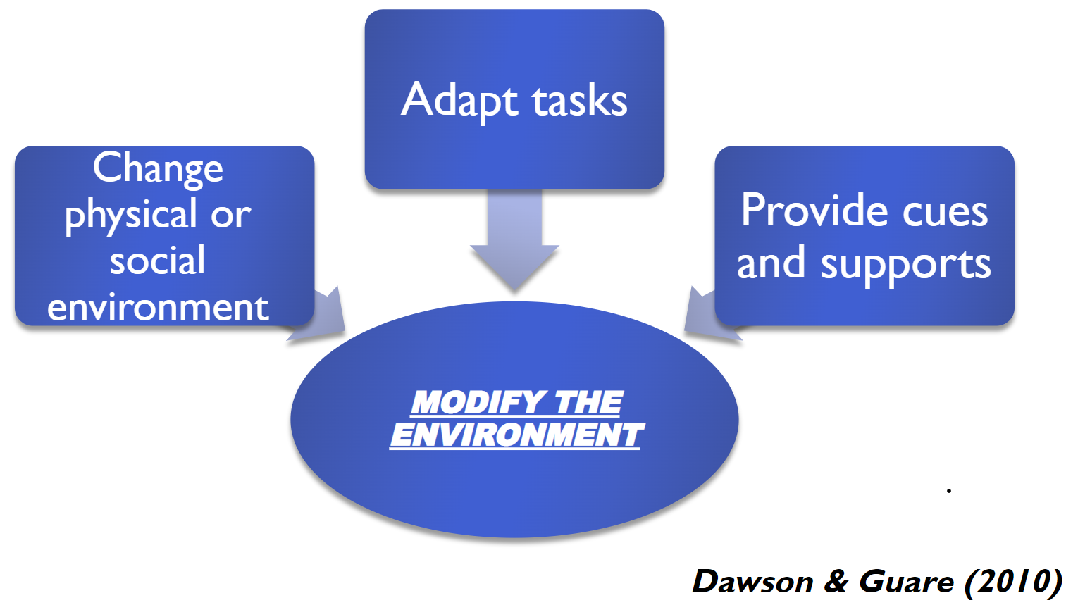
Modifying the Environment by Changing Physical or Social Environment

Slide 28
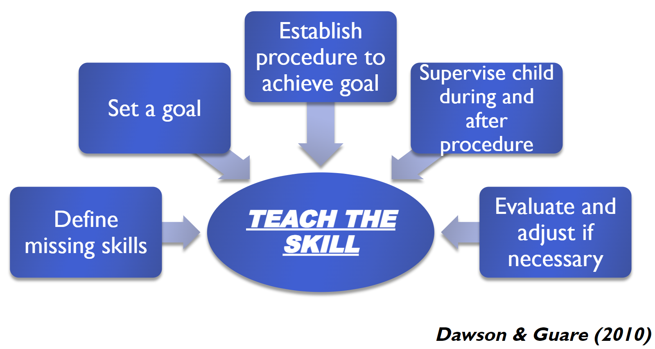
Sequence of Teaching the Skill

Slide 29
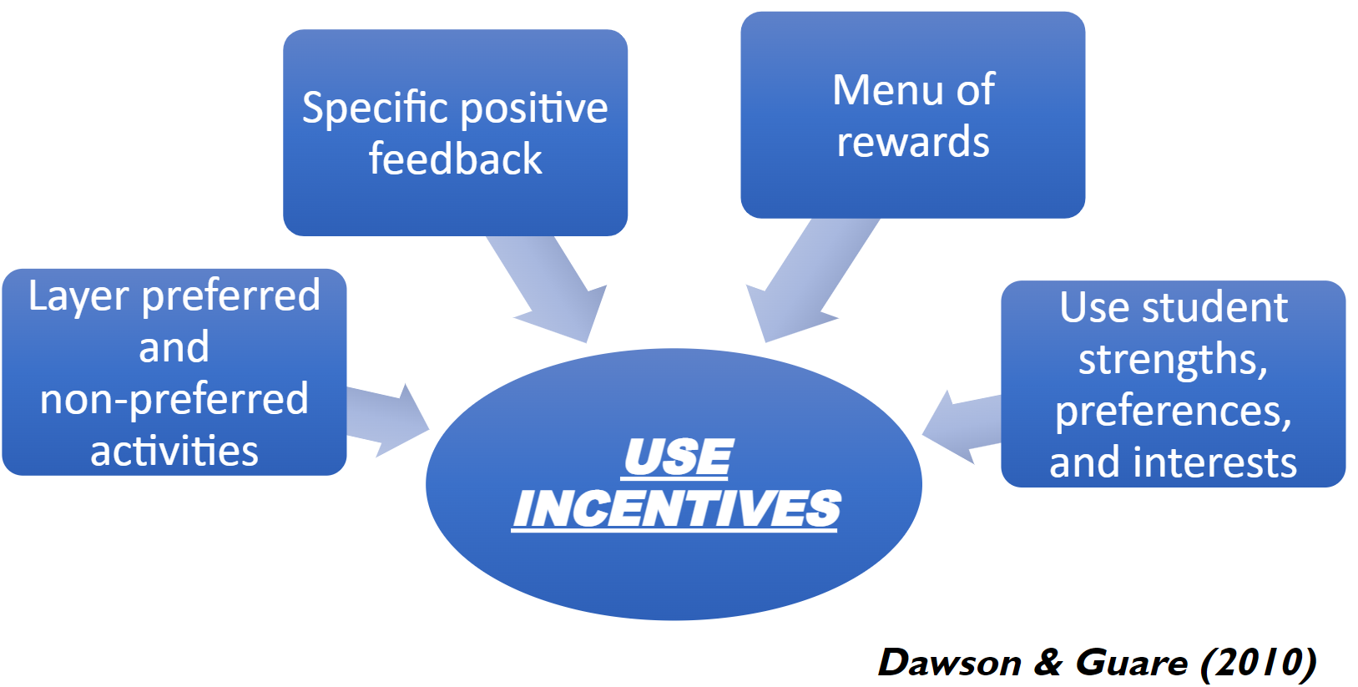
Using Incentives

Slide 30

REVIEW & REFLECT - ACTIVITY
Think back to the Family Reunion activity where you listed what you would need to do.
Which method would have been effective in bridging barriers to make the to-do list more effective?
Modify the environment
Teach the Skill
Use Incentives

Slide 31
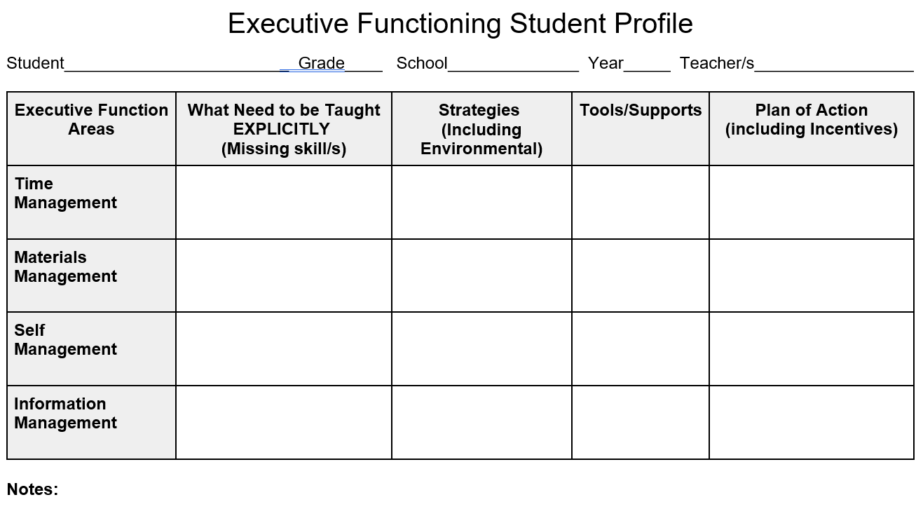
Executive Function Student Profile

Slide 32
Thank you!
Tracy Mail, Educational Consultant
State Support Team Region 8 – Ohio
tracym@sst8.org
https://www.sst8.org

