Slide 1
Mental health promotion and executive function skills to improve occupational performance in the academic setting and beyond
Presented by Sarah S. Greene, OTD, OTR/L
January 21, 2023

Slide 2
About this Presentation
This presentation will outline ideas and interventions to support executive function skills and mental health promotion to improve occupational engagement using multi-tiered systems of support.
At the conclusion of this presentation, participants will:
Describe the important difference between mental health and mental illness
Recognize the foundational need for positive mental health on executive functioning and occupational performance
Identify strategies to use, based on MTSS, in the school-based setting to address mental health promotion, executive functioning, and occupational performance
Summarize effective approaches, ideas, and advocacy measures to move mental health promotion into the everyday activities within the school-setting

Slide 3
To Begin
"We cannot change what we are not aware of, and once we are aware, we cannot help but change."
- Sheryl Sandberg

Slide 4
Mental Illness and Mental Health
Mental Illness (American Psychiatric Association, 2022)
Mental Health (CDC, 2018; WHO, 2018)
Health Conditions involving emotions, thinking, behaviors or a combination
Associated with distress and/or problems functioning in social, work, school, or family activities
Diagnosable mental disorders which involve the above
Integral to overall health
More than absence of mental illness, mental disorders, or mental disabilities (CDC, 2018a; WHO, 2018)
Fundamental for interacting with others, earn a living, participate in and enjoy life, and is essential across the lifespan (CDC, 2018b; U.S. Department of Health & Human Services, 2020; WHO, 2018).
Foundation for emotions, thinking, communication, learning, resilience, hope, and self-esteem

Slide 5
Mental Health
Mental health is the foundation for:
Mental Health is key in:
  Emotions
  Thinking
  Communication
  Learning
  Resilience
  Hope
  Self-esteem.
  Relationships
  Personal Well-being
  Emotional Well-Being
  Contributing to community and/or society
  Coping with Adversity

Slide 6
Well-Being
Holistic term integrating the mind and the body (CDC, 2018b)
Associated with self-perceived health, longevity, and factors into both physical and social environments (CDC, 2018b)
Impacts job, family, and related economic benefits (CDC, 2018b)
Ultimate goal of health promotion (AOTA, 2020)
Subjective well-being is associated with greater school satisfaction, academic self-perceptions, academic achievement, higher quality social relationships, and better physical health, as well as predictor of future success in students (Roth et al., 2017)
Mentally healthy youth - more ready to learn, actively engage in school and activities, have supportive connections, and add to school culture (Youth.gov, n.b.a.)

Slide 7
Positive Mental Health
Positive Mental Health involves
(CDC, 2018a; CDC, 2018b; U.S. Department of Health & Human Services, 2020; WHO, 2018 )
Positive Emotions
Positive Affect
Interest in life
Actively participating in Daily Life Activities
Happiness
Positive Psychological Functioning (sense of belonging, sense of self, positive attitude towards others, and meaningful social outlets and relationships)

Slide 8
Occupational Engagement
Linked to overall well-being
Active participation in occupations
Including academics, extracurriculars, lunch/recess, social interactions, play/leisure, belonging, and other subjective areas of participation, including hobbies and interests
Meaningful, valuable, and purposeful to the individual
Occupations are "personalized everyday activities that people do as individuals, in families, and with communities to occupy time and bring meaning and purpose to life." (WFOT, 2012, para. 2).

Slide 9
Take a Step Back and Reflect
“It is neither wealth nor splendor; but tranquility and occupation which give you happiness.”
- Thomas Jefferson, Personal letter to his sister

Slide 10
Mental Health and Executive Function Skills
How does our Mental Health impact our Executive Functioning?
Proactive versus Reactive Responses?
Executive functions are cognitive processes carried out by the prefrontal area of the frontal lobe and include planning, working memory, inhibition, self-monitoring, attention, initiation, and self-regulation (Goldstein and Naglieri, 2014).

Slide 11
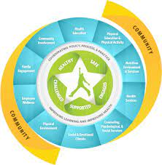
WSCC Model (CDC, 2021) Whole School, Whole Community, Whole Child Model
The child is the focal point, with the green encircling them (healthy, safe, engaged, supported, and challenged)
The white emphasizes collaborating policy, process and practice to improve learning and improve health
The blue is the 10 key components to support health and learning to assist each child, each school, and each community
The yellow is the community, emphasizing the school community, and how the community requires input, resources, and collaboration to fully support each child
Adapted from ESSA Advocacy meeting, 11-16-2021 PowerPoint presentation:
Image: https://www.cdc.gov/healthyschools/wscc/index.htm

Slide 12
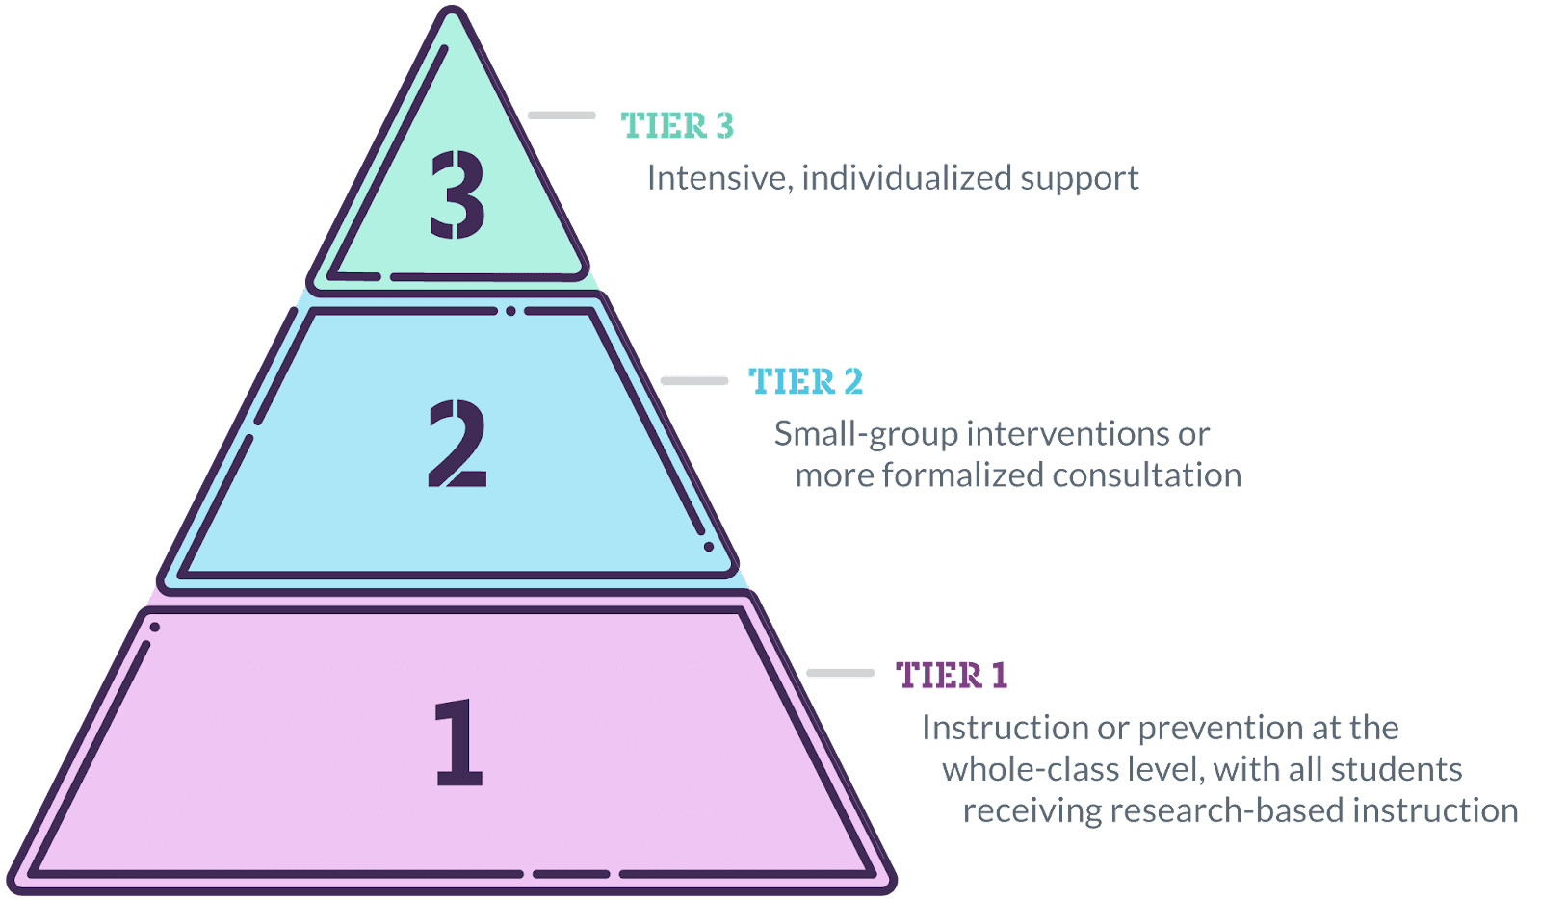
Multi-Tiered Systems of Support
Current standard for implementing mental health services in schools (Cahill & Egan, 2017)
Framework to improve outcomes for all students using EBP (Center on Positive Behavioral Interventions & Supports, 2021)
Tier 3 - Identified needs, Intensive, individualized interventions.
Tier 2 - Individuals at risk
Tier 1 - Whole-Class

Slide 13
Public Health Model and Mental Health Promotion
Initiatives aim to (WHO, 2020):
    Emotional Regulation
    Enhance Alternatives to Risk-Taking Behaviors
    Build Resilience
    Promote Supportive Social Environments and networks
Shift of focus from reactive to proactive
Emphasis on improving students; social, physical, and economic environments (Bazyk, 2011)
Interdisciplinary collaboration is essential to meet all students’ needs (Bazyk, 2011)
Minnesota Department of Health has a webpage devoted to Health Promotion

Slide 14
The Importance of Environment
Environments influence and shape the well-being and development of the children and youth who grow up in them (WHO, 2020).
Schools are ideal place to enhance interactions (Garcia-Carrion et al., 2018; Kumar & Mohideen, 2019).
When interventions are Universal, all students can be reached (AOTA, n.d.; Cahill et al., 2020; Feiss et al., 2019; Walter et al., 2018)
Supportive and safe environments with positive mental health and well-being programs, can (Leschied et al., 2018)
  Increase classroom participation
  Facilitate and help develop trusting relationships for students and staff

Slide 15
Equity, Access, and Who is Responsible?
Teachers and staff do not feel well equipped (National Academics of Sciences, Engineering, and Medicine, 2021; O’Reilly et al., 2018 )
Mental health needs should be a focus of education through interdisciplinary approaches, and a part of a whole school, multi-tiered approach, including all school personnel (Suldo et al., 2014; O’Reilly et al., 2018)
Teachers need to believe in programming and feel confident (Leschied et al., 2018)
Not a lot of evidence based, concrete ways to address and with limited resources, priority is not always given (Atkins et al., 2010)
Identifying support personnel and resources (Atkins et al., 2010; Bazyk et al., 2015)
School mental health teams should work together to benefit students through initiatives to meet the needs of all students (Bazyk et al., 2018; Suldo et al., 2014)

Slide 16
Academic Success
Mental health impacts academic outcomes; Academic achievement impacts student mental health and well-being (Suldo et al., 2014)
Impact of school climate on success (Suldo et al., 2014)
Now is the Time (youth.gov, n.d.)
    Initiatives to improve mental health access and equip schools
    EBP to address school climate, early intervention, promotion of mental health and well-being, and staff development and coaching
Interaction-based mental health programming in schools show correlate with academic achievement long-term, which may lead to other long-term positive effects (Garcia-Carrion et al., 2019)

Slide 17
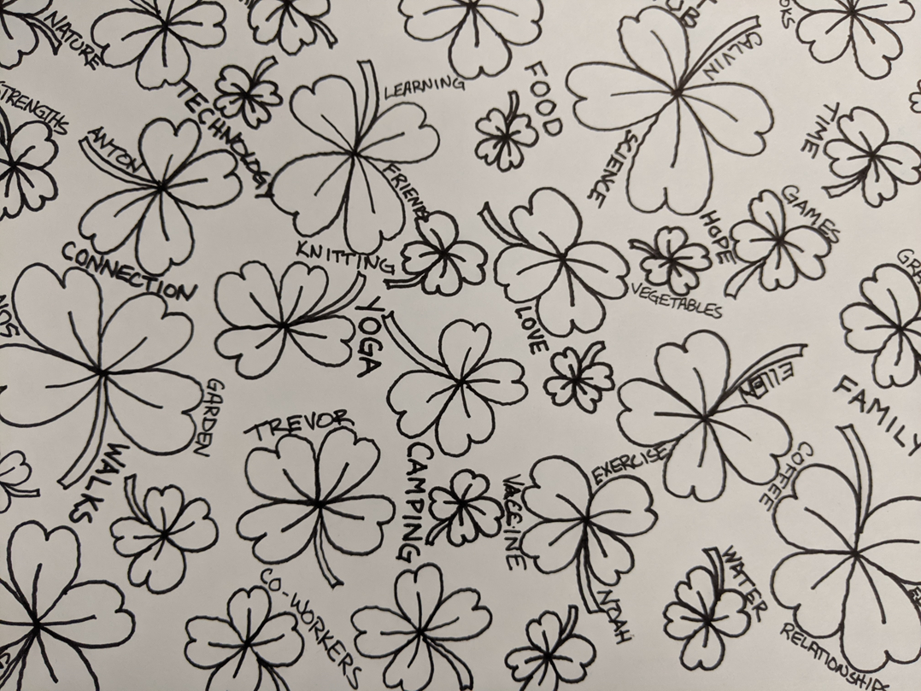
Intervention Ideas
Positive Psychology
Mental Health Literacy
Character Strengths
Daily Check-ins
Individualized Planner Systems
Occupational Exploration
Every Moment Counts Resources

Slide 18
Positive Psychology Interventions (PPI)
Positive psychology is defined as:
Positive Psychology Interventions (PPI) affect (Bazyk et al., 2020; Cilar et al., 2020):
"a field of psychological theory and research that focuses on the psychological states (e.g., contentment, joy), individual traits or character strengths (e.g., intimacy, integrity, altruism, wisdom), and social institutions that enhance subjective well-being and make life most worth living" (American Psychological Association, 2020. Para. 1).
Happiness
Well-Being
Flourishing
Emotional Regulation
Reducing Mental Health Symptoms
Participation in Occupations
Attitude towards others

Slide 19
Mental Health Literacy
Mental Health Impacts (CDC, 2020):
Mental Health Literacy Ideas:
How we think, feel, and act
Our emotional, psychological, and social well-being
How we relate to others
Make health choices
Reducing Stigma (Bazyk, 2011)
Incorporating conversations
Literature addressing Mental Health, Inclusion, Equity, Diversity, and more
Writing about feelings, emotions, mental health and well-being
Social Emotional Learning programs
Incorporating ideas into daily and weekly routines (Cahill & Beisbeir, 2020)

Slide 20
Character Strengths
Research links character strength education to:
What is it?
A way to promote positive behavior and effective learning (Proctor et al., 2011)
Focus on abilities, identifying and building upon them, versus focusing on deficits, limitations, and disabilities (AOTA, n.d.)
Promote individual differences, making it more personal and encouraging (Lavy, 2020)
Well-Being
Flourishing
Increased life satisfaction and happiness
Decreased psychopathology
Improved self-esteem
Positive affect changes
Academic achievement
Flourish in times of adversity
Less withdrawal to challenge
Increased optimism
Decreased behavioral problems
Class cohesion
(Oppenheimer et al., 2014; Proctor et al., 2011; Quinlan et al., 2015)

Slide 21
Research on Character Strengths
Oppenheimer et al. (2014): Impact well-being through lessons
Froh et al. (2008): Gratitude Interventions had both immediate and long-term effects
Proctor et al., (2011): Higher life satisfaction, increased positive affect, and self-esteem
Jin & Wang (2019): Gratitude is significantly positively correlated with learning
Lavy (2020): Interventions showed positive correlations
"Perhaps, identifying character strengths is where we can start. Everyone has strengths. They need to be recognized, celebrated, strengthened, and used" (Park and Peterson, 2008, p. 91)

Slide 22
Strengths Based Interventions
School personnel help develop children from academic, personal, social, and emotional perspectives
Strengths-based approaches can strengthen students' occupational performance, social participation, activities of daily living (ADLs), education, work, play/leisure, and sleep/rest (AOTA, n.d.).
Thanks! A strengths-based gratitude curriculum for tweens and teens. (GGSC, n.d.)
VIA Institute on Character

Slide 23
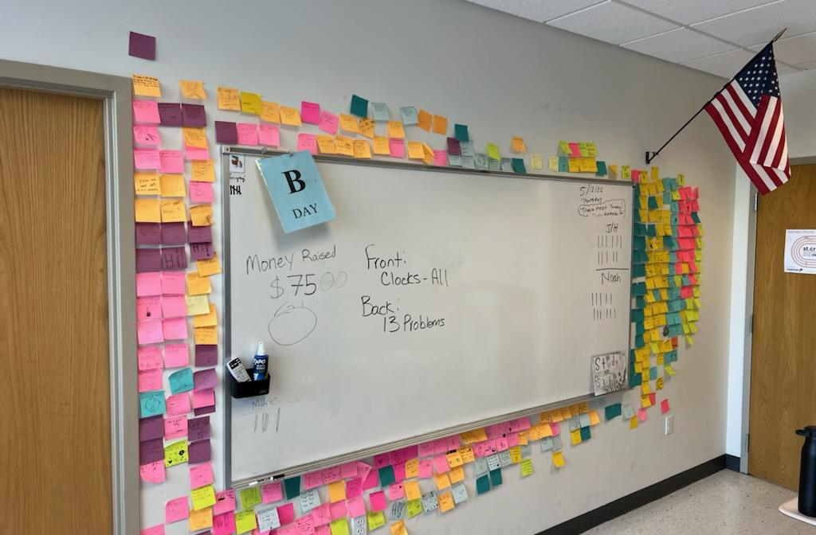
Daily Check-Ins
Positive Post-It Notes
All About Me Activity
Index Card Notes
Gratitude Practices
Planner activities

Slide 24
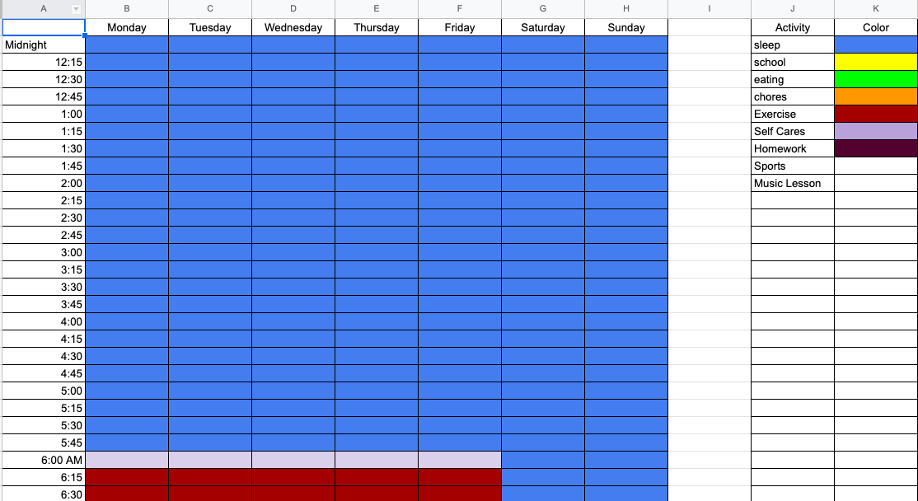
Individualized Planner System
Weekly Planner
Big Life Journal
Time Management Activities
Individualized Planner developed in collaboration

Slide 25
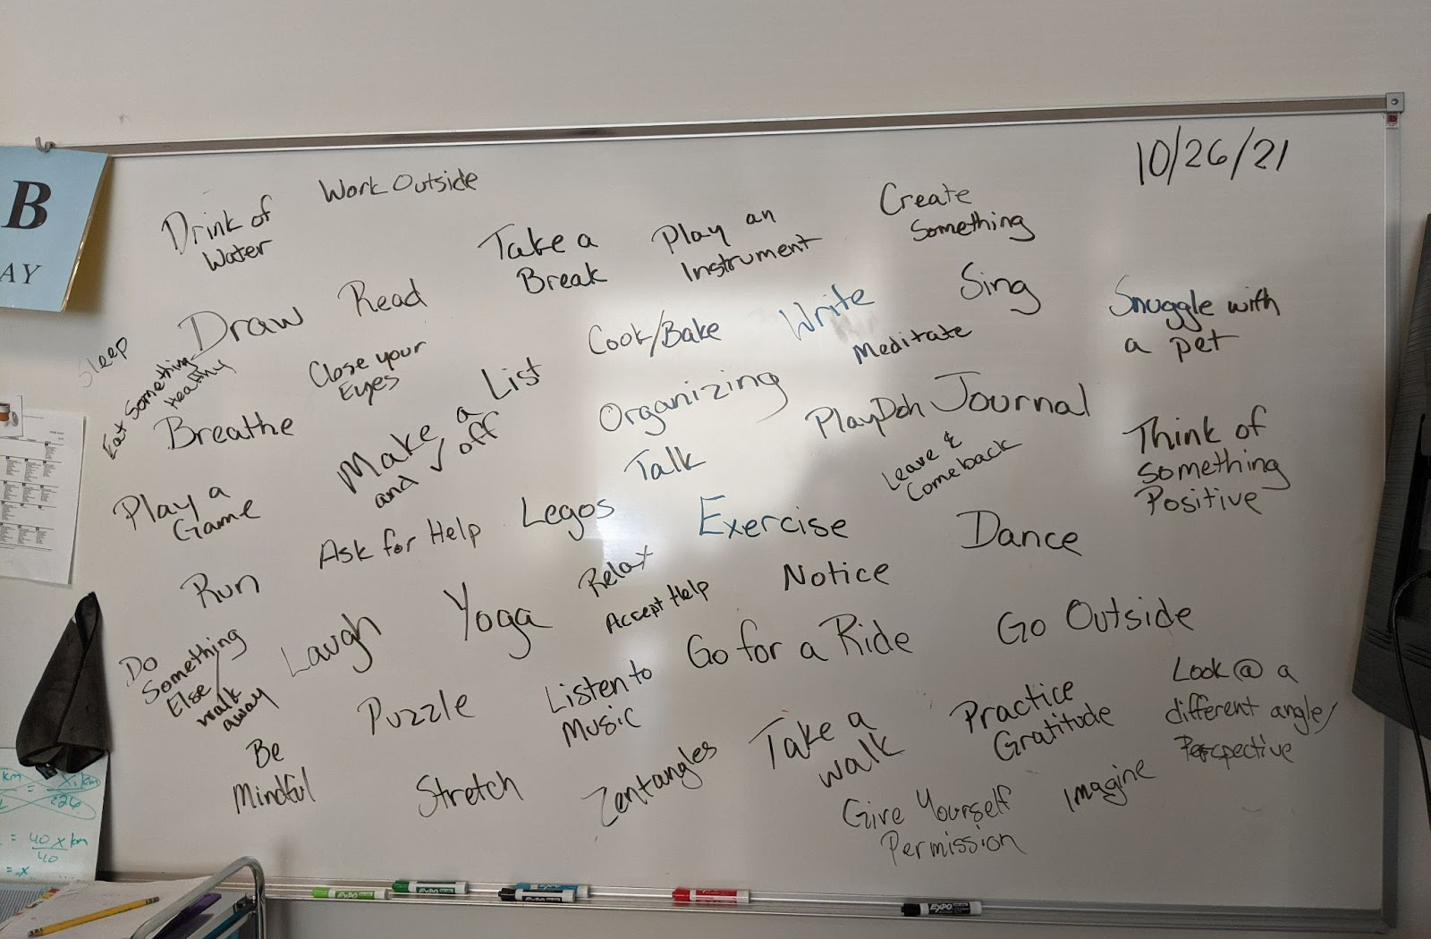
Occupational Exploration
Make time for exploration of what brings joy and happiness
Focus on strengths
Activities that are meaningful
Activity Based Interventions
The importance of practicing what we preach

Slide 26

Every Moment Counts
Embedded Strategies
Calm Moments Cards
Comfortable Cafeteria
Refreshing Recess
Making Leisure Matter
(https://everymomentcounts.org/)

Slide 27
More Ideas and Resources
Big Life Journal (https://biglifejournal.com/)
GoZen (https://gozen.com/)
Calming and Coping Strategies
Goal Writing
Action for Happiness (https://actionforhappiness.org/)

Slide 28
In Closing
“Change will not come if we wait for some other person or some other time. We are the ones we've been waiting for. We are the change that we seek.”
- Barack Obama

Slide 29
References (Page 1)
American Occupational Therapy Association. (2020). Occupational therapy in the promotion of health and well-being. American Journal of Occupational Therapy, 74, 7403420010.
American Occupational Therapy Association (n.d.). School Mental Health Toolkit.
American Psychiatric Association (November 2022). What is mental illness?. Retrieved December 3, 2022, from
American Psychological Association (2020). APA Dictionary of Psychology. American Psychological Association.
Atkins, M. S., Hoagwood, K. E., Kutash, K., & Seidman, E. (2010). Toward the integration of education and mental health in schools. Administration and Policy in Mental Health and Mental Health Services Research, 37(1), 40-47.
Bazyk, S., Pataki, K., & DeBoth, K. (2018). Building Capacity of Occupational Therapy Students to Address the Mental Health Needs of Children During Level II Fieldwork in School Settings. American Journal of Occupational Therapy, 72(4_Supplement_1),
Bazyk, S., Demirjian, L., LaGuardia, T., Thompson-Repas, K., Conway, C., & Michaud, P. (2015). Building capacity of occupational therapy practitioners to address the mental health needs of children and youth: A mixed-methods study of knowledge translation. American Journal of Occupational Therapy, 69(6), 6906180060.
Bazyk, S., & Bazyk, J. (2009). Meaning of occupation-based groups for low-income urban youths attending after-school care. American Journal of Occupational Therapy, 63, 69–80.
Cahill, S. M., & Egan, B. E. (2017). Identifying youth with mental health conditions at school. OT Practice, 22(5), 1-7.
Cahill, S. M., Egan, B. E., & Seber, J. (2020). Activity- and occupation-based interventions to support mental health, positive behavior, and social participation for children and youth: A systematic review. American Journal of Occupational Therapy, 74, 7402180020.

Slide 30
References (Page 2)
Center for Disease Control and Prevention (2018a, January 26). Learn About Mental Health - Mental Health - CDC.
Centers for Disease Control and Prevention (2018b, October 31). Well-Being Concepts.
Feiss, R., Dolinger, S. B., Merritt, M., Reiche, E., Martin, K., Yanes, J. A., ... & Pangelinan, M. (2019). A systematic review and meta-analysis of school-based stress, anxiety, and depression prevention programs for adolescents. Journal of youth and adolescence, 48(9), 1668-1685.
Froh, J. J., Sefick, W. J., & Emmons, R. A. (2008). Counting blessings in early adolescents: An experimental study of gratitude and subjective well-being. Journal of school psychology, 46(2), 213-233.
Froh, J. J., Bono, G., Fan, J., Emmons, R. A., Henderson, K., Harris, C., ... & Wood, A. M. (2014). Nice thinking! An educational intervention that teaches children to think gratefully. School Psychology Review, 43(2), 132-152.
Goldstein, S., & Naglieri, J. A. (Eds.) (2014). Handbook of executive functioning. Springer.
Greater Good Science Center (n.d.). Thanks! A strengths-based gratitude curriculum for tweens and teens
Jin, G., & Wang, Y. (2019). The influence of gratitude on learning engagement among adolescents: The multiple mediating effects of teachers' emotional support and students' basic psychology
Kumar, A., & Mohideen, F. (2019). Strengths-Based Positive Schooling Interventions: a Scoping Review. Contemporary School Psychology, 1-13. Lavy, S. (2020). A review of character strengths interventions in twenty-first-century schools: Their importance and how they can be fostered. Applied Research in Quality of Life, 15(2), 573-596.
Magical needs. Journal of adolescence, 77, 21-31.

Slide 31
References (Page 3)
Leschied, A., Saklofske, D., & Flett, G. (2018). Handbook of school-based mental health promotion: An evidence-Informed framework for implementation (1st ed. 2018.).
Springer International Publishing. Minnesota Department of Health (n.d.). Mental Health Promotion.
National Academies of Sciences, Engineering, and Medicine (2021). A population health perspective on middle school success: Activities, programs, and policies: Proceedings of a workshop. Washington, DC: The National Academies Press. Oppenheimer, M. F., Fialkov, C., Ecker, B., & Portnoy, S. (2014). Teaching to strengths character Education for Urban Middle School Students. Journal of Character Education, 10(2), 91.
O'Reilly, M., Adams, S., Whiteman, N., Hughes, J., Reilly, P., & Dogra, N. (2018). Whose responsibility is adolescent's mental health in the U.K.? Perspectives of key stakeholders. School mental health, 10(4), 450-461. Petrenchik, T. M., & King, G. A. (2011). Pathways to positive development: Childhood participation in everyday places and activities. In S. Bazyk (Ed.), Mental health promotion, prevention, and intervention in children and youth: A guiding framework for occupational therapy (pp. 71–94). Bethesda, MD: AOTA Press.
Proctor, C., Tsukayama, E., Wood, A. M., Maltby, J., Eades, J. F., & Linley, P. A. (2011). Strengths gym: The impact of a character strengths-based intervention on the life satisfaction and well-being of adolescents. The Journal of Positive Psychology, 6(5), 377-388.
Quinlan, D. M., Swain, N., Cameron, C., & Vella-Brodrick, D. A. (2015). How 'other people matter' in a classroom-based strengths intervention: Exploring interpersonal strategies and classroom outcomes. The Journal of Positive Psychology, 10(1), 77-89.
Roth, R. A., Suldo, S. M., & Ferron, J. M. (2017). Improving middle school students' subjective well-being: Efficacy of a multicomponent positive psychology intervention targeting small groups of youth. School Psychology Review, 46(1), 21-41.

Slide 32
References (Page 4)
Shea, C. K., & Jackson, N. (2015). Client perception of a client-centered and occupation-based intervention for at-risk youth. Scandinavian Journal of Occupational Therapy, 22, 173–180.
Suldo, S. M., Gormley, M. J., DuPaul, G. J., & Anderson-Butcher, D. (2014). The impact of school mental health on student and school-level academic outcomes: Current status of the research and future directions. School Mental Health, 6(2), 84-98.
Tokolahi, E., Hocking, C., & Kersten, P. (2016). Development and content of a school-based occupational therapy intervention for promoting emotional wellbeing in children. Occupational Therapy in Mental Health, 32, 245–258.
U.S. Department of Health & Human Services. (2020, May 28). What is mental health? Mental Health.Gov; Let's Talk about It.
VIA Institute on Character. (2022).
Walter, H. J., Kaye, A. J., Dennery, K. M., & DeMaso, D. R. (2019). Three‐Year Outcomes of a School‐Hospital Partnership Providing Multi-tiered Mental Health Services in Urban Schools. Journal of school health, 89(8), 643-652.
World Federation of Occupational Therapists. (2012). About occupational therapy: Definition "occupation."
World Health Organization. (2018, March 30). Mental health: strengthening our response. Mental Health: Strengthening Our Response.
Youth.gov (n.d.). School-Based Supports.

Slide 33
Thank you!
With sincere gratitude for each and every one of you and what you bring to the world!
Sarah S. Greene, OTD, OTR/L
sarahsuegreene@gmail.com

