Slide 1
Executive Function Scaffolding for Students with Complex Communication Needs:
Receptive Communication Strategies
Danielle Deschaine, MS, CCC-SLP
January 21, 2023

Slide 2
My Background
Speech-language pathologist specializing in AAC since 2008
Easter Seals Chicago Autism Therapeutic Day School (federal level 5)
Saint Paul Public Schools
Bridge View School (federal level 4)
district AT team
All Voices Augmentative Communication (private practice)
in-home AAC services in the Twin Cities metro area
all ages

Slide 3
Land Acknowledgement
I am based out of Saint Paul, Minnesota. I live and work near Bdote Mni Sota (the confluence of the Minnesota and Mississippi rivers). Bdote Mni Sota, according to the Dakota creation story, is were the Dakota people (the Seven Fires of the Dakota) first came to the earth.
Learn more about the Dakota:
Dakota Wicohan website (https://dakotawicohan.org/)
Bdote Memory Map (http://bdotememorymap.org/)
Books by Native authors and illustrators:
AICL best books lists (https://americanindiansinchildrensliterature.blogspot.com/p/best-books.html)

Slide 4
Outline
Foundation
Scaffolds
Stimuli
Processing Time
Supports
Final Notes
Discussion

Slide 5
Foundation: Receptive vs. Expressive Communication
Receptive Communication
Expressive Communication
Speech and language information a person takes in and interprets
Speech and language messages a person expresses

Slide 6
Foundation: Receptive vs. Expressive Communication, continued
Receptive Communication
Expressive Communication
Speech and language information a person takes in and interprets
Speech and language messages a person expresses

Slide 7
Foundation
Language Processing is Hard!

Slide 8
Foundation, continued
Success, growth, and learning are possible for every person.

Slide 9
Foundation: Bridge View Sign

Slide 10
Scaffold: Decrease Stimuli, Focus Stimuli
Executive functions you are scaffolding:
self control, inhibitory control
working memory
planning

Slide 11
Scaffold: Decrease Stimuli, Focus Stimuli, continued
Auditory stimuli and strategies to decrease excess sources of noise
music, fans, hallway noise, cell phones
stop and listen to what you may have tuned out
noise blocking headphones, FM systems
staff chatter
subtle signal to staff when they are getting chatty or commenting too much during lesson
“review the footage”

Slide 12
Scaffold: Decrease Stimuli, Focus Stimuli, continued 2
Visual and physical stimuli, and strategies to decrease
people coming in and out of the classroom
plan beginning/ending of staff breaks
place sign on classroom door
student personal space
set a standard of respecting personal space as much as possible
be aware of touching students; leaning on their wheelchair, desk, chair

Slide 13
Scaffold: Decrease Stimuli, Focus Stimuli, continued 3
Canva.com

Slide 14
30 second stretch break

Slide 15
Scaffold: Provide Adequate Wait Time
Executive functions you are scaffolding:
organization
mental flexibility
planning
task initiation

Slide 16
Scaffold: Provide Adequate Wait Time, continued
Make it a norm to provide adequate wait time
Count to ten in your head
Get classroom staff on board
sign or hand signal to show other staff that you are waiting and not to prompt or talk

Slide 17
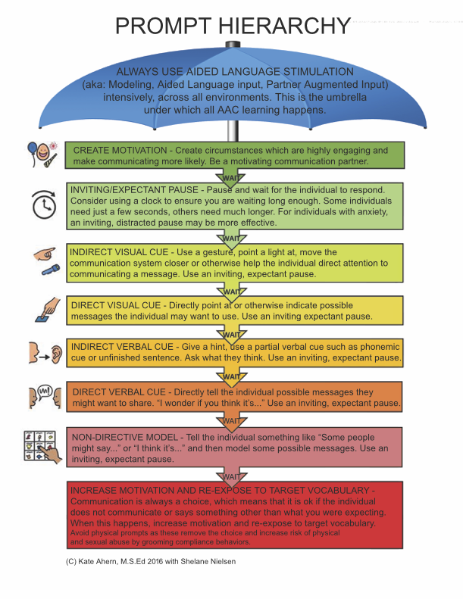
Scaffold: Provide Adequate Wait Time, continued 2
Prompting
wait to prompt
you definitely can and should prompt less than you do
know your prompt hierarchy
Kate Ahern’s prompt hierarchy —> (http://bit.ly/3xC1E0p)

Slide 18
Scaffold: Provide Adequate Wait Time, continued 3
Give whole classroom group wait time before asking students to respond
set a short timer if needed
pause more, slow down speaking rate
No time for wait time?
shorten or simplify your lesson

Slide 19
Scaffold: Multimedia Supports
Executive functions you are scaffolding:
mental flexibility
working memory
organization

Slide 20
Scaffold: Multimedia Supports, continued
Tools
visual timers
symbols, photos, videos
include appropriate adaptations (e.g. objects or tactile symbols, closed captioning)
sign language
core words

Slide 21
Scaffold: Multimedia Supports, continued 2
Clear and simple presentation
simplify language
simplify tasks
minimize clutter

Slide 22
Scaffold: Multimedia Supports, continued 3
(Clear and simple presentation)

Slide 23
Scaffold: Multimedia Supports, continued 4
(Clear and simple presentation)

Slide 24
Scaffold: Multimedia Supports, continued 5
Provide clear explanations, directions, demonstrations
know each student’s strengths and help them use them
use multimodal instruction, engaging multiple senses/modes
model concepts and task execution

Slide 25
Final Notes: The first step is the hardest
Pick one strategy and work at it until it is a habit, then add the next to your repertoire.
First step ideas:
always hold off on prompting for 10 seconds
give group wait time/silence for 10 seconds
simplify and shorten one lesson
develop a “quiet” signal with classroom staff
help each other remember not to lean on student wheelchairs

Slide 26
Final Notes: Send it home
You’re doing the work, you’re seeing results…share that success with the whole team, especially parents and home caregivers. If they’re open to it, help them figure out how to carry it over at home.

Slide 27
Thank you!
Danielle Deschaine, MS, CCC-SLP
All Voices Augmentative Communication
danielle@allvoicesaac.com
(651) 432-0890 (call, text, and TTY)

